Slide 1
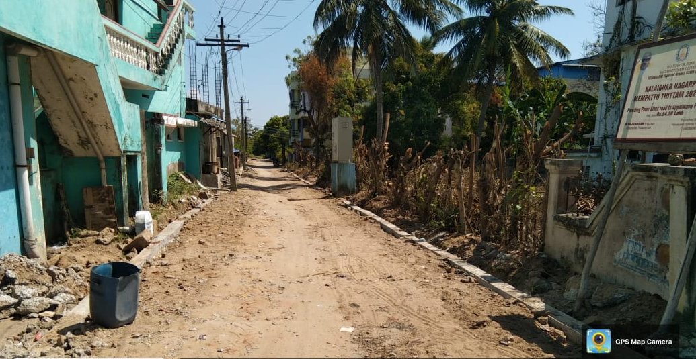
VELANKANNI (Special Grade) TOWN PANCHAYAT, NAGAPATTINAM DISTRICT
KALAIGNAR NAGARPURA MEMPATTU THITTAM 2021-2022
PROVIDING PAVER BLOCK ROAD TO APPASWAMY PILLAI THOTTAM AND
BUS STAND BASK SIDE
Estimate Amount Rs.84.20 Lakh
APPASWAMY PILLAI THOTTAM

Slide 2
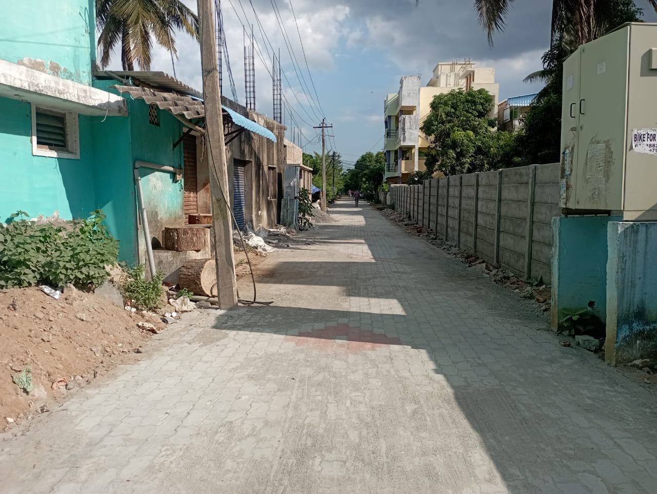
APPASWAMY PILLAI THOTTAM
VELANKANNI (Special Grade) TOWN PANCHAYAT, NAGAPATTINAM DISTRICT
KALAIGNAR NAGARPURA MEMPATTU THITTAM 2021-2022
PROVIDING PAVER BLOCK ROAD TO APPASWAMY PILLAI THOTTAM AND
BUS STAND BASK SIDE
Estimate Amount Rs.84.20 Lakh

Slide 3
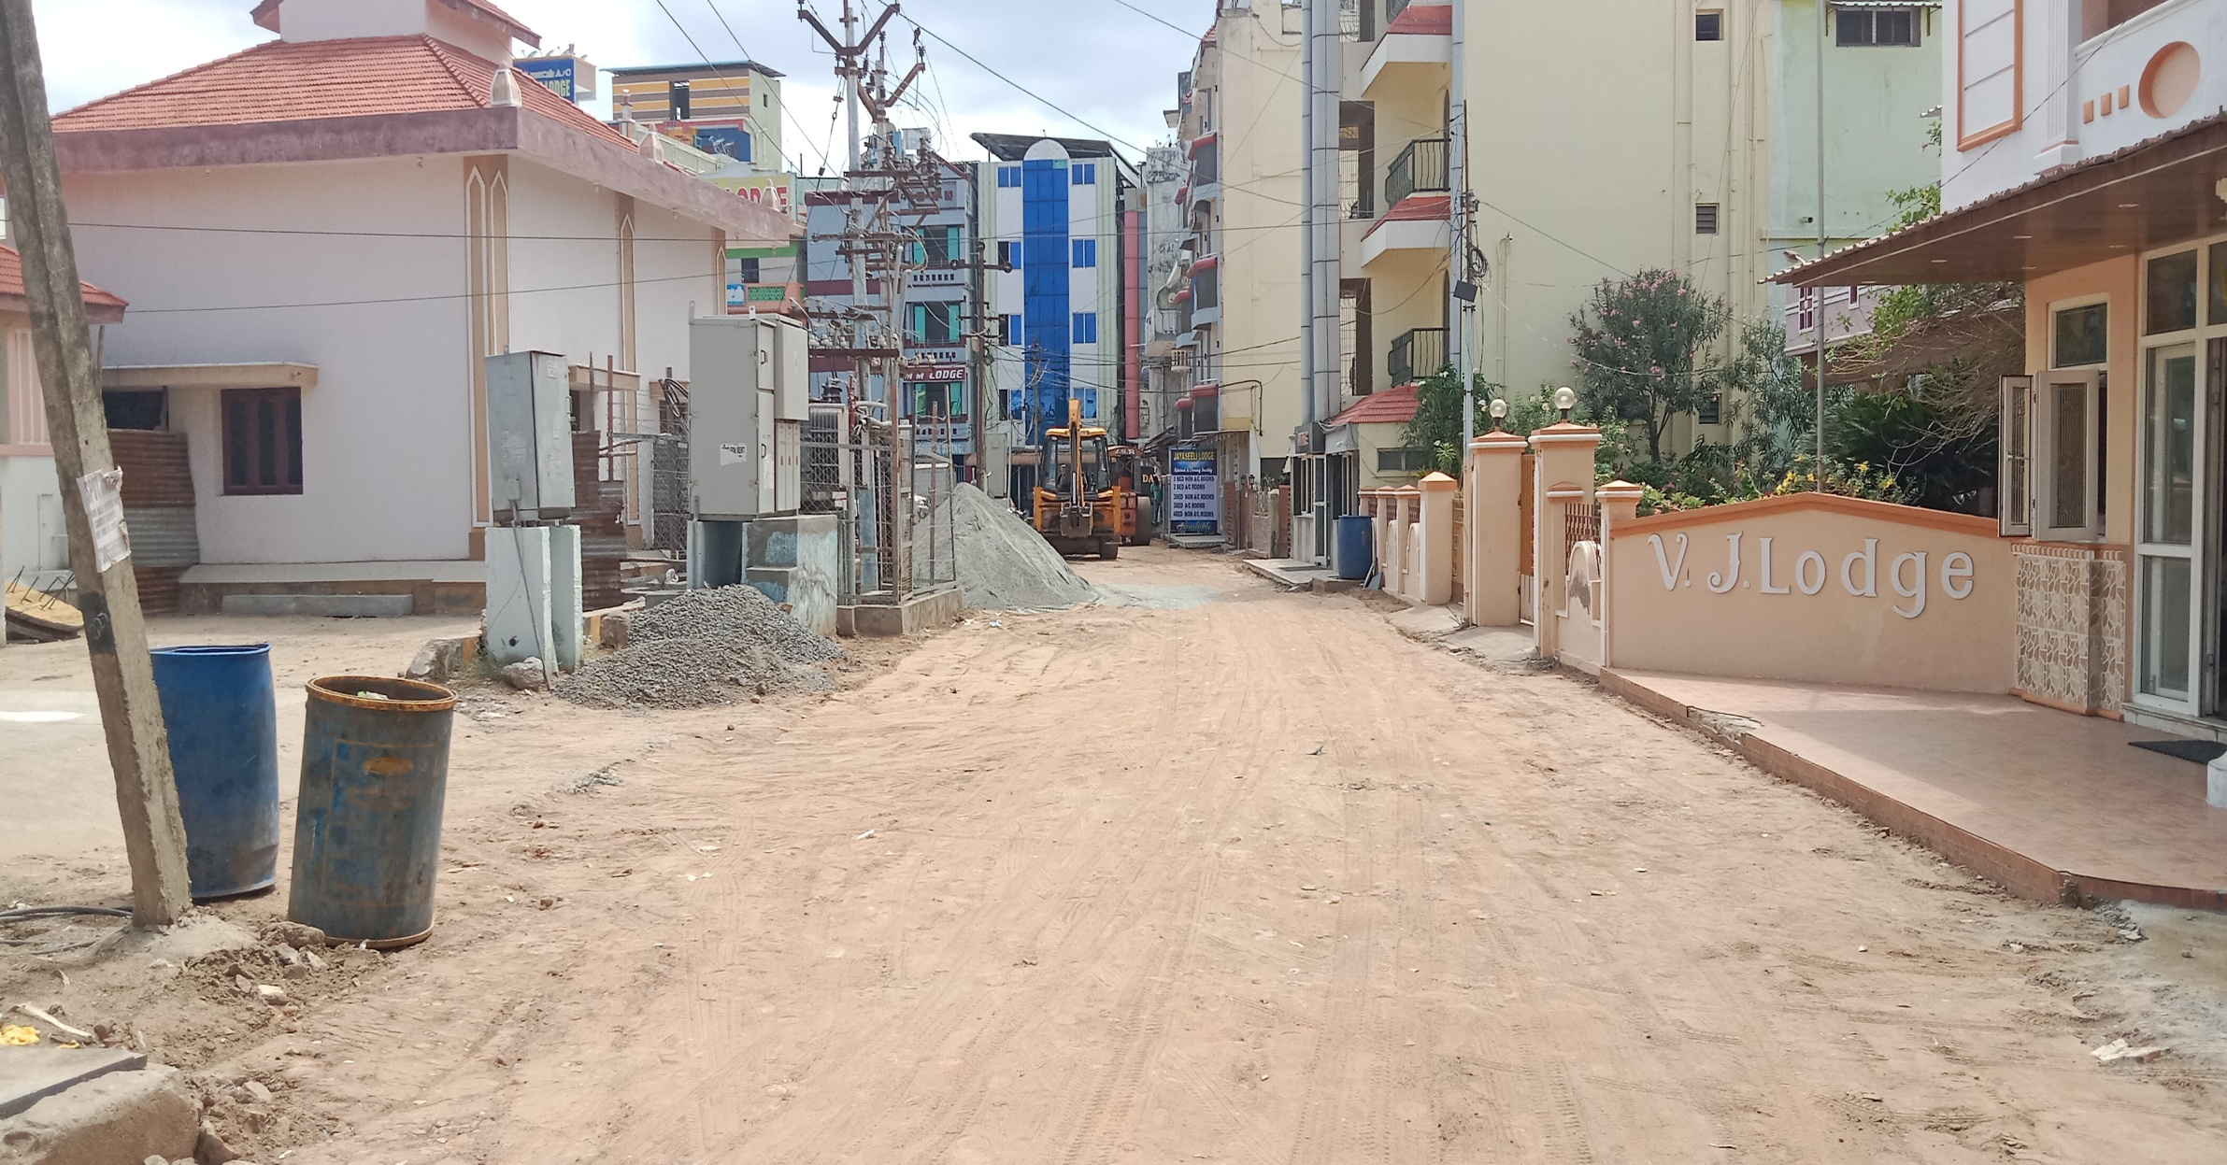
BUS STAND BACK SIDE
VELANKANNI (Special Grade) TOWN PANCHAYAT, NAGAPATTINAM DISTRICT
KALAIGNAR NAGARPURA MEMPATTU THITTAM 2021-2022
PROVIDING PAVER BLOCK ROAD TO APPASWAMY PILLAI THOTTAM AND
BUS STAND BASK SIDE
Estimate Amount Rs.84.20 Lakh

Slide 4
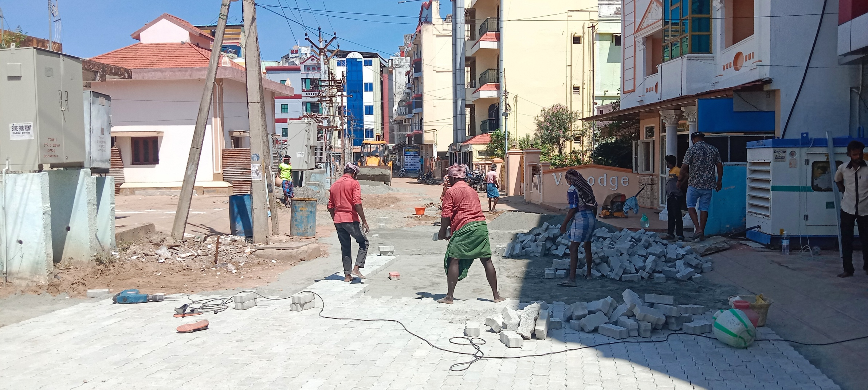
BUS STAND BACK SIDE
VELANKANNI (Special Grade) TOWN PANCHAYAT, NAGAPATTINAM DISTRICT
KALAIGNAR NAGARPURA MEMPATTU THITTAM 2021-2022
PROVIDING PAVER BLOCK ROAD TO APPASWAMY PILLAI THOTTAM AND
BUS STAND BASK SIDE
Estimate Amount Rs.84.20 Lakh

