Slide 1
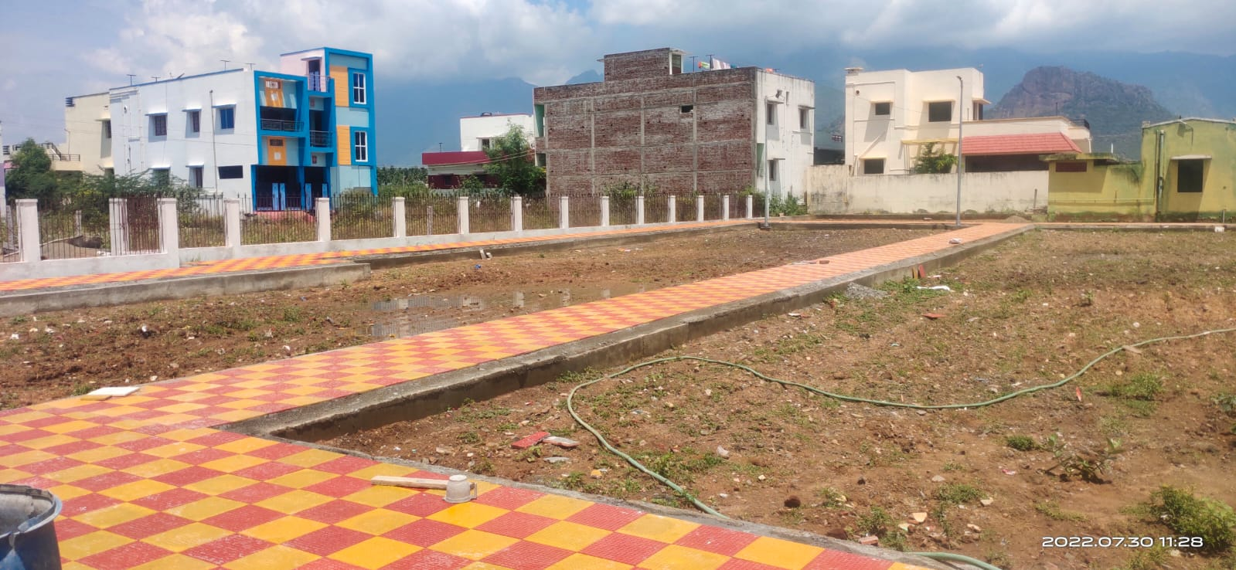
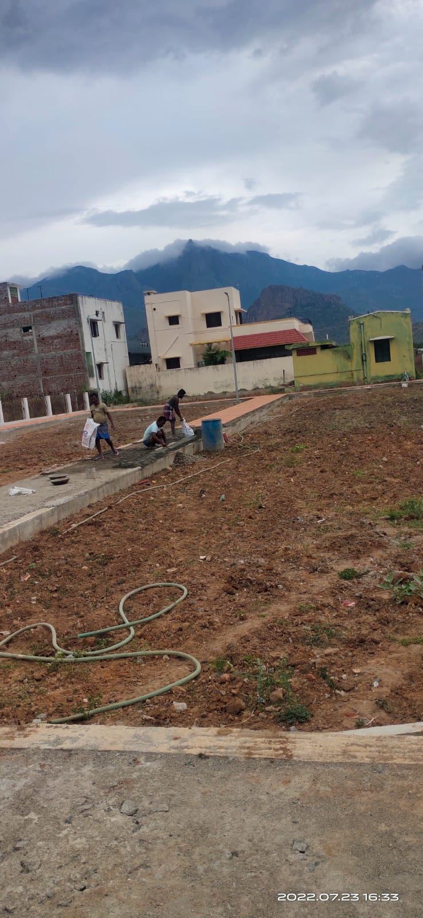
BODINAYAKANUR MUNICIPALITY KNMT 2021-22
NAME OF WORK: Improvements of park at Kulasekarapandiyan layout in ward No.22 Bodinayakanur Municipality.
STAGE OF WORK: Foot path work under progress LATITUDE : 10.008095
ESTIMATE AMOUNT: Rs. 40.00 Lakhs LONGITUDE : 77.343980

