Slide 1
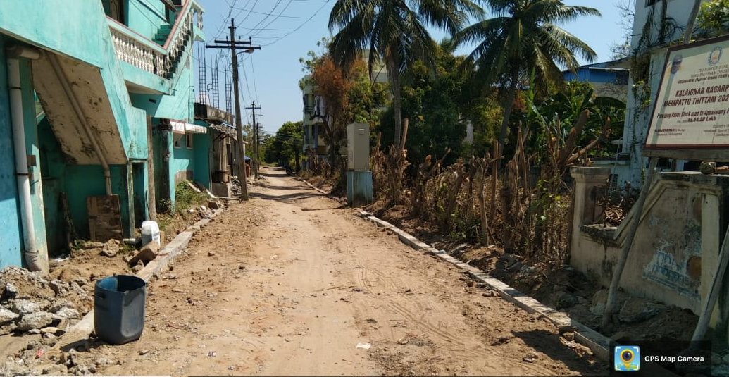
VELANKANNI (Special Grade) TOWN PANCHAYAT, NAGAPATTINAM DISTRICT
KALAIGNAR NAGARPURA MEMPATTU THITTAM 2021-2022
PROVIDING PAVER BLOCK ROAD TO APPASWAMY PILLAI THOTTAM AND
BUS STAND BASK SIDE
Estimate Amount Rs.84.20 Lakh

Slide 2
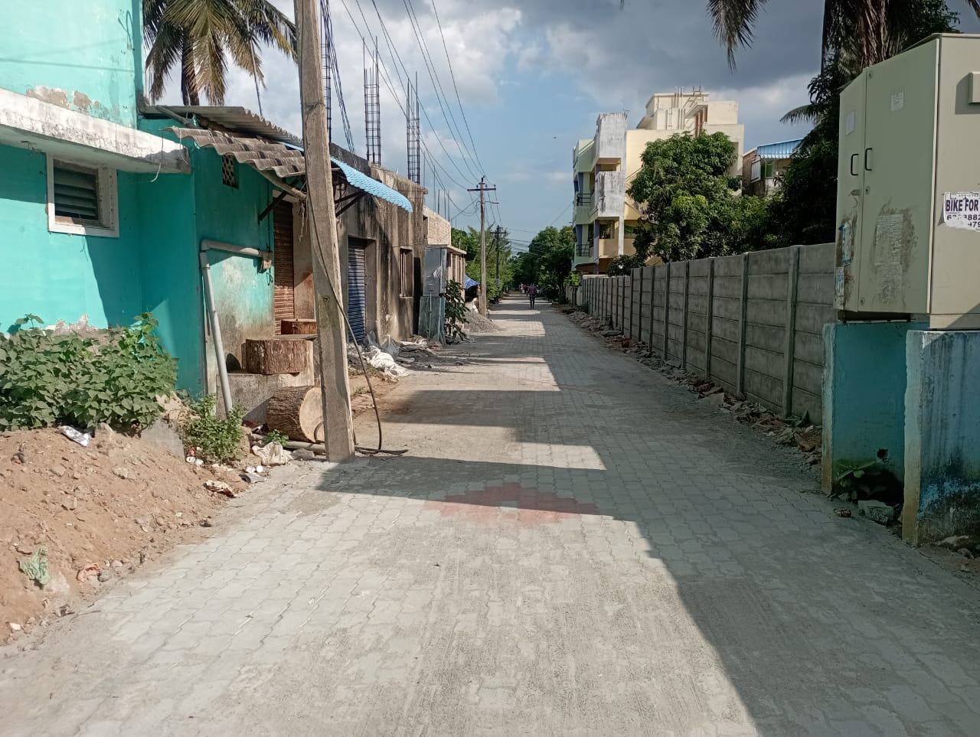
VELANKANNI (Special Grade) TOWN PANCHAYAT, NAGAPATTINAM DISTRICT
KALAIGNAR NAGARPURA MEMPATTU THITTAM 2021-2022
PROVIDING PAVER BLOCK ROAD TO APPASWAMY PILLAI THOTTAM AND
BUS STAND BASK SIDE
Estimate Amount Rs.84.20 Lakh

