Slide 1
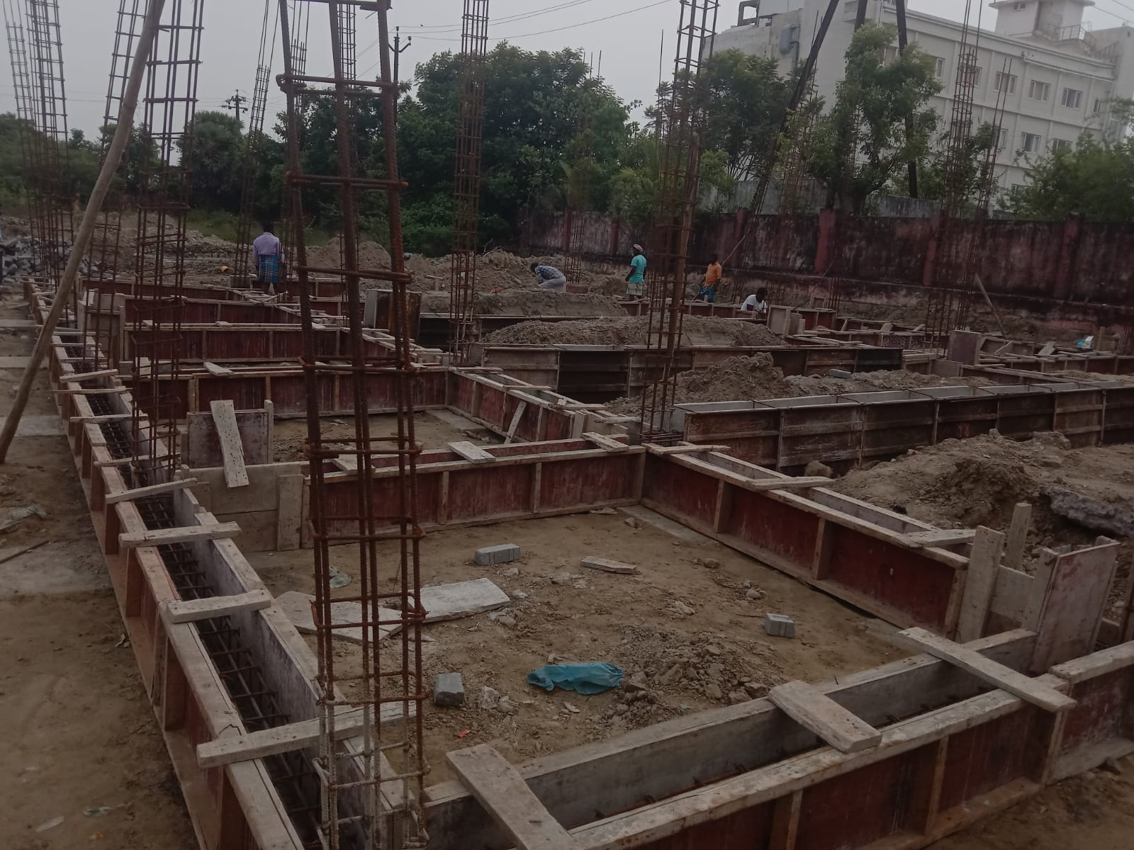
NAGAPATTINAM DISTRICT, VELANKANNI TOWN PANCHAYAT
KALAIGNAR NAGARPURA MEMPATTU THITTAAM 2021-2022
CONSTRUCTION OF LPG GASSIFIER CREMATORIUM @ GRAMATHUMEDU ROAD BURIAL GOURND, Est. Amt. Rs.142.00 Lakh

Slide 2
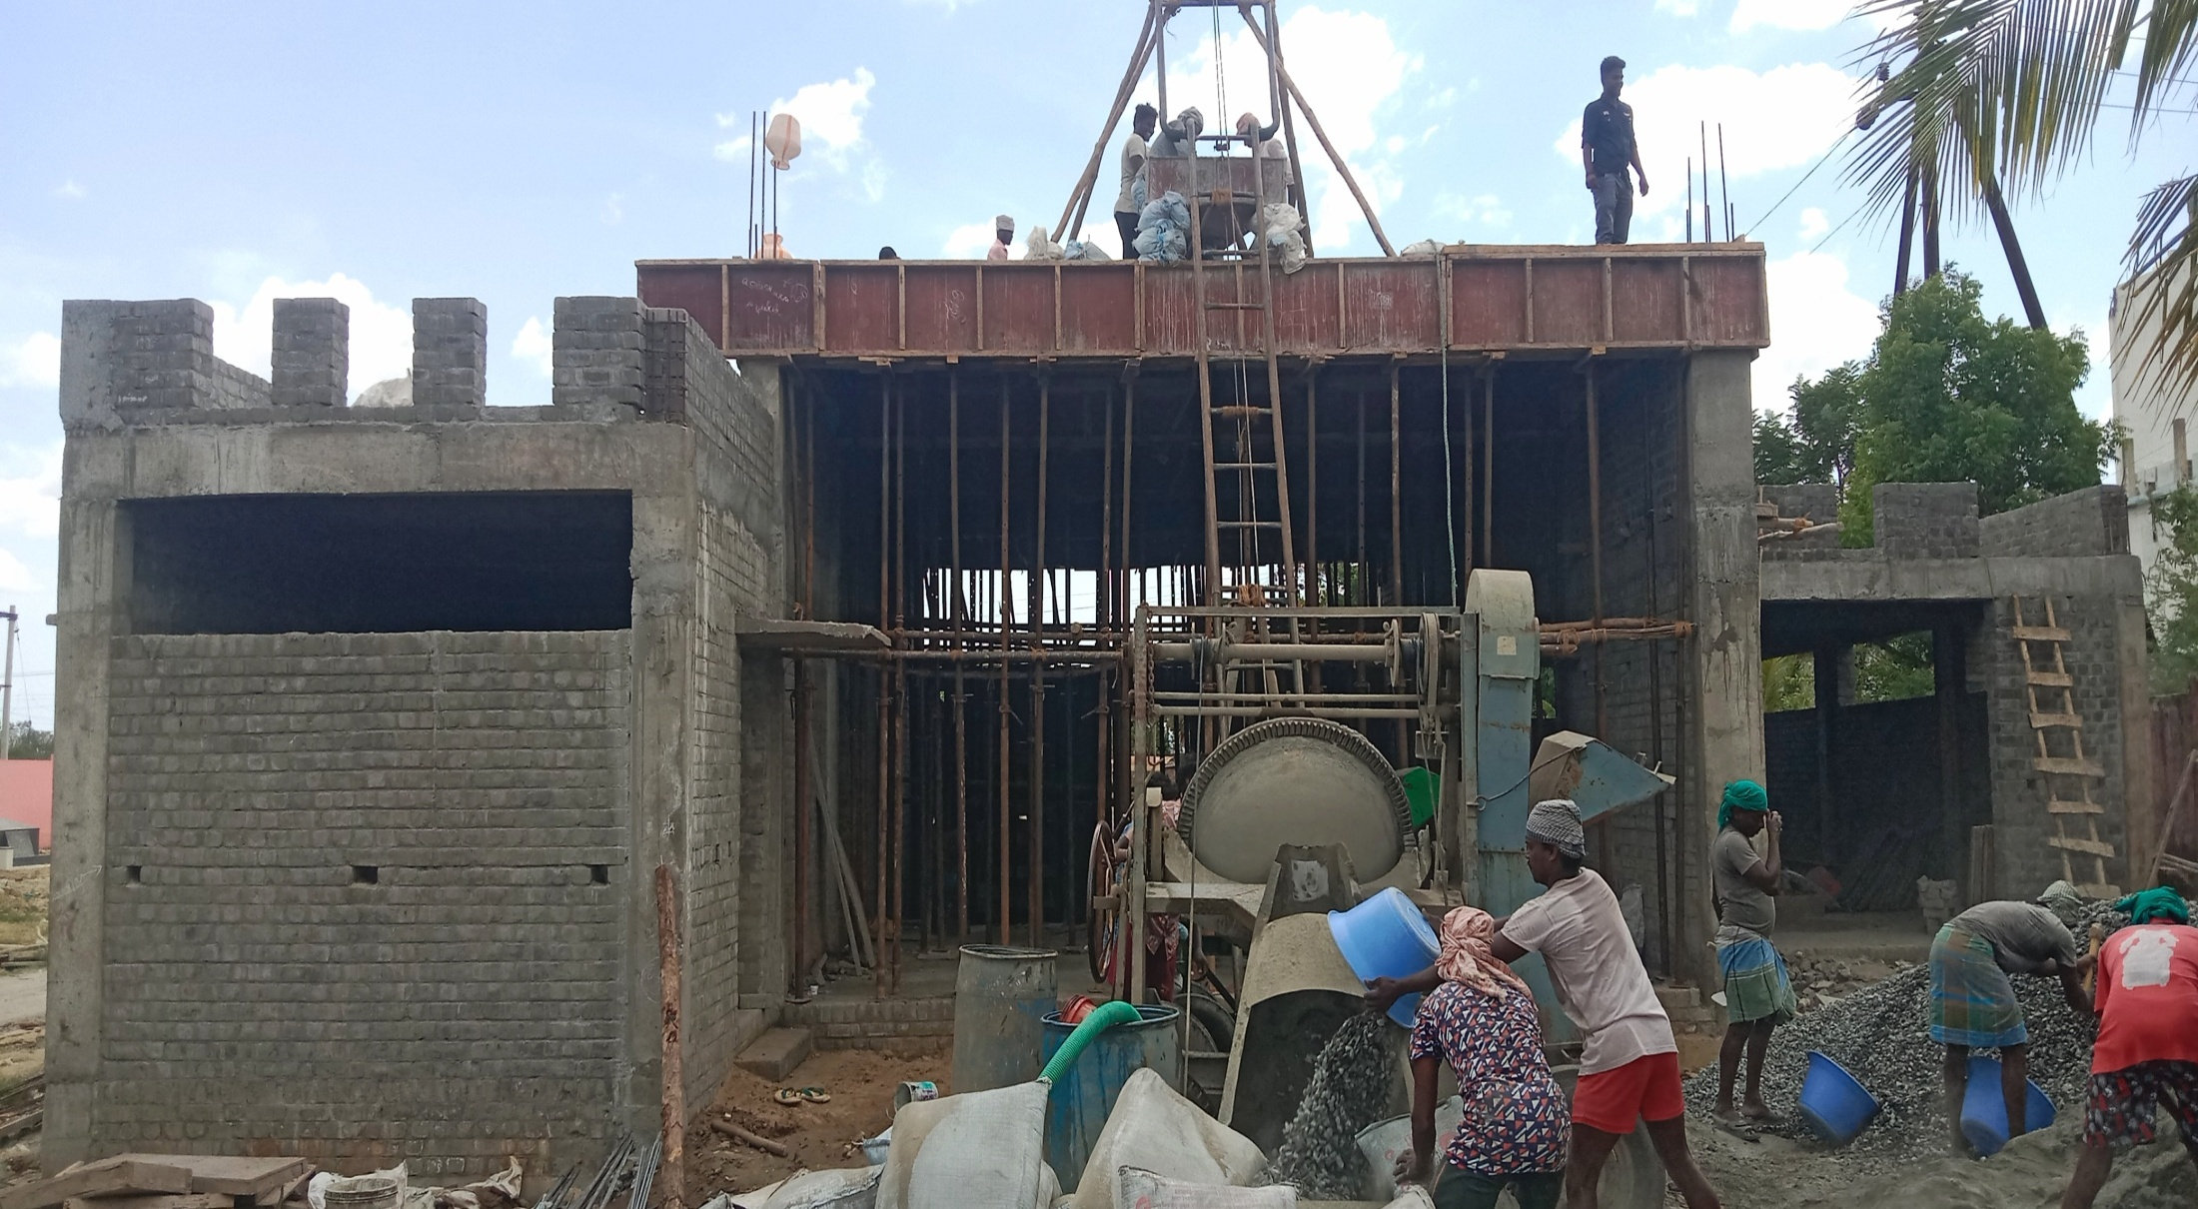
NAGAPATTINAM DISTRICT, VELANKANNI TOWN PANCHAYAT
KALAIGNAR NAGARPURA MEMPATTU THITTAAM 2021-2022
CONSTRUCTION OF LPG GASSIFIER CREMATORIUM @ GRAMATHUMEDU ROAD BURIAL GOURND,
Est. Amt. Rs.142.00 Lakh

