Slide 1
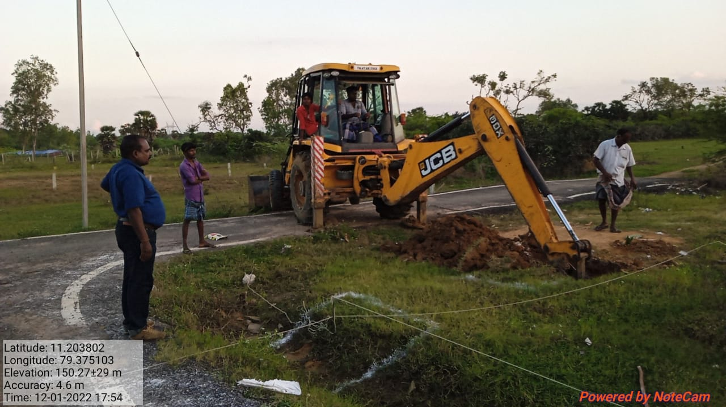
JAYANKONDAM MUNICIPALITY KNMT 2021-22
NAME OF WORK :- New Creation of Park at Pappankulam in Ward No.05
LATITUDE : 11.203802°
LONGITUDE : 79.375103°
ESTIMATE AMOUNT : 42.30 LAKHS.
STAGE OF WORK : Putting Earth Work is in Progress.

