Slide 1
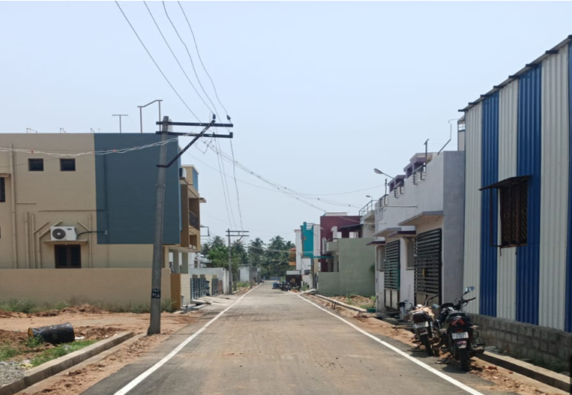
BODINAYAKANUR MUNICIPALITY KNMT 2021-22
NAME OF WORK: PROVIDING BT SURFACE AT POONGA NAGAR 2 IN WARD NO: 2 (120002R051) (PACKAGE 1/1)
STAGE OF WORK: Work Completed LATITUDE : 10.018542
ESTIMATE AMOUNT: Rs. 115.91 Lakhs LONGITUDE : 77.351210

