Slide 1
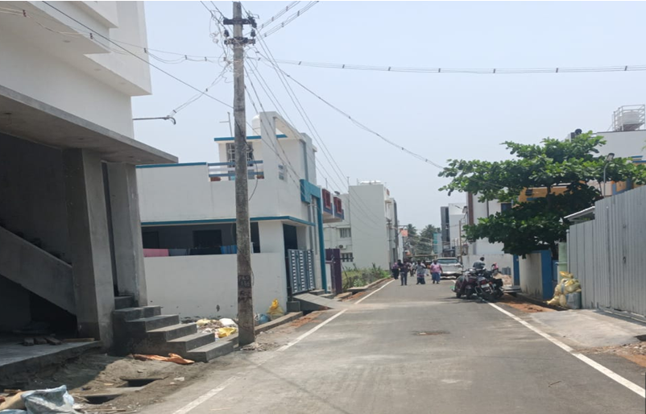
BODINAYAKANUR MUNICIPALITY KNMT 2021-22
NAME OF WORK: PROVIDING BT SURFACE AT SAKTHI NAGAR EXTENSION 1 IN WARD NO: 2 (120002R055)
STAGE OF WORK: WORK COMPLETED LATITUDE : 10.015828
ESTIMATE AMOUNT: Rs. 115.91 Lakhs LONGITUDE : 77.357862

