Slide 1
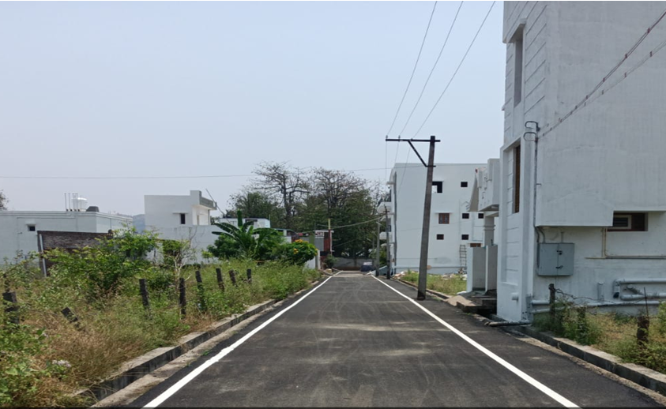
BODINAYAKANUR MUNICIPALITY KNMT 2021-22
NAME OF WORK: PROVIDING BT SURFACE AT SAKTHI NAGAR EXTENSION 3 IN WARD NO: 2 (120002R0507) (PACKAGE 1/1)
STAGE OF WORK: WORK COMPLETED LATITUDE : 10.015225
ESTIMATE AMOUNT: Rs. 115.91 Lakhs LONGITUDE : 77.357737

