Slide 1
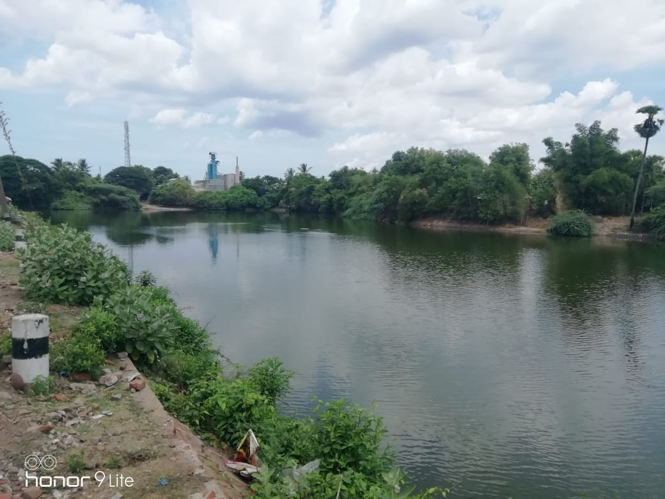
NAGAPATTINAM DISTRICT, KEELVELUR TOWN PANCHAYAT
KALAIGNAR NAGARPURA MEMPATTU THITTAM 2021-2022
IMPROVEMENT OF WATER BODY IN ARASANI KULAM, W.NO.8, S.NO.103/1, Est. Rs.140 L

Slide 2
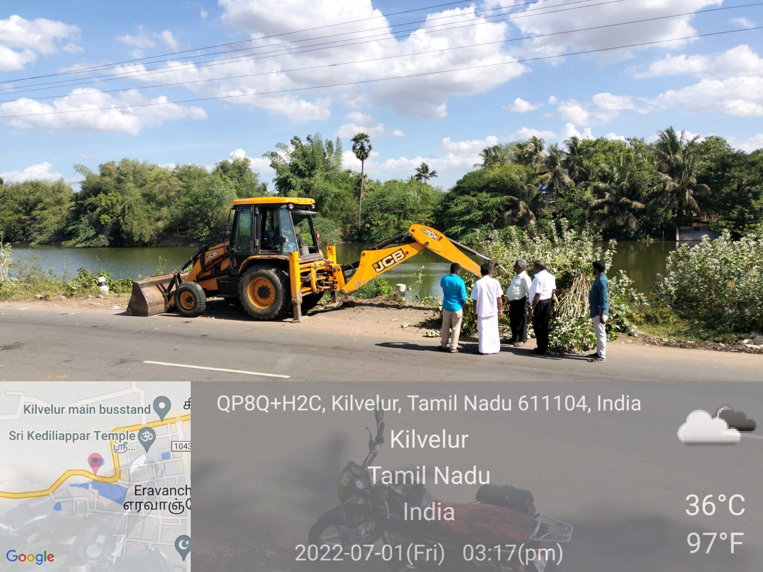
NAGAPATTINAM DISTRICT, KEELVELUR TOWN PANCHAYAT
KALAIGNAR NAGARPURA MEMPATTU THITTAM 2021-2022
IMPROVEMENT OF WATER BODY IN ARASANI KULAM, W.NO.8, S.NO.103/1, Est. Rs.140 L

