Slide 1
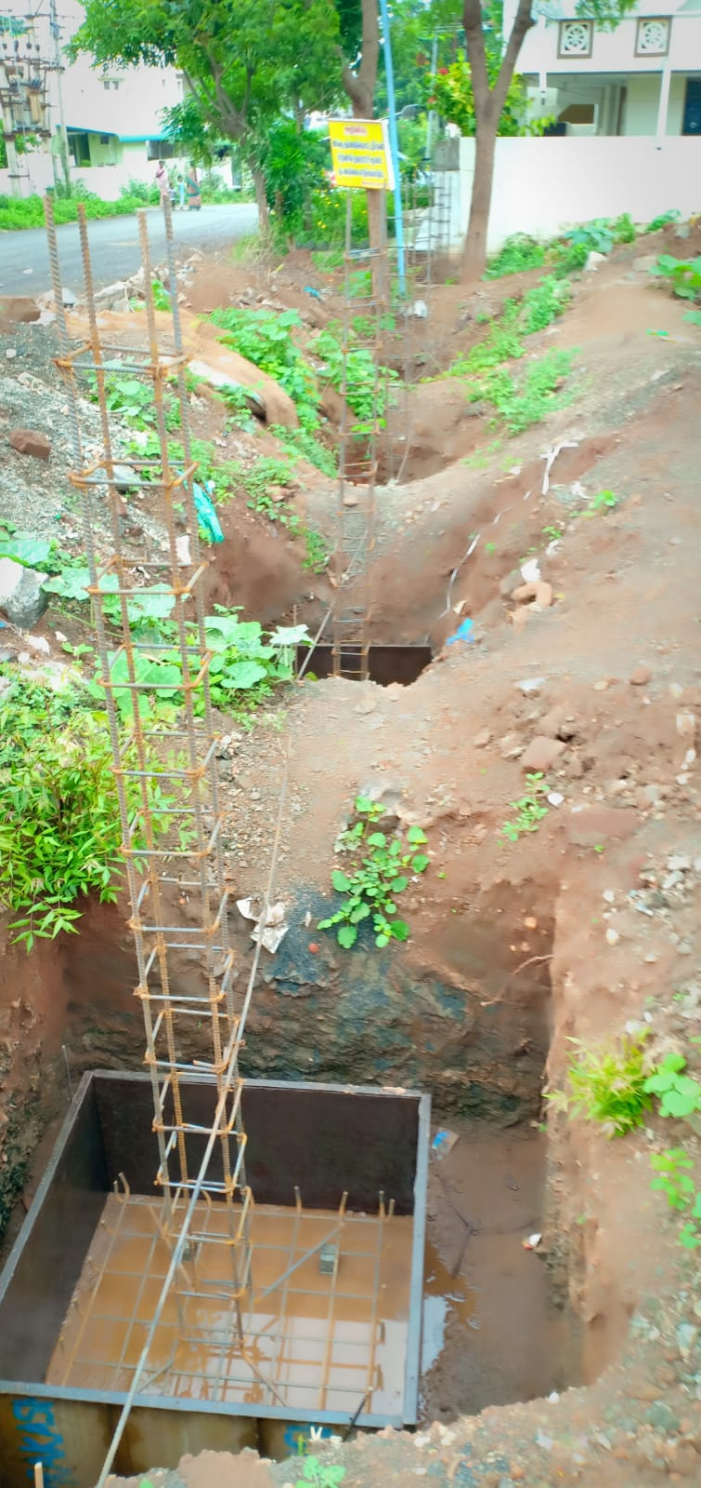
TIRUPUR REGION
METTUPALAYAM MUNICIPALITY
Providing New Green Park development at Vasantham nagar in Ward no.32

