Slide 1
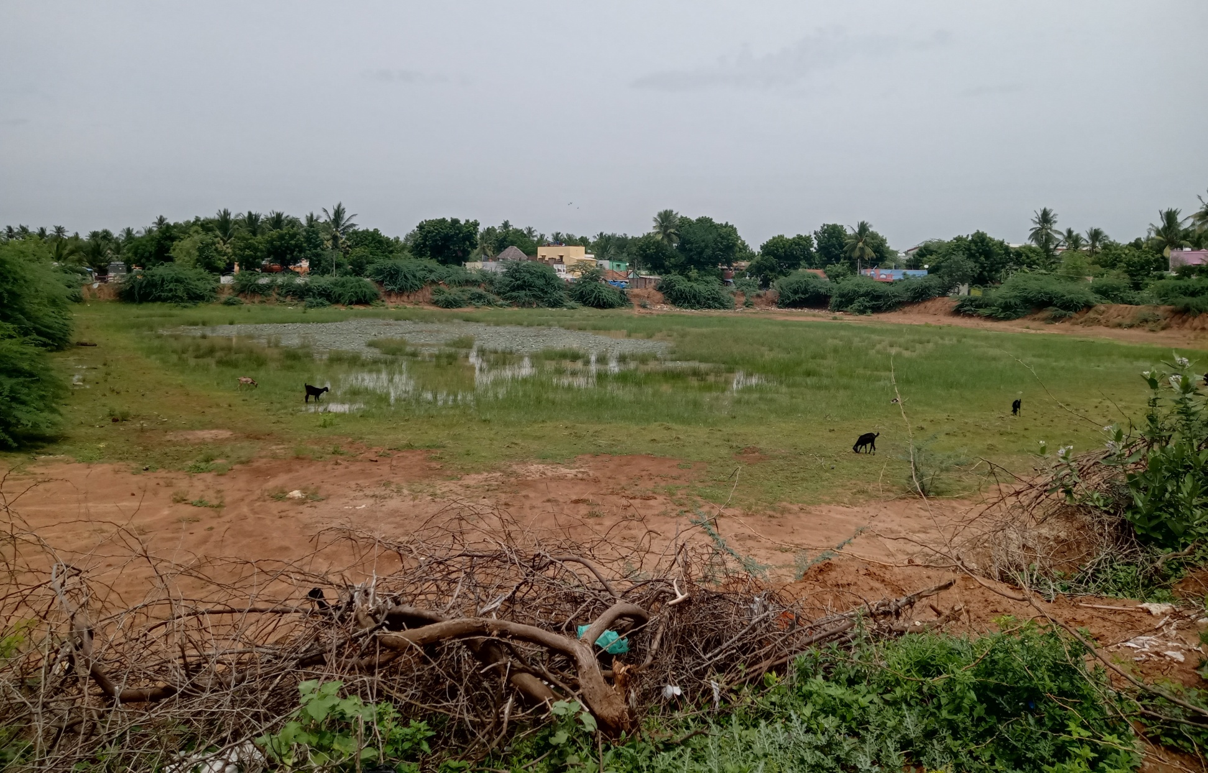
MANAPPARAI MUNICIPALITY KNMT 2021-22
NAME OF WORK: Ward No.13 Improvement of water bodies at Muniya Vannan Kulam in Manapparai Municipality
ESTIMATE AMOUNT: Rs. 180.00 Lakhs LATITUDE : 10°36’01”
LONGITUDE : 78°25’37”

