Slide 1
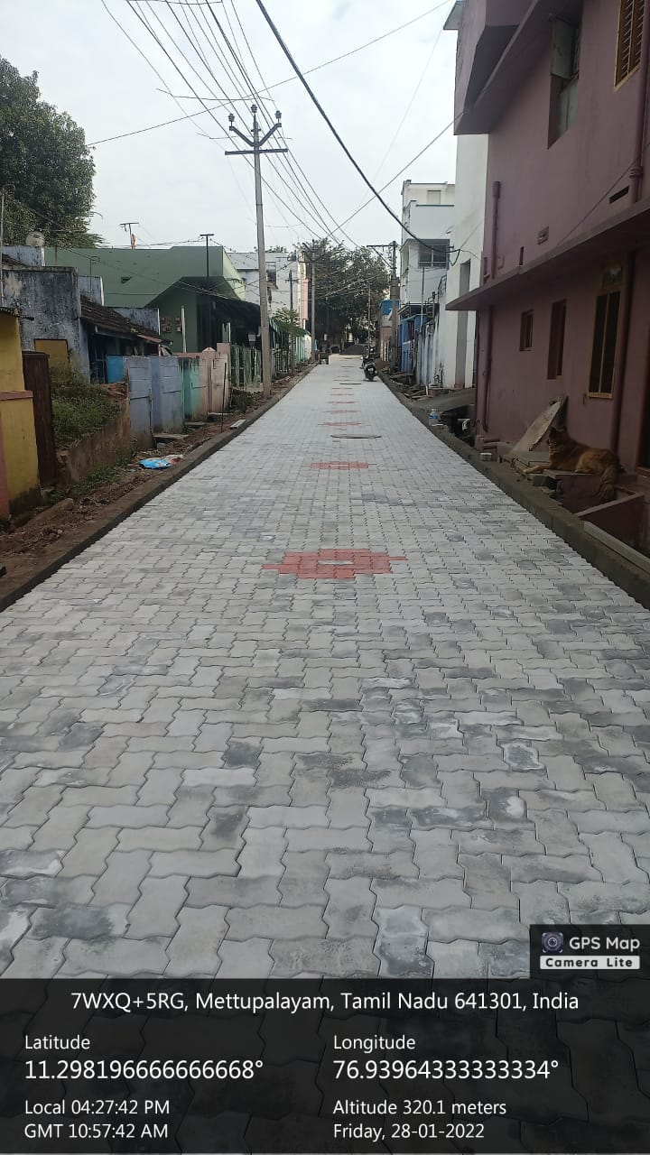
TIRUPUR REGION
METTUPALAYAM MUNICIPALITY
KNMT – 2021-22
Providing Paver Block road at Shanthi nagar in ward no.32

Slide 2
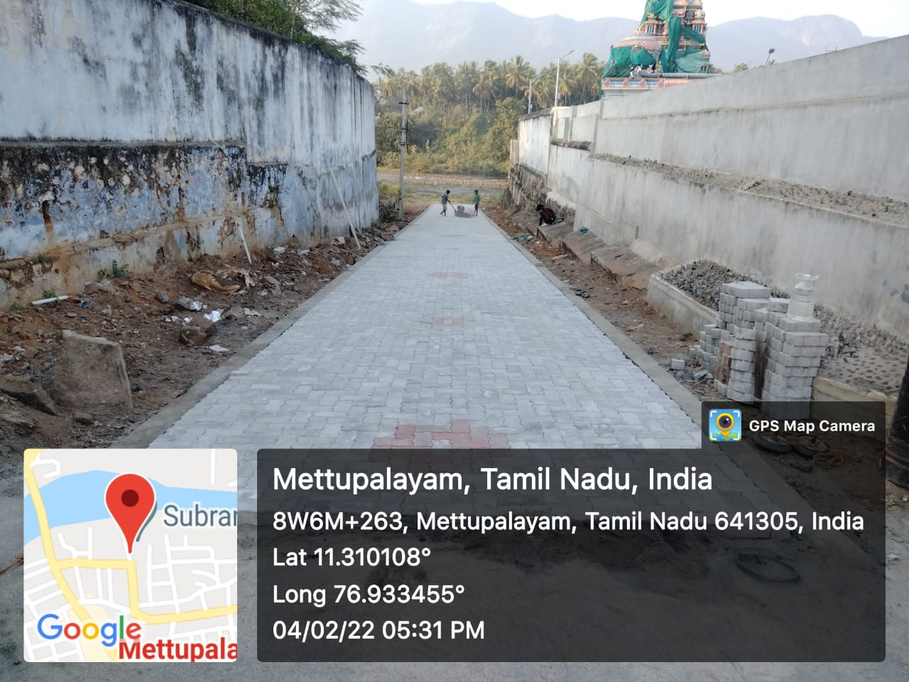
TIRUPUR REGION
METTUPALAYAM MUNICIPALITY
KNMT – 2021-22
Providing Paver Block road at Padithurai in ward no.7

Slide 3
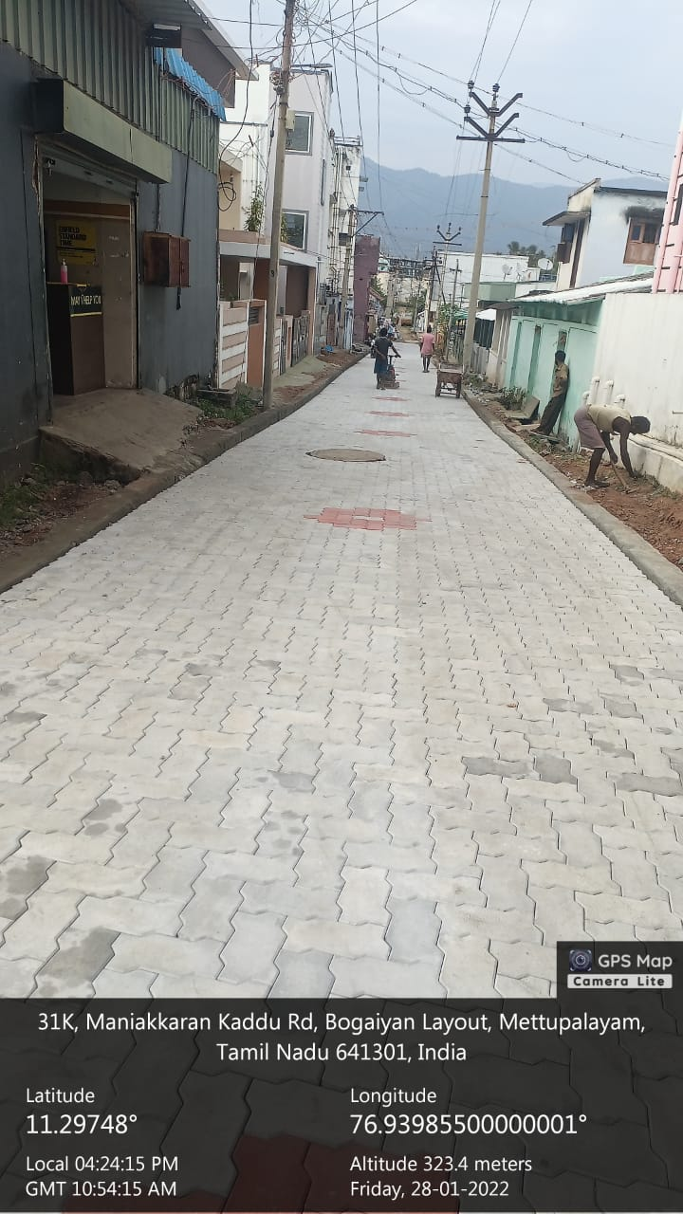
TIRUPUR REGION
METTUPALAYAM MUNICIPALITY
KNMT – 2021-22
Providing Paver Block road at GMRC Road in ward no.30

