Slide 1
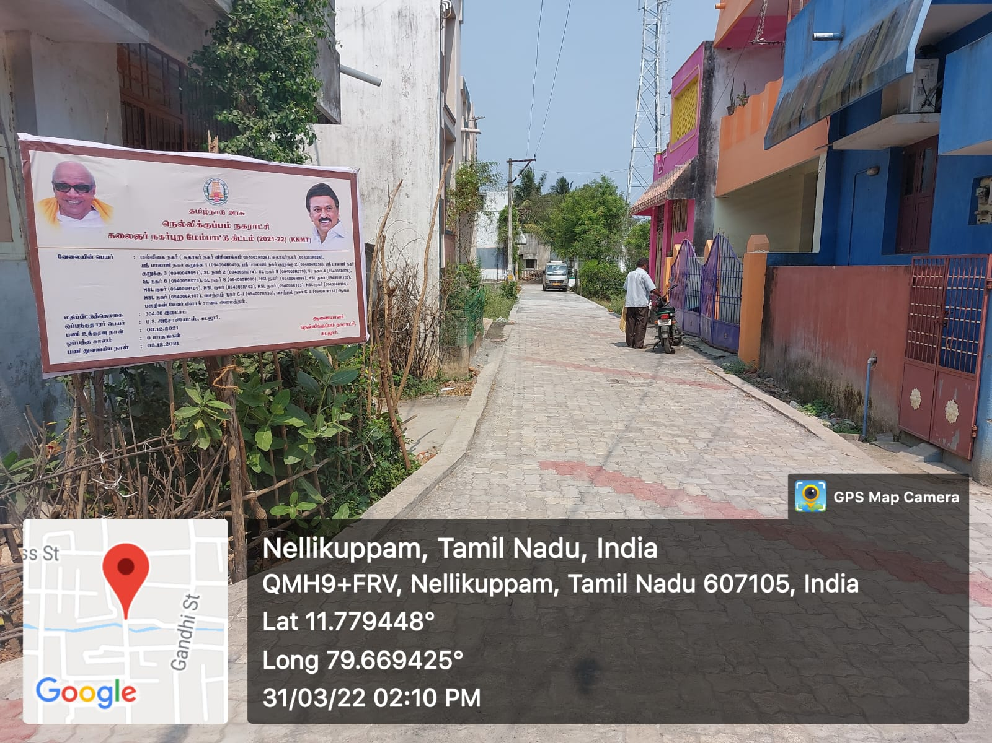
CHENGALPET REGION – Nellikuppam Municipality
KNMT SCHEME 2021-22
Providing Paver Block Road Malligai Nagar Sudhagar Nagar Extn (Unique code-094003R026 ,L =146.30 m X 4.00m ) – Total cost of Estimate 304.00 lakhs

Slide 2
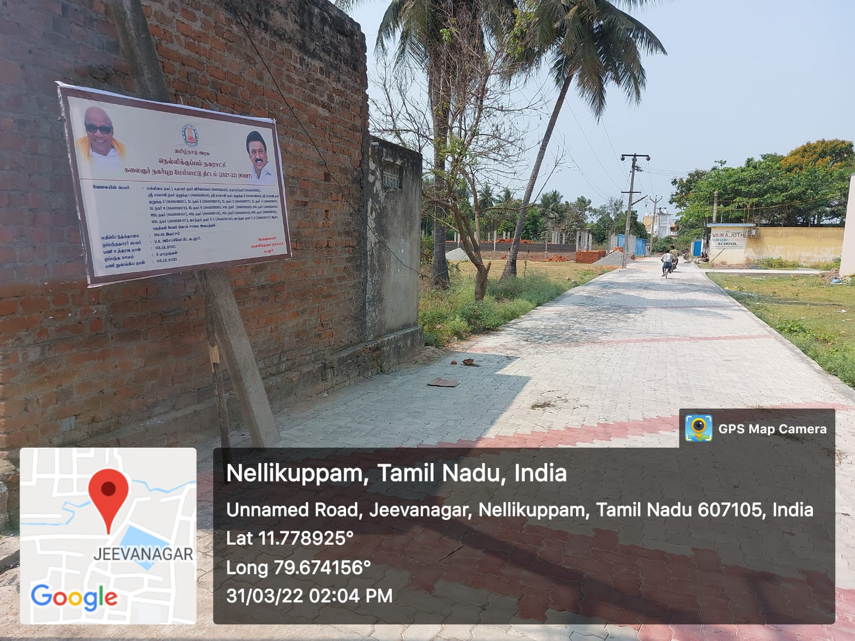
CHENGALPET REGION – Nellikuppam Municipality
KNMT SCHEME 2021-22
Providing Paver Block Road Vasantham Nagar (Unique code-094007R136 ,L =123.45 m X 5.00m ) – Total cost of Estimate 304.00 lakhs

Slide 3
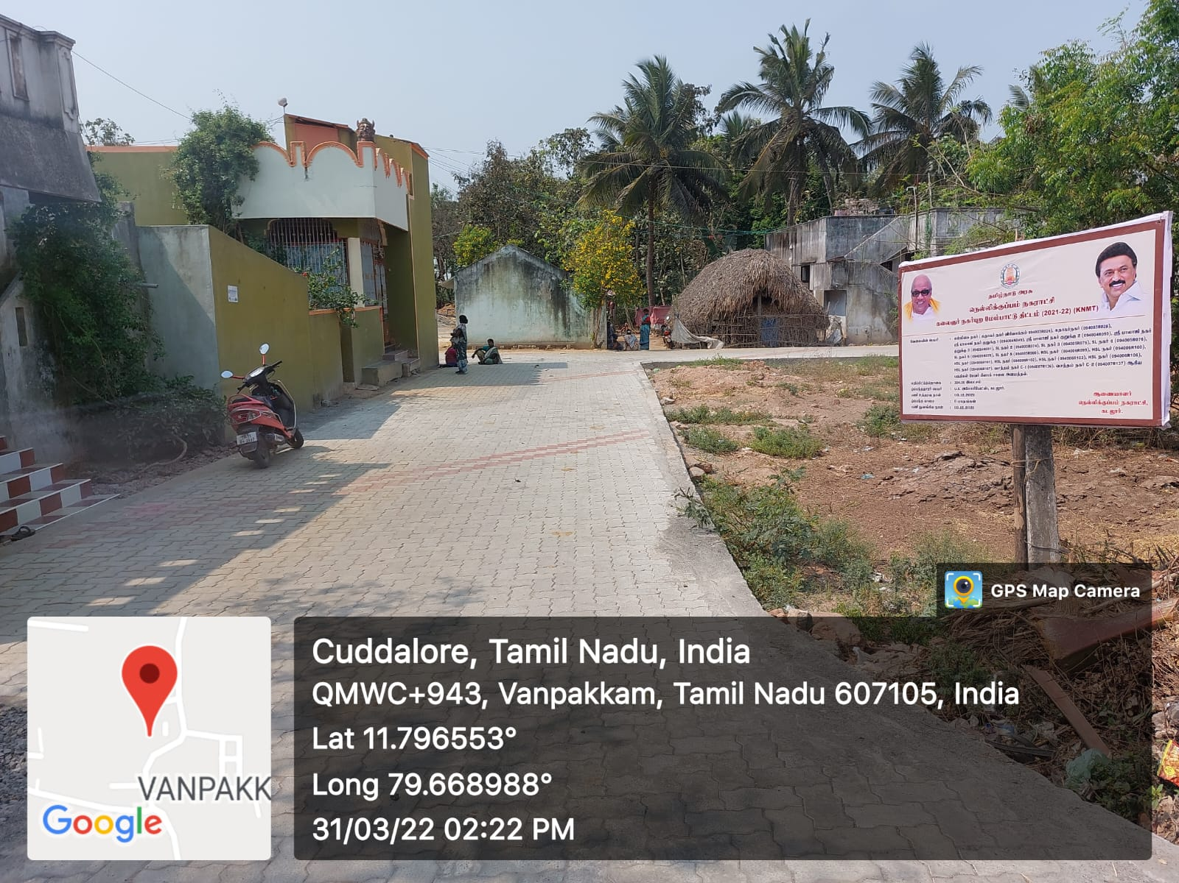
CHENGALPET REGION – Nellikuppam Municipality
KNMT SCHEME 2021-22
Providing Paver Block Road Sri Balaji Nagar (Unique code-094004R049
L =192.65 m X 5.00m ) – Total cost of Estimate 304.00 lakhs

Slide 4
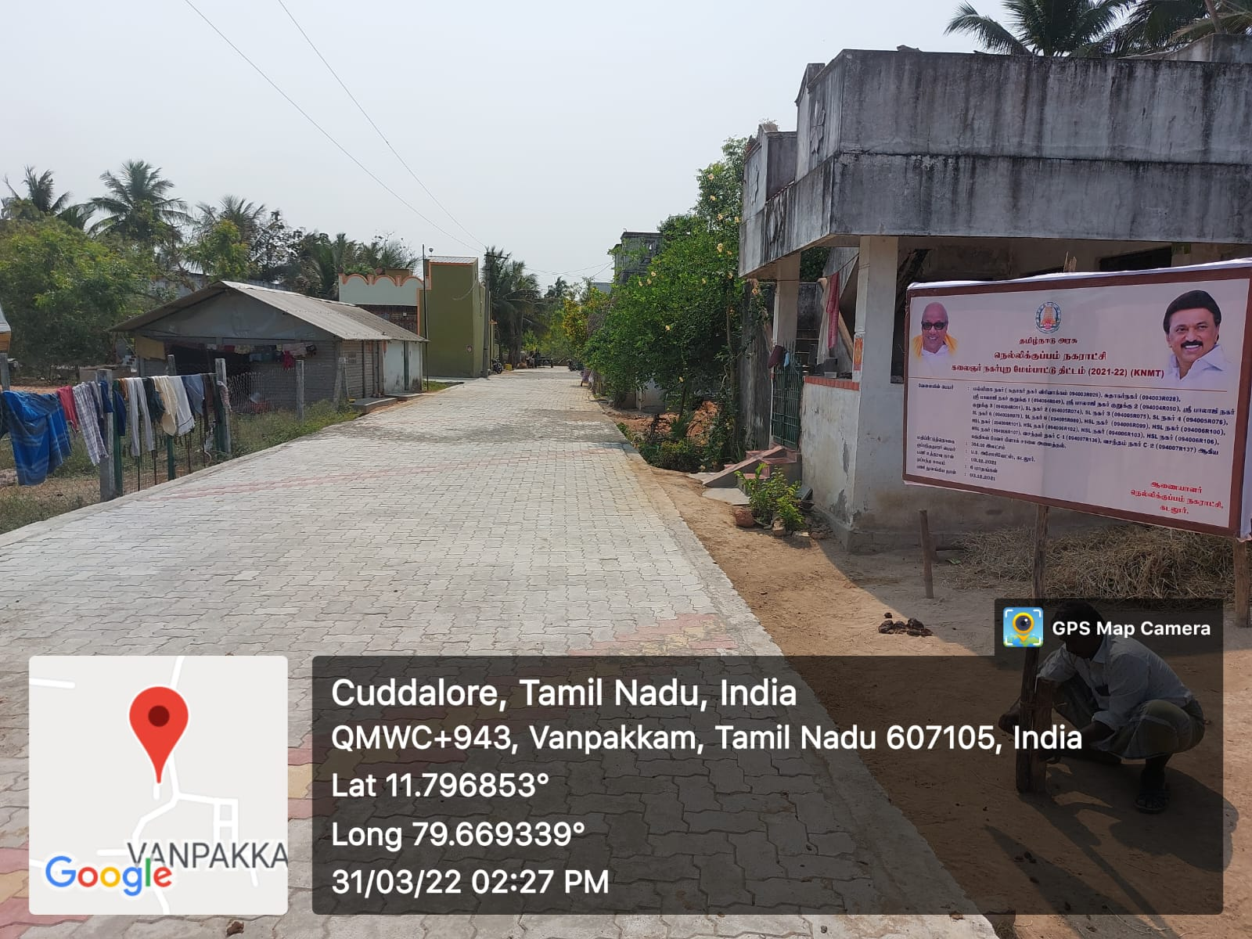
CHENGALPET REGION – Nellikuppam Municipality
KNMT SCHEME 2021-22
Providing Paver Block Road Sri Balaji Nagar (Unique code-094004R051

Slide 5
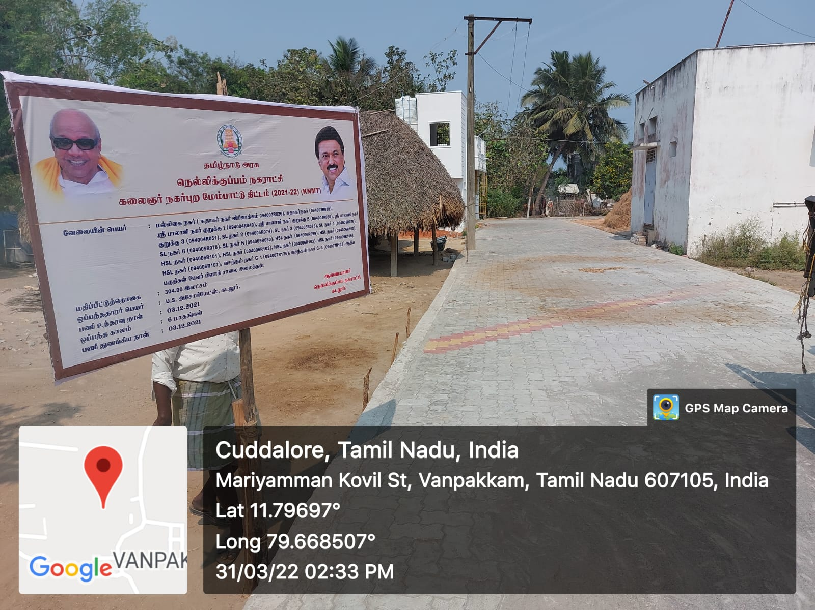
CHENGALPET REGION – Nellikuppam Municipality
KNMT SCHEME 2021-22
Providing Paver Block Road Sri Balaji Nagar (Unique code-094004R050

Slide 6
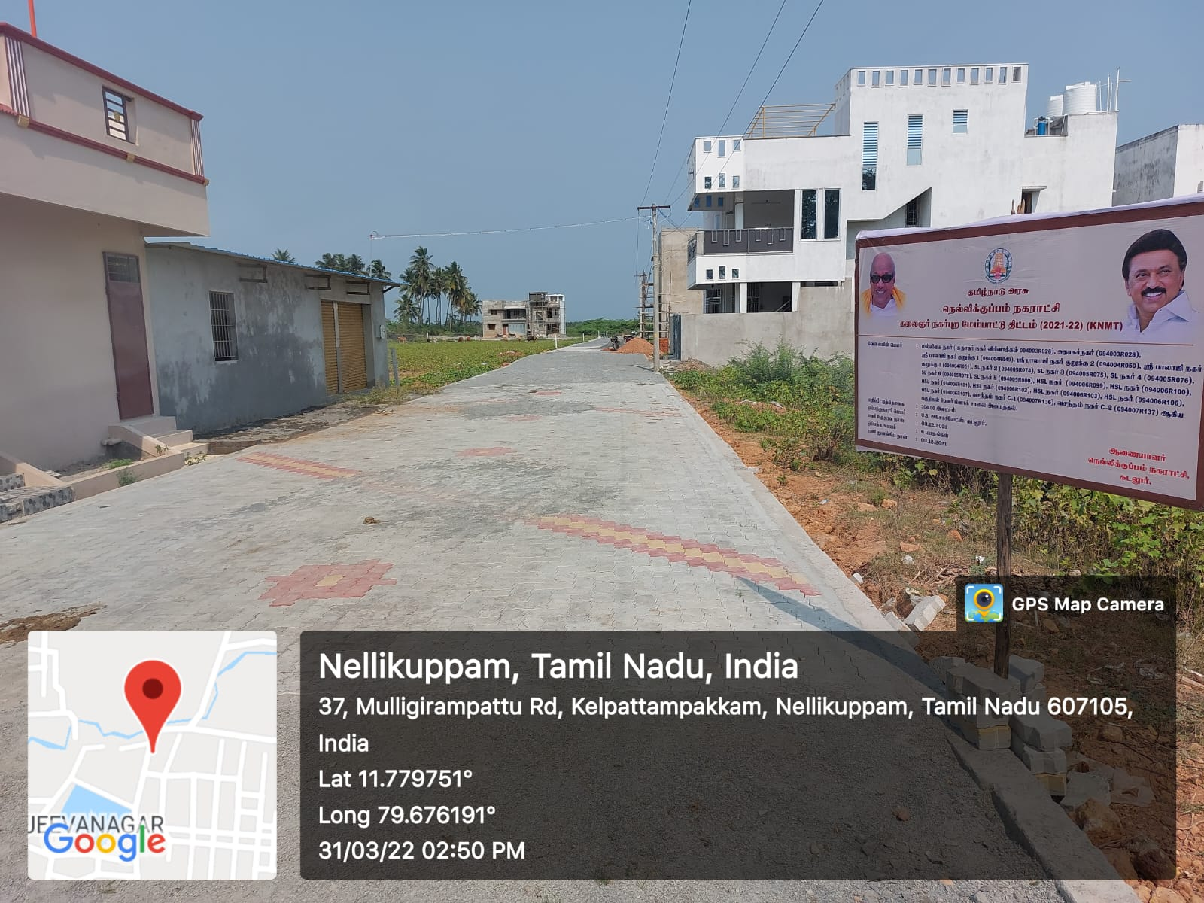
CHENGALPET REGION – Nellikuppam Municipality
KNMT SCHEME 2021-22
Providing Paver Block Road SL Nagar (Unique code-094005R074
Total cost of Estimate 304.00 lakhs

Slide 7
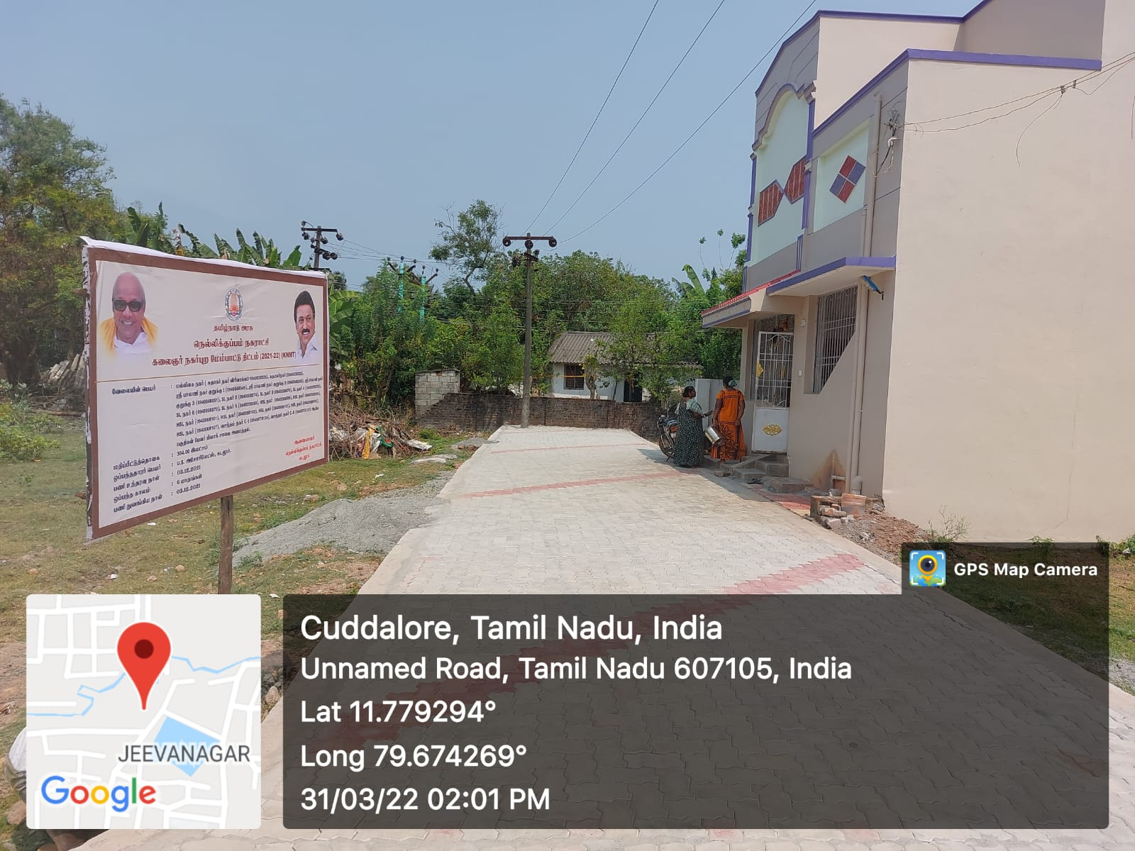
CHENGALPET REGION – Nellikuppam Municipality
KNMT SCHEME 2021-22
Providing Paver Block Road Vasantham Nagar (Unique code-094007R137

Slide 8
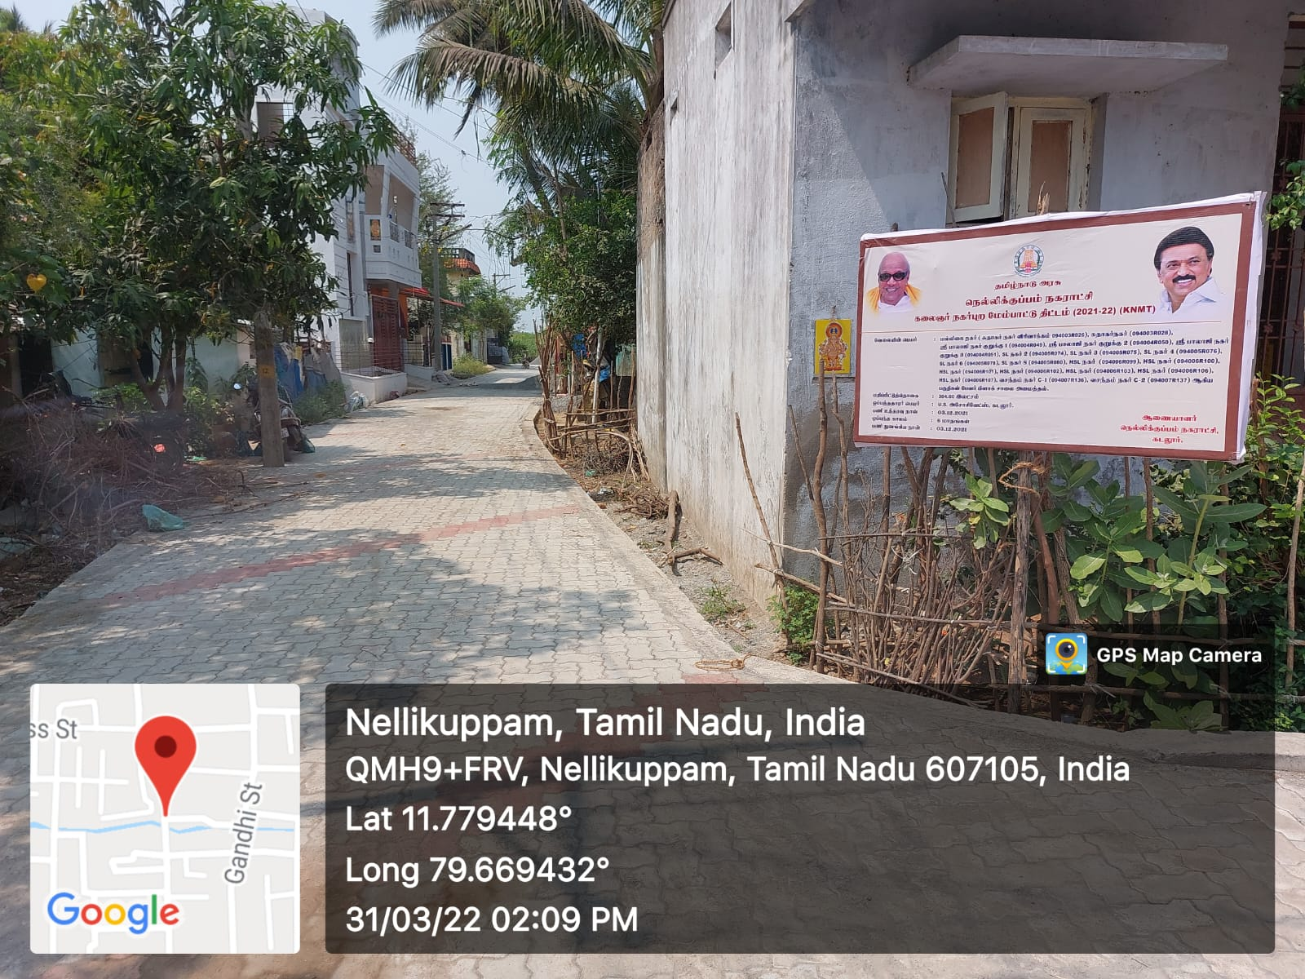
CHENGALPET REGION – Nellikuppam Municipality
KNMT SCHEME 2021-22
Providing Paver Block Road Malligai Nagar Sudhagar Nagar Extn (Unique code-094003R028

