Slide 1
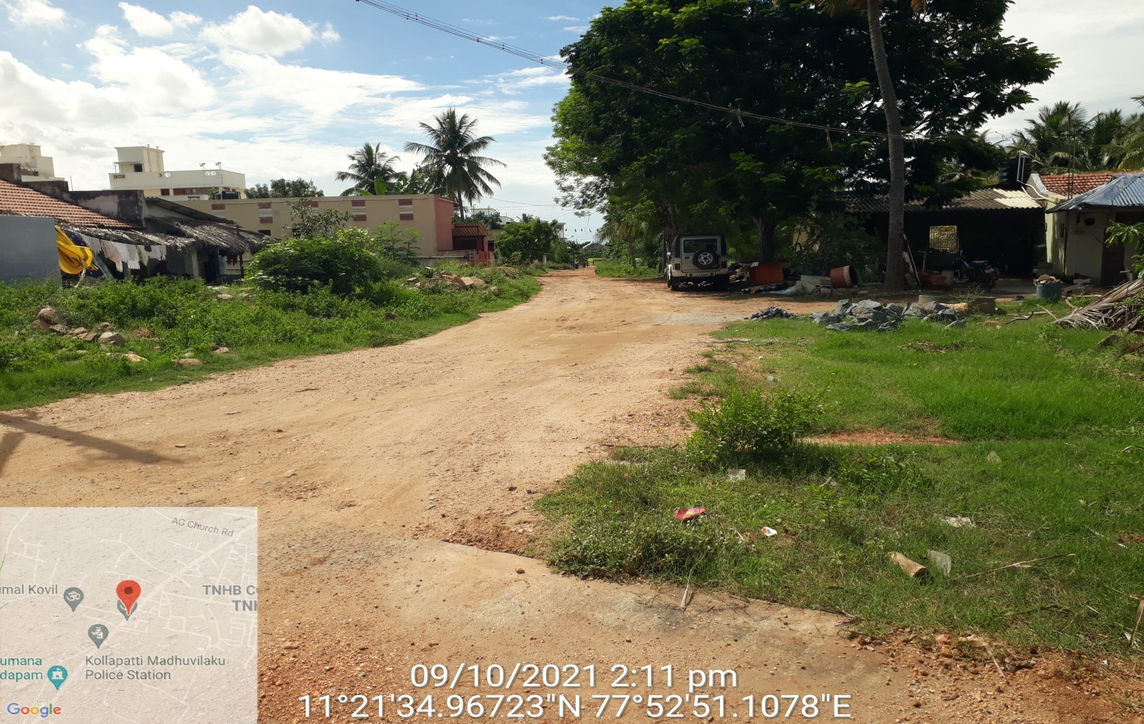
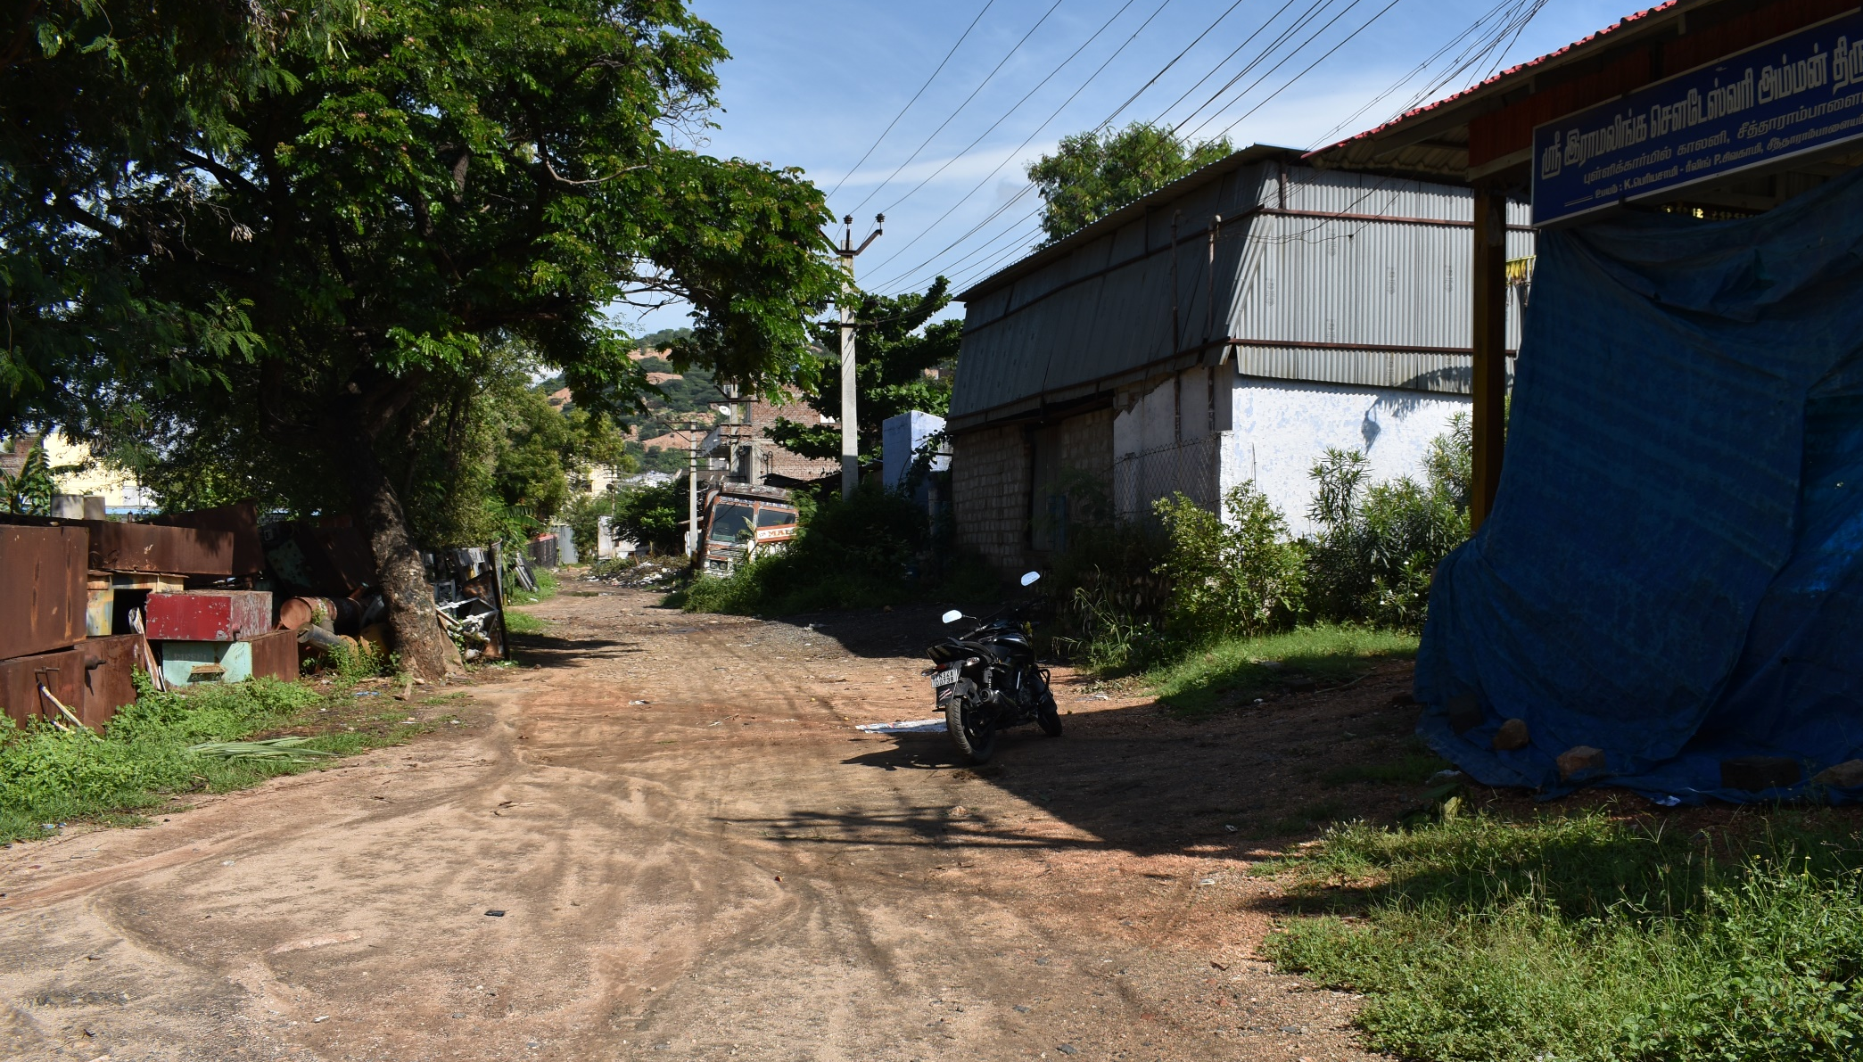
TIRUCHENGODE MUNICIPALITY Salem Region Namakkal District
Assistant Engineer, Municipal Engineer,
Tiruchengode Municipality. Tiruchengode Municipality.
.

