Slide 1
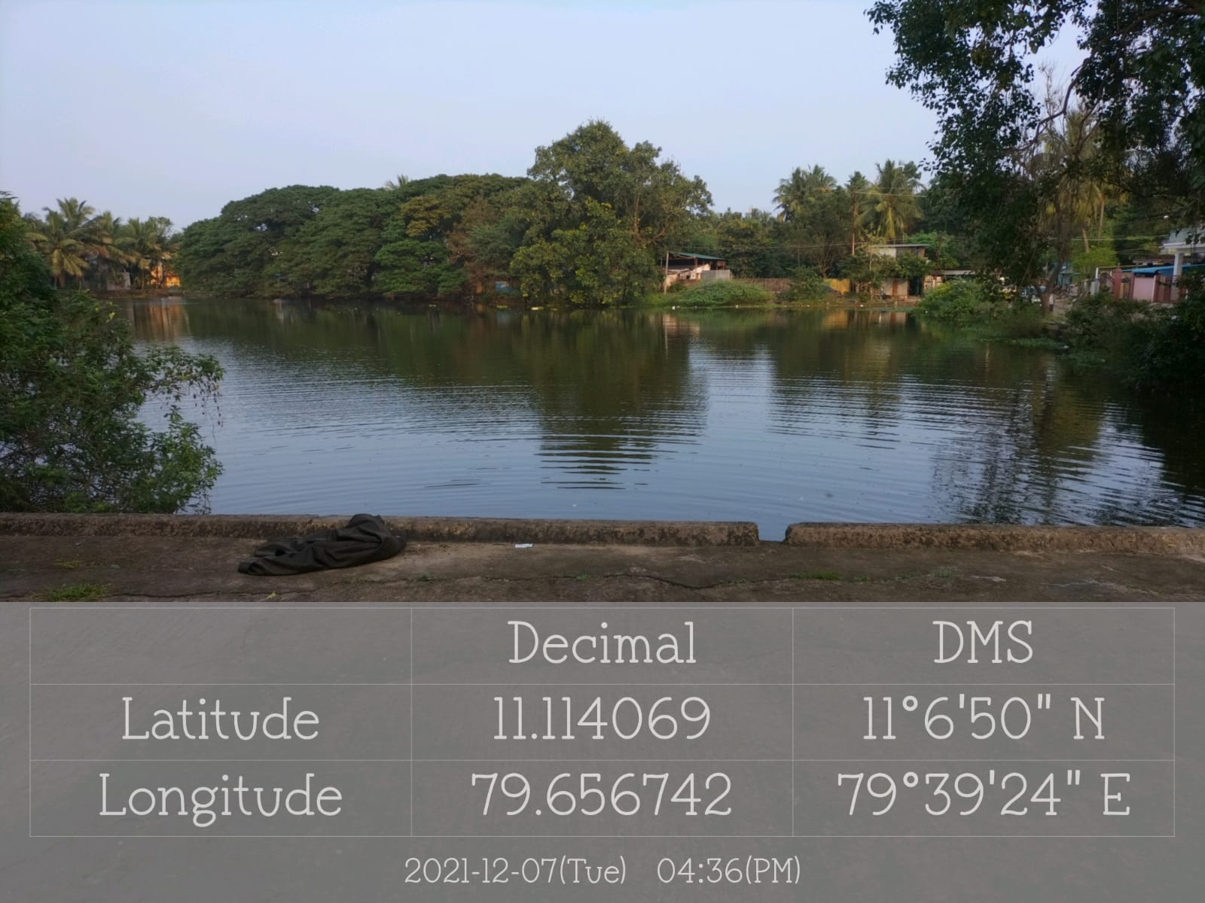
MAYILADUTHURAI MUNICIPALITY
NAME OF THE WORK:IMPROVEMENT OF SENTHANKUDI KULAM WARD-07
IN MAYILADUTHURAI MUNICIPALITY
SENTHANKUDI KULAM

