Slide 1
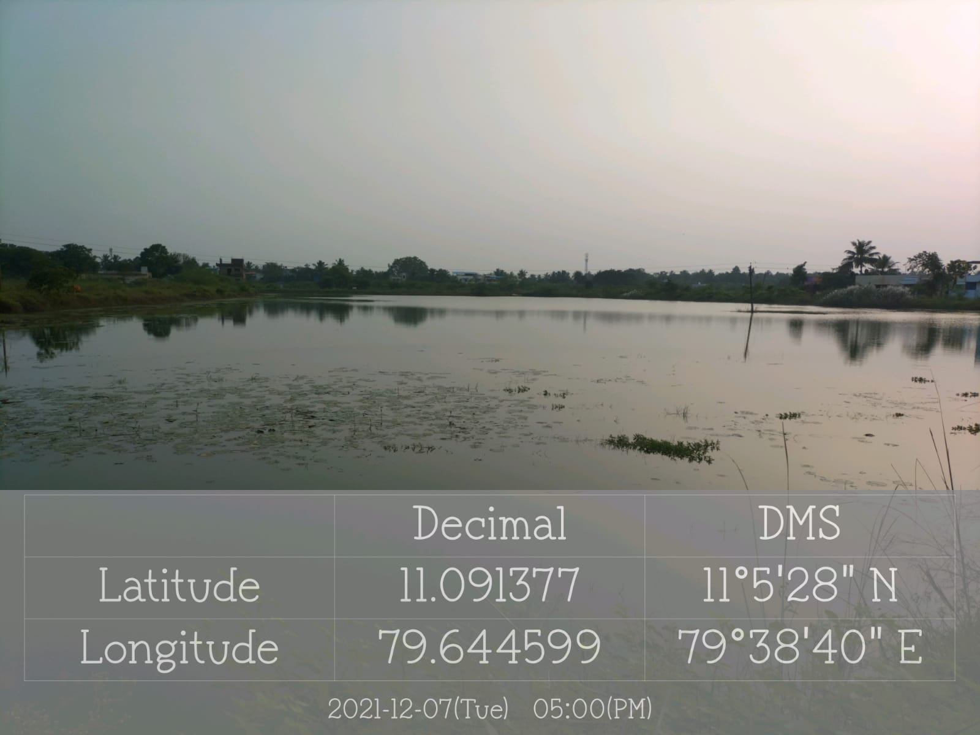
MAYILADUTHURAI MUNICIPALITY
NAME OF THE WORK : IMPROVEMENT OF VANNAN KULAM WARD-04
IN MAYILADUTHURAI MUNICIPALITY
VANNAN KULAM- NORTH SIDE

