Slide 1
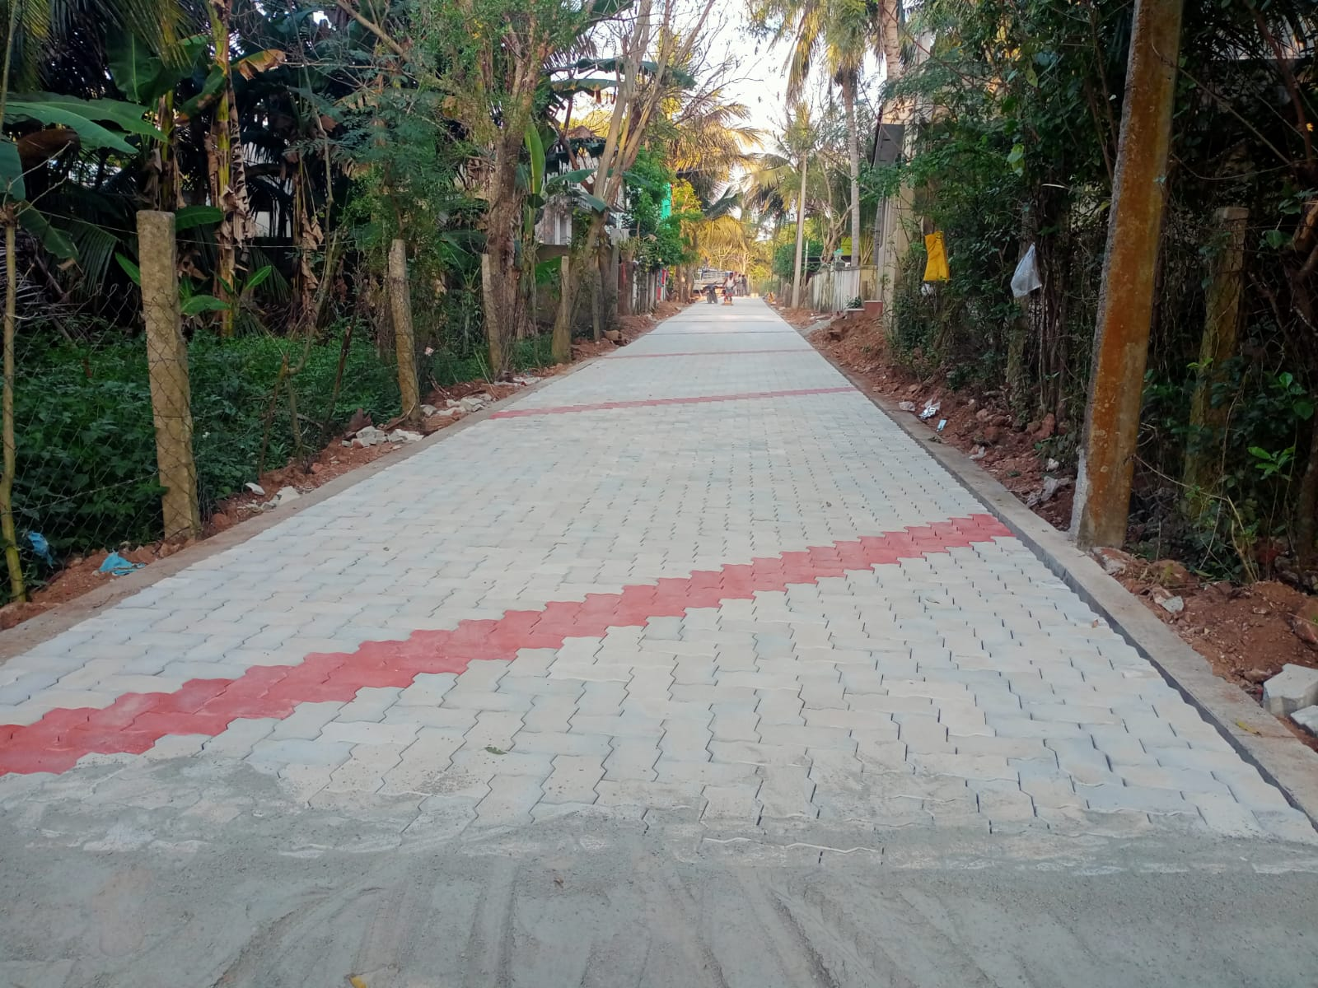
MAYILADUTHURAI MUNICIPALITY KNMT 2021-22
Name of work : Providing Paver Block surface to L.B Nagar (097007R097) (Package - 1/5)
Est.Amt : Rs. 15.47 Lakhs Latitude : 11.10478
Longitude : 79.65789

