Slide 1
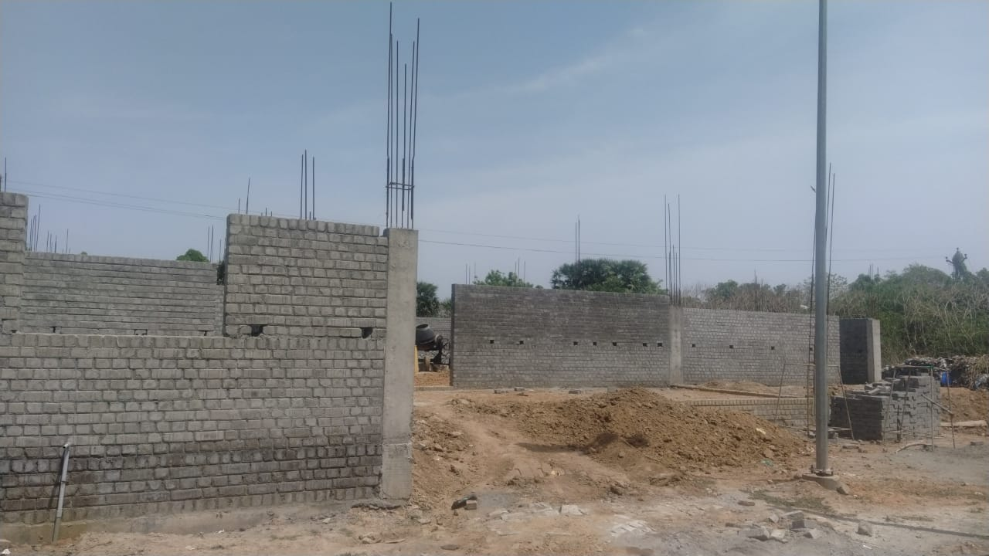
NAGAPATTINAM DISTRICT, KEELVELUR TOWN PANCHAYAT
KALAIGNAR NAGARPURA MEMPATTU THITTAM 2021-2022
Construction of LPG Gassifier Crematorium @ Pillaitheru Vasal Burial Ground, Est. Rs.140.00 L

