Slide 1
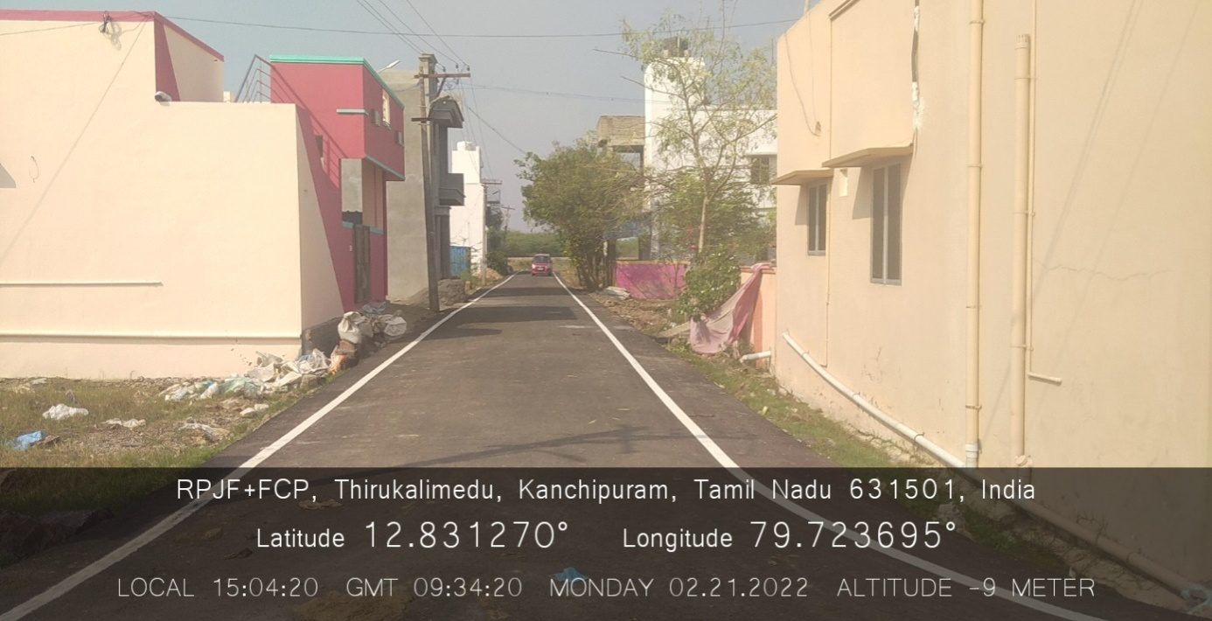
KANCHEEPURAM CORPORATION KALAIGNAR NAGARPURA MEMPATTU THITTAM (KNMT) - 2020-2021 ARIHANT AVENUE

Slide 2
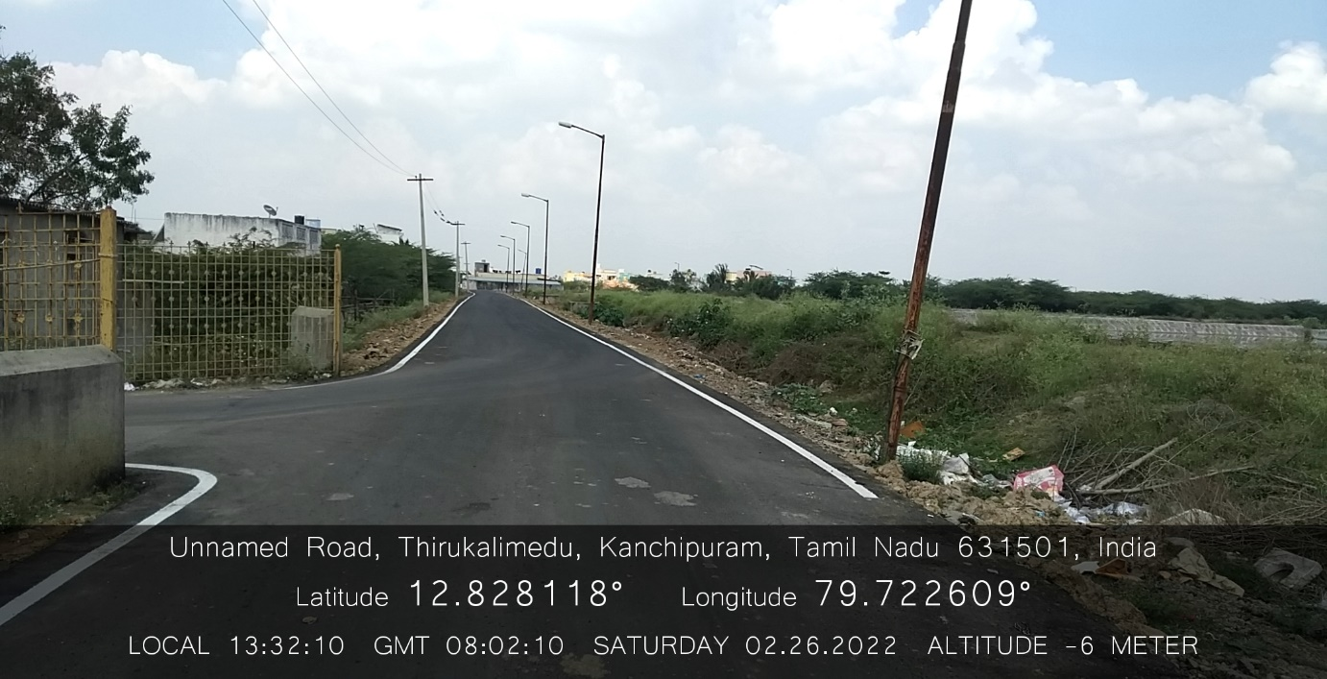
KANCHEEPURAM CORPORATION KALAIGNAR NAGARPURA MEMPATTU THITTAM (KNMT) - 2020-2021 NSK NAGAR COMPOST YARD ROAD

Slide 3
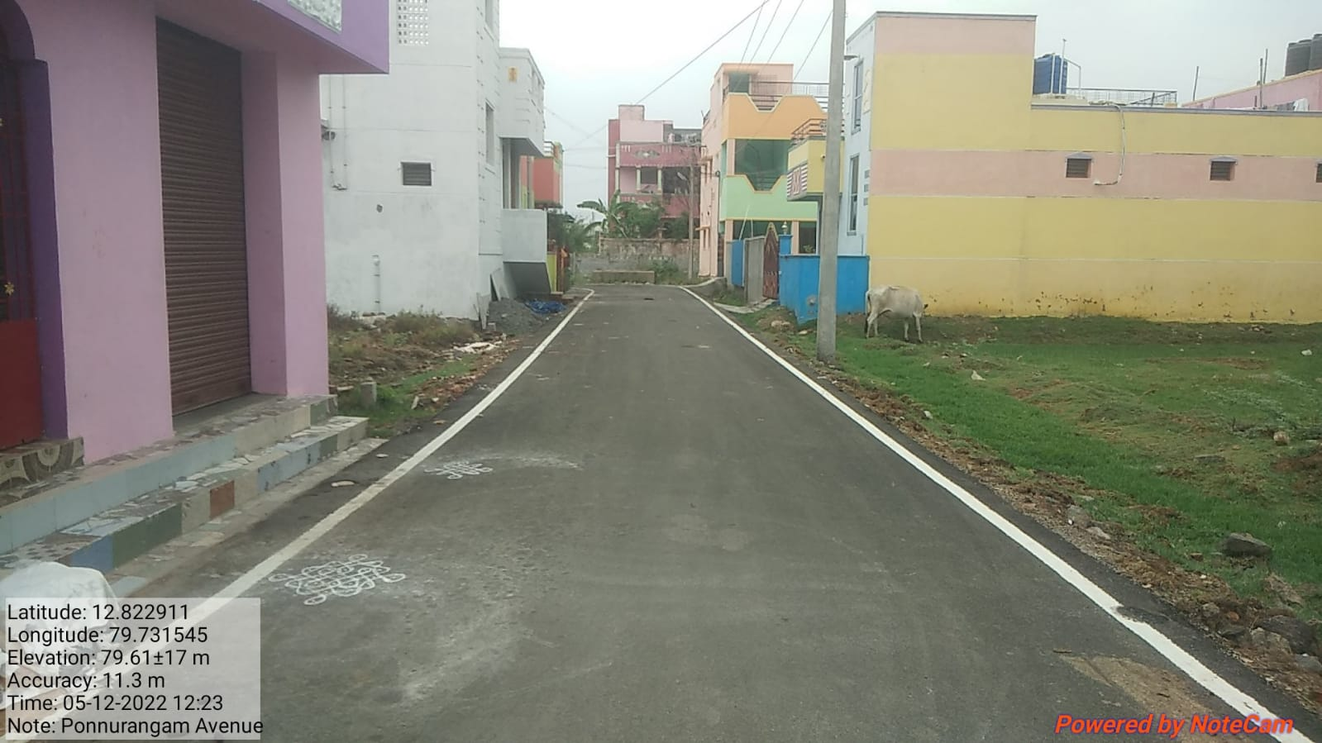
KANCHEEPURAM CORPORATION KALAIGNAR NAGARPURA MEMPATTU THITTAM (KNMT) - 2020-2021 PONNURANGAM AVENUE

Slide 4
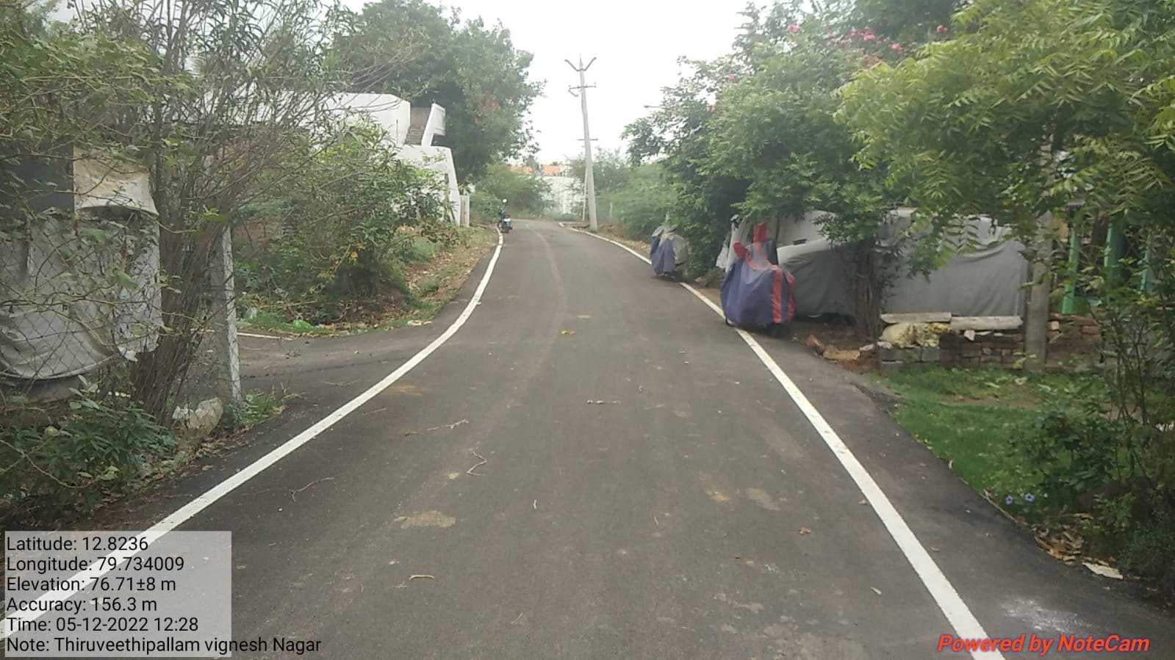
KANCHEEPURAM CORPORATION KALAIGNAR NAGARPURA MEMPATTU THITTAM (KNMT) - 2020-2021 THIRUVETHIPALLAM VIGNESH NAGAR

Slide 5
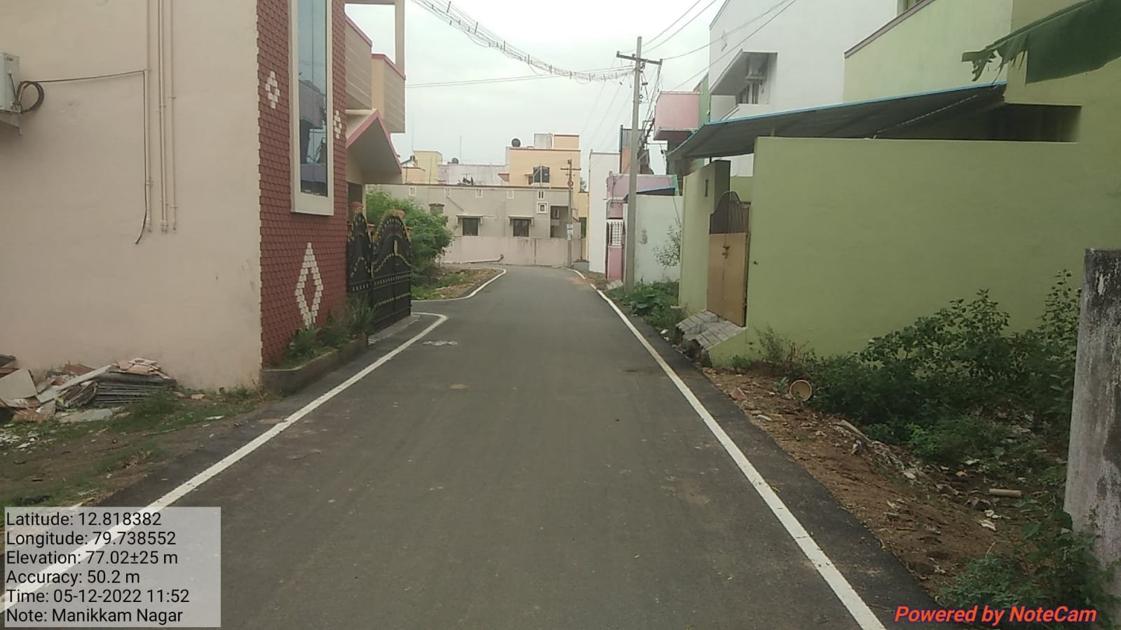
KANCHEEPURAM CORPORATION KALAIGNAR NAGARPURA MEMPATTU THITTAM (KNMT) - 2020-2021 MANIKKAM NAGAR

Slide 6
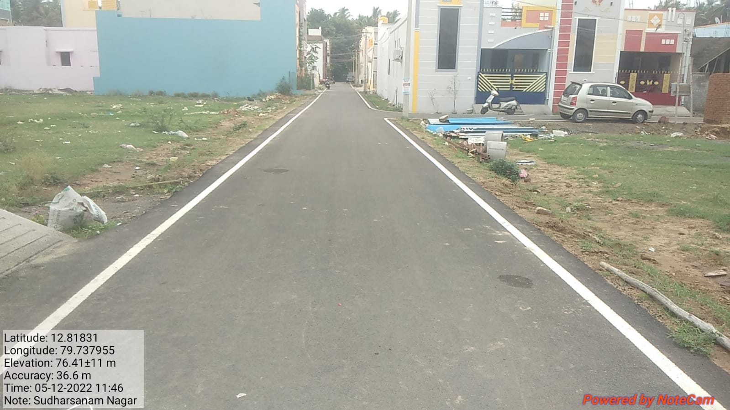
KANCHEEPURAM CORPORATION KALAIGNAR NAGARPURA MEMPATTU THITTAM (KNMT) - 2020-2021 SUDHARSANAM NAGAR ROAD

Slide 7
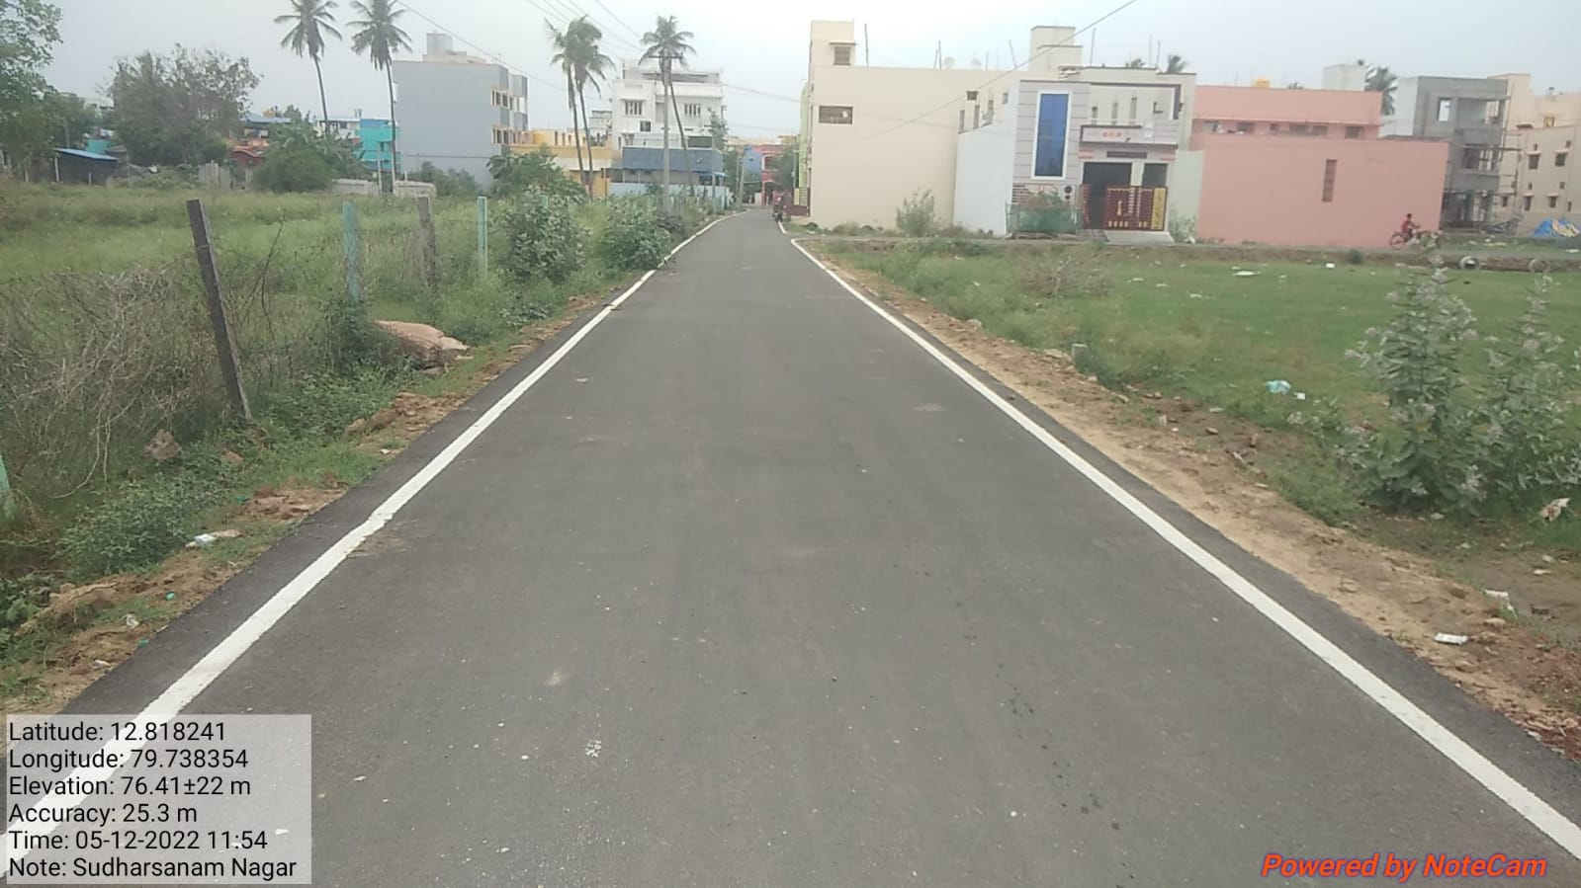
KANCHEEPURAM CORPORATION KALAIGNAR NAGARPURA MEMPATTU THITTAM (KNMT) - 2020-2021 SUDHARSANAM NAGAR ROAD

Slide 8
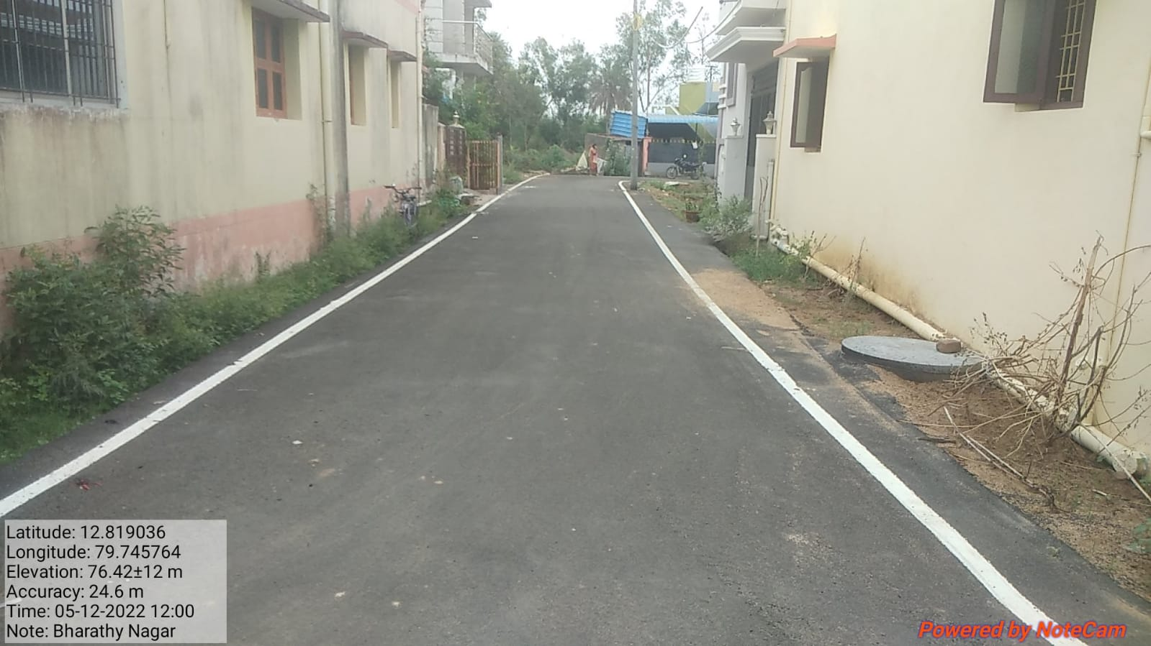
KANCHEEPURAM CORPORATION KALAIGNAR NAGARPURA MEMPATTU THITTAM (KNMT) - 2020-2021 BHARATHI NAGAR

Slide 9
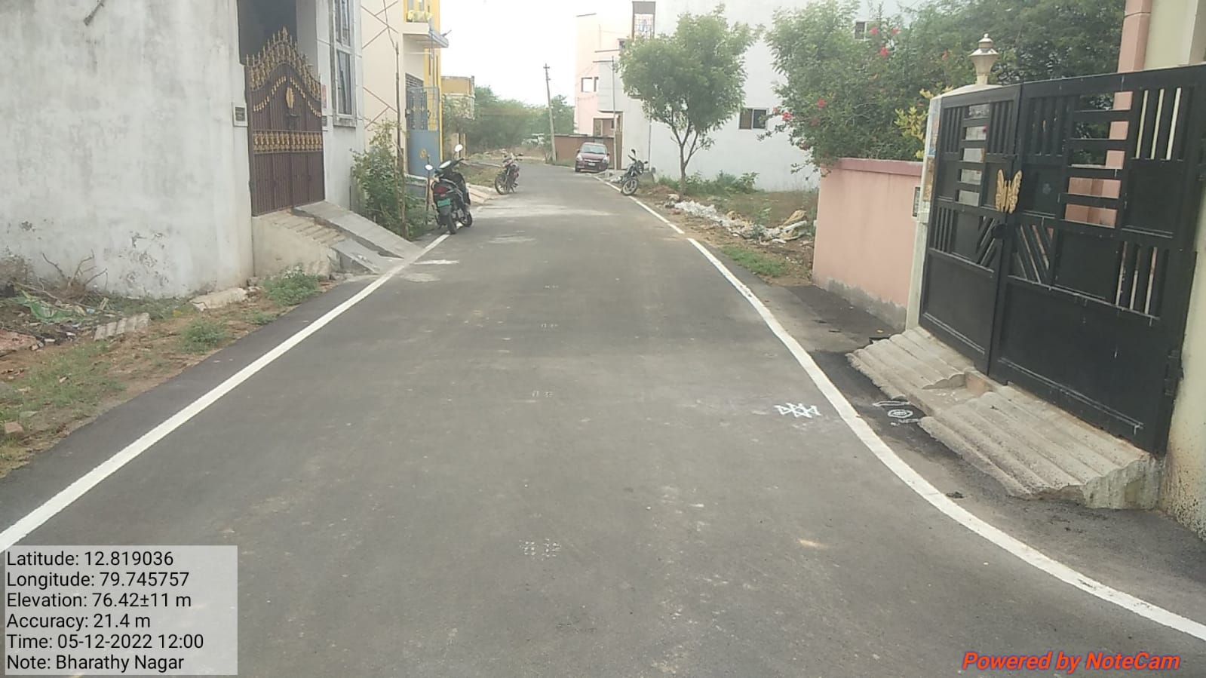
KANCHEEPURAM CORPORATION KALAIGNAR NAGARPURA MEMPATTU THITTAM (KNMT) - 2020-2021 BHARATHI NAGAR

Slide 10
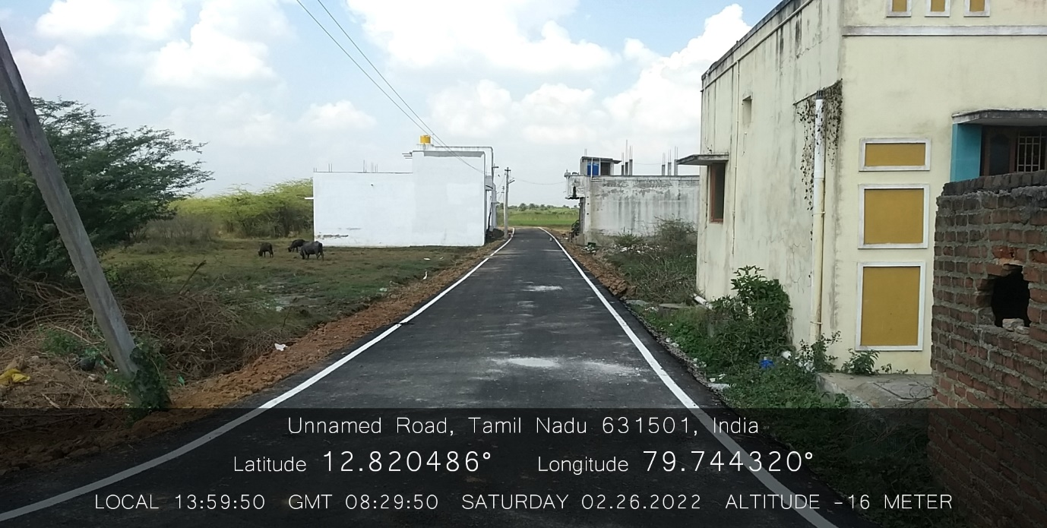
KANCHEEPURAM CORPORATION KALAIGNAR NAGARPURA MEMPATTU THITTAM (KNMT) - 2020-2021 NATHAPETTAI VENKATESWARA NAGAR

Slide 11
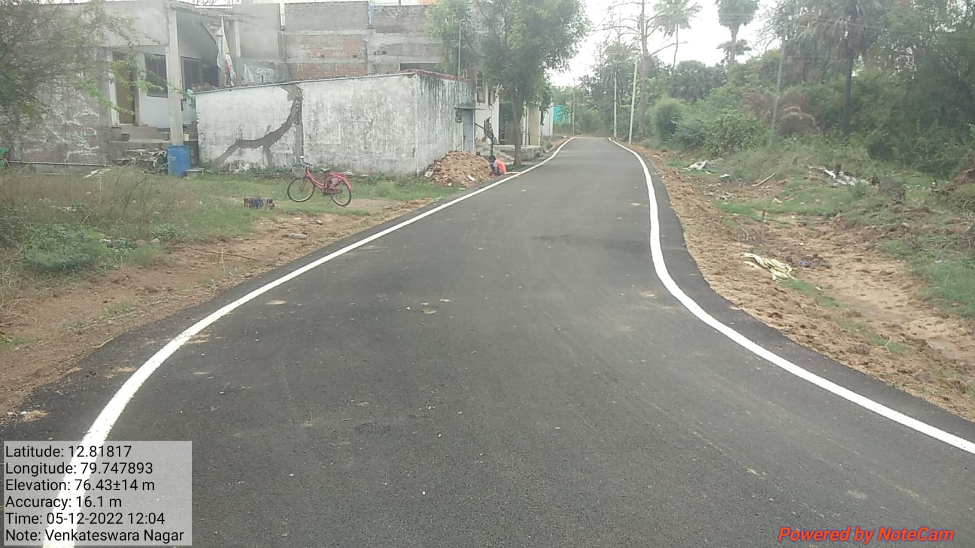
KANCHEEPURAM CORPORATION KALAIGNAR NAGARPURA MEMPATTU THITTAM (KNMT) - 2020-2021 NATHAPETTAI VENKATESWARA NAGAR

Slide 12
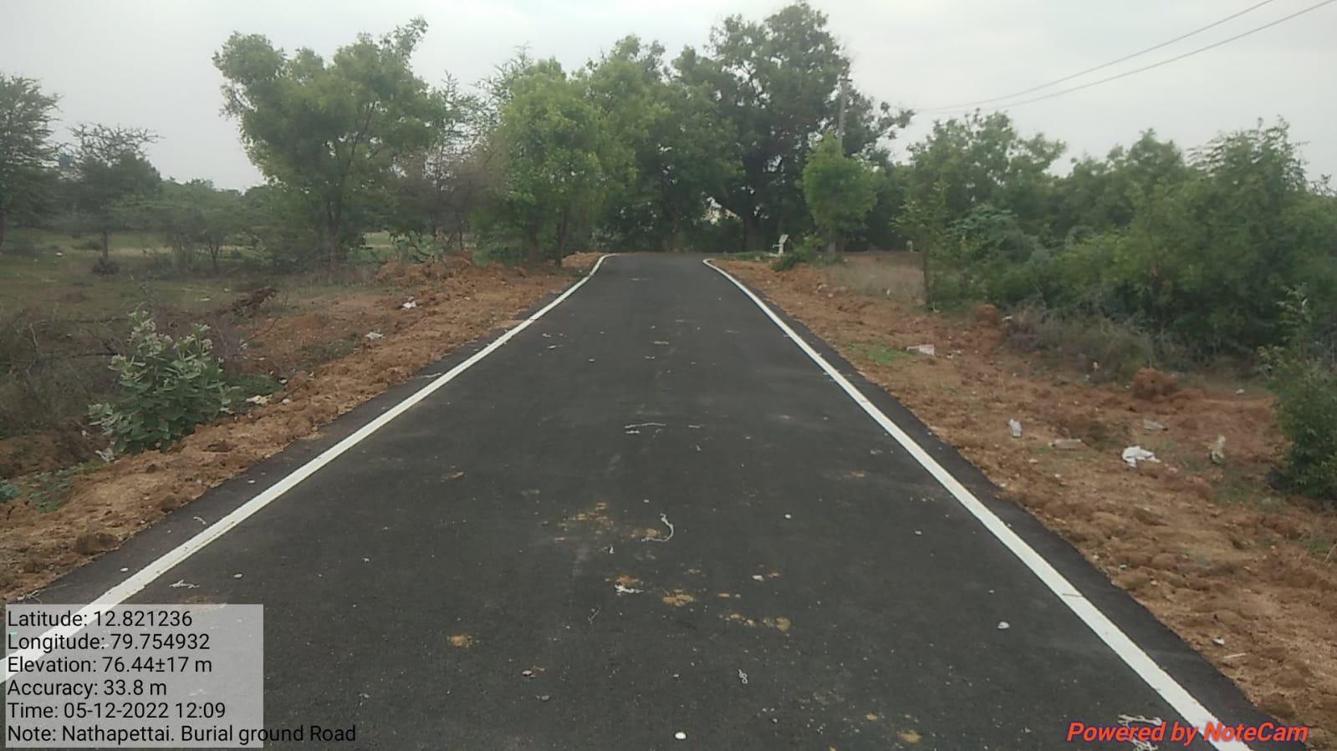
KANCHEEPURAM CORPORATION KALAIGNAR NAGARPURA MEMPATTU THITTAM (KNMT) - 2020-2021 NATHAPETTAI BURIAL GROUND ROAD

Slide 13
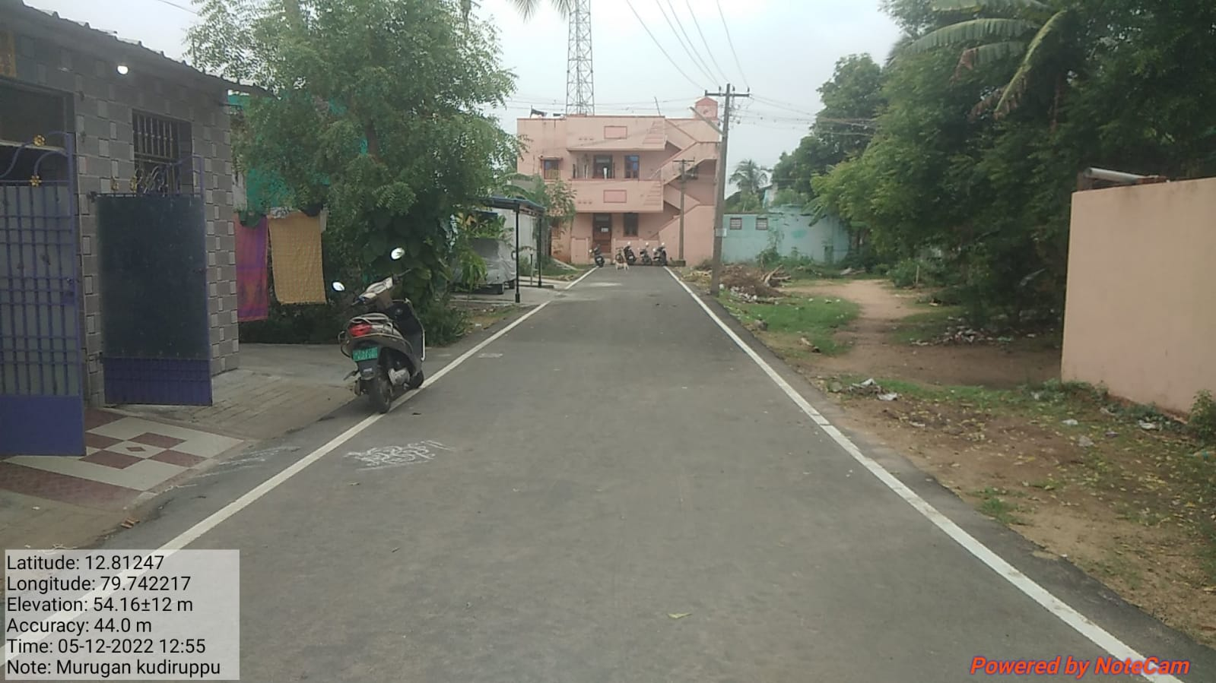
KANCHEEPURAM CORPORATION KALAIGNAR NAGARPURA MEMPATTU THITTAM (KNMT) - 2020-2021 MURUGAN KUDIRUPPU

Slide 14
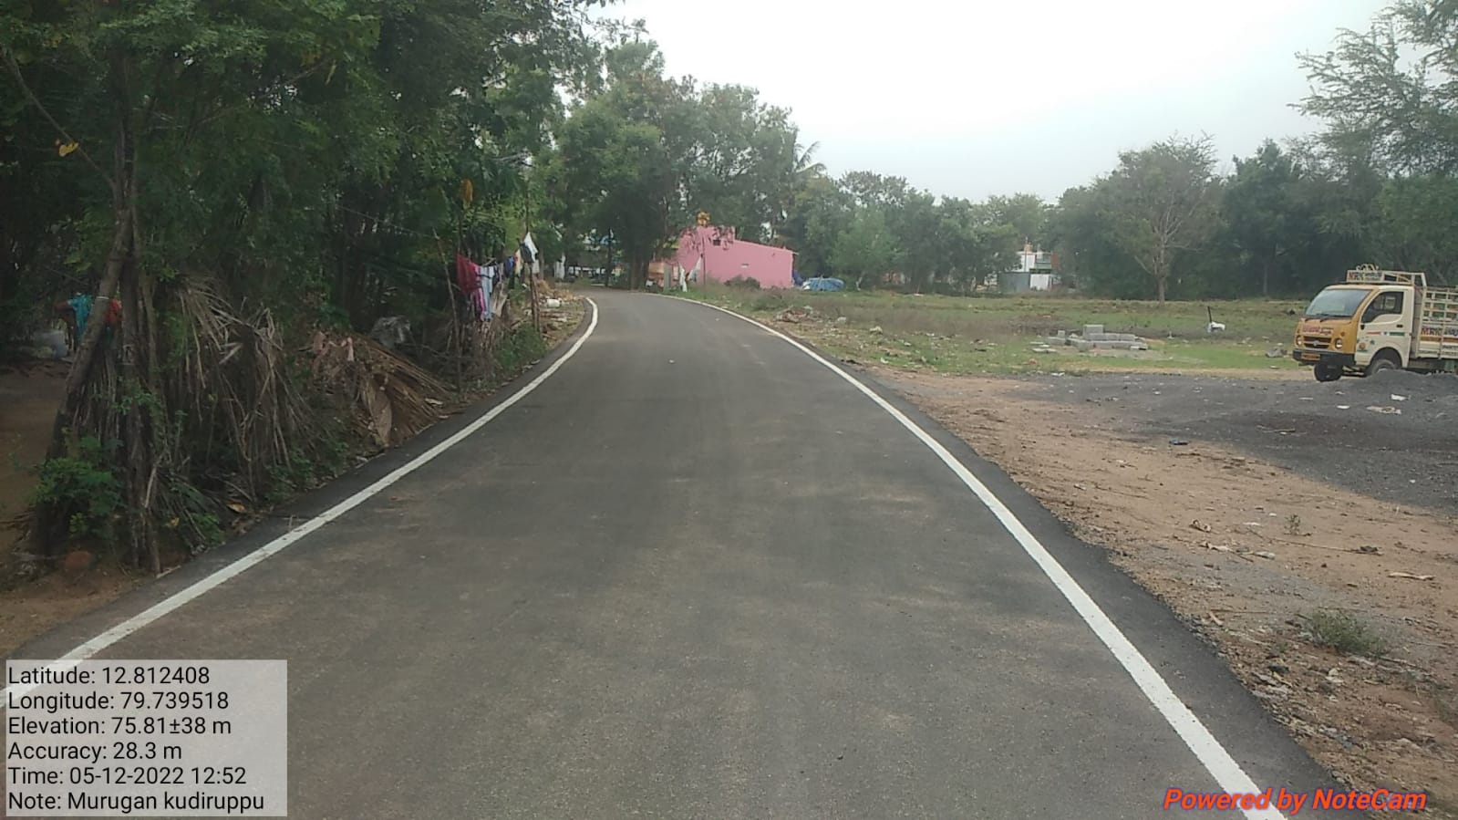
KANCHEEPURAM CORPORATION KALAIGNAR NAGARPURA MEMPATTU THITTAM (KNMT) - 2020-2021 MURUGAN KUDIRUPPU

Slide 15
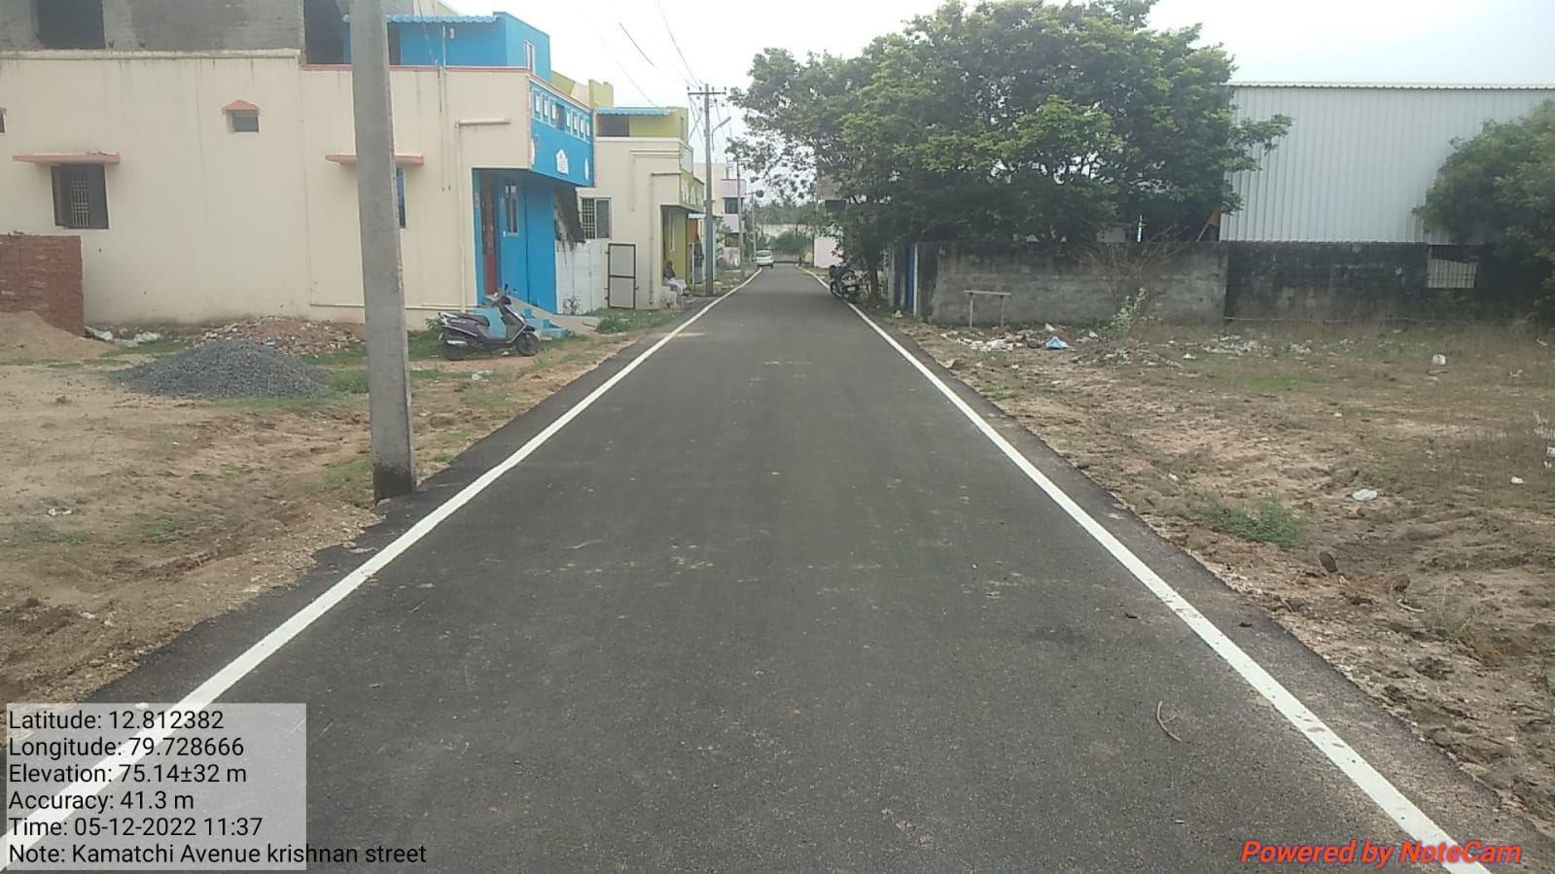
KANCHEEPURAM CORPORATION KALAIGNAR NAGARPURA MEMPATTU THITTAM (KNMT) - 2020-2021 KAMATCHI AVENUE KRISHNAN STREET

