Slide 1
aisensum coding challenge
sandeep sisupalan

Slide 2
table of contents
PROBLEM STATEMENT
BACKGROUND
APPROACH
RESULTS
concluding note

Slide 3
KEY QUESTIONS
PROBLEM STATEMENT
Best Model to Predict Sales Next Month and "why" you chose that model?
Generate Forecast for 3 months based on best selected model
Provide validation results (Error metrics) for your generated forecast

Slide 4
data nuggets
background
Data is collected at the daily level (From Apr-Sept).
Data contains information of different mobile operators.
There are 1983 outlets.
There are 6 operators and 10 brands.
There are 56 cities.
There are 11 sub regions.
There are 4 outlet sizes.
There are 5 outlet brandings.
There are 7 type of packs and 3 types.

Slide 5

data steps
approach
introduce a lag feature*
aggregate data on id_outlet and month level*
target is total sales price*
model steps
ridge
data
svm
generate forecasts
stack models
xgboost
train
test
lightgbm
rf
*For detailed explanations, it is highly recommended to read 03_Solution Write-Up.html

Slide 6
validation metrics for model to forecast for next month
results
Model | Train RMSE | Test RMSE | Train MAPE | Test MAPE
Ridge | 2199.54 | 1118.38 | 30.56 | 433.39
Support Vector Machines | 9393.06 | 7740.11 | 457.48 | 4091.21
Extreme Gradient Boosting | 345.40 | 132.35 | 3.44 | 15.68
Light Gradient Boosting | 519.59 | 147.25 | 6.96 | 73.99
Random Forest | 262.10 | 136.49 | 3.38 | 17.67
Stacking | 178.95 | 162.36 | 1.76 | 15.83
Stacking is the recommended model*
*For detailed explanations, it is highly recommended to read 03_Solution Write-Up.html

Slide 7
validation metrics for model to forecast for next three months
results
Model | Train RMSE | Test RMSE | Train MAPE | Test MAPE
Ridge | 2387.42 | 1146.52 | 32.11 | 450.07
Support Vector Machines | 9393.20 | 7735.48 | 456.64 | 4084.63
Extreme Gradient Boosting | 553.49 | 171.51 | 4.29 | 16.16
Light Gradient Boosting | 939.19 | 195.54 | 8.75 | 91.66
Random Forest | 484.11 | 185.45 | 4.10 | 21.68
Stacking | 266.70 | 209.10 | 2.44 | 17.05
Stacking is the recommended model*
*For detailed explanations, it is highly recommended to read 03_Solution Write-Up.html

Slide 8
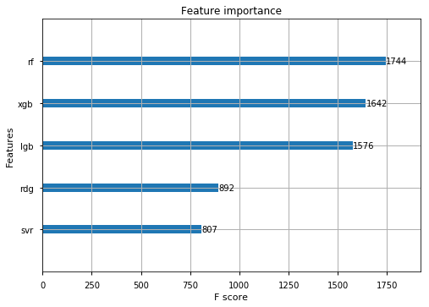
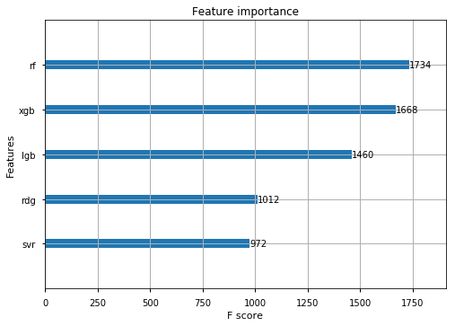
feature importance graphs
results
MODEL FOR FORECASTING FOR NEXT MONTH
MODEL FOR FORECASTING FOR NEXT THREE MONTHS

Slide 9
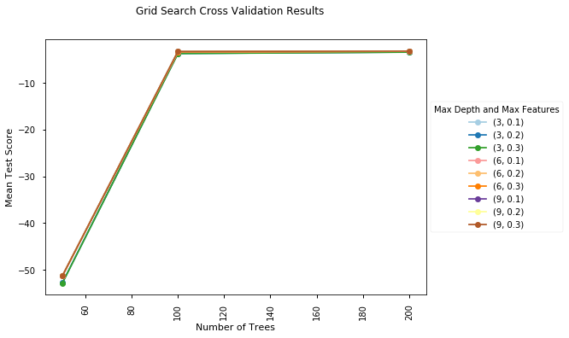
GRID SEARCH CROSS VALIDATION RESULTS*
results
*Grid search results are the same for both 30 days forecasting and 90 days forecasting model

Slide 10
future scope:
concluding notes
LSTMS for time series modelling
traditional time series models
repository*:
https://github.com/sisupalan/coding_challenge_ml
code execution order:
01_Data preparation
02_model build
03_solution-write-up**
*All code is available as python notebooks under the notebooks folder at GitHub
**For detailed explanations, it is highly recommended to read 03_Solution Write-Up.html

