Slide 1
Principal Component Analysis(PCA)
Guowei Wei
Department of Mathematics
Michigan State University
References:
Andrew Ng’s notes
Wikipedia

Slide 2
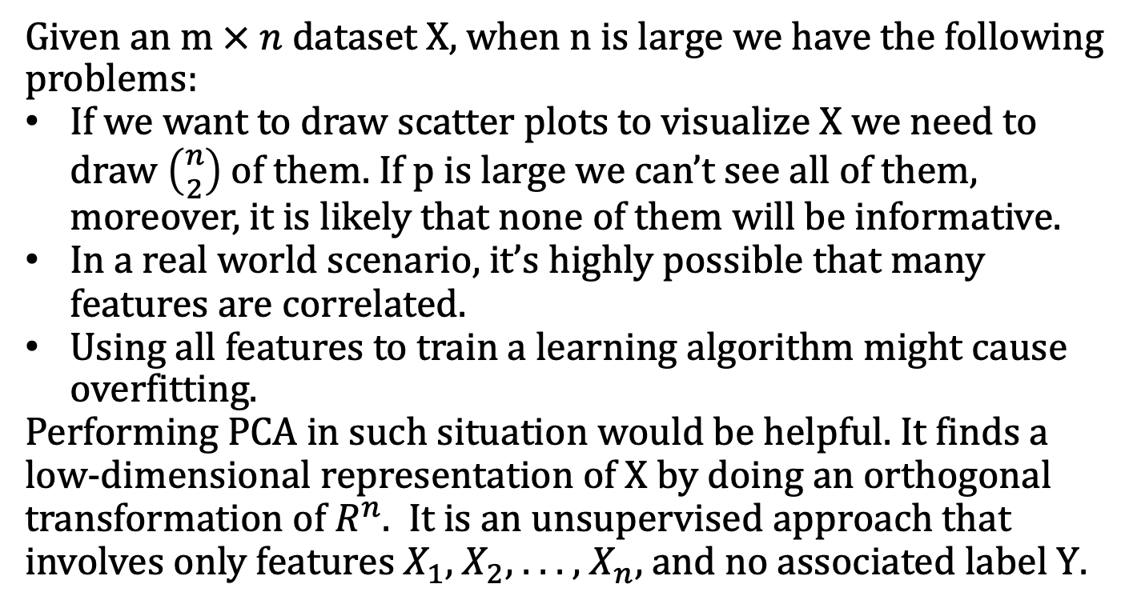
Motivation
Given an $m × n$ dataset X, when n is large we have the following problems:
If we want to draw scatter plots to visualize X we need to draw $\left({n \atop 2}\right)$ of them. If p is large we can’t see all of them, moreover, it is likely that none of them will be informative.
In a real world scenario, it’s highly possible that many features are correlated.
Using all features to train a learning algorithm might cause overfitting.
Performing PCA in such situation would be helpful. It finds a low-dimensional representation of X by doing an orthogonal transformation of $R^{n}$. It is an unsupervised approach that involves only features $X_{1}$, $X_{2}$, . . . , $X_{n}$, and no associated label $\text{Y}$.

Slide 3
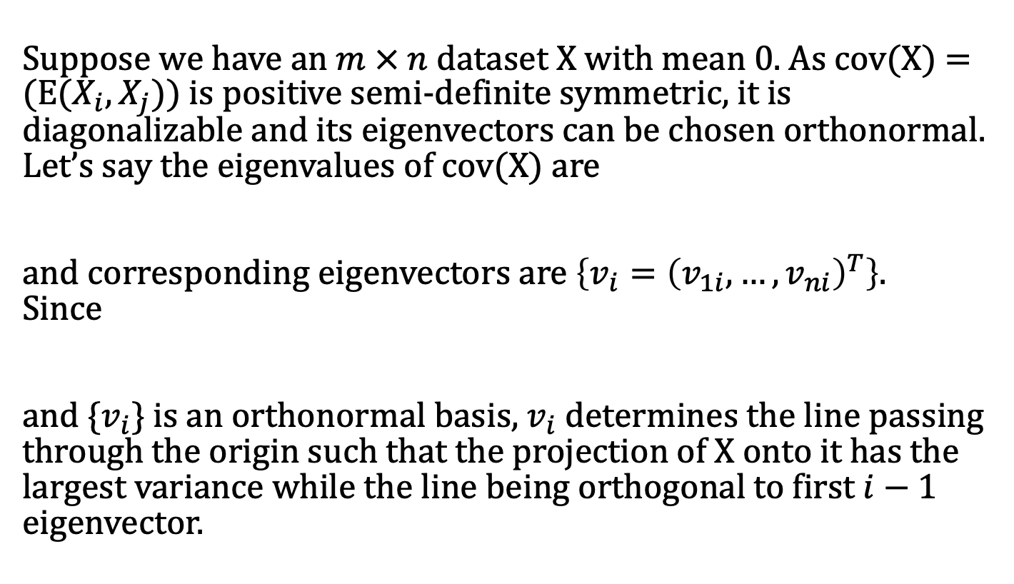
Algorithm
Suppose we have an $m × n$ dataset X with mean 0. As cov(X) = (E($X_{i}, X_{j}$)) is positive semi-definite symmetric, it is diagonalizable and its eigenvectors can be chosen orthonormal. Let’s say the eigenvalues of cov(X) are
and corresponding eigenvectors are $\left\{v_{i}={\left(v_{1i}, …,v_{ni}\right)}^{T}\right\}$.
Since
and $\{v_{i}\}$ is an orthonormal basis, $v_{i}$ determines the line passing through the origin such that the projection of X onto it has the largest variance while the line being orthogonal to first $i−1$ eigenvector.

Slide 4
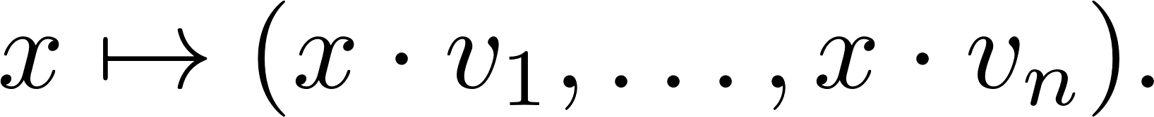
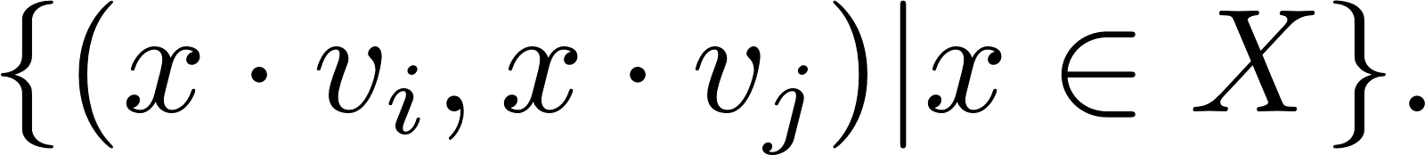
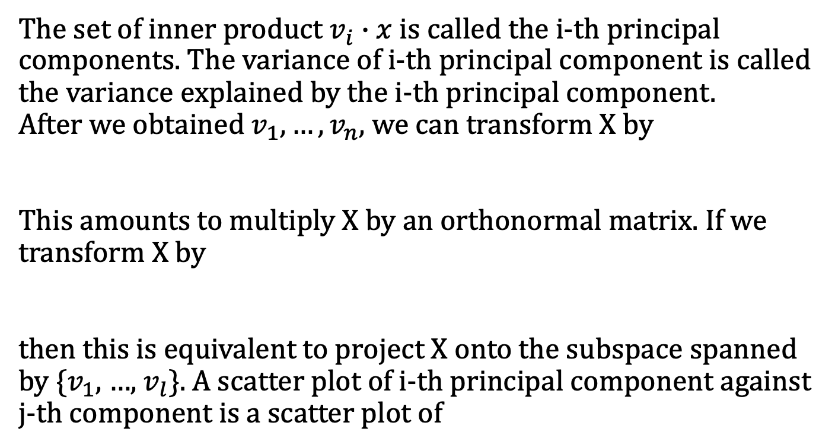
Transformation of Data
The set of inner product $v_{i}∙x$ is called the i-th principal components. The variance of i-th principal component is called the variance explained by the i-th principal component.
After we obtained $v_{1}, …, v_{n}$, we can transform X by
This amounts to multiply X by an orthonormal matrix. If we transform X by
then this is equivalent to project X onto the subspace spanned by {$v_{1}$, …, $v_{l}$}. A scatter plot of i-th principal component against j-th component is a scatter plot of

Slide 5
Feature scaling is important
Principal components will be biased towards features with high variance. For example, human height varies less than human height if their respective scales are meters and kilos. PCA would then determine that weight is much more important than height and most information of height would be lost. This could affect the performance of subsequent algorithms. Always do feature scaling before performing PCA is a good idea.
In certain settings, however, the variables may be measured in the same units. In this case we might not wish to scale the variables before performing PCA.

Slide 6
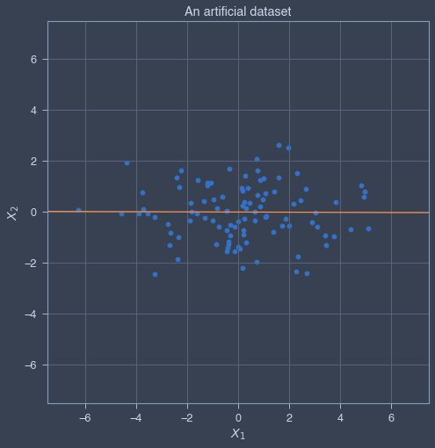
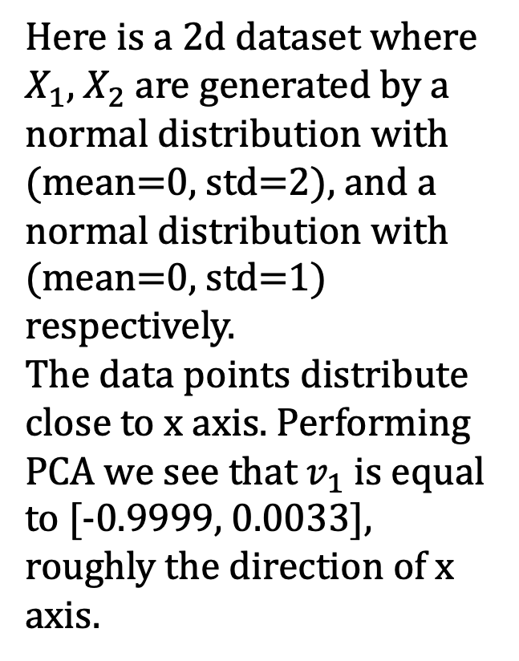
A toy example of PCA
Here is a 2d dataset where $X_{1}$, $X_{2}$ are generated by a normal distribution with (mean=0, std=2), and a normal distribution with (mean=0, std=1) respectively.
The data points distribute close to x axis. Performing PCA we see that $v_{1}$ is equal to [-0.9999, 0.0033], roughly the direction of x axis.

Slide 7
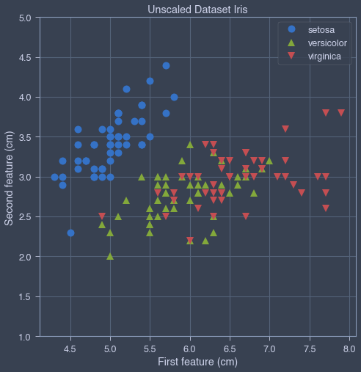
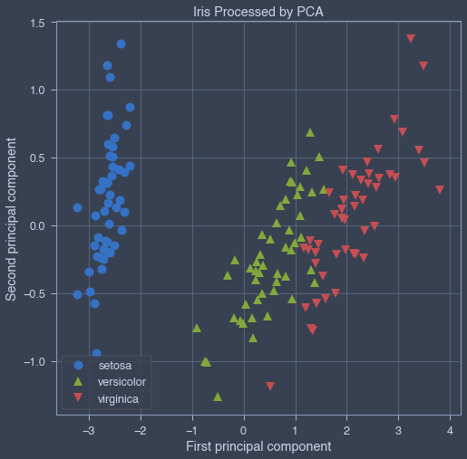
Dataset iris
Iris is a classic labeled dataset that can be loaded using scikit-learn. We perform PCA and draw the scatter plot of the first PC against the second. We can see that there is a clear clustering of three classes in right diagram whereas in the left diagram points with label versicolor and virginica are mingled.

Slide 8
Remarks
Usually a scatter plot of principal components is more informative than a scatter plot of features.
One may feed principal components to subsequent machine learning algorithms such as k-means clustering, linear regression, and neural network. As now there are fewer features, PCA improves the speed of subsequent algorithms and reduces overfitting. When p is extremely large, dimension reduction technique like PCA would be indispensable.
One just keep the first l (< n) principal components. There are some ad-hoc rules on how to choose l. For example, one can choose l to be the smallest integer such that a chosen ratio of total variation is explained by the first l principal components.

Slide 9
Pros and Cons of PCA
Pros
Removes correlated features
Reduces overfitting
Improves visualization
Speeds subsequent algorithm
Cons
Principal Components are the linear combination of your original features. They are not as readable and interpretable as original features.
Accidentally we might lose critical information after performing PCA.

