Slide 1
A comparison of PCA assisted k-means clustering with k-mean clustering
Xiaoqi Wei
Department of Mathematics
Michigan State University

Slide 2
Experiment Design
We choose some labeled datasets and perform clustering alone or after PCA.
The number of clusters is chosen to be the same as the number of labels or classes.
We use external evaluation, i.e. we take the labels as ground truth and compare them with clustering results. Several measures exist and here adjusted Rand index (ARI) is used. ARI takes value in [-1,1] and higher ARI implies higher similarity between two clustering. We compute ARI for k-means clustering and PCA assisted k-means clustering with different number of principal components (PCs).

Slide 3
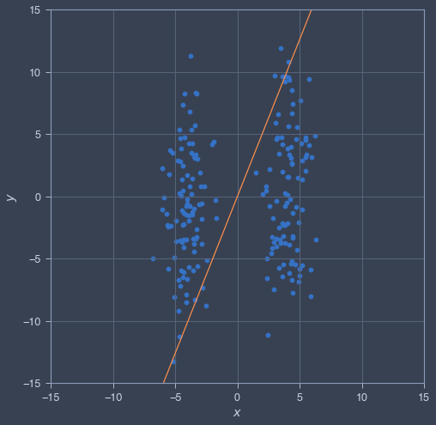
A fictitious example
Before we go further, let’s examine a fictitious dataset. It has been pointed out by some scholars that PCA would negatively affect clustering in some edge cases as shown in this diagram. The projection of two cluster on the first PC direction would mingle and no clustering algorithm can separate them.

Slide 4
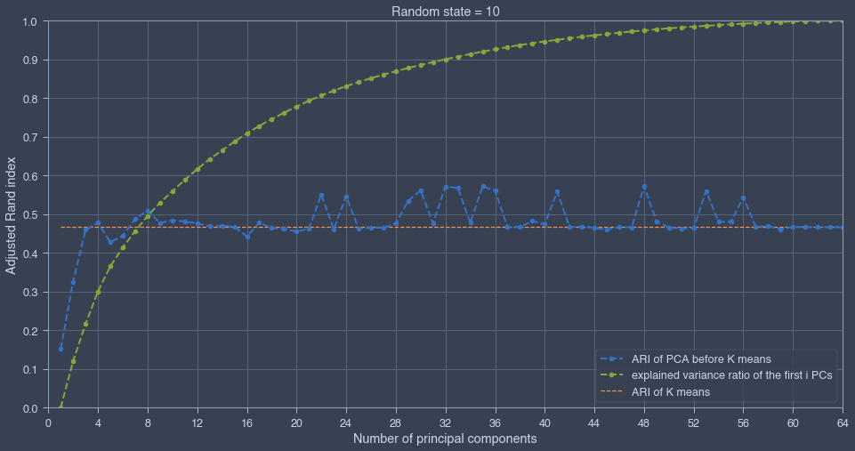
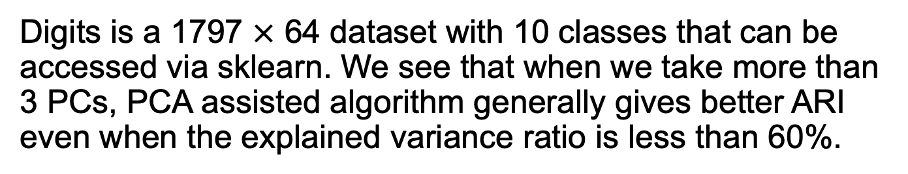
Dataset digits
Digits is a 1797 $×$ 64 dataset with 10 classes that can be accessed via sklearn. We see that when we take more than 3 PCs, PCA assisted algorithm generally gives better ARI even when the explained variance ratio is less than 60%.

Slide 5

Dataset mnist
We load mnist from keras and only use its test data (10000 $×$ 784). For k-means clustering we always set random_state = 10. ARI without PCA is 0.3242. The results of PCA assisted clustering is shown below. We see that when the explained variance ratio is larger than 0.7, performing PCA makes ARI slightly higher.
Number of PCs | 2 | 5 | 11 | 19 | 32 | 50 | 75 | 116 | 193
Explained variance ratio | 0.1 | 0.2 | 0.3 | 0.4 | 0.5 | 0.6 | 0.7 | 0.8 | 0.9
ARI with PCA | 0.1952 | 0.2990 | 0.3234 | 0.3181 | 0.3253 | 0.3224 | 0.3244 | 0.3267 | 0.3278

Slide 6
Remarks
For smaller sklearn dataset wine, iris and breast cancer, it seems that ARI of PCA assisted k-means clustering doesn’t increase as much as we saw in the case of digits. This is probably due to their small size.
The method of external evaluation has its own drawback. In big dataset there might be hidden clusters that aren’t reflected by their labels. The number of labels might be too small and it causes clustering algorithm performing badly. This explains why the ARI of mnist dataset is less than 0.5 and only a tiny increase of ARI is observed when PCA is involved.
We haven’t observed a significant decrease of ARI when PCA is involved, so it’s always a good idea to do PCA since it can speed up clustering, especially when we have more than thousands of features.

