Slide 1
LAB 4

Slide 2
Work with one or two other students
Each group download one template
https://docs.google.com/document/d/11x4VsiucaZ8_hQAcITvHLfSF3DZUrXozzGD3yGUjsWM/edit

Slide 3
Check the information on the website below:
https://alltransistors.com/pdfview.php?doc=irfz44n.pdf&dire=_update
Use the information and your own knowledge to complete the template from 1 to 4.

Slide 4
Create a circuit using a motor, a battery pack and a power transistor.
(a) Identify which pins on your MOSFET are ground, source, drain.
(b) Turn the power transistor on by connecting a wire from gate to VCC. The motor should start turning.
(c) Pull out the wire, the motor may continue to turn or stop. Why?
Write the reason on the template.
The schematic is on the next page.
Feel the power transistor with your finger. If it gets warm unplug immediately and debug or ask the TA for help.

Slide 5
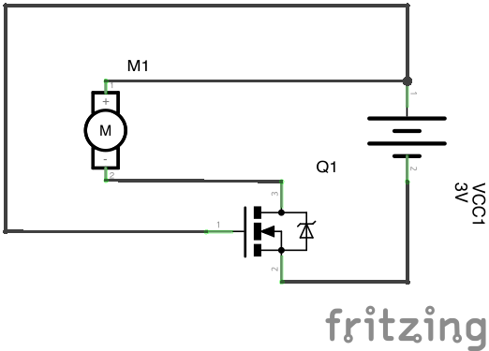
(d) Connect the wire to ground. The motor should turn off. Check again for power transistor temperature and SHUT OFF IMMEDIATELY if it’s too warm.

Slide 6
That’s all for the preparation
The last task:
Write a function on the arduino to set the power to the motor that takes the following parameters:
void power(int pin, int percent), where the pin selects which pin to pulse, percent represents a percentage from 0 (off) to 100 (full power)

Slide 7
void setup() { power(11, 100); // turn pin 11 to 100% power power(11, 50); // turn pin 11 to 50% power power(11, 20); // turn pin 11 to 20% power
Determine the duty cycle percentage for your motor at which the motor stops working.

Slide 8
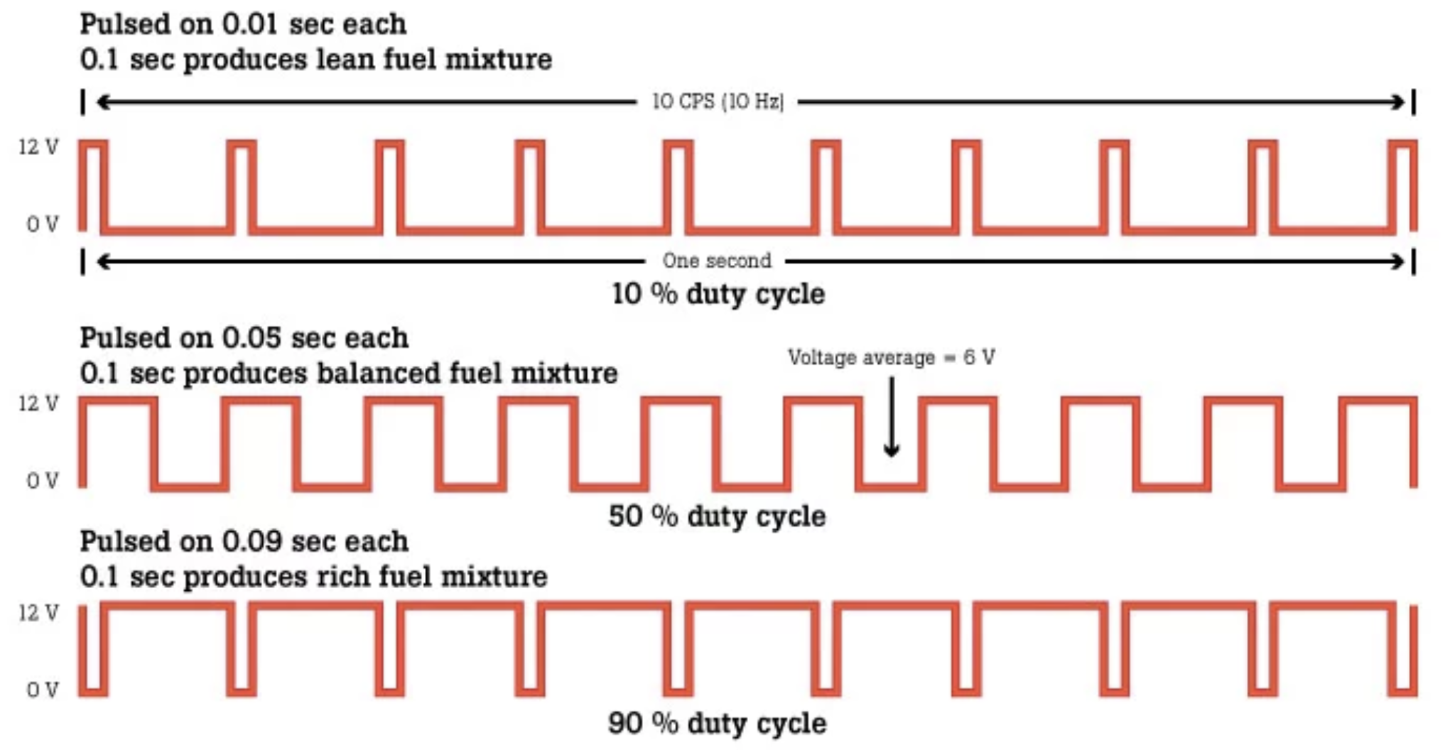
Duty cycle

Slide 9
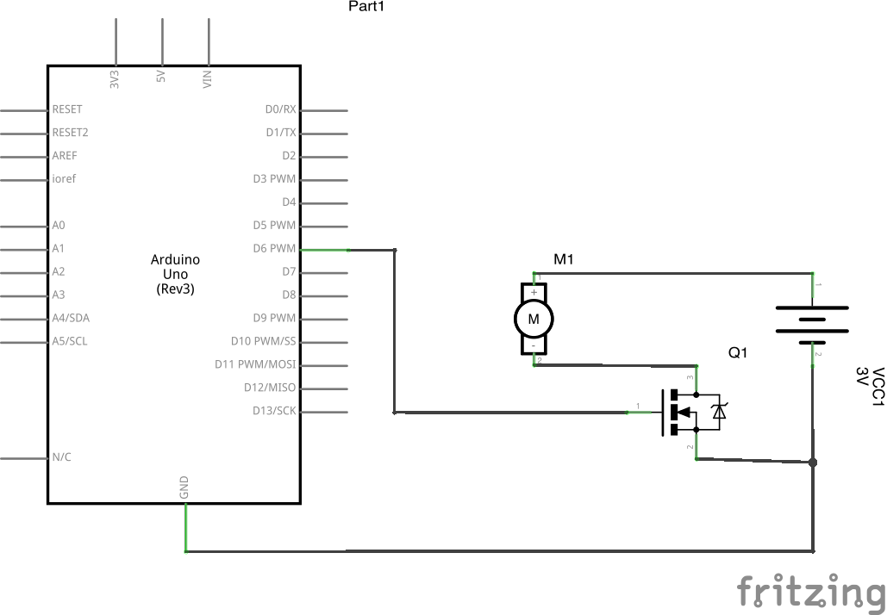
Sample schematic of Arduino

Slide 10
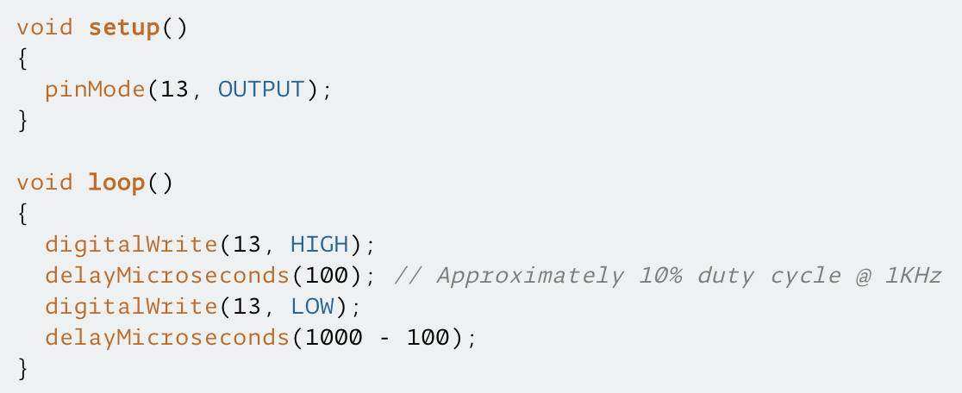
Sample code of power function

