Slide 1

Note: The data and information in this document is reflective of a hypothetical situation and client. This document is to be used for KPMG Virtual Internship purposes only.
Sprocket Central Pty Ltd
Data analytics approach
[Data Analytics Department] - [Tony Smith], [Sitara Aghayeva]

Slide 2
Note: The data and information in this document is reflective of a hypothetical situation and client. This document is to be used for KPMG Virtual Internship purposes only.
Agenda
Introduction
- Briefly about the company, data, and purpose of analysis
Data Exploration
- Data provided by company and
- Data from external sources
Model Development
- Factors that affect the future sales
- Determining the potential customers
- Market Segment Analysis
Interpretation
- Estimate the future sales
- Appropriate promotion activities

Slide 3
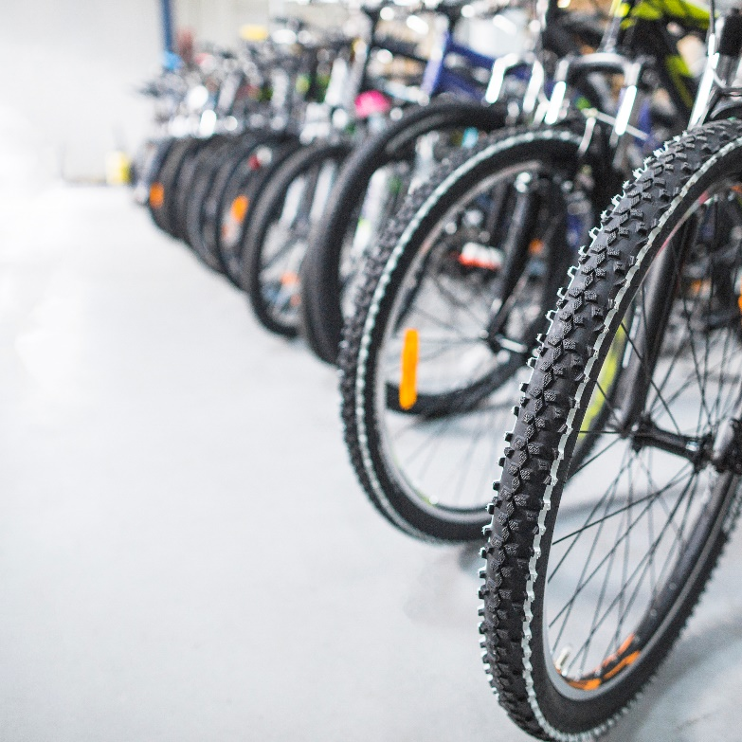
Note: The data and information in this document is reflective of a hypothetical situation and client. This document is to be used for KPMG Virtual Internship purposes only.
Introduction
Sprocket Central Pty Ltd is a mid-size seller of bicycle and related products.
The KPMG Data Analytics Team is trying to find out the key factors and estimate the future sales. Moreover, the necessary actions to take will be offered at the end of the analysis to increase the company revenues.
We have the Transactions, Customer Demographics, Customer Address and New Customer data with 4000 older,1000 new customers and transactions in the years of 2015-2017 to analyze.
Source: freepik.com
Link to image: <a href='https://www.freepik.com/photos/business'>Business photo created by freepik - www.freepik.com</a>

Slide 4
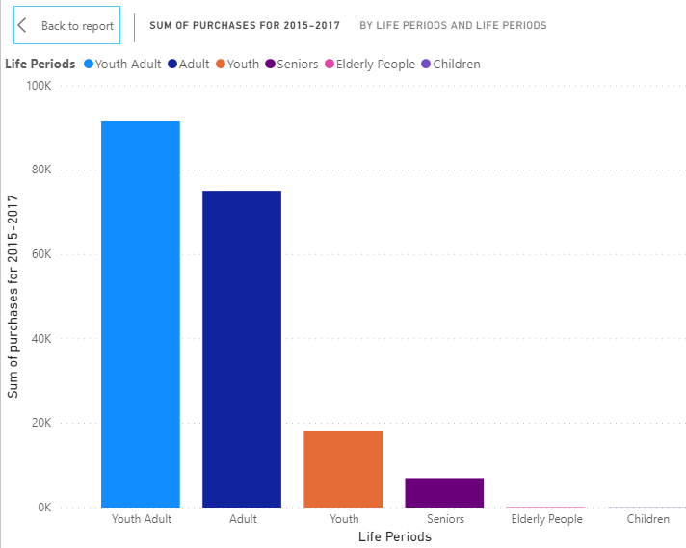
Note: The data and information in this document is reflective of a hypothetical situation and client. This document is to be used for KPMG Virtual Internship purposes only.
Data Exploration
The data about transactions and customer information were sent by Sprocket Central Pty Ltd.
We need to determine and analyze the market factors in to estimate future sales and define the customer segment. In order to do it at we will look data that is provided by Sprocket Central Pty Ltd in detail. Furthermore, the social factors will be taken into consideration. The data about the demographic indicators will be obtained from the surveys conducted by Australian Bureau of Statistics.
Place any supporting images, graphs, data or extra text here.

Slide 5
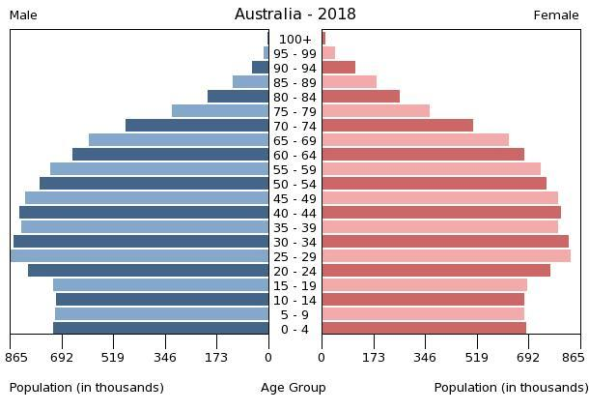
Note: The data and information in this document is reflective of a hypothetical situation and client. This document is to be used for KPMG Virtual Internship purposes only.
Model Development
The necessary indicators that will be analyzed are mentioned below:
Age (and determined age groups);
Geographical factors;
Wealth segment;
Top 20% customers (according to number of transactions in Transaction Sheet);
Top 20% customers (bike related purchases for 2015-2017;
The rival companies in Australia;
Demographic indicators in Australia (in 2015-2017 and now);
Place any supporting images, graphs, data or extra text here.
Source: Australian Bureau of Statistics

Slide 6
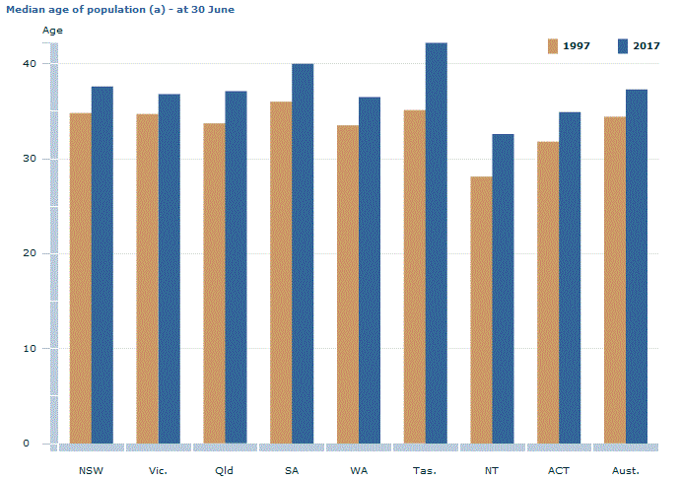
Note: The data and information in this document is reflective of a hypothetical situation and client. This document is to be used for KPMG Virtual Internship purposes only.
Interpretation
According to the results insights and advices for actions should be taken in future will be provided.
The most affecting factors and the change in variables affecting sales;
Strong relationships with top 20% customers (in terms of sales);
The necessary promotion activities targeting the market segmentation will be determined.
Place any supporting images, graphs, data or extra text here.

Slide 7
Note: The data and information in this document is reflective of a hypothetical situation and client. This document is to be used for KPMG Virtual Internship purposes only.
Appendix

Slide 8
Note: The data and information in this document is reflective of a hypothetical situation and client. This document is to be used for KPMG Virtual Internship purposes only.
Appendix
Related external survey data to analyze
4177.0 - Participation in Sport and Physical Recreation, Australia, 2013-14
Tourism and Transport

