Slide 1
Data Science Final project
Predicating credit risk of micro loans
WBS DS#004 Liang Zeng

Slide 2
Agenda
About the project
1
About the dataset
About the ML pipeline
2
3
About result communication
4

Slide 3
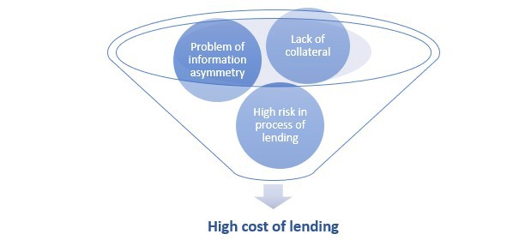

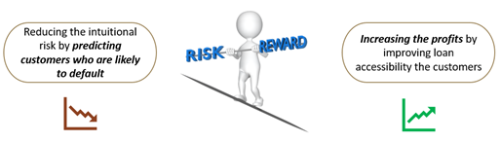
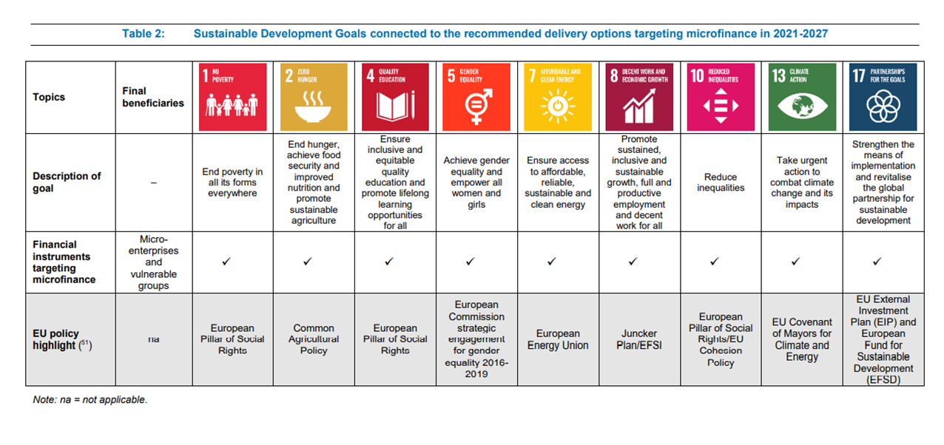
1. About the project
ML
Problem definition:
Loan defaults, high costs
Obstacles to accessing finance
Source: Microfinance in the European Union: Market analysis and recommendations for delivery options in 2021-2027
Notes:
This seems obvious, but is not, since the definition of “microfinance” is less than clear.
Broadly speaking, microfinance for loans (i.e., microcredit) is the provision of smallscale financial services to people who lack access to traditional banking services.
Based on 2018 data
Any loan under $50,000 as a microloan, but many of these loans are in the $5,000 to $10,000 range. Micro loan vary from country to country depending on income level
But in general it is under 50K USD.The average loan size is $1839 in 2018, after filtering out the database of the Microfinance Information Exchange (MIX) for loans greater than $30000. However, the median loan size is much lower: the global median is $684 for 2018.
More Than 2 Billion People Lack Access to Financial Services
Despite the extensive efforts to provide funding through microfinance, more than 2 billion people globally are still outside the banking system. Only 20% of the world’s estimated three billion poor have access to microfinance. While microfinance has grown extensively in the past decades, it remains unable to reach the majority of its target market.
World bank
Source: World Bank Document
https://documents1.worldbank.org/curated/en/682911468313761317/pdf/423810NWP0Doin10Box321452B01PUBLIC1.pdf

Slide 4
2. About the dataset
Data Owner: Alibaba Cloud Database
The loan data has been potentially gathered from Alibaba‘s microlending platform operated by its fintech arm - Ant Group which has its own internet bank as well.
A glimpse of the dataset:
Total cases: 1 Million
Training set: 80K
Test set: 20K
Total variable of training dataset: 47
15 variables are kept unknown/anonymous;
Data in employmentTitle, purpose,postCode and title have been modified and desensitized.
Source: Tianchi: Data Sets (aliyun.com)

Slide 5
3. Machine Learning pipeline
Business Problem
Understanding
Data Collection
Exploratory Data Analysis (EDA)
Data preparation
Model Building and Evaluation
Model deployment
Model Maintenance

Slide 6
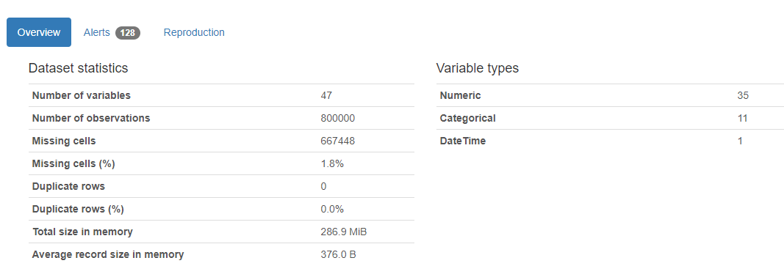
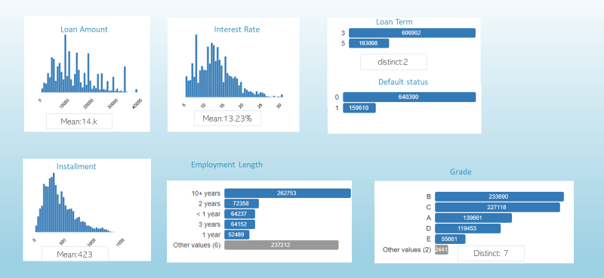
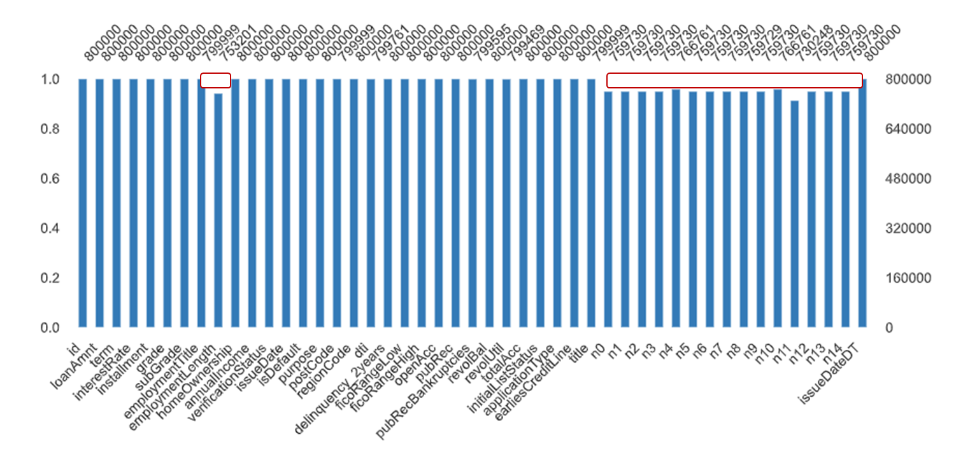
3.1Exploratory data analysis
Notes:
profilereport

Slide 7
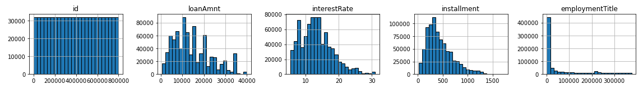
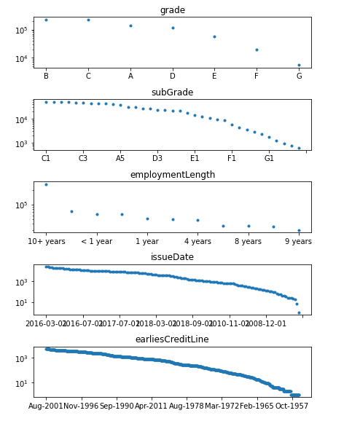
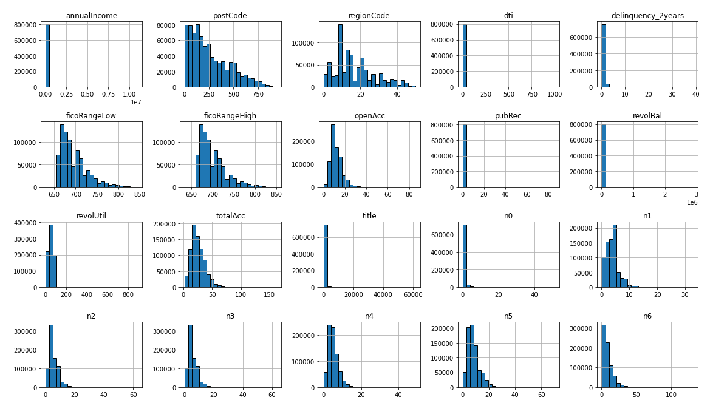
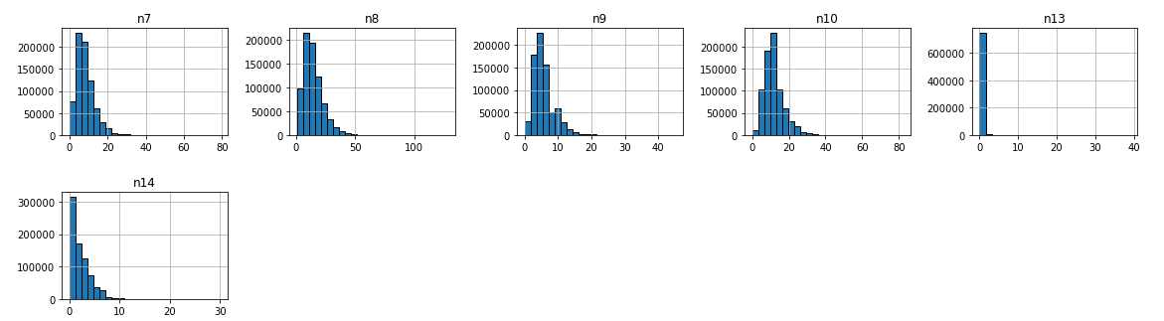
Categorical features
Numerical continuous features
3.2Exploratory data analysis – distribution

Slide 8
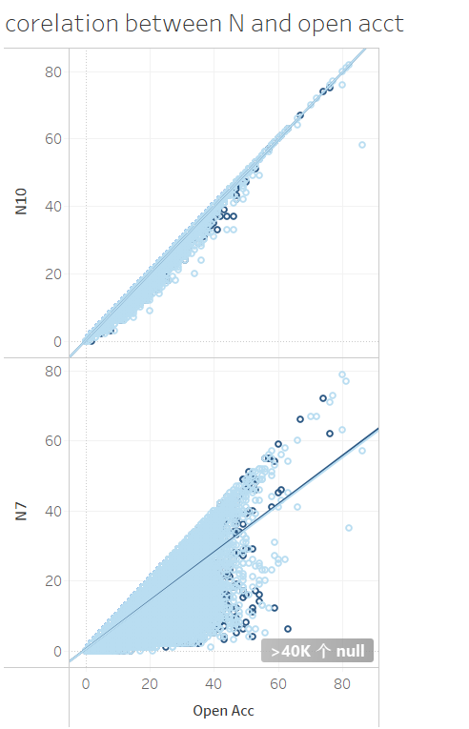
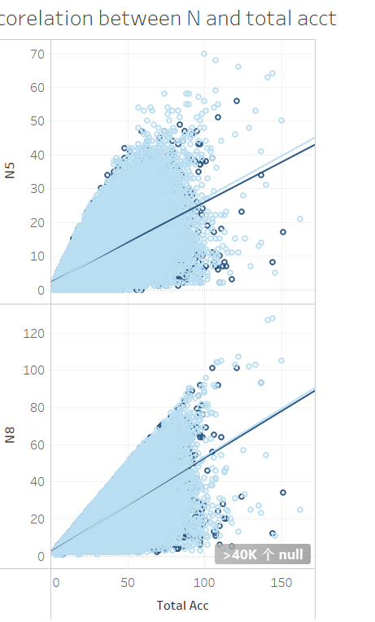
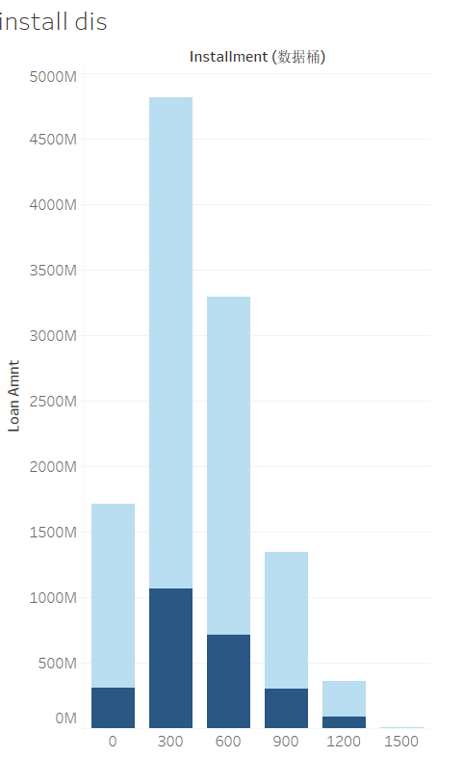
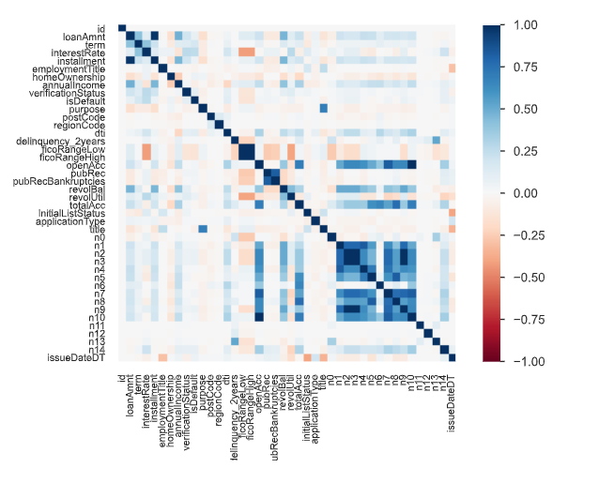
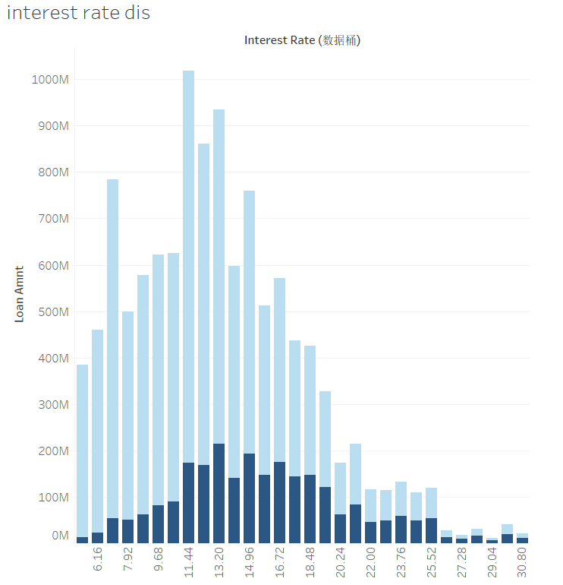
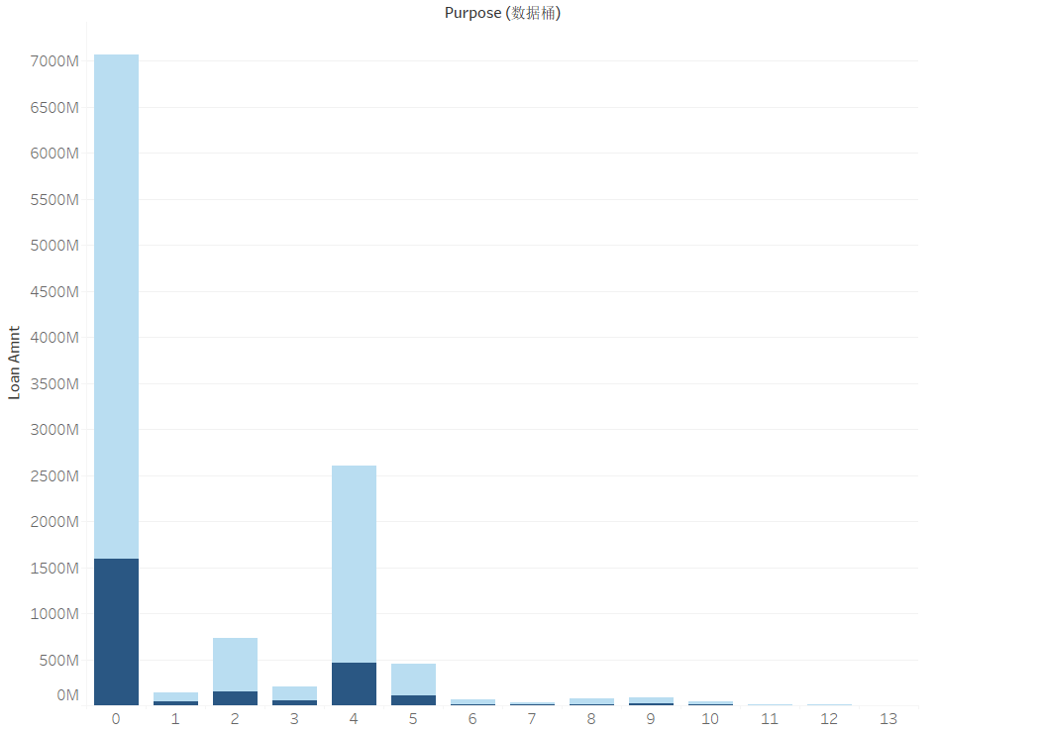
3.3 Exploratory data analysis – outliers and correlations
Notes:
Edit | #DS004_Final Project_Tableau_Visualization
https://public.tableau.com/authoring/DS004_FinalProject_Tableau_Visualization/correlation#1

Slide 9
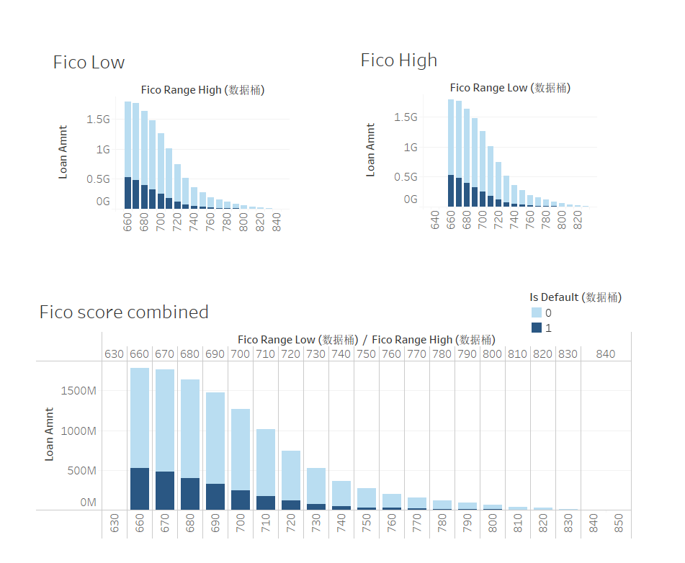
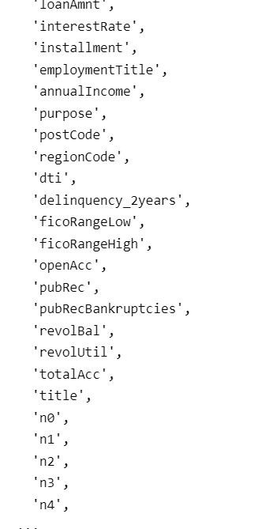
3.4 data preparation – cleaning and feature engineering

Slide 10
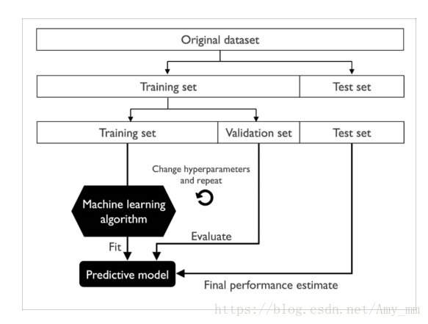
Original dataset
Training set (800k, 47variables)
Test set(200k, 46variables)
Training set (80%)
Validation set (20%)
Test set(20%)
Hyperparameter change & repeat
ML Algorithm
Fit
Evaluate
Predictive model
Final performance estimate
3.5. Model building and evaluation

Slide 11
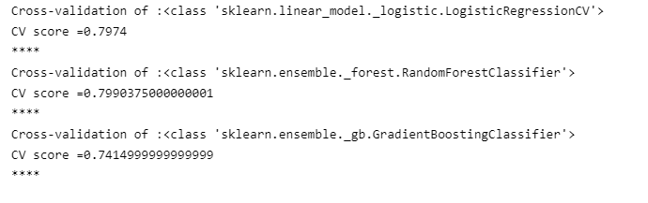
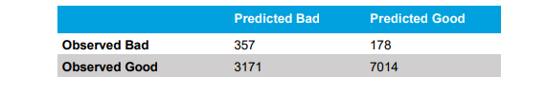
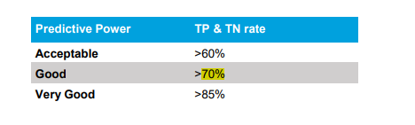

3.5. Model building and evaluation
CV score comparisons
Confusion Matrix of Statistical credit scoring developed by Deloitte
Predictive Power Interpretation
Source: Credit scoring Case study in data analytics, Deloitte (2016)
Notes:
Credit scoring - Case study in data analytics (deloitte.com)
https://www2.deloitte.com/content/dam/Deloitte/global/Documents/Financial-Services/gx-be-aers-fsi-credit-scoring.pdf
68.7%

Slide 12






4. Communicating the model result
Publish on Tableau Public
Push to Github and Google drive upon completion
readme file
python file
Data set (csv)
Other reference works
Powerpoint presenation

Slide 13
The End
19.04.2022

