Slide 1
Data Science Final project
Predicating credit risk of micro loans of an internet bank
WBS DS#004 Liang Zeng

Slide 2
Agenda
About the project
1
About the dataset
About the ML pipeline
2
3
About result communication
4

Slide 3
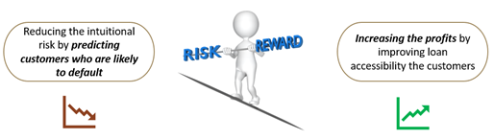
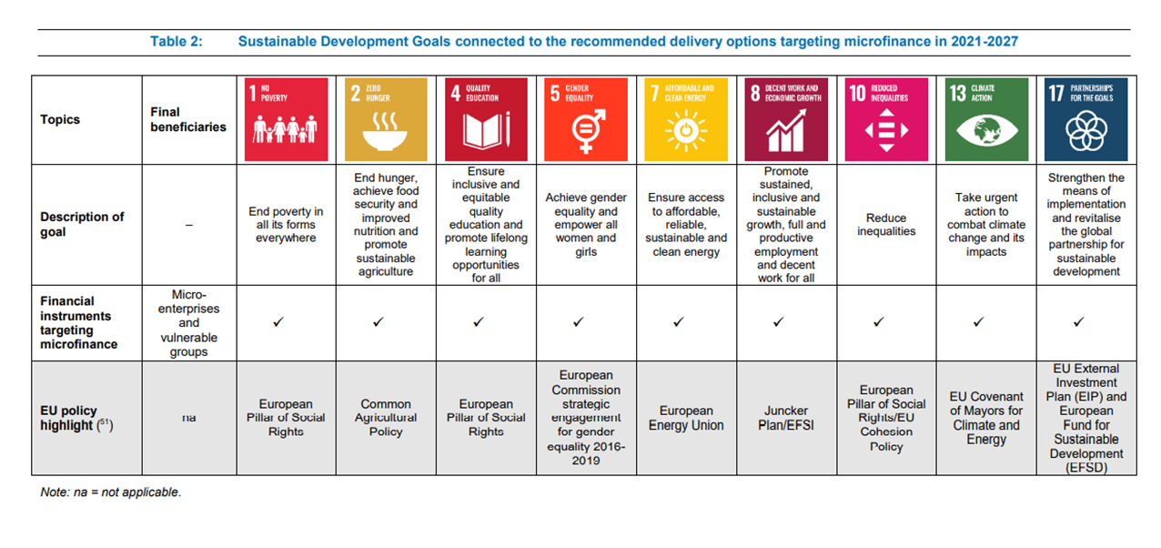
1. About the project
Problem definition:
MFI: Loan defaults remain one lingering challenge of microfinance
Underbanked population: Inaccessibility of micro loans
Solution:
To build AI-assisted loan default prediction model for micro loans using the historical data to access the likelihood of default.
Reducing the credit risk of the financial institution
Cost reduction due to automation
Increasing the profits by improving loan accessibility of the customers
Increasing the financial inclusion
Source: Microfinance in the European Union: Market analysis and recommendations for delivery options in 2021-2027

Slide 4
2. About the dataset
Owner: Alibaba Cloud Database
Tianchi: Data Sets (aliyun.com)
The loan data has been potentially gathered from Mybank, the internet bank for microlending backed by Alibaba‘s fintech arm Ant Group.
A glimpse of the dataset:
Total cases: 1 Million
Training set: 80K
Test set: 20K
Total variable of training dataset: 47
15 variables are kept unknown/anonymous;
Data in employmentTitle, purpose,postCode and title have been modified and desensitized.

Slide 5
3. ML pipeline
Business Problem
Understanding
Data Collection
Exploratory Data Analysis (EDA)
Data preparation
Model Building and Evaluation
Model deployment
Model Maintenance

Slide 6
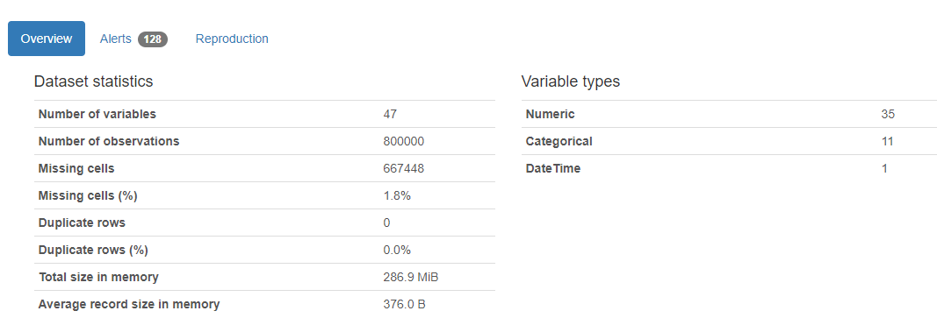
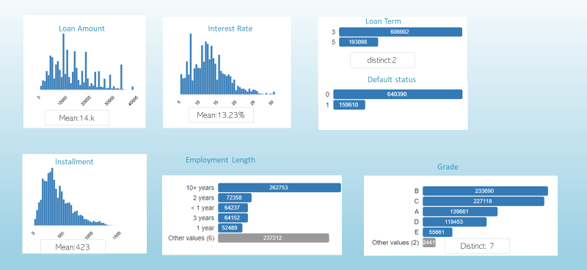
3.1Exploratory data analysis
Notes:
profilereport

Slide 7
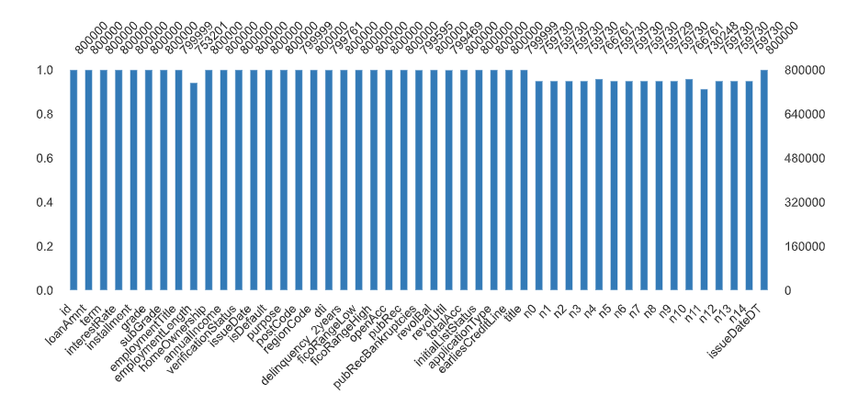
3.1Exploratory data analysis – Missing values

Slide 8
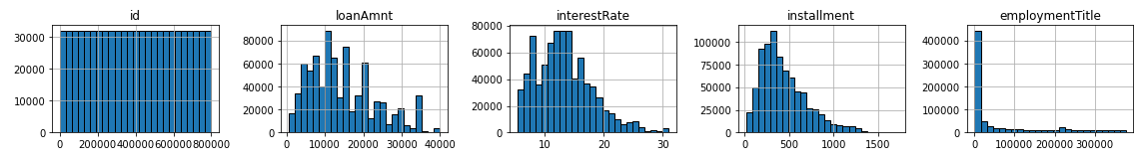
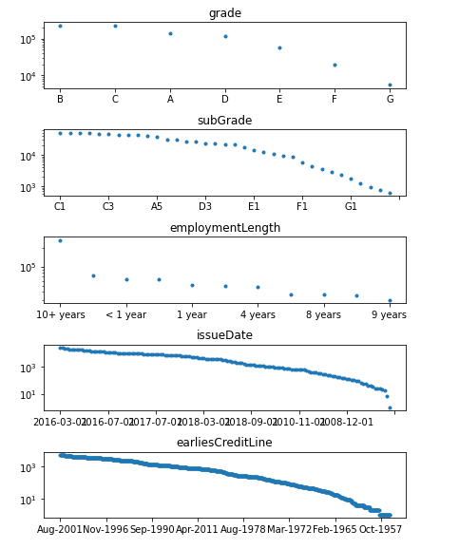
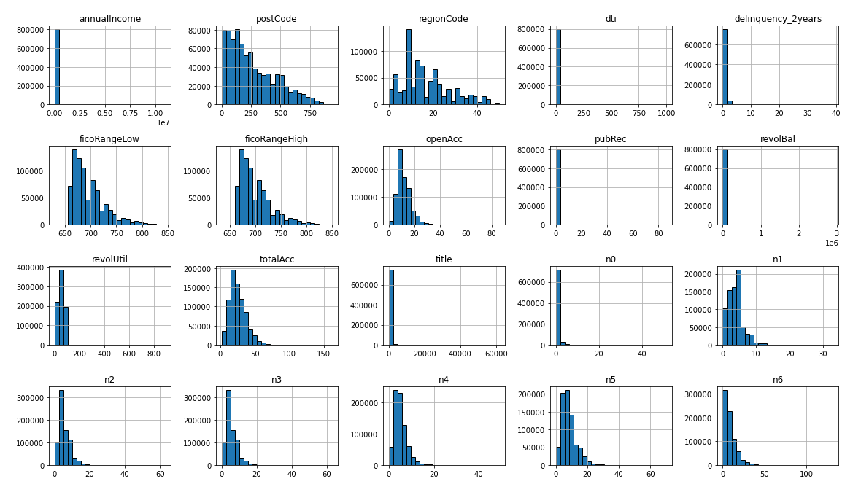
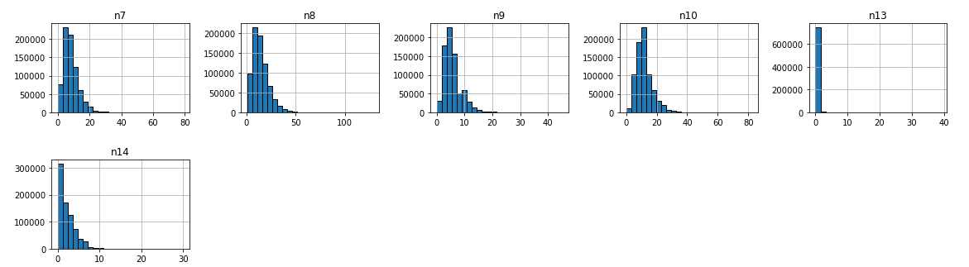
Categorical features
Numerical continuous features
3.2Exploratory data analysis – distribution

Slide 9
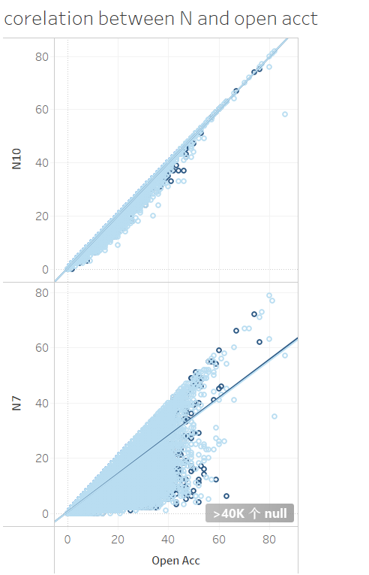
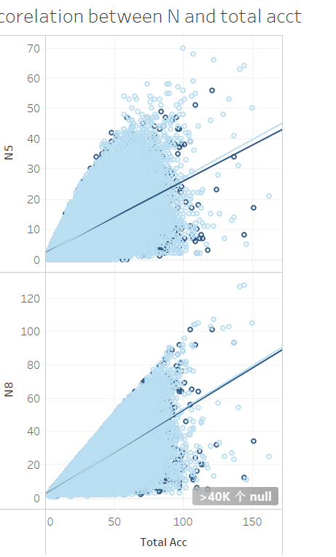
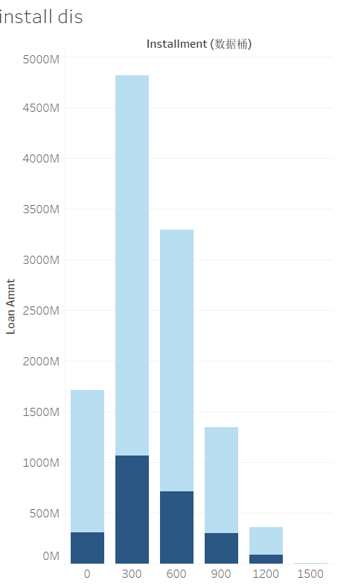
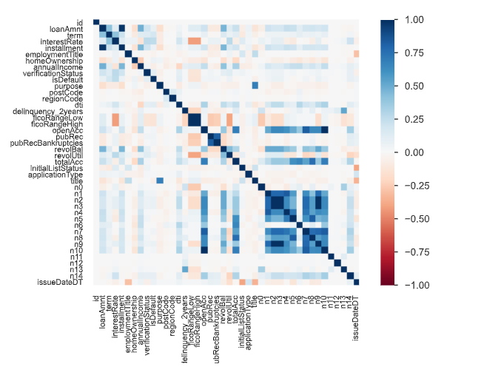
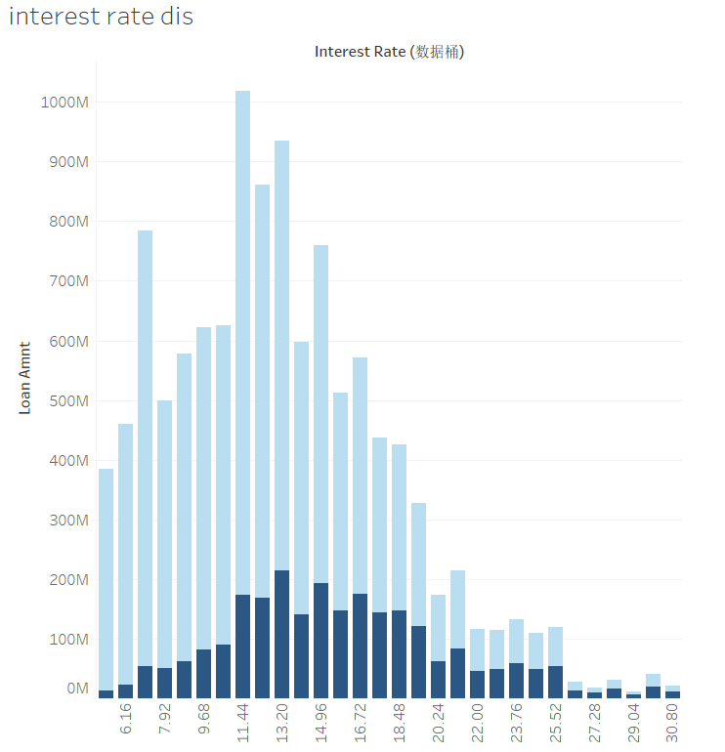
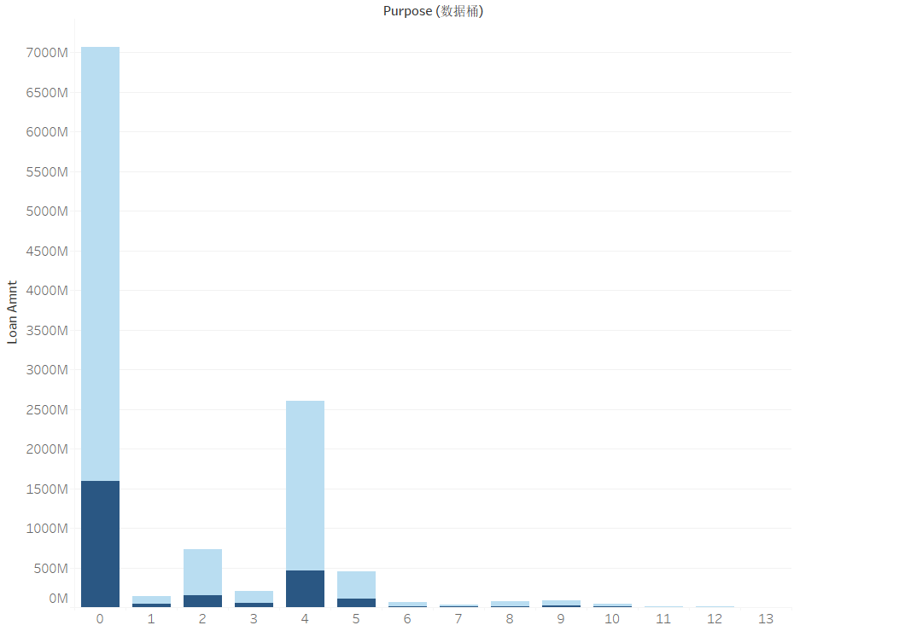
3.3 Exploratory data analysis – outliers and correlations

Slide 10
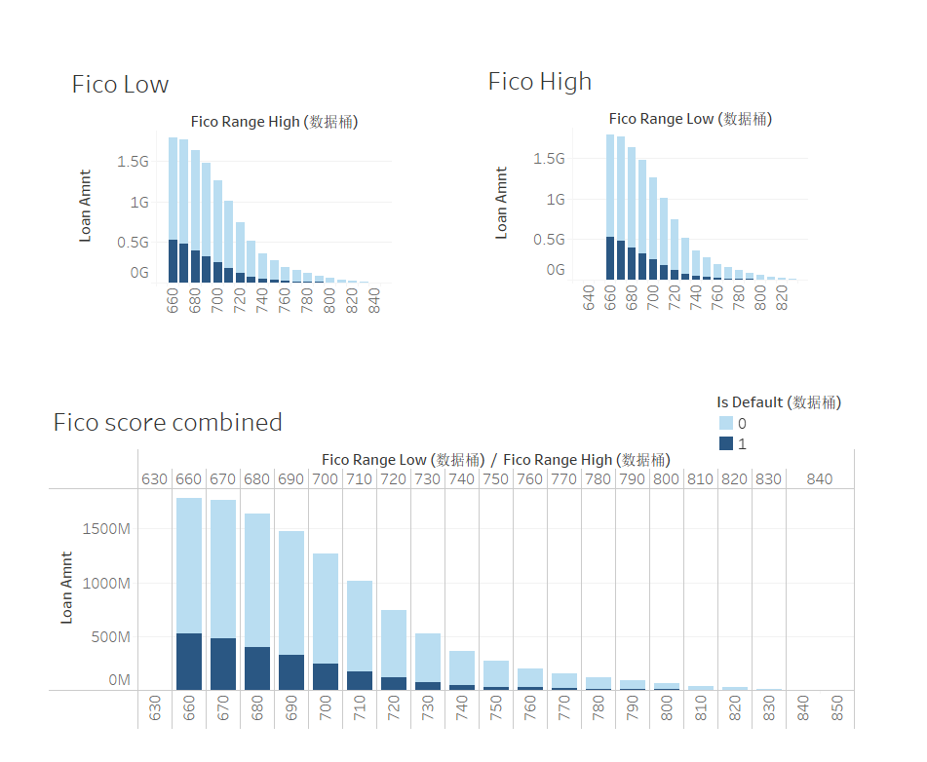
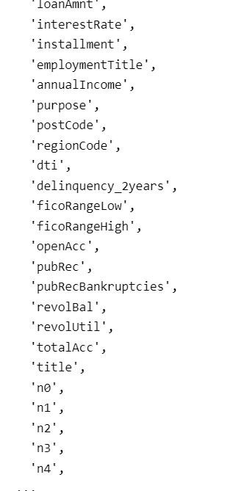
3.4 data preparation – cleaning and feature engineering

Slide 11
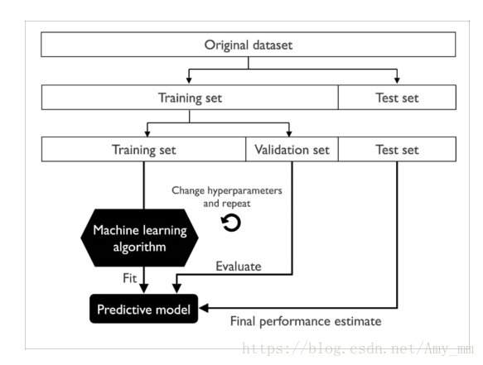
Original dataset
Training set (800k, 47variables)
Test set(200k, 46variables)
Training set (80%)
Validation set (20%)
Test set(20%)
ML Algorithm
Hyperparameter change & repeat
Fit
Evaluate
Predictive model
Final performance estimate
3.5. Model building and evaluation

Slide 12
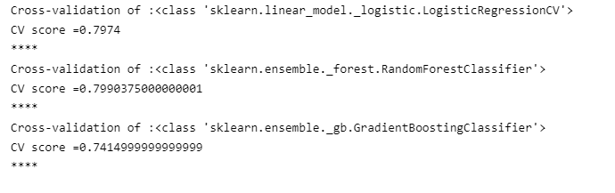

3.5. Model building and evaluation
CV score comparisons
Notes:
Compute Area Under the Receiver Operating Characteristic Curve (ROC AUC) from prediction scores.
The area, good for AUC values between 0.8-0.9, fair for AUC values between 0.7-0.8, poor for AUC values between 0.6-0.7 and failed for AUC values between 0.5-0.6. under the ROC curve (AUC) results were considered excellent for AUC values between 0.9-1
sklearn.metrics.roc_auc_score

Slide 13






4. Communicating the model result
Publish on Tableau Public
Push to Github and Google drive upon completion
readme file
python file
Data set (csv)
Other reference works
Powerpoint presenation

Slide 14
The End
19.04.2022

