Slide 1

SCALA
By: Sital Sharma

Slide 2
PRE-REQUISITES
JAVA : ARRAY, THREADS, OBJECT, COLLECTION ETC.
SOFTWARE NEEDED: JAVA(JDK),JVM, ECLIPES (IDE).

Slide 3
What is scala?
Scala is a general-purpose, high-level, multi-paradigm programming language. It is a pure object-oriented programming language which also provides the support to the functional programming approach.
N.B: There is no concept of primitive data type in scala as everything is treated as an object in scala.

Slide 4
Need for Scala
Scala is simple to learn and is more similar to high level programming languages like Java, C, and C++. As a result, anyone can learn Scala extremely easily. Scala is simpler to learn for Java programmers.
Scala is more functional, scalable, and productive since it contains the greatest characteristics of other languages, including C, C++, Java, and others.
Close integration with Java: The source code of the Scala is designed in such a way that its compiler can interpret the Java classes. Also, Its compiler can utilize the frameworks, Java Libraries, and tools etc. After compilation, Scala programs can run on JVM.

Slide 5
Need for Scala
Web – Based & Desktop Application Development: For the web applications it provides the support by compiling to JavaScript. Similarly for desktop applications, it can be compiled to JVM bytecode.

Slide 6
FEATURES OF SCALA
OBJECT ORIENTED
FUNCTIONAL
FASTER THATN : RUBY, JS,PYTHON,JAVA
Concurrent & Synchronize Processing

Slide 7
FEATURES OF SCALA
Run on JVM & Can Execute Java Code: Java and Scala have a common runtime environment. So the user can easily move from Java to Scala. The Scala compiler compiles the program into .class file, containing the Bytecode that can be executed by JVM. All the classes of Java SDK can be used by Scala. With the help of Scala user can customize the Java classes.

Slide 8
HOW TO INSTALL SCALA ON TOP OF JAVA
Go to the link : https://www.scala-lang.org/
Download eclipse on machine via: eclipse.org
Specify the working directory
Click on file>new>java project

Slide 9
Scala Synatx: Comments
Single-line comments start with //,
  e.g., // This is a single-line comment
Multi-line comments are enclosed between /* and */,
e.g.,
/*This is a
multi-line comment*/

Slide 10
Scala Synatx: Semicolons:
Unlike some other languages, Scala does not require semicolons ( Except for Interactive mode) at the end of statements. However, you can use them to separate multiple statements on the same line if needed.
E.g: print(“hello); interactive mode

Slide 11
Scala Synatx: Variables and Values
You can declare variables using var and constants (immutable values) using val. For example:
                var x = 10 // variable
                val y = 20 // constant

Slide 12
Scala Synatx: Data Types
You can declare variables with types like this:
val age: Int = 30
val name: String = “Vibanshu“

Slide 13
Scala Synatx: String Interpolation:
Scala supports string interpolation using s or f prefixes for strings. This allows you to embed variables or expressions within strings.
val name = "Bob“
val greeting = s"Hello, $name!" // "Hello, Bob!"

Slide 14
Scala Synatx: Operators
Scala supports common operators like:
+, -, *, /, %, ==, !=, <, <=, >, >=, &&, ||, etc., for numerical and logical operations.

Slide 15
Scala Synatx: Conditional Statements:
Scala has if, else if, and else for conditional statements. For example:
val x = 10
if (x > 5)
{ println("x is greater than 5")
} else
{ println("x is not greater than 5")
}

Slide 16
Scala Synatx: Functions and Methods
Functions are defined using the def keyword. You can also define methods within classes and objects. For example:
def add(x: Int, y: Int): Int = x + y

Slide 17
Scala Synatx: Classes and Objects
Classes are defined using the class keyword, and objects are instances of classes. Scala uses the new keyword to create objects. For example:
class Person(name: String, age: Int)
val person = new Person("Alice", 30)

Slide 18
Simple Scala program
object HelloWorld {
def main(args: Array[String]): Unit = {
println("Hello, world!")
}
}

Slide 19
Simple Scala program- Scala 3
@main
def helloWorld(): Unit = {
println("Hello, world!")
}

Slide 20
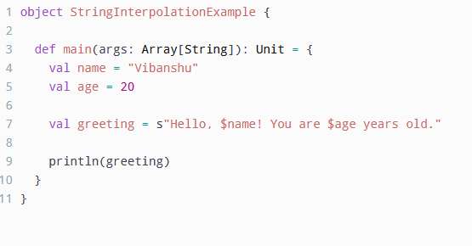
Simple Scala program: String Interpolation

Slide 21
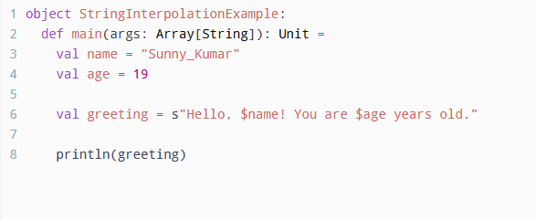
Simple Scala-3 program: String Interpolation

Slide 22
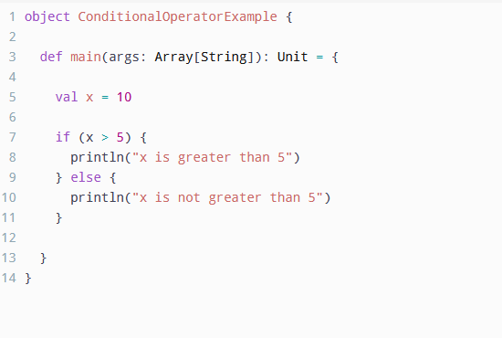
Simple Scala program: Conditional statement

Slide 23
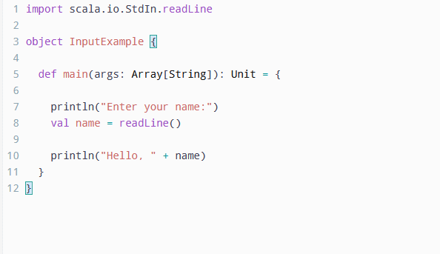
Simple Scala program: taking input

Slide 24
Simple Scala program: Collection

