Slide 1
MAP REDUCE : FRAMEWORK AND ITS ARCHITECTURE
Sital Shama
Assistant Professor
BDA Theory ( Summer Session)

Slide 2
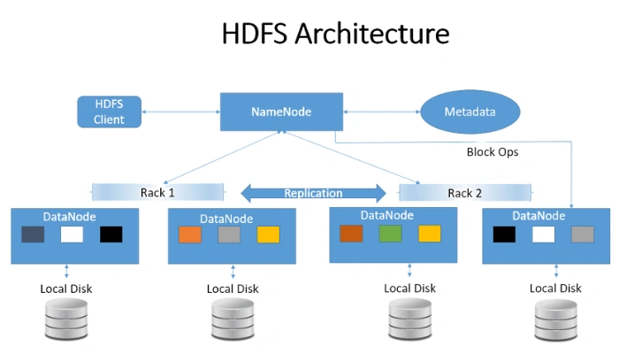

Slide 3
Map Reduce Introduction
Hadoop's MapReduce architecture is used to create applications that can process enormous volumes of data on big clusters. It is also known as a programming model that enables us to process big datasets across computer clusters. This program enables the distributed storage of data. Large-scale computation and huge volumes of data are made simpler.

Slide 4
Map Reduce Definition
MapReduce is a processing technique and a program model for distributed computing based on java. The MapReduce algorithm contains two important tasks, namely Map and Reduce. Map takes a set of data and converts it into another set of data, where individual elements are broken down into tuples (key/value pairs). Secondly, reduce task, which takes the output from a map as an input and combines those data tuples into a smaller set of tuples. As the sequence of the name MapReduce implies, the reduce task is always performed after the map job.

Slide 5
The Algorithm
MapReduce program executes in three stages, namely map stage, shuffle stage, and reduce stage.
Map stage − The map or mapper’s job is to process the input data. Generally the input data is in the form of file or directory and is stored in the Hadoop file system (HDFS). The input file is passed to the mapper function line by line. The mapper processes the data and creates several small chunks of data.
Reduce stage − This stage is the combination of the Shuffle stage and the Reduce stage. The Reducer’s job is to process the data that comes from the mapper. After processing, it produces a new set of output, which will be stored in the HDFS.

Slide 6
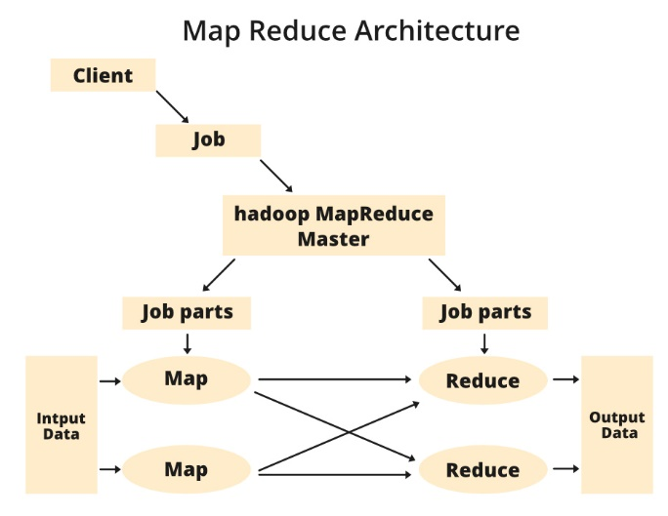
MapReduce Architecture
Client: The MapReduce client is the one who brings the Job to the MapReduce for processing. There can be multiple clients available that continuously send jobs for processing to the Hadoop MapReduce Manager.
Job: The MapReduce Job is the actual work that the client wanted to do which is comprised of so many smaller tasks that the client wants to process or execute.
Hadoop MapReduce Master: It divides the particular job into subsequent job-parts.
Job-Parts: The task or sub-jobs that are obtained after dividing the main job. The result of all the job-parts combined to produce the final output.
Input Data: The data set that is fed to the MapReduce for processing.
Output Data: The final result is obtained after the processing.

Slide 7
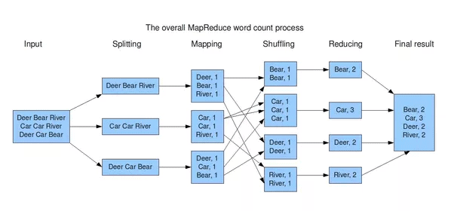
MapReduce Example

Slide 8
YARN

Slide 9
YARN Architecture
Apache Hadoop YARN (Yet Another Resource Negotiator) is a resource management layer in Hadoop. YARN came into the picture with the introduction of Hadoop 2.x. It allows various data processing engines such as interactive processing, graph processing, batch processing, and stream processing to run and process data stored in HDFS (Hadoop Distributed File System).
YARN was introduced to make the most out of HDFS, and job scheduling is also handled by YARN.

Slide 10
YARN Architecture
Apache Hadoop YARN (Yet Another Resource Negotiator) is a resource management layer in Hadoop. YARN came into the picture with the introduction of Hadoop 2.x. It allows various data processing engines such as interactive processing, graph processing, batch processing, and stream processing to run and process data stored in HDFS (Hadoop Distributed File System).
YARN was introduced to make the most out of HDFS, and job scheduling is also handled by YARN.

Slide 11
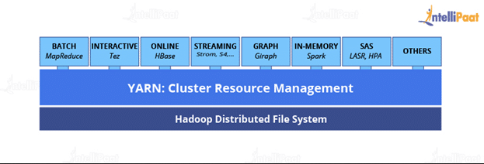
YARN

Slide 12
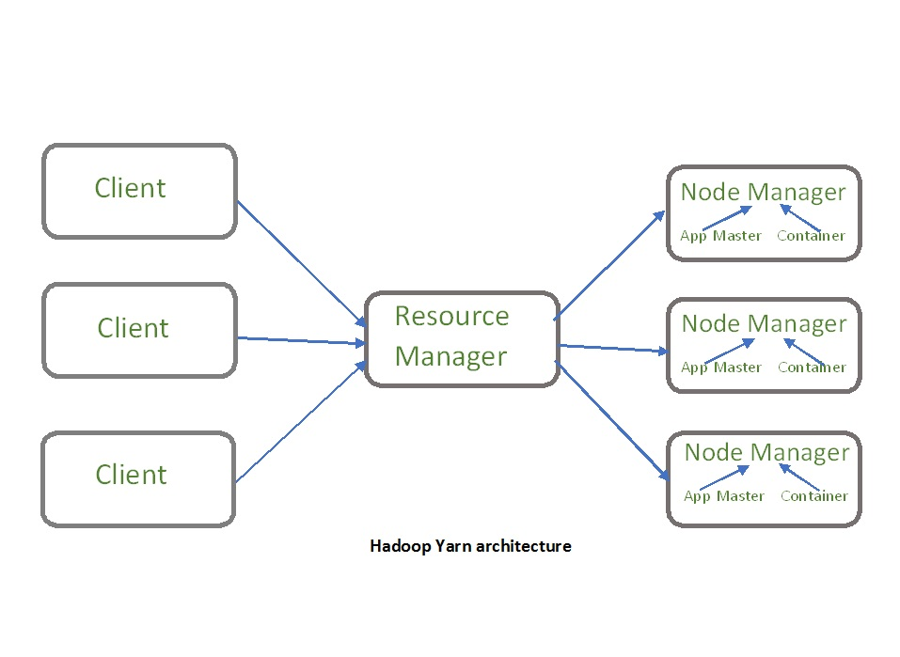
YARN Architecture

Slide 13
YARN Architecture Components
Client: It submits map-reduce jobs.
Resource Manager: It is the master daemon of YARN and is responsible for resource assignment and management among all the applications. Whenever it receives a processing request, it forwards it to the corresponding node manager and allocates resources for the completion of the request accordingly. It has two major components:
  Scheduler: It performs scheduling based on the allocated application and available resources. It is a pure scheduler, means it does not perform other tasks such as monitoring or tracking and does not guarantee a restart if a task fails. The YARN scheduler supports plugins such as Capacity Scheduler and Fair Scheduler to partition the cluster resources.
  Application manager: It is responsible for accepting the application and negotiating the first container from the resource manager. It also restarts the Application Master container if a task fails.

Slide 14
YARN Architecture Components
Node Manager: It take care of individual node on Hadoop cluster and manages application and workflow and that particular node. Its primary job is to keep-up with the Resource Manager. It registers with the Resource Manager and sends heartbeats with the health status of the node. It monitors resource usage, performs log management and also kills a container based on directions from the resource manager. It is also responsible for creating the container process and start it on the request of Application master.

Slide 15
YARN Architecture Components
Application Master: An application is a single job submitted to a framework. The application master is responsible for negotiating resources with the resource manager, tracking the status and monitoring progress of a single application. The application master requests the container from the node manager by sending a Container Launch Context(CLC) which includes everything an application needs to run. Once the application is started, it sends the health report to the resource manager from time-to-time.

Slide 16
YARN Architecture Components
Container: It is a collection of physical resources such as RAM, CPU cores and disk on a single node. The containers are invoked by Container Launch Context(CLC) which is a record that contains information such as environment variables, security tokens, dependencies etc.

Slide 17
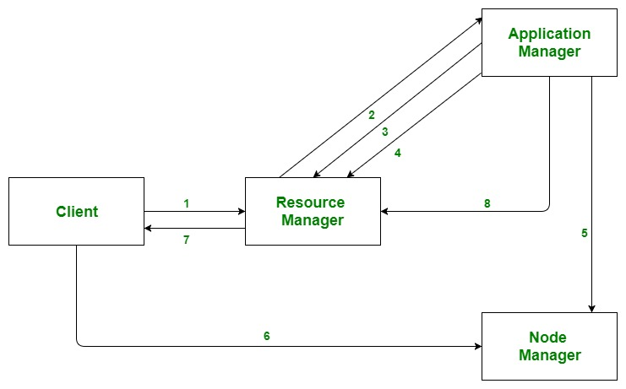
Application workflow in Hadoop YARN
Client submits an application
The Resource Manager allocates a container to start the Application Manager
The Application Manager registers itself with the Resource Manager
The Application Manager negotiates containers from the Resource Manager
The Application Manager notifies the Node Manager to launch containers
Application code is executed in the container
Client contacts Resource Manager/Application Manager to monitor application’s status
Once the processing is complete, the Application Manager un-registers with the Resource Manager

