Slide 1
CAP THEOREM

Slide 2
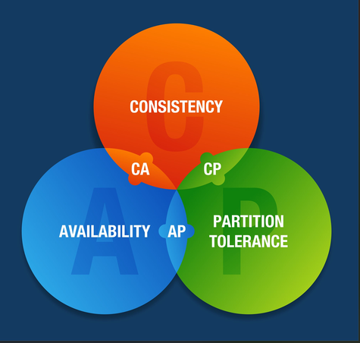

Slide 3
What

Slide 4
What
The CAP theorem states that any distributed data store can simultaneously provide at most two out of the three core guarantees

Slide 5
What
The CAP theorem states that any distributed data store can simultaneously provide at most two out of the three core guarantees
A system can be CP (Consistent and Partition Tolerant) or AP (Available and Partition Tolerant), but cannot guarantee all three at the same time in the presence of network failures

Slide 6
Partition Tolerance (P)

Slide 7
Partition Tolerance (P)
Definition: The cluster continues to operate despite arbitrary communication breakdown or node failures

Slide 8
Partition Tolerance (P)
Definition: The cluster continues to operate despite arbitrary communication breakdown or node failures
How it works: If one machine goes down or the network link connecting it fails, the remaining nodes must continue serving requests independently without halting the entire system

Slide 9
Availability (A)

Slide 10
Availability (A)
Definition: Every non-failing node returns a response for every read or write request, ensuring clients can always access their data

Slide 11
Availability (A)
Definition: Every non-failing node returns a response for every read or write request, ensuring clients can always access their data
How it works: To ensure availability during a node failure, data is replicated across multiple machines.If one node crashes, requests are served by another replica containing that data

Slide 12
Consistency (C)

Slide 13
Consistency (C)
Definition: All nodes see the exact same data at the same time. Any read request should return the most recent write

Slide 14
The Fundamental Trade-off: Consistency vs. Availability

Slide 15
The Fundamental Trade-off: Consistency vs. Availability
When a network partition happens, updates written to one machine take time to replicate across other machines.

Slide 16
The Fundamental Trade-off: Consistency vs. Availability
When a network partition happens, updates written to one machine take time to replicate across other machines.
If a read request arrives before replication is complete:

Slide 17
The Fundamental Trade-off: Consistency vs. Availability
When a network partition happens, updates written to one machine take time to replicate across other machines.
If a read request arrives before replication is complete:
  To guarantee Availability (AP): The system returns the stale data immediately. You preserve uptime and fast response, but sacrifice strict consistency

Slide 18
The Fundamental Trade-off: Consistency vs. Availability
When a network partition happens, updates written to one machine take time to replicate across other machines.
If a read request arrives before replication is complete:
  To guarantee Availability (AP): The system returns the stale data immediately. You preserve uptime and fast response, but sacrifice strict consistency
  To guarantee Consistency (CP): The system blocks or returns an error until all replicas are synchronized. You preserve correct data, but sacrifice availability

Slide 19
SHARED NOTHING ARCHITECTURE

Slide 20
SHARED RAM ARCHITECTURE

Slide 21
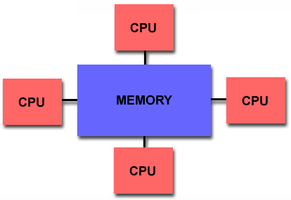
SHARED RAM ARCHITECTURE

Slide 22
SHARED DISK ARCHITECTURE

Slide 23
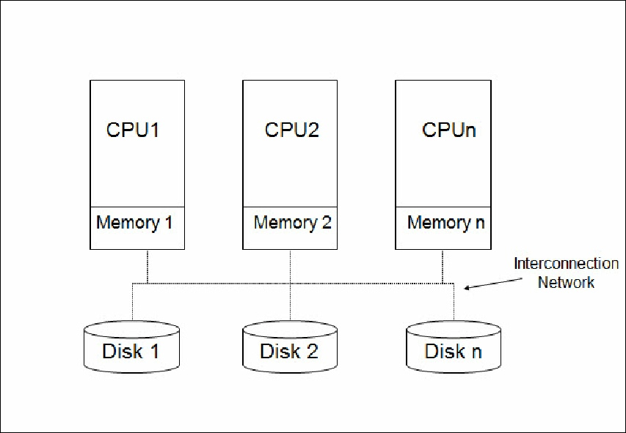
SHARED DISK ARCHITECTURE

Slide 24
SHARED NOTHING ARCHITECTURE

Slide 25
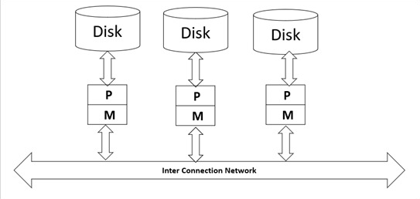
SHARED NOTHING ARCHITECTURE

Slide 26
BLOOM FILTER

Slide 27
WHAT ?
A Bloom Filter is a space-efficient, probabilistic data structure used to test set membership specifically, to check whether a given element belongs to a set of elements.

Slide 29
E.G
Insert element 20 and 17 in the blooms filter of size 5 considering the following hash function :
1. h1(x)= x mod 5
2. h2(x)=(2x+6) mod 6
Check whether 19,24 is present in the set or not

Slide 30
E.G
Given :
m=5
Hash function
Numbers to insert
Number to check

