Slide 1
SAMPLING

Slide 3

POPULATION

Slide 4
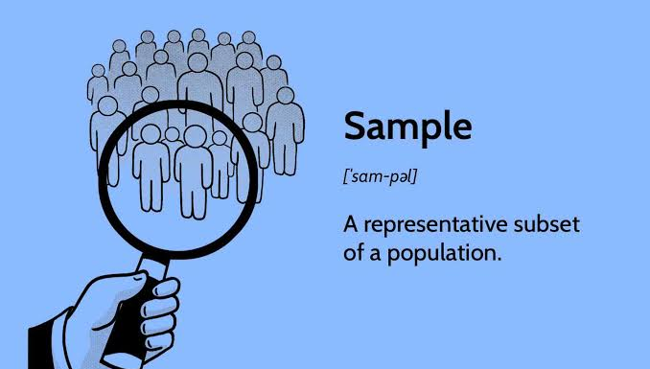
SAMPLE

Slide 5
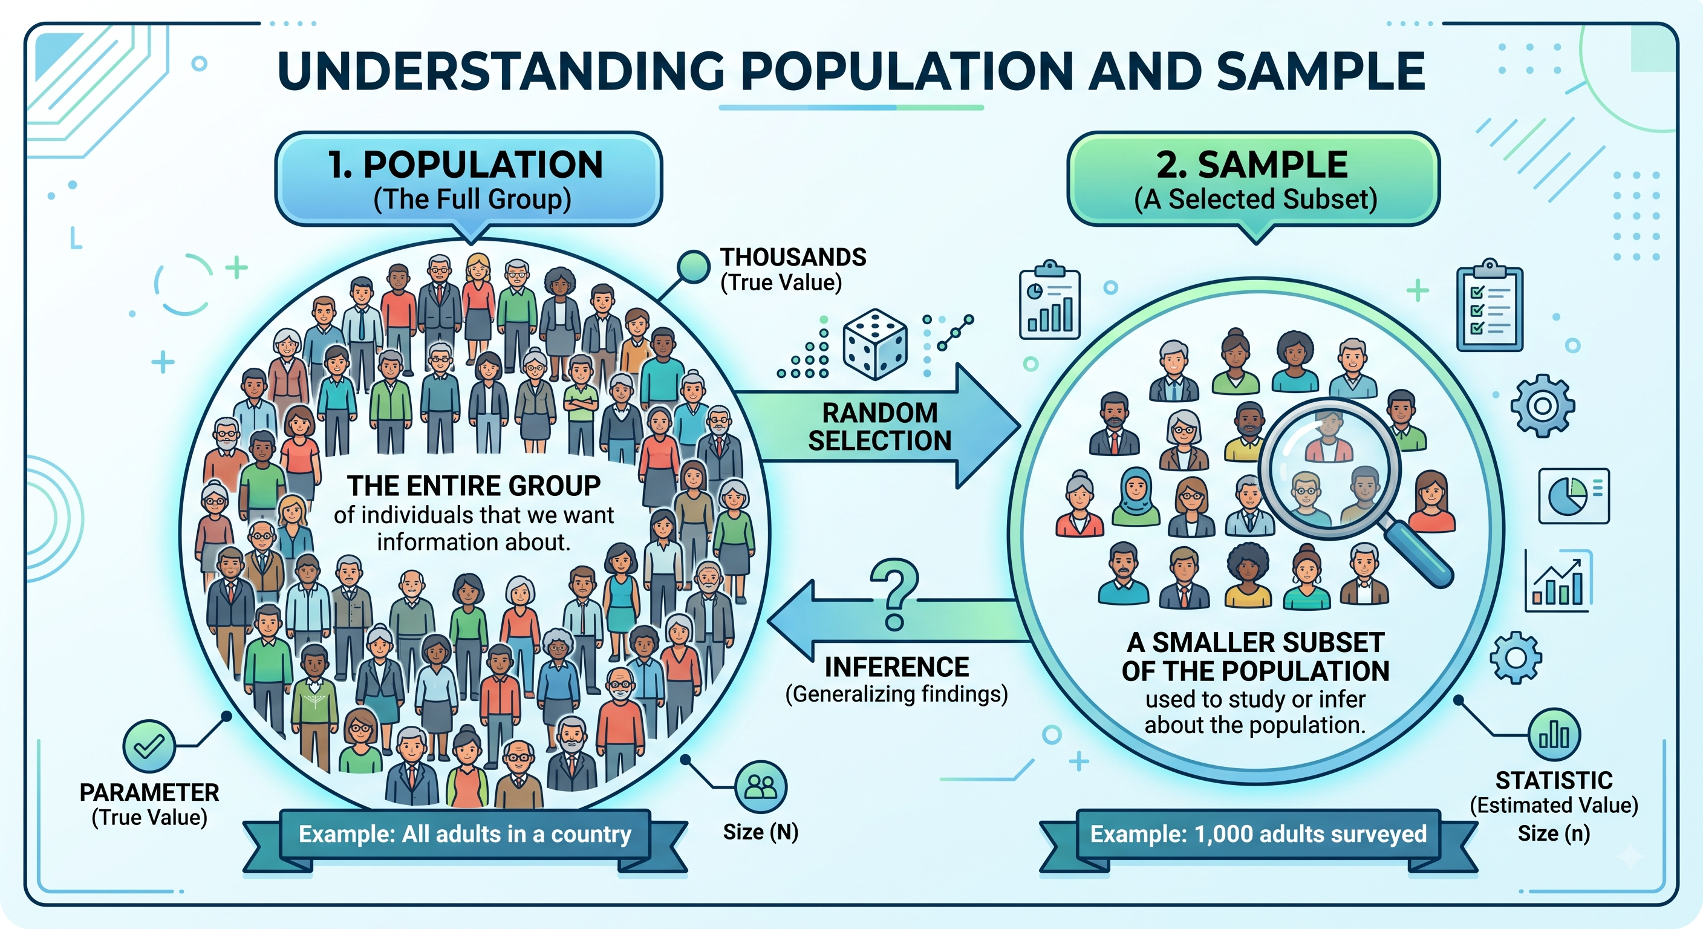

Slide 6
Types of sampling

Slide 7
Simple Random Sampling (PS)

Slide 8
Systematic Sampling (PS)

Slide 9
Stratified Sampling (PS)

Slide 10
Cluster Sampling (PS)

Slide 11
Multistage Sampling (PS)

Slide 12
Convenience Sampling (NPS)

Slide 13
Judgment/Purposive Sampling (NPS)

Slide 14
Quota Sampling (NPS)

Slide 15
Snowball Sampling (NPS)

Slide 16


