Slide 1
Confidence Intervals for Proportions
-IDS LECTURE SERIES(SMIT)
-SITAL SHARMA
-sitalneo@gmail.com

Slide 2
What

Slide 3
DEF.
A confidence interval for a proportion is a statistical method used to estimate the range of plausible values for a population proportion based on information obtained from a sample.

Slide 4

EXAMPLE

Slide 5
For example, suppose a university wants to know the proportion of students who prefer online classes. It is usually impractical to ask every student, so a sample is selected.

Slide 6
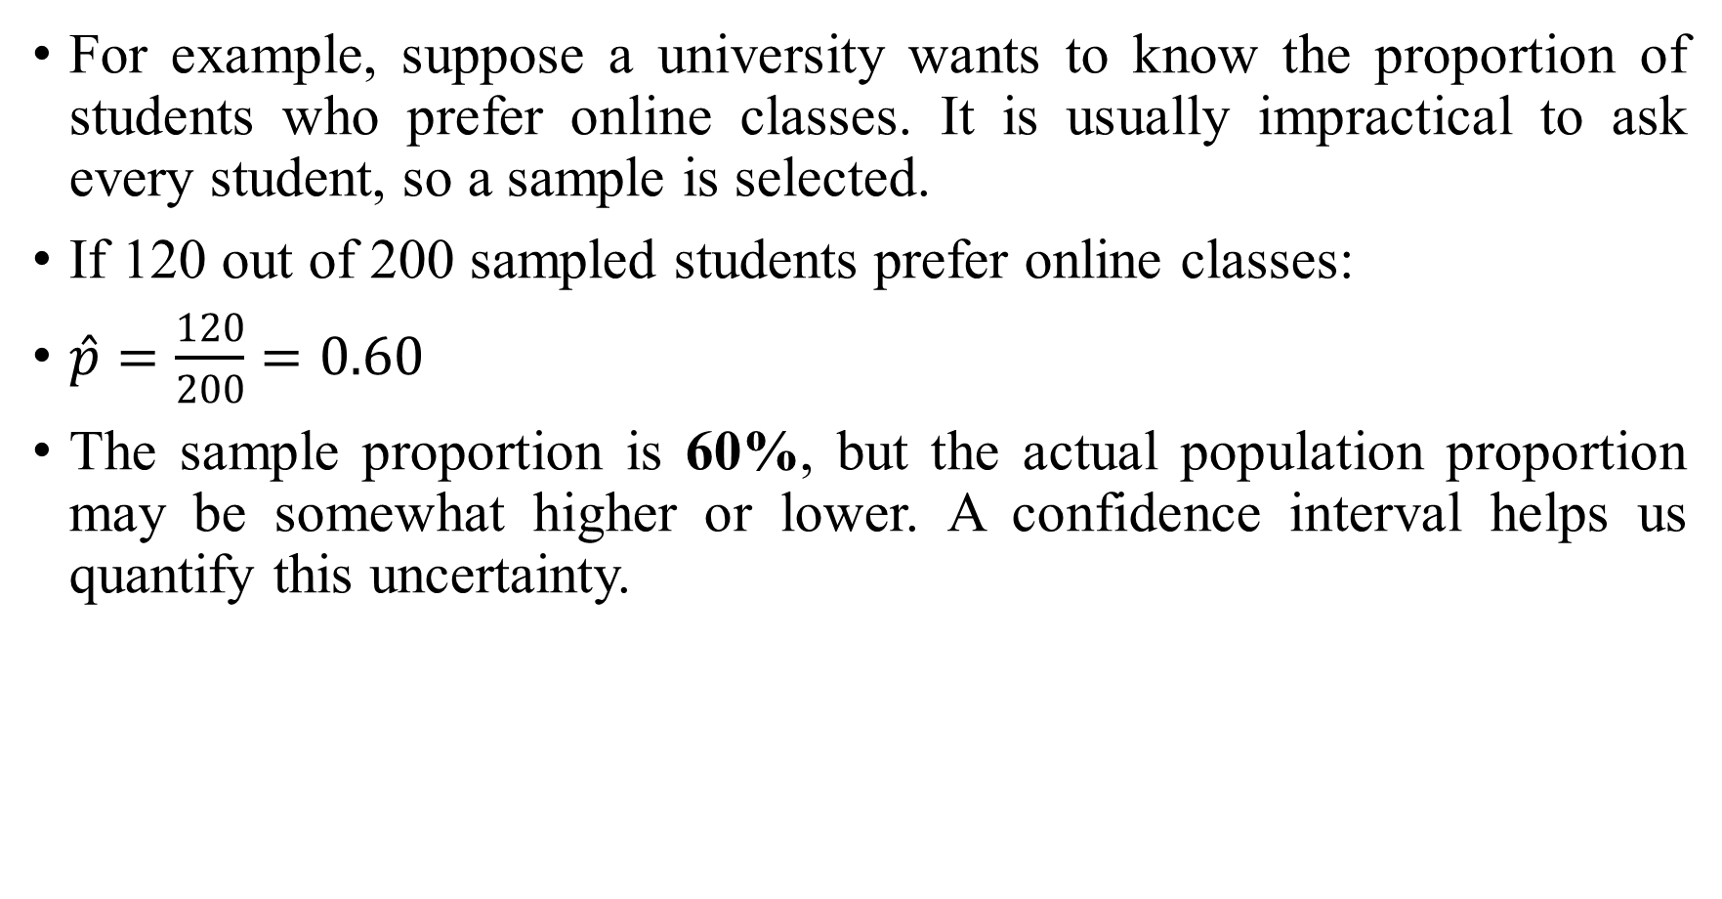
For example, suppose a university wants to know the proportion of students who prefer online classes. It is usually impractical to ask every student, so a sample is selected.
If 120 out of 200 sampled students prefer online classes:
$\hat{p}=\frac{120}{200}=0.60$
The sample proportion is 60%, but the actual population proportion may be somewhat higher or lower. A confidence interval helps us quantify this uncertainty.

Slide 7


Slide 8
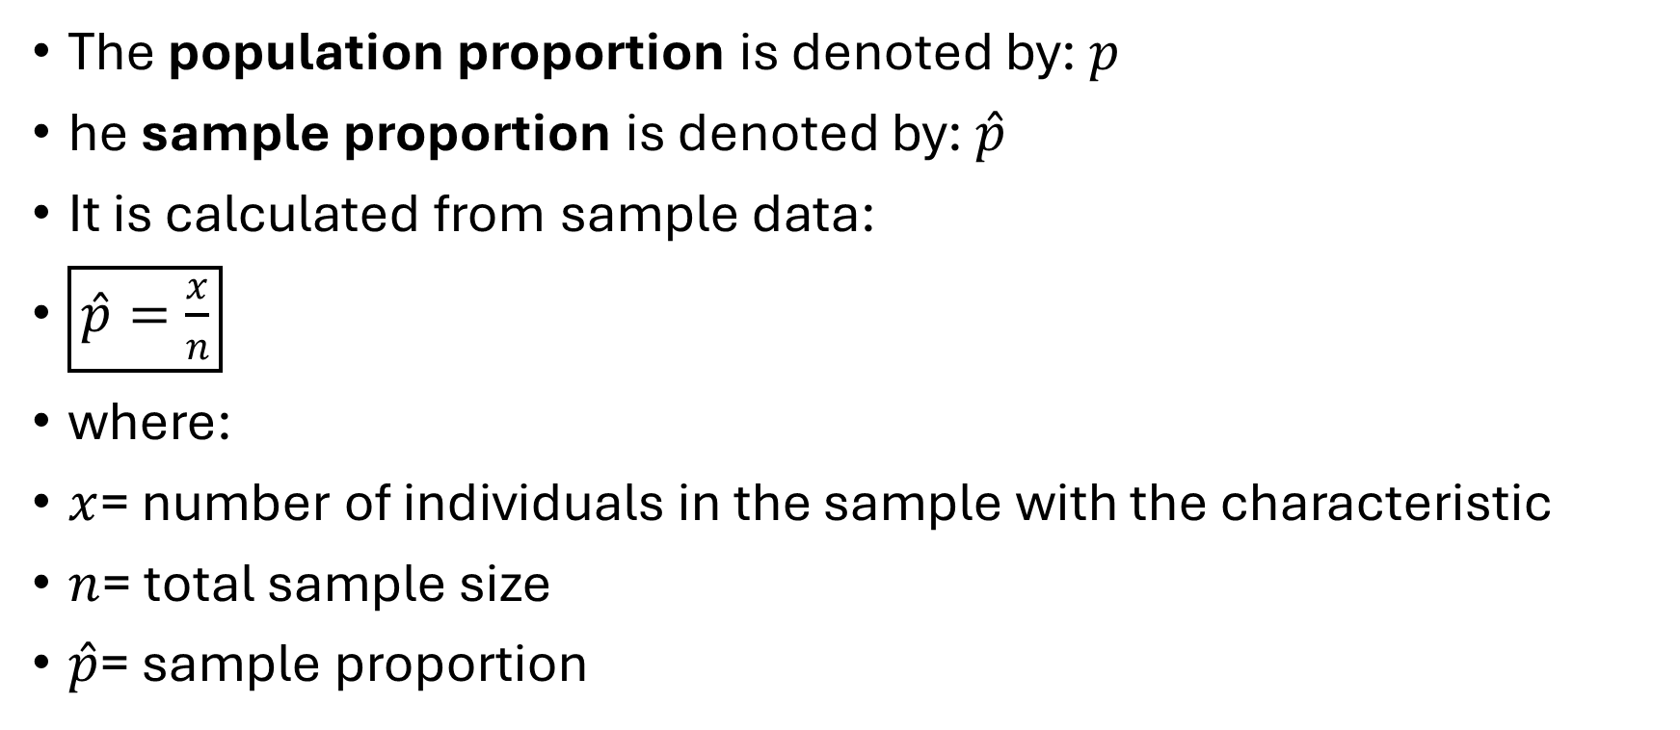
Important note
The population proportion is denoted by: $p$
he sample proportion is denoted by: $\hat{p}$
It is calculated from sample data:
$\boxed{\hat{p}=\frac{x}{n}}$
where:
$x$= number of individuals in the sample with the characteristic
$n$= total sample size
$\hat{p}$= sample proportion

Slide 9
What Is a Confidence Interval?
TELL ME

Slide 10
What Is a Confidence Interval?
A confidence interval (CI) gives a range of values that is used to estimate an unknown population parameter.

Slide 11
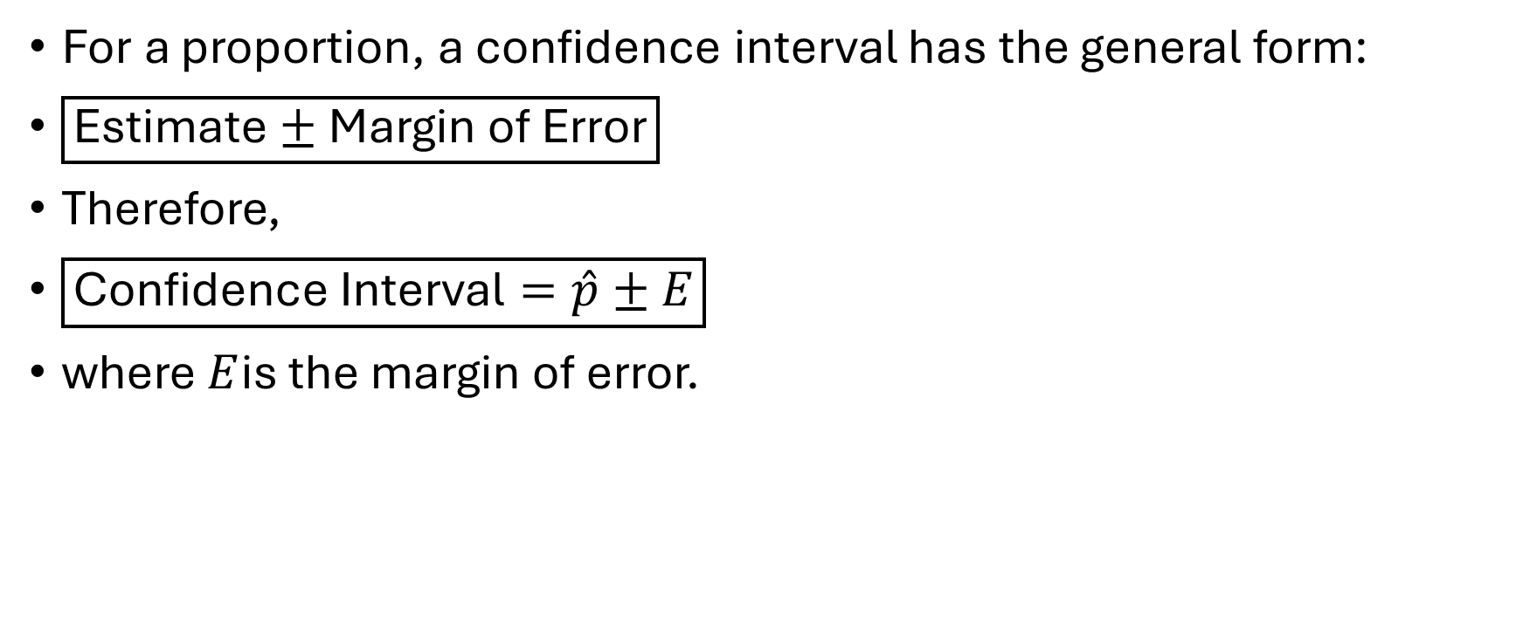
What Is a Confidence Interval?
For a proportion, a confidence interval has the general form:
$\boxed{\text{Estimate}±\text{Margin of Error}}$
Therefore,
$\boxed{\text{Confidence Interval}=\hat{p}±E}$
where $E$is the margin of error.

Slide 12

Confidence Interval Formula for a Proportion
For a sufficiently large sample, the commonly used confidence interval is:
$\boxed{\hat{p}±z_{α/2}\sqrt{\frac{\hat{p}\left(1−\hat{p}\right)}{n}}}$

Slide 13
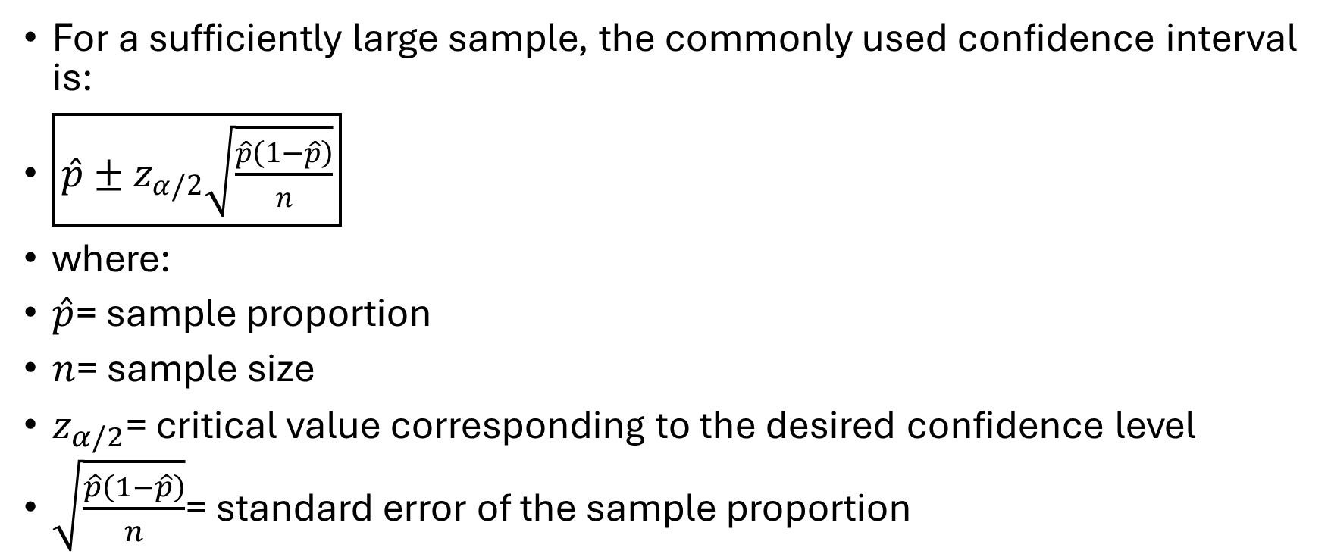
Confidence Interval Formula for a Proportion
For a sufficiently large sample, the commonly used confidence interval is:
$\boxed{\hat{p}±z_{α/2}\sqrt{\frac{\hat{p}\left(1−\hat{p}\right)}{n}}}$
where:
$\hat{p}$= sample proportion
$n$= sample size
$z_{α/2}$= critical value corresponding to the desired confidence level
$\sqrt{\frac{\hat{p}\left(1−\hat{p}\right)}{n}}$= standard error of the sample proportion

Slide 14

Confidence Interval Formula for a Proportion
The interval can therefore be written as:
$\boxed{\hat{p}±z^{∗}\sqrt{\frac{\hat{p}\left(1−\hat{p}\right)}{n}}}$
where $z^{∗}$is the appropriate standard-normal critical value.

Slide 15
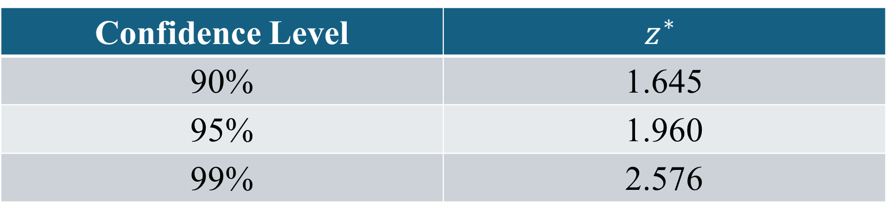
Common Confidence Levels
Confidence Level | $$z^{∗}$$
90% | 1.645
95% | 1.960
99% | 2.576

Slide 16

Standard Error
For a proportion:
$\boxed{SE\left(\hat{p}\right)=\sqrt{\frac{\hat{p}\left(1−\hat{p}\right)}{n}}}$

Slide 17

Margin of Error
The margin of error (ME) is:
$\boxed{ME=z^{∗}\sqrt{\frac{\hat{p}\left(1−\hat{p}\right)}{n}}}$

Slide 18
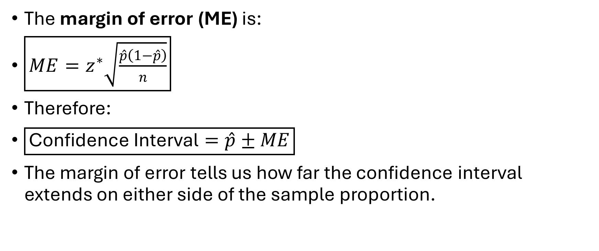
Margin of Error
The margin of error (ME) is:
$\boxed{ME=z^{∗}\sqrt{\frac{\hat{p}\left(1−\hat{p}\right)}{n}}}$
Therefore:
$\boxed{\text{Confidence Interval}=\hat{p}±ME}$
The margin of error tells us how far the confidence interval extends on either side of the sample proportion.

Slide 19
Example
A researcher wants to estimate the proportion of students in a college who use public transportation. A random sample of 400 students is selected. Among them, 240 students use public transportation. Find a 95% confidence interval for the population proportion.

Slide 20

Calculate the sample proportion
$\hat{p}=\frac{x}{n}$

Slide 21

Calculate the sample proportion
$\hat{p}=\frac{x}{n}$
Therefore:
$\hat{p}=\frac{240}{400}$
$\boxed{\hat{p}=0.60}$
So the sample proportion is:
60%

Slide 22
Find the critical value

Slide 23

Find the critical value
For a 95% confidence interval:
$\boxed{z^{∗}=1.96}$

Slide 24
Calculate the standard error
FORMULA???

Slide 25

Calculate the standard error
The formula is:
$SE=\sqrt{\frac{\hat{p}\left(1−\hat{p}\right)}{n}}$
Substitute the values:

Slide 26

Calculate the standard error
The formula is:
$SE=\sqrt{\frac{\hat{p}\left(1−\hat{p}\right)}{n}}$
Substitute the values : SE≈0.02449​

Slide 27
Calculate the margin of error
FORMULA?

Slide 28

Calculate the margin of error
The formula is:
$ME=z^{∗}×SE$

Slide 29

Calculate the margin of error
The formula is:
$ME=z^{∗}×SE$
Thus:
$\boxed{ME≈0.048}$
or approximately:
4.8%

Slide 30
Calculate the confidence interval
FORMULA??

Slide 31

Calculate the confidence interval
The general formula is:
$\hat{p}±ME$

Slide 32

Calculate the confidence interval
Therefore:
$\boxed{0.552<p<0.648}$
In percentage form:
55.2%<p<64.8%​

Slide 33
Class work
Dr. Om Prakash Singh wants to estimate the proportion of students who are satisfied with the SMIT college Mess. A random sample of 250 students is selected, and 175 students report that they are satisfied.Construct a 95% confidence interval for the true proportion of all students who are satisfied with the SMIT Mess.

Slide 34
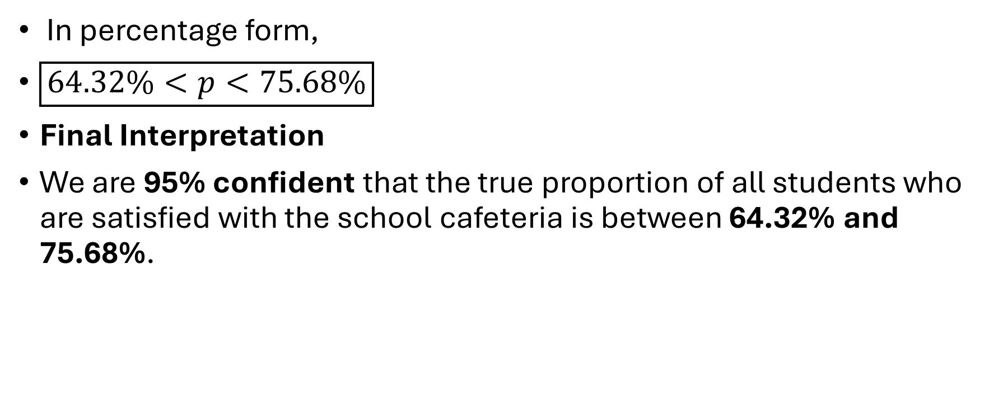
Class work
In percentage form,
$\boxed{64.32\%<p<75.68\%}$
Final Interpretation
We are 95% confident that the true proportion of all students who are satisfied with the school cafeteria is between 64.32% and 75.68%.

Slide 35


