Slide 1
Confidence Interval for Variance

Slide 2
First, what are we trying to estimate?
Suppose we want to know how spread out the values in a population are.
We use variance to measure this spread.

Slide 3
GRAPH

Slide 4

Example
Suppose we take a sample of 5 students' marks:
$10, 12, 14, 16, 18$
We want to find a 95% confidence interval for the population variance.

Slide 5
Find the sample mean

Slide 6

Find the sample mean
$\overline{x}=\frac{10+12+14+16+18}{5}$
xˉ=14

Slide 7
Step1: Find the sample mean
$\overline{x}=\frac{10+12+14+16+18}{5}$
xˉ=14

Slide 8
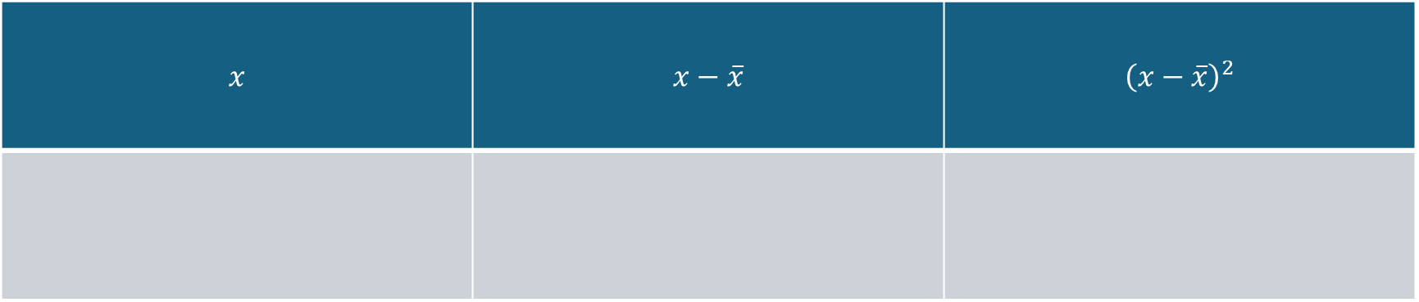
Step 2: Find the deviations and squared deviations
$$x$$ | $$x−\overline{x}$$ | $${\left(x−\overline{x}\right)}^{2}$$

Slide 9
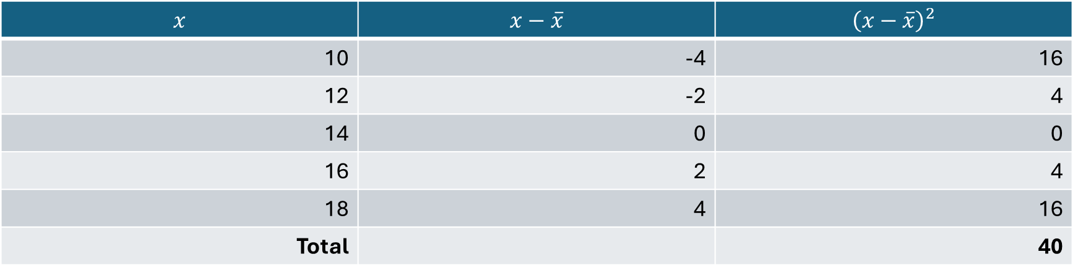
Step 2: Find the deviations and squared deviations
$$x$$ | $$x−\overline{x}$$ | $${\left(x−\overline{x}\right)}^{2}$$
10 | -4 | 16
12 | -2 | 4
14 | 0 | 0
16 | 2 | 4
18 | 4 | 16
Total |  | 40
So,
∑(x−xˉ)2=40

Slide 10

Step 3: Find sample variance
The sample variance is:
$s^{2}=\frac{\sum{(}\left.x−\overline{x}{\left.)\right.}^{2}\right.}{n−1}$
$s^{2}$=??

Slide 11

Step 3: Find sample variance
The sample variance is:
$s^{2}=\frac{\sum{(}\left.x−\overline{x}{\left.)\right.}^{2}\right.}{n−1}$
$s^{2}$= 10

Slide 12
Step 4: Find the Degrees of Freedom
For a confidence interval for population variance:
df=n−1
Df=?????

Slide 13

Step 5: Use the Chi-square distribution
For a normally distributed population, the confidence interval for variance is:
$\boxed{\frac{\left(n−1\right)s^{2}}{χ_{0.975}^{2}}<σ^{2}<\frac{\left(n−1\right)s^{2}}{χ_{0.025}^{2}}}$

Slide 14
Step 6: Determine the Chi-Square Critical Values
????????

Slide 15

Step 6: Determine the Chi-Square Critical Values
For a 95% confidence interval:
$α=0.05$
Therefore,
2 / α​=0.025

Slide 16
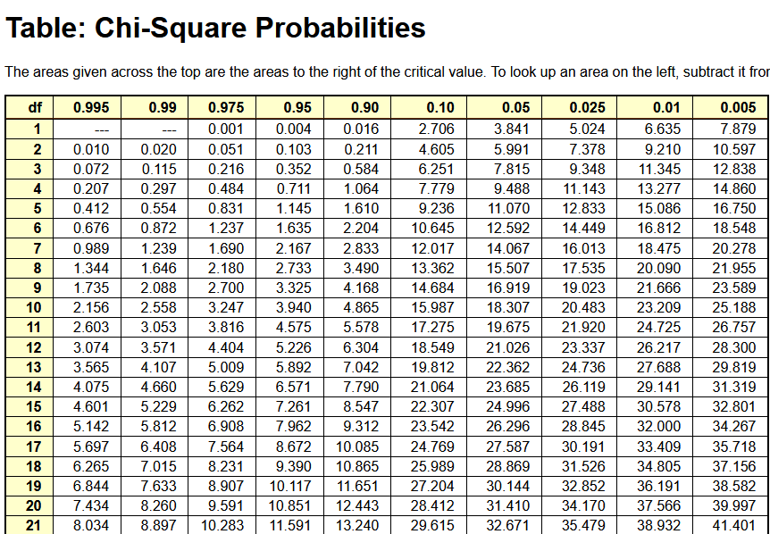
Table

Slide 17

Calculate the C.I for d.f 4
For a normally distributed population, the confidence interval for variance is:
$\boxed{\frac{\left(n−1\right)s^{2}}{χ_{0.975}^{2}}<σ^{2}<\frac{\left(n−1\right)s^{2}}{χ_{0.025}^{2}}}$

Slide 18
Final answer

Slide 19

Final answer
So if you write the formula exactly in that order, you get:
$82.64<σ^{2}<3.59$

Slide 20

Final answer
So if you write the formula exactly in that order, you get:
$82.64<σ^{2}<3.59$
which is impossible because 82.64 cannot be less than 3.59.

Slide 21
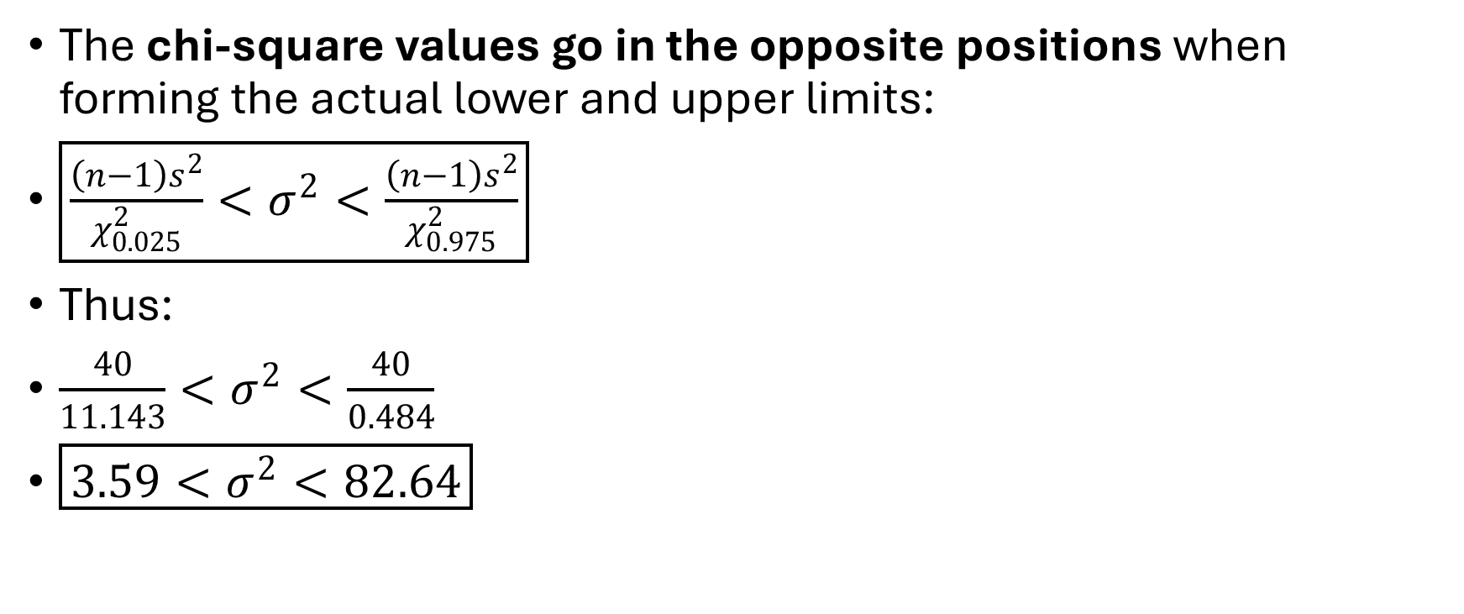
Therefore, here's the important correction
The chi-square values go in the opposite positions when forming the actual lower and upper limits:
$\boxed{\frac{\left(n−1\right)s^{2}}{χ_{0.025}^{2}}<σ^{2}<\frac{\left(n−1\right)s^{2}}{χ_{0.975}^{2}}}$
Thus:
$\frac{40}{11.143}<σ^{2}<\frac{40}{0.484}$
$\boxed{3.59<σ^{2}<82.64}$

