Slide 1
Confidence Interval for the Mean

Slide 2
Meaning

Slide 3

Formal Definition
A confidence interval for the mean is a range of values that we use to estimate the unknown population mean $μ$.

Slide 4
Why do we need a Confidence Interval?

Slide 5
What does "95% Confidence" mean?

Slide 6
Basic Structure
Every confidence interval has the same basic form:
Confidence Interval= Estimate±Margin of Error​
For estimating a population mean:
CI=Xˉ±Margin of Error​

Slide 7

Two Main Cases
$σ$is known
Case 1: $σ$ is known
Use the Z-distribution.
$\boxed{\overline{X}±z_{α/2}\frac{σ}{\sqrt{n}}}$

Slide 8

Two Main Cases
Case 2: $σ$is unknown
Use the t-distribution.
$\boxed{\overline{X}±t_{α/2,n−1}\frac{s}{\sqrt{n}}}$
where $s$ is the sample standard deviation.

Slide 9

Example
Population Standard Deviation is Known:
Suppose:
$μ=?$
$\overline{X}=50$
$σ=10$
$n=100$
Find the 95% confidence interval.

Slide 10

Critical Value
For a 95% confidence level:
$\boxed{z_{α/2}=1.96}$ = 1−0.025=0.975

Slide 11
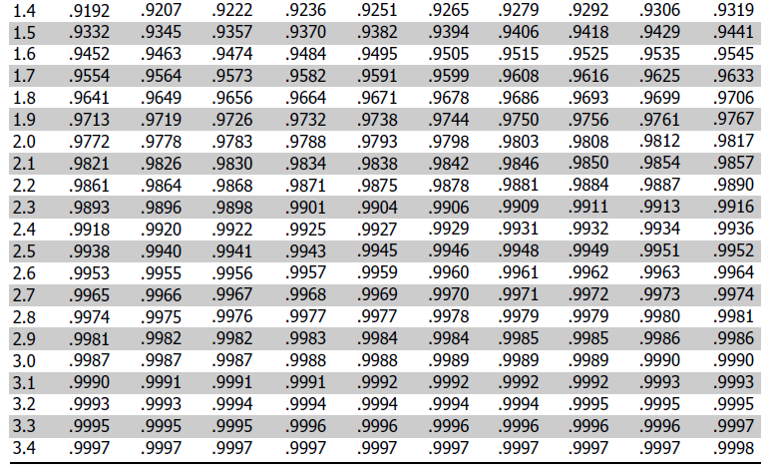

Slide 12

Critical Value and Standard Error
For a 95% confidence level:
$\boxed{z_{α/2}=1.96}$
Calculate the standard error
$SE=\frac{σ}{\sqrt{n}}$

Slide 13
Calculate for 95% CI
ANS:?

Slide 14
Calculate for 95% CI
ANS: 48.04 to 51.96

Slide 15
Calculate the Margin of Error
The margin of error is:
ME=t×SE​

Slide 16

Build the Confidence Interval
Now we finally use:
$\boxed{CI=\overline{X}±ME}$

Slide 17
Build the Confidence Interval
Now we finally use:
$\boxed{CI=\overline{X}±ME}$

Slide 18

Final Answer
Now we finally use:
$\boxed{CI=\overline{X}±M \text{Therefore, the 95\% confidence interval for the population mean is: 45.872<μ<54.128​}E}$

Slide 19
S.D (p) is Unknown
A random sample of 25 students has a mean test score of 50 and a sample standard deviation of 10.
Find the 95% confidence interval for the population mean score.

Slide 20

Given
n=25
$\overline{X}=50$
$s=10$
Confidence level:
$95\%$
We want:
Confidence Interval for μ​

Slide 21

Method
Since $σ$is unknown, the confidence interval is:
$\boxed{\overline{X}±t_{α/2, n−1}\frac{s}{\sqrt{n}}}$

Slide 22

Find the degrees of freedom
The formula is:
$\boxed{df=n−1}$
Our sample size is:
$n=25$
Therefore:
$df=25−1$
df=24

Slide 23
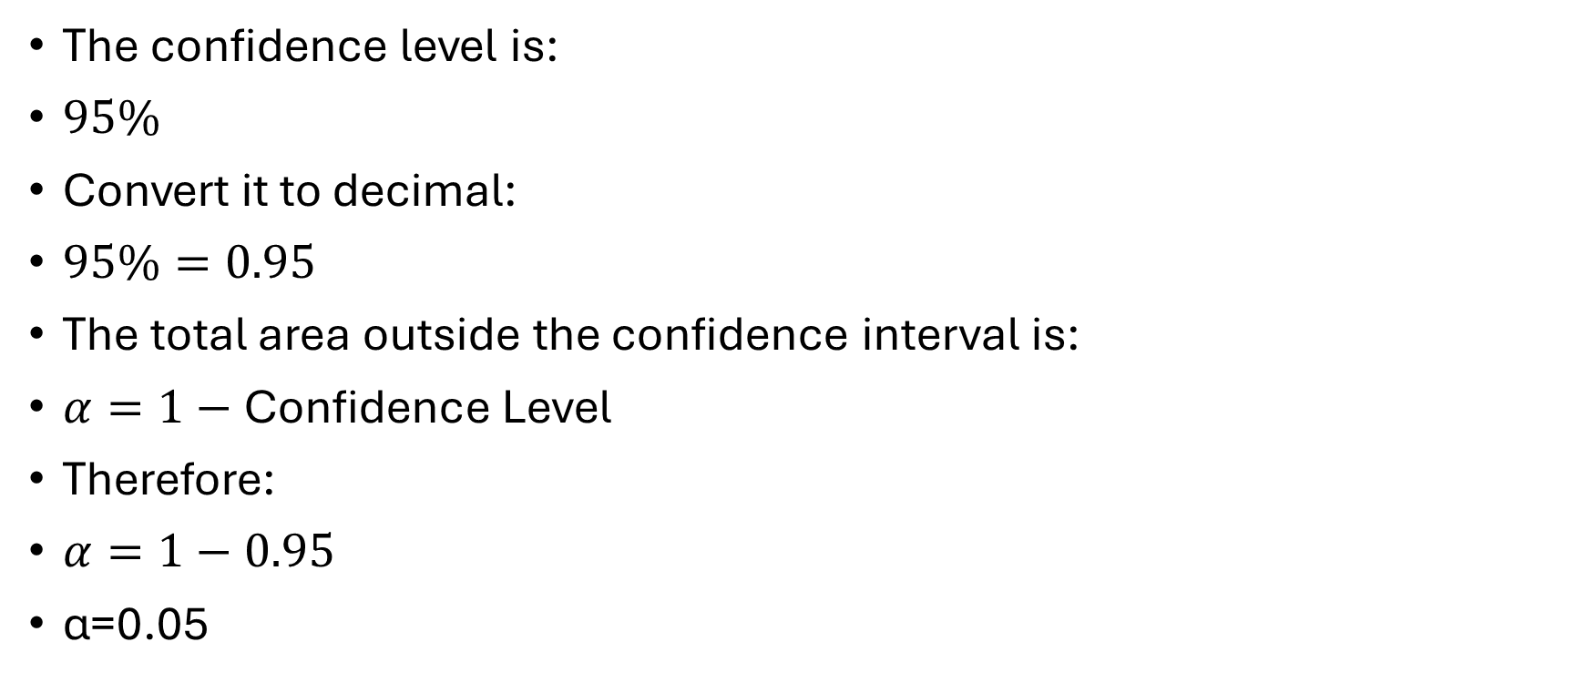
Find α
The confidence level is:
$95\%$
Convert it to decimal:
$95\%=0.95$
The total area outside the confidence interval is:
$α=1−\text{Confidence Level}$
Therefore:
$α=1−0.95$
α=0.05

Slide 24

Find the t-value from the t-table
Degrees of freedom:
$\boxed{df=24}$
Tail probability:
The value is:
$t_{α/2,}$
$\boxed{2.064}$
Therefore:
$\boxed{t_{0.025,24}=2.064}$

Slide 25
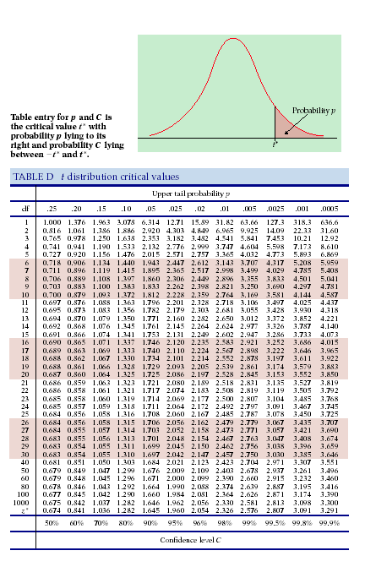

Slide 26

Calculate the Standard Error
Since the population standard deviation is unknown, we use:
$\boxed{SE=\frac{s}{\sqrt{n}}}$

Slide 27

Calculate the Standard Error
Since the population standard deviation is unknown, we use:
$\boxed{SE=\frac{s}{\sqrt{n}}}$
$\boxed{SE=2}$

Slide 28

Calculate the Margin of Error
The margin of error is:
$\boxed{ME=t×SE}$

Slide 29

Calculate the Margin of Error
The margin of error is:
$\boxed{ME=t×SE}$
4.128​

Slide 30

Build the Confidence Interval
Now we finally use:
$\boxed{CI=\overline{X}±ME}$
Our sample mean is:
$\overline{X}=50$
and our margin of error is:
$ME=4.128.$
Therefore:
CI= 50±4.128

Slide 31
Build the Confidence Interval
Now we finally use:
$\boxed{CI=\overline{X}±ME}$
Our sample mean is:
$\overline{X}=50$
and our margin of error is:
$ME=4.128.$
Therefore:
CI= 50±4.128

Slide 32
Excercise
A random sample of 25 students has a mean score of 50 and a sample standard deviation of 10.
Find the 95% confidence interval for the population mean.

Slide 33
Excercise
A random sample of 25 students has a mean score of 50 and a sample standard deviation of 10.
Find the 95% confidence interval for the population mean.
50±4.128

