Slide 1
Point Estimation — Method of Moments

Slide 2
What is Point Estimation?

Slide 3
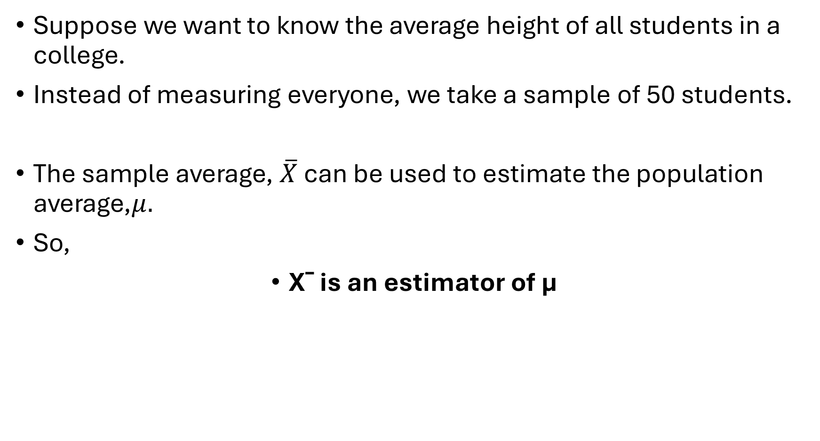
Suppose we want to know the average height of all students in a college.
Instead of measuring everyone, we take a sample of 50 students.
The sample average, $\overline{X}$ can be used to estimate the population average,$μ.$
So,
Xˉ is an estimator of μ​

Slide 4
What is an Estimator?

Slide 5
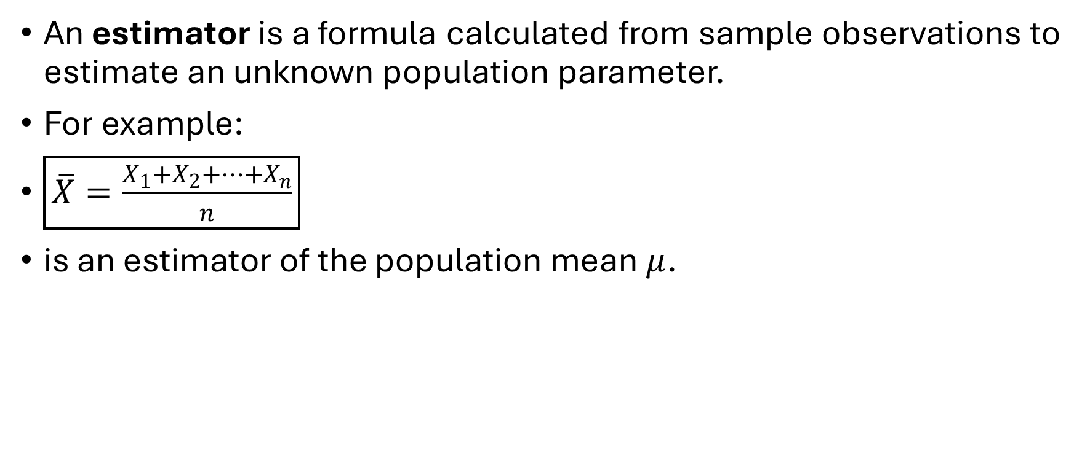
What is an Estimator?
An estimator is a formula calculated from sample observations to estimate an unknown population parameter.
For example:
$\boxed{\overline{X}=\frac{X_{1}+X_{2}+⋯+X_{n}}{n}}$
is an estimator of the population mean $μ$.

Slide 6
Term | Meaning
Parameter | Unknown population value
Estimator | Formula used to estimate the parameter
Estimate | Actual numerical answer obtained from the sample

Slide 7

Question
For example:
$μ → \overline{X} → 25.4$
Here:
$?????????$= parameter
??????????= estimator
$??????????$= estimate

Slide 8

Question
For example:
$μ → \overline{X} → 25.4$
Here:
$μ$= parameter
$\overline{X}$= estimator
$25.4$= estimate

Slide 9
What is the Method of Moments?
The Method of Moments (MOM) is a simple method for finding an estimator.

Slide 10
What is the Method of Moments?
Compare : Population moments with sample moments and make them equal.

Slide 11
What is moment
Moments are numbers that describe important features of a probability distribution.

