Slide 1
Outlier Treatment, Skewness & Pearson’s Median Skewness Coefficient

Slide 2
What is an Outlier?
An outlier is an observation that lies unusually far from the other observations in a dataset.

Slide 3
What is an Outlier?
₹20,000
₹22,000
₹24,000
₹25,000
₹27,000
₹2,50,000

Slide 4
Why Do Outliers Matter?

Slide 5
Methods of Detecting Outliers
Visual Inspection

Slide 6
IQR Method
First calculate:
IQR=Q3​−Q1​
where:
  Q1​ = First quartile
  Q3​ = Third quartile
Then calculate:
  Lower Fence=Q1​−1.5(IQR) Upper Fence=Q3​+1.5(IQR)
Any observation below the lower fence or above the upper fence is generally treated as a potential outlier.

Slide 7
What is Interquartile

Slide 8
Example
Given :
  Q1​=20,Q3​=40
  IQR=?

Slide 9
Example
Given :
  Q1​=20,Q3​=40
  IQR=40−20=20
  LOW-FENCE:??

Slide 10
Example
Given :
  Q1​=20,Q3​=40
  IQR=40−20=20
  LOW-FENCE: 20−1.5(20)=−10
  Upper fence:????

Slide 11
Example
Given :
  Q1​=20,Q3​=40
  IQR=40−20=20
  LOW-FENCE: 20−1.5(20)=−10
  Upper fence: 40+1.5(20)=70

Slide 12
Example
Given :
  Q1​=20,Q3​=40
  IQR=40−20=20
  LOW-FENCE: 20−1.5(20)=−10
  Upper fence: 40+1.5(20)=70
Therefore, values below −10 or above 70 are potential outliers.

Slide 13
Z-Score Method

Slide 14
Treatment of Outliers
Retain the outlier

Slide 15
Treatment of Outliers
Retain the outlier
Correct the observation

Slide 16
Treatment of Outliers
Retain the outlier
Correct the observation
Remove the observation

Slide 17
Treatment of Outliers
Retain the outlier
Correct the observation
Remove the observation
Transform the data

Slide 18
What is Asymmetry?

Slide 19
What is Asymmetry?
Asymmetry refers to the lack of symmetry in a probability distribution or frequency distribution.
A distribution is symmetric when its left and right sides have approximately the same shape.
When one side has a longer or heavier tail than the other, the distribution is skewed.

Slide 20
Type 1: Symmetric distribution
Mean=Median=Mode
2, 3, 4, 5, 6, 7, 8

Slide 21
Type 2: Positive Skewness
A positively skewed distribution has a longer tail toward the right.
It is also called right-skewed.

Slide 22
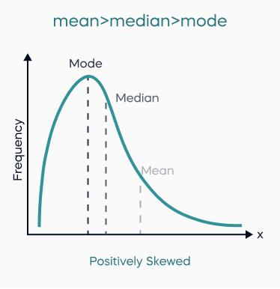
Type 2: Positive Skewness

Slide 23
Type 2: Negative Skewness
A negatively skewed distribution has a longer tail toward the left.
It is also called left-skewed.

Slide 24
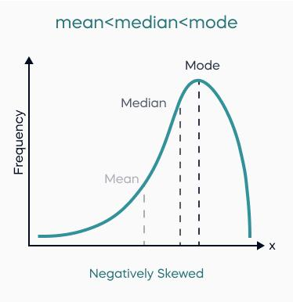
Type 2: Negative Skewness

Slide 25

Part III — Pearson's Measures of Skewness
Pearson's Coefficient of Skewness:
There are two commonly encountered Pearson coefficients.
Pearson's First Coefficient:
xˉ = Mean
Mode = Mode
s = Standard deviation

Slide 26

Part III — Pearson's Measures of Skewness
PROBLEM?

Slide 27
Part III — Pearson's Measures of Skewness
However, the mode may be difficult to determine or may not exist uniquely.
Therefore, another form is often used.

Slide 28

Pearson's Median Skewness Coefficient
When the median is used instead of the mode:
where:
xˉ = Arithmetic mean
Median = Median
s = Standard deviation
This is commonly called Pearson's second coefficient of skewness or the Pearson coefficient based on the median.

Slide 29
Interpretation of Pearson's Median Skewness Coefficient
Skp​=0
The distribution is approximately symmetric.

Slide 30
Interpretation of Pearson's Median Skewness Coefficient
Skp​>0
The distribution is positively skewed.

Slide 31
Interpretation of Pearson's Median Skewness Coefficient
Skp​<0
The distribution is negatively skewed.

Slide 32
Class work
Mean = 50
Median = 45
Standard deviation = 10
Skewness:????

Slide 33
Class work
Mean = 40
Median = 45
Standard deviation = 10
Skewness:????

Slide 34
Class work
Mean = 60
Median = 60
Standard deviation = 12
Skewness:????

Slide 35


Slide 36


