Slide 1
Effects of Climate change on Agriculture and adaptation.
EDA COURSE PROJECT
Focus Topic :
INDIAN CLIMATE AND AGRICULTURE

Slide 2
Team details
Name | Roll No | USN
Tanvi Bhujannavar | 511 | 01FE20BCS252
Sitanshu Hallad | 514 | 01FE20BCS260
Abhishek Masur | 522 | 01FE20BCS281
Satwik Kulkarni | 515 | 01FE20BCS262

Slide 3
Problem statement
To analyze and predict factors effecting climate change and agriculture, hence recommend crops which are most efficient and economical for regions specified with their respective factors effecting climate and agriculture.

Slide 4
FACTORS THAT EFFECT AGRICULTURE AND CLIMATE
In order to achieve the predictions and understanding of factors we have considered most relevant and important parameters:
Temperature
Rainfall
Soil
Texture
color
NPK value for crops
CO2 emissions

Slide 5
COLLECTION OF DATASETS AND UNDERSTANDING OF THEIR RELATIONS
RAINFALL
1
The above diagram shows how relations were derived between the factors.
TEMPERATURE
CROPS PRODUCTION OF STATES
CROP
RECOMENDATION
CO2 emissions
SOILS

Slide 6
Dataset and attributes
Temperature:
State name
Years
Data in Celsius

Slide 7
Dataset and attributes
Rainfall:
State name
Years
Data in mm

Slide 8
Dataset and attributes
Soils data set:
State name
Soil names

Slide 9
Dataset and attributes
Crop recommendation:
NPK values
Temperature
Rainfall
Soil names
ph ranges of soil
Humidity ranges

Slide 10
Dataset and attributes
CO2 emissions:
Year
Emission

Slide 11
Data preprocessing
Data preprocessing was done on datasets mentioned before in following steps:
Data integration
Data cleaning
Data reduction
Data transformation

Slide 12
Data integration
Data integration was not required for selected datasets as each one them have their own identity and it was easier to operate and analyze without integration.

Slide 13
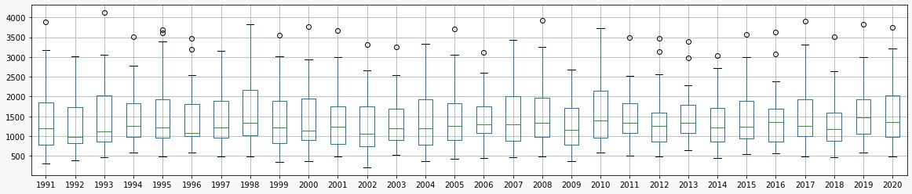
Data cleaning
Missing values :
Rows with missing values were deleted
Outliers:
(The above figure shows outliers in temperature dataset)

Slide 14
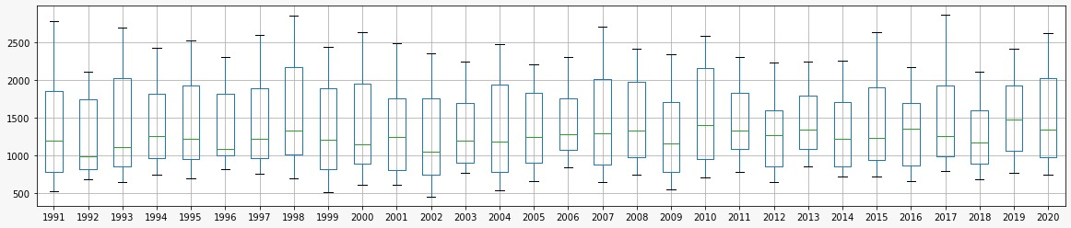
After using flooring and capping to remove outliers:
(the above figure shows the temperature dataset box plot with no outliers)

Slide 15
Data Reduction
Years were reduced to 1991 to 2020
Dropped data of countries other than India
Reduction of multiple entries in crop recommendation to a range of the attributes

Slide 16
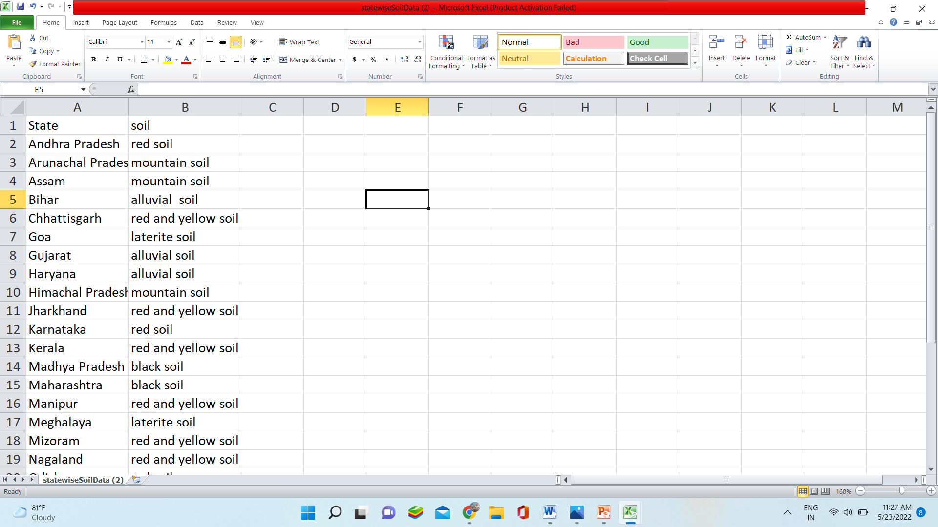
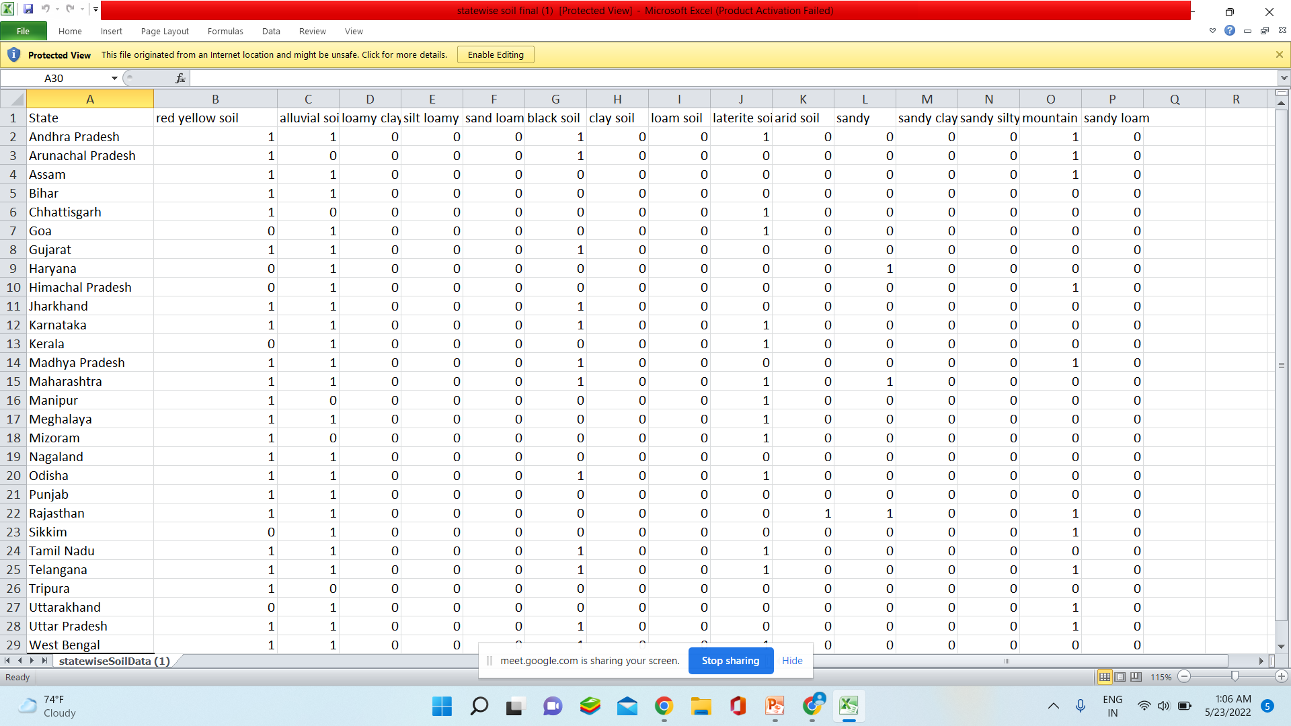
Data transformation
One hot encoding
Soil dataset:

Slide 17
Data warehouse
All the datasets were preprocessed to requirements and were used for further inferences.

Slide 18
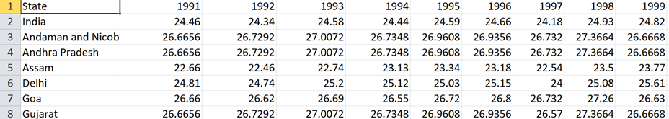
DATASETS AND ATTRIBUTES
Dataset of temperature of all states in India
Temperature in Celsius :
Year: 1991-2020

Slide 19
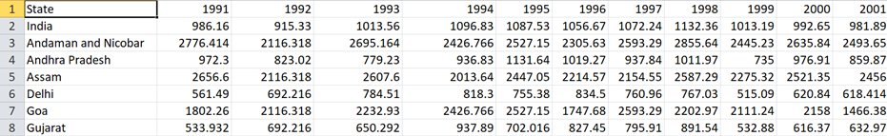
DATASETS AND ATTRIBUTES
Dataset of rainfall of all states in India
rainfall in mm :
Year: 1991-2020

Slide 20
DATASETS AND ATTRIBUTES
Dataset of soils present in each state of India
Soil in areas

Slide 21
DATASETS AND ATTRIBUTES
Crop Recommendation dataset for all effecting factors:
rainfall : mm
Temperature : Celsius
NPK values measure : kg / hectare
Soil classification based on :
texture : determines water drainage and nutrient hold of a soil.
color : determines capacity of organic matter(dark),water clogging (grey/blue hue),iron content(red),humus(black) in the soil

Slide 22
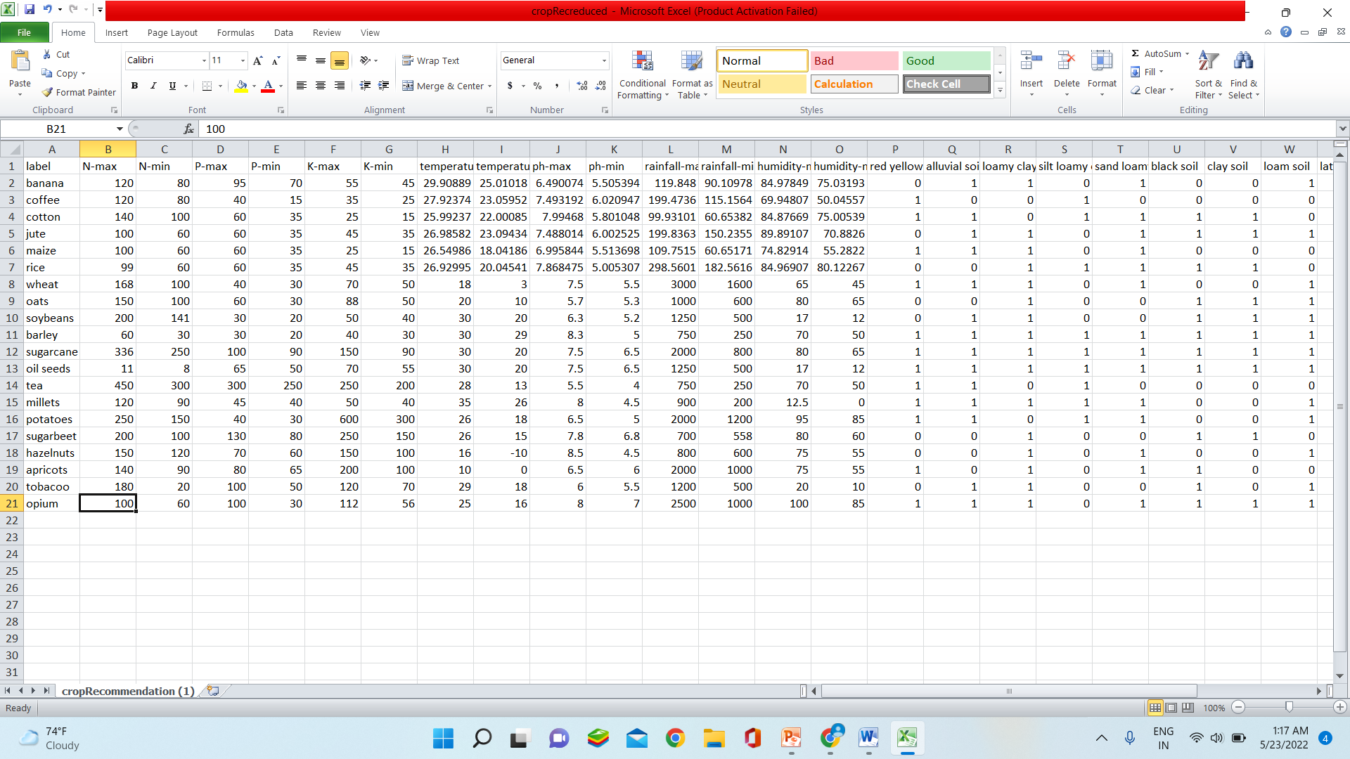
DATASETS AND ATTRIBUTES

Slide 23
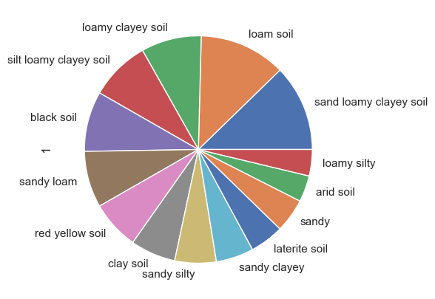
Which soils and plants are the most versatile?
Analysis : Pie chart for soils having maximum number of plants grown under them.
Alluvial soil = loamy +clayey +silt
Inference :
alluvial soil is more versatile.
proves to have perfect texture and constitutes to support crop growth

Slide 24
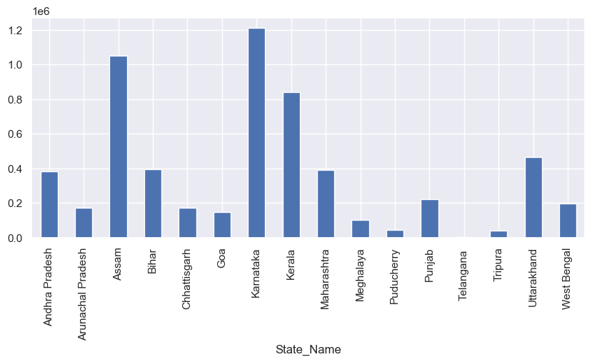
Further Analysis : crop production graph of states and soil that is available in the state with highest production.
(The above graph is the production graph of states year 2014)
Further Inference :
Karnataka State that acquires alluvial soil has an economical advantage. This also depends on the area of the state covered by the soil as well as climate of that year.

Slide 25
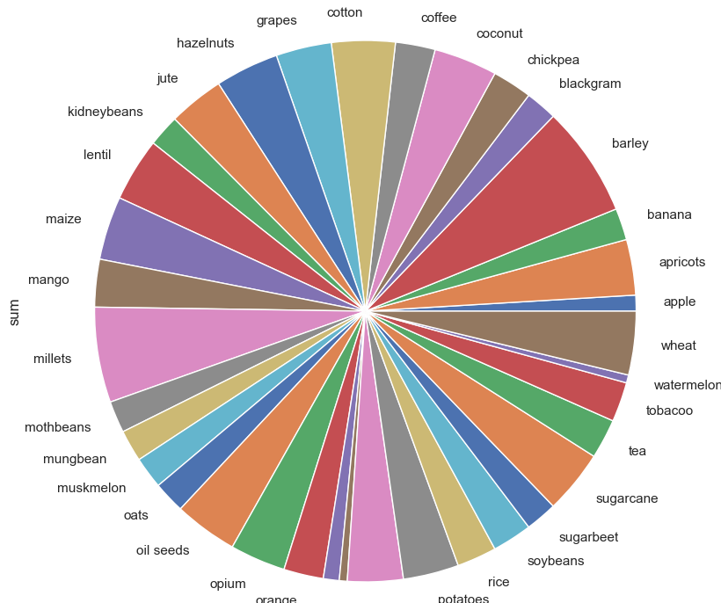
Analysis : Pie chart for crops growing under number of soils.
Inference :
Millets Crop and sugarcane can grow in variety of soils
Rice Crop can grow in least variety of soils

Slide 26
Further Analysis : research on soil needs for both kinds of crops above. Also analyze their temperature and rainfall needs from crop production data base.
Millet : grown largely in sandy soil
Sugarcane: needs large amount of precipitation and nutrients from soil.
Barley : can be grown in sandy soil
Further Inference :
Millet and barley Crops are drought crops.
Sugar cane crop is a tropical crop.

Slide 27
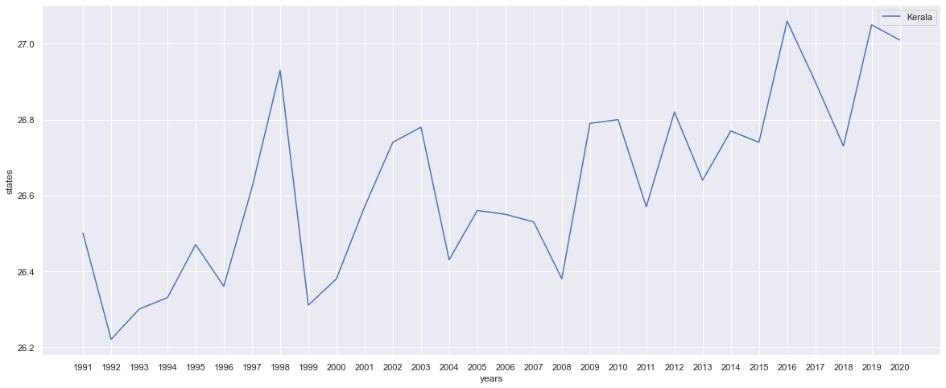
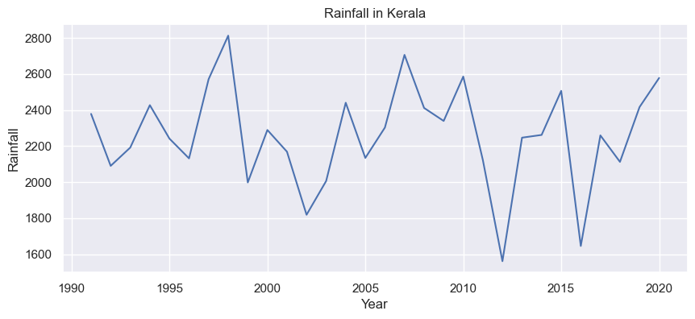
Relation between temperature and rainfall influenced by gas levels (kerala)
Analysis : bar line chart to analyze temperature, rain as well as gas levels.
Temp:
Rain:

Slide 28
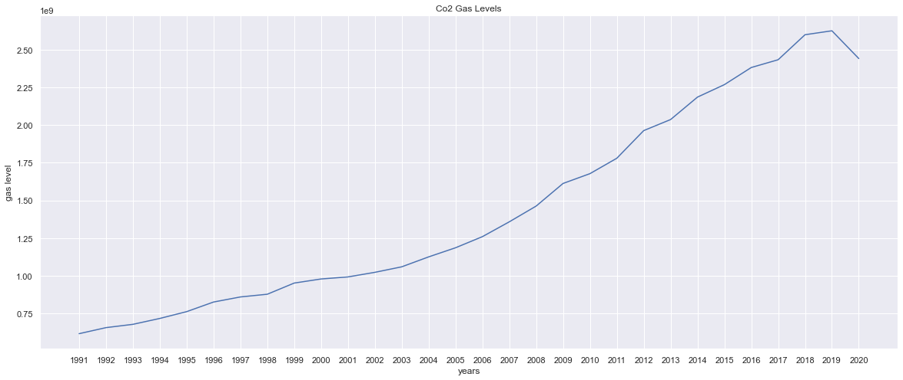
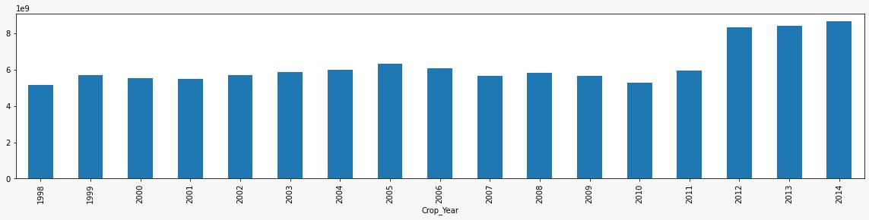
CO2 emissions:
Production level:

Slide 29
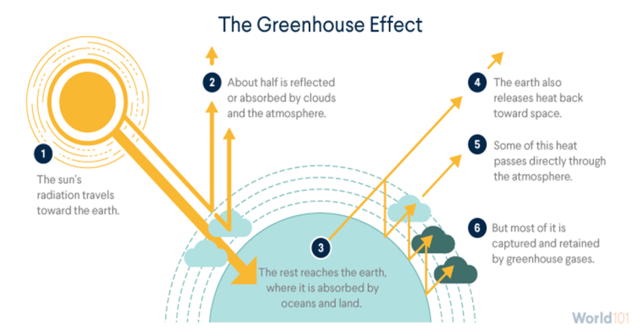
Inference :
Temperature increases and rainfall increases.
Further analysis and inference:
The gas levels increase temperature rises evaporation is trapped hence change in rainfall occur. Referenced to water cycle on earth.

Slide 30
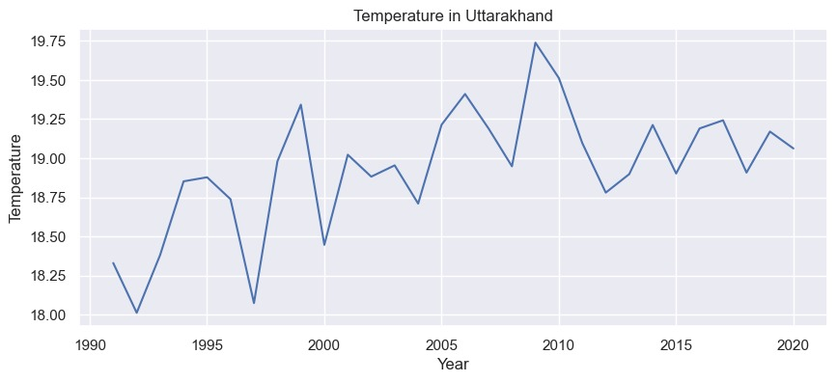
How is this change profitable for some states?
Northern states with increase in temp.(Uttarakhand)

Slide 31
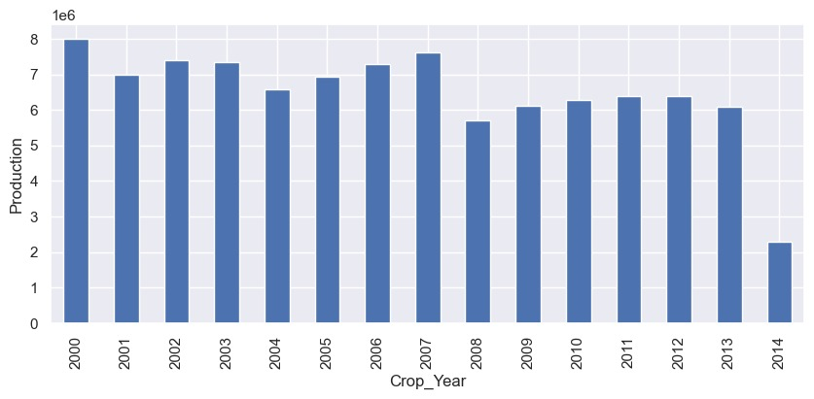

Slide 32
Building a regression model

Slide 33
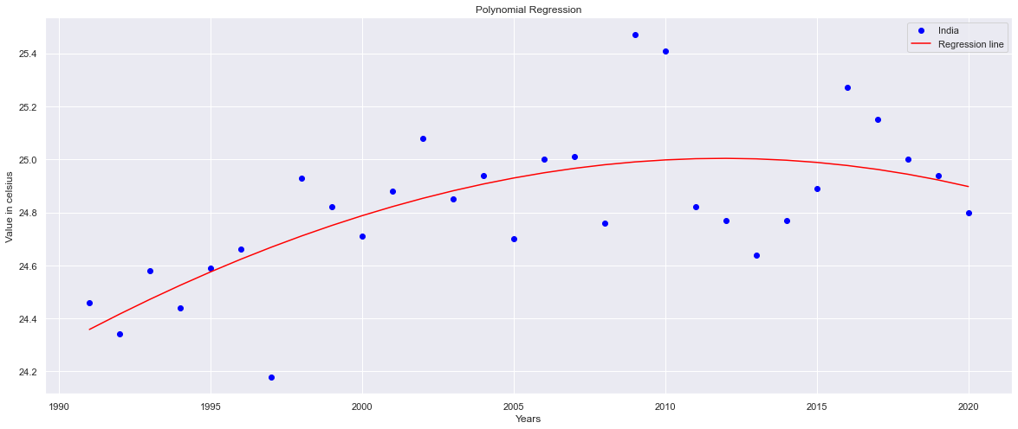
Regression model for prediction
Temperature :

Slide 34
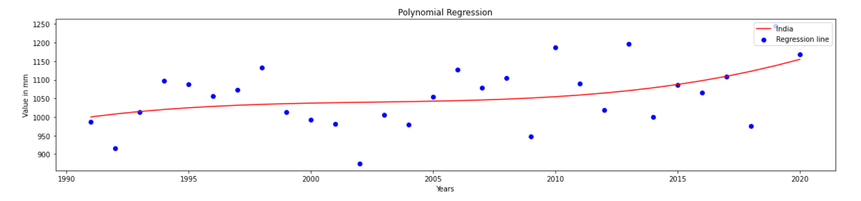
Rainfall :

Slide 35
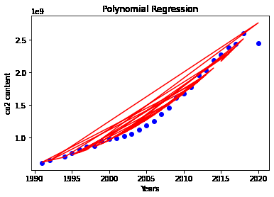
Gas levels : co2

Slide 36
Crop Recommendation of a state in future.
Consider state: Karnataka
Year : 2025
From regression model ::
Rainfall: 1391.22 mm
Temperature: 26.8 C
Inference:

Slide 37
From crop recommendation dataset we get with consideration of factors listed before as well as soil available:
coffee Crop
Sugarcane
Assuming :: PH – 5.5 P- 70 K-60 N-100
Inference and analysis :
The quality of soil matters with the existing factors at hand hence testing of soil and comparison is necessary.

Slide 38
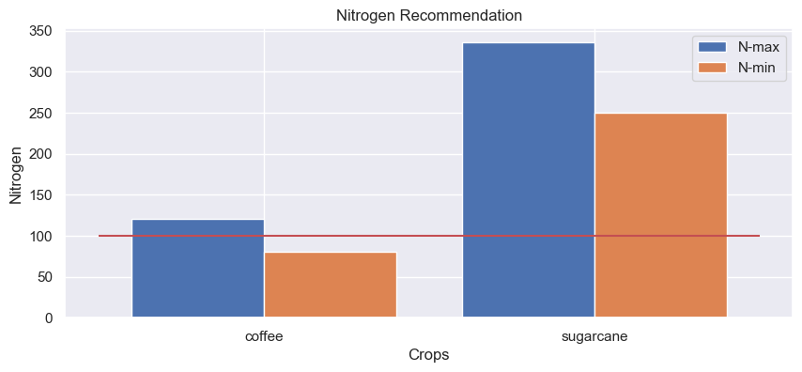
How to determine economical crops to grow?
Analysis : plot NPK and PH requirement graph for each crop given the quality of soil.

Slide 39
Inference :
the difference in range of requirement of crops nutrients and naturally available amount of nutrients in the soil determine how economical a crop can be.
Also helps in controlling soil pollution and intern water pollution as well.
Here, we infer a cycle of dependency between agriculture and climate change

Slide 40
Thank You.

