Slide 1
Git
A Distributed Version Control System

Slide 2
Distributed Version Control
A “Distributed” Version Control System
  Every dev has his/her own repository
  All repositories are (usually) “clones” of the central repository
  Easy to work offline
    Commits made while offline retain their identity; they don't get collapsed into one big commit
  Commit-then-merge, not merge-then-commit

Slide 3
What's different about git?
Cryptographically secure integrity checks builtin
Fast
  Most operations are local
  Network operations are highly optimised
  Ideal for distributed teams
Easy to setup/deploy
  Server requires minimal hardware
  No license costs

Slide 4
What's different about git?
Very small repository size
  Mozilla repository, changes from 1998 or so
    CVS: 2.7 GB
    SVN: 8.2 GB
    Git: 450 MB
    (just the files: 350 MB)
Very, very, cheap branching
Excellent merging

Slide 5
Life in SVN
Slow on large repos
.SVN directories all over the place
  Often almost as large as the entire project history in git!
Refactor/rename support lacking
Nice branching
  But merging...?

Slide 6
Life in SVN...
Merge tracking not very well done
  Does not record who did the branch (attributes all changes to the dev who did the merge)
  Does not record “merge-only” changes separately from the two branches
  Can make repeated merges very difficult
    SVN mergeinfo has many limitations
Merges can be slow
Large merges can be painful

Slide 7
Life in SVN...
Lack of local commits
  You don't want to “break the build”
  So you keep lots of uncommitted changes outside the VCS
  And do one big checkin when you're ready

Slide 8
Productivity Advantages of Git
History tracking handled much better; makes repeated merges a breeze
  All “commits” identified by a SHA-1 checksum
    this is what gives it the cryptographically secure integrity check
  A branch is just a pointer to some commit
  Every commit records its parent commit's SHA
  A merge is just a commit with more than one parent commit
So, every commit knows all of its ancestors
  Regardless of repository, branch, etc

Slide 9
Productivity...
Complex merges handled much better; frees devs from worrying about it most of the time
  Merges involving renames
  Criss-cross merges
Encourages many small commits instead of few large commits
  Easier code reviews
  Easier debugging
  Easier cherry picking
  Easier merging/rebasing (conflict resolution happens in much smaller units)

Slide 10
Productivity...
Encourages creating local branches
  No need to pollute the central server
  Experimental code can be developed “on the side”
    If it works, promote it to the central server, with the full history of commits intact
    Otherwise, delete it; no need to immortalise failed experiments on the central server :-)
  Branch names are also local
    We can all have a branch called “my-test” or “test” or whatever, without worrying about “is someone else using the same branch name?”

Slide 11
Productivity...
Encourages using the tools available
  Important VCS operations (like “diff”) do not need network access
  Blazingly fast
    Even against a very old revision
    Or a version in some other branch
  Centralised VCSs take too long
    Painful to use
    So programmers avoid them (?)

Slide 12
Productivity...
Cherry picking

Slide 13
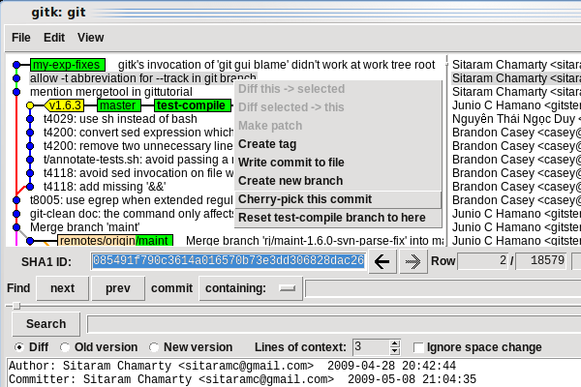
Cherry-picking

Slide 14
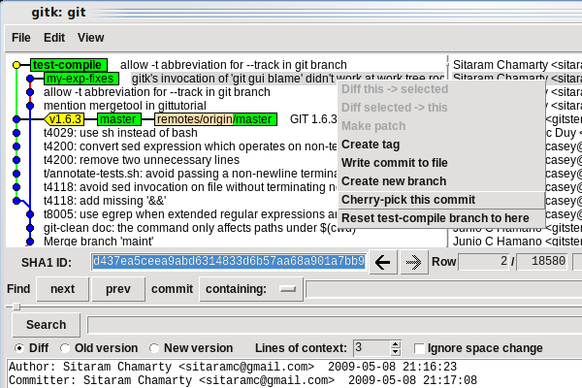
Cherry-picking...

Slide 15
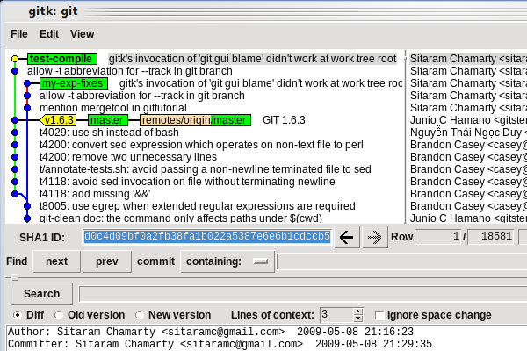
Cherry-picking...

Slide 16
Maintainability advantages
In SVN, renaming a file
  Is treated as a copy+delete
  Loses history (?)
How about...
  Rename + move + edit a file in one branch
  While making some bugfixes to it in another?
Git handles this without any fuss

Slide 17
Maintainability...
Refactoring: code movement
  Example:
    Move an important function with lots of history to some other file
What would SVN do to the history?
Next 5 slides show code movement
  Displayed using “git gui blame”, one of the 3 GUI tools that come with git

Slide 18
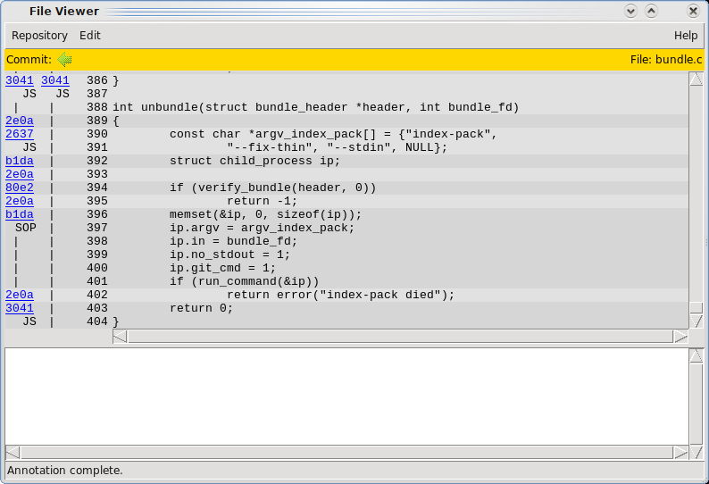

Slide 19
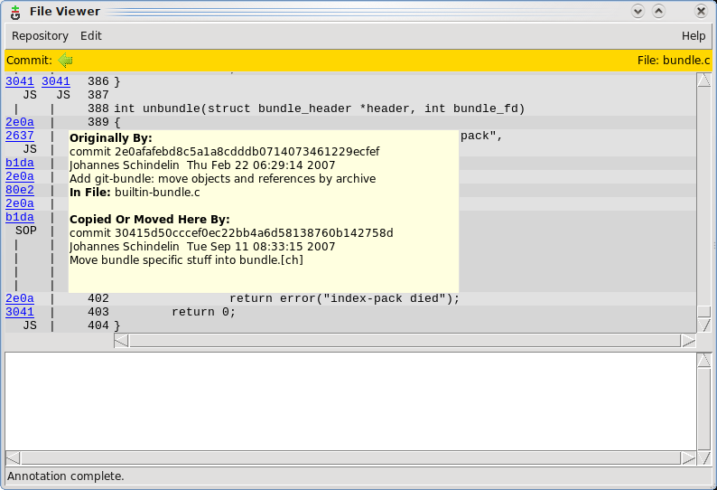

Slide 20
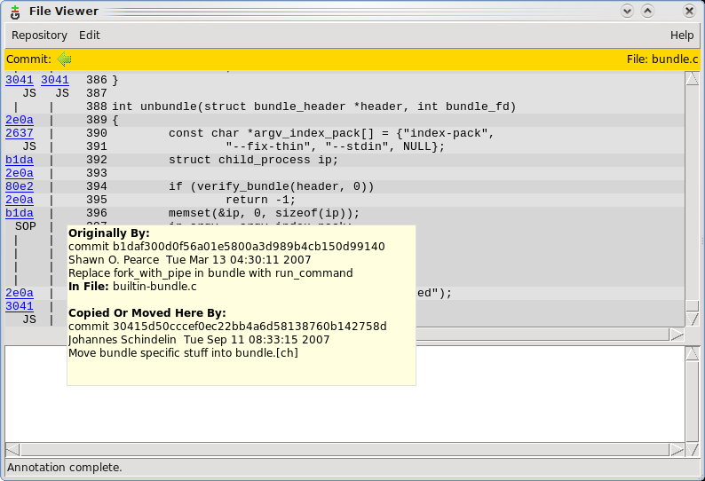

Slide 21
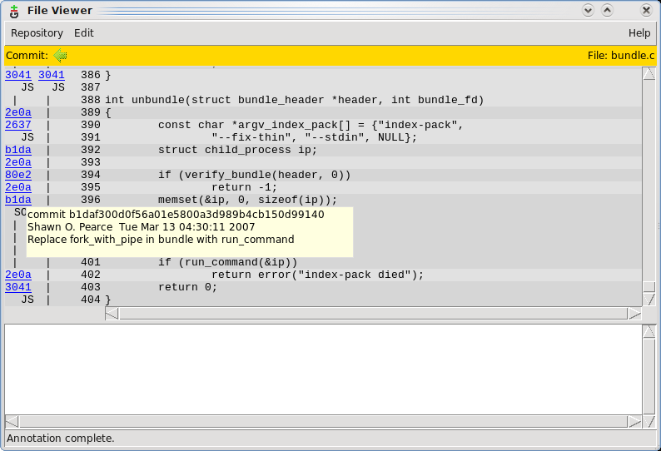

Slide 22
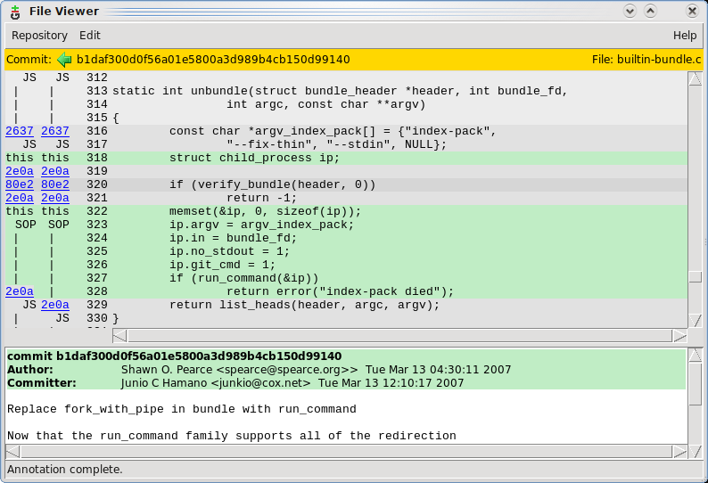

Slide 23
Code movement...
Detecting code movement
  This is way beyond what any other VCS can even dream of
  Great help for new people trying to understand existing code base
Here's a secret...
  The information you see is not stored in the repository
  It is computed on demand, dynamically!
  Which mean you can get the same tracability for all your existing code
    Simply by converting to git!

Slide 24
Revision history viewer
Git has another GUI to show you the version history graph
  Very intuitive, shows merges etc very nicely
  Lots of “right click” options in various places, to help track things down...
  (one small example follows; there are many, many, more features – there is not enough time to talk about more!)

Slide 25
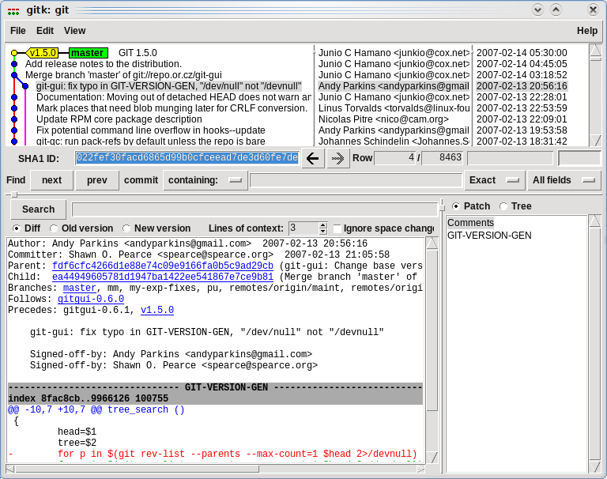

Slide 26
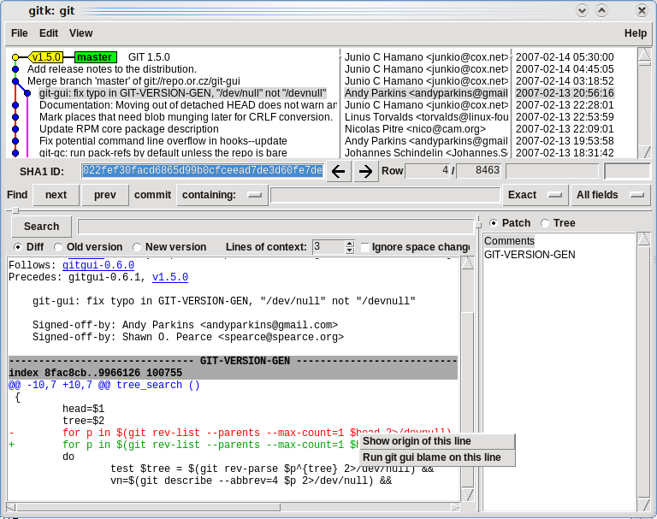

Slide 27
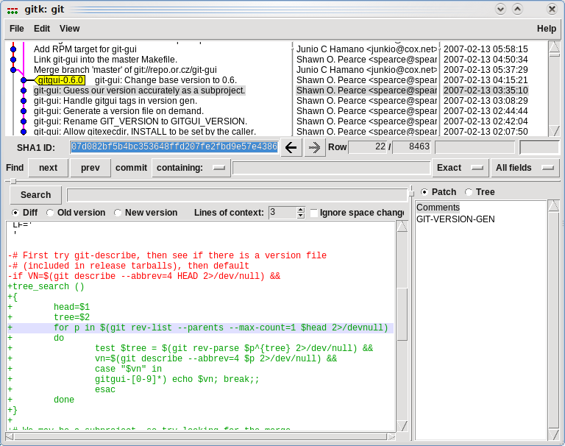

Slide 28
Caveats
So what are the downsides?
  No partial checkouts – it's the whole project or nothing
    But you can use the “submodule” mechanism if you know in advance what pieces will be separately needed
  Will not track
    Permissions and ownership, except the “x” (executable) bit
      In Unix terms, only cares about the first “x” in rwxrwxrwx
    Empty directories
  Not optimised for tracking very large binary files (movies, etc)

Slide 29
IDEs and git
Git has plugins for Eclipse and VS
  Basic features
  Good enough for day-to-day operations (checkin/checkout/diff etc)
  But not git's extra features
    Best to use the 3 GUI tools that come with git
    Using just the plugins can be a little “limiting”
    They only cater to the “common” features found in all VCSs

Slide 30
Mindset changes needed
Learn to make many fine-grained commits rather than a few large ones
Commit locally before performing any remote operations
  Example, in the typical “svn update” scenario, if your changes are not yet ready to be sent to the server, you can either
    Avoid doing the update
    Do it and pray :-)
  In git, you just commit locally before doing the “git pull”

Slide 31
A couple of links...
One good resource comparison is at http://git.or.cz/gitwiki/GitSvnComparsion
  It's not biased :-)
There is also a Git - SVN crash course at http://git-scm.com/course/svn.html

Slide 32
And we're done!
Thank you

Slide 33
Extras...
Git bisect
Git rebase
Git stash

