Slide 1
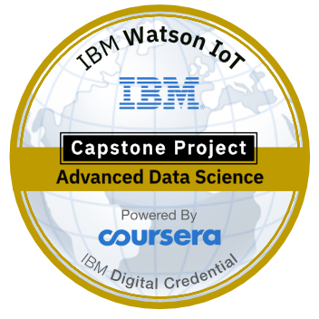
Coursera Capstone Project

Slide 2



Project definition and Business Direction
Methodology
Machine learning
Recommender System
Exploratory analysis

Slide 3
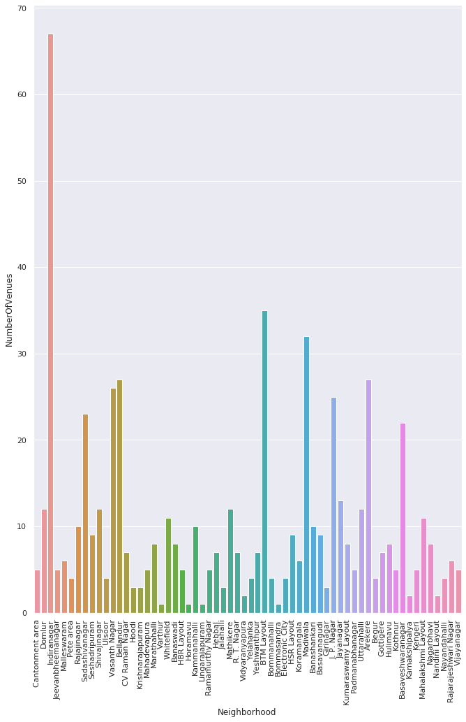
Number of Venues Vs Neighborhood

Slide 4
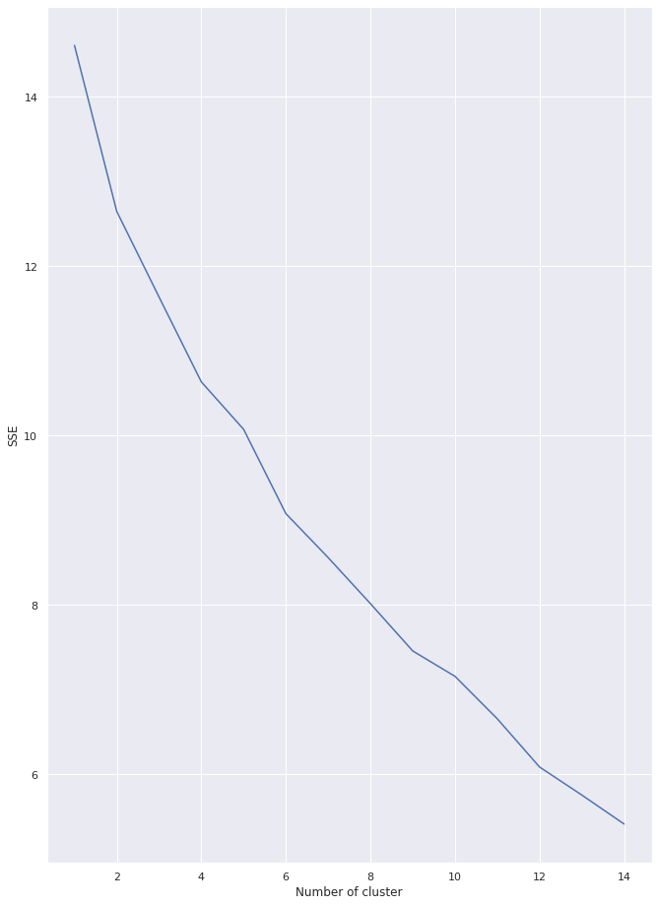
Optimal value for cluster is : 5

Slide 5
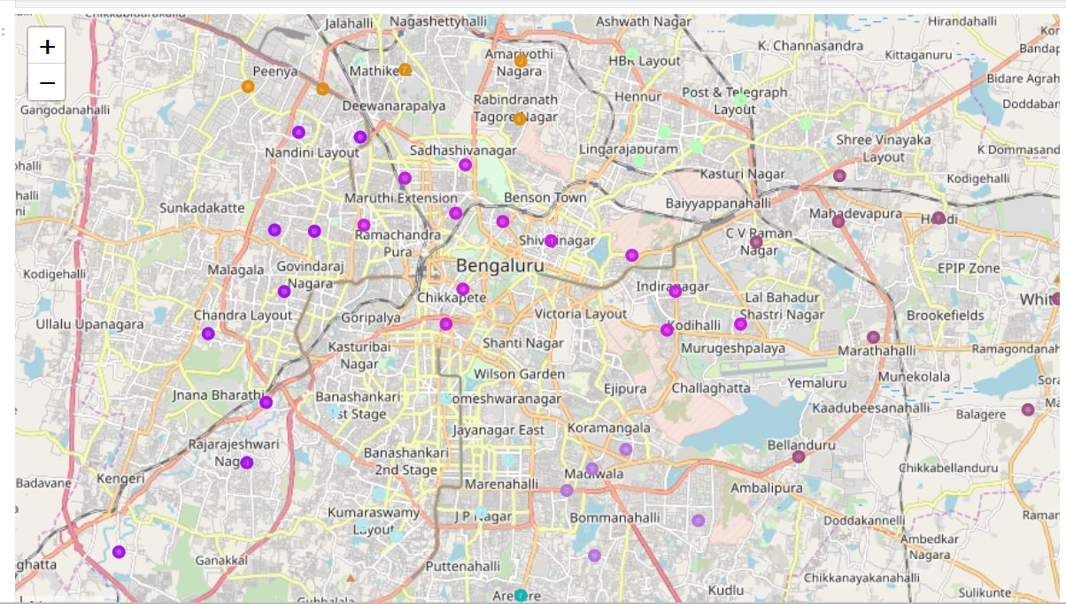
Bengaluru Map

Slide 6
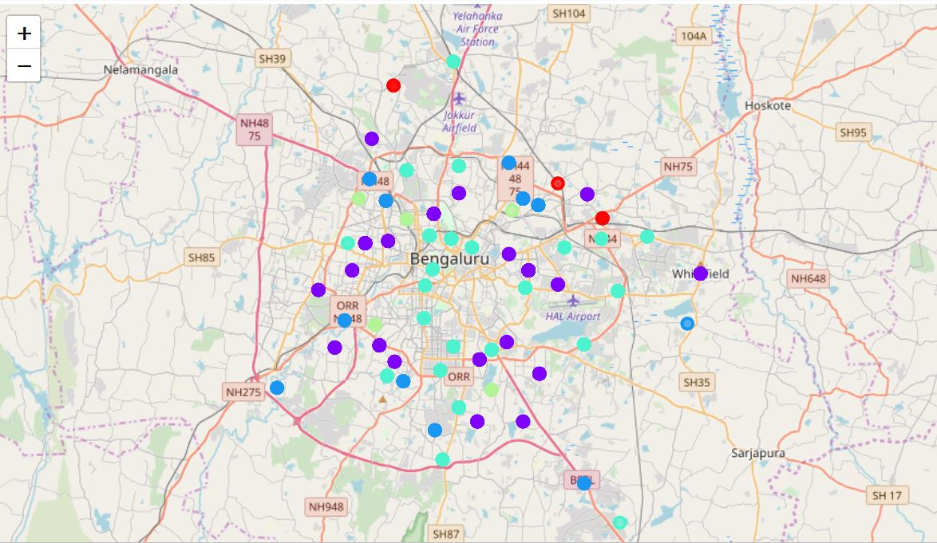
Clustering

Slide 7
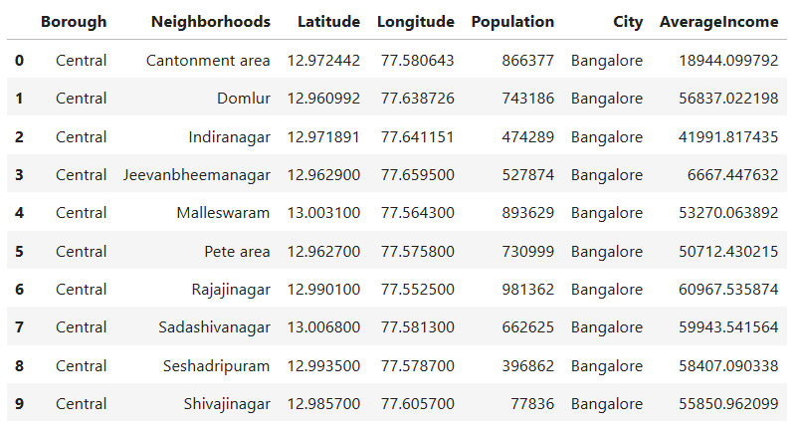
DATASET

Slide 8
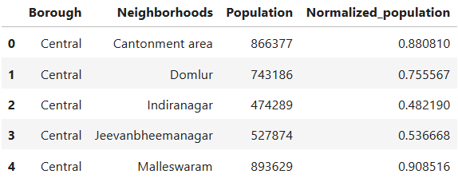
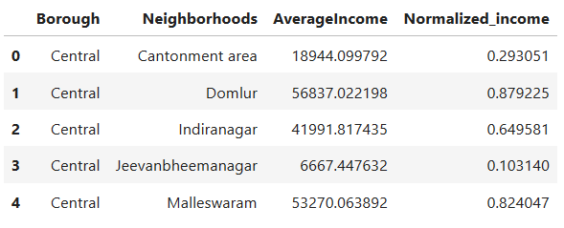
DATASET

Slide 9
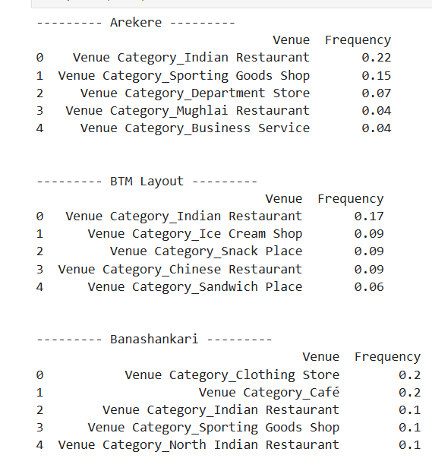
Results

Slide 10
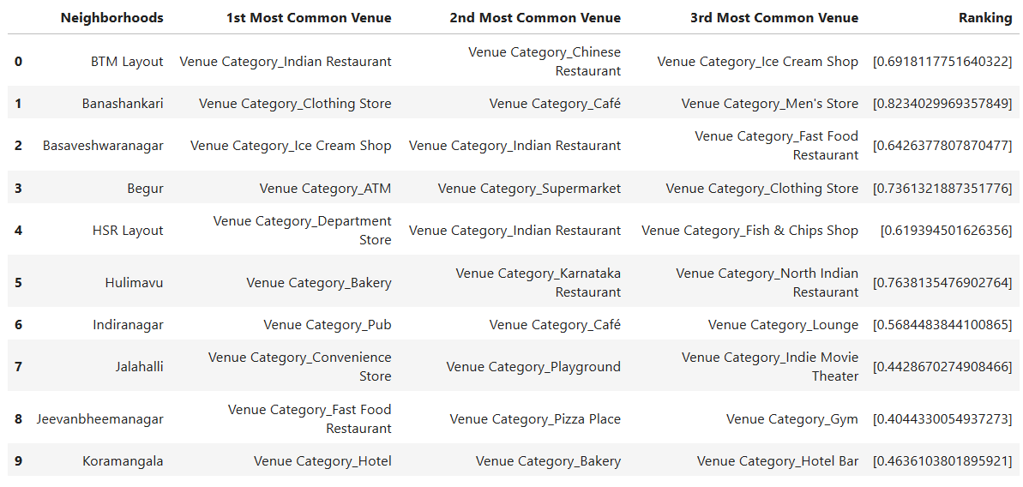
Conclusion for Whitefield

Slide 11
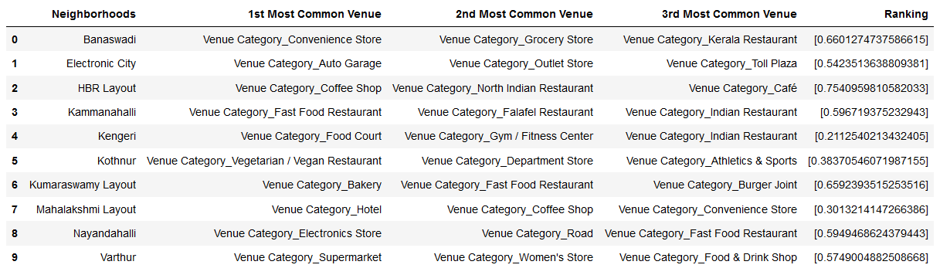
Conclusion for Kammanahalli

Slide 12
Thank You

