Slide 1
Mini SOC for Law Enforcement – November 2025
  – Law Enforcement SOC Project
Notes:
Intro: Thank the audience and briefly say this is my November update for my Law Enforcement-style Security Operations Center project. Mention that you'll walk through the environment, new AI technology, the troubleshooting journey, and how you're balancing everything.

Slide 2
Project Overview: Mini SOC for Law Enforcement
  Simulated Security Operations Center for police-style cyber operations
  Detects, analyzes, and responds to threats against critical infrastructure
  Implements chain-of-custody and courtroom-ready evidence workflows
  Red Team (Parrot OS attacker) vs Blue Team (Ubuntu endpoint) structure
  SIEM dashboards, detection rules, and incident playbooks
  Bridges classroom learning with real-world law enforcement cybersecurity
Notes:
Explain that the goal is to build a realistic mini SOC that could sit inside a police department or public safety agency. Emphasize critical infrastructure, evidence handling, and the Red Team/Blue Team setup. Connect this to your long-term goal of working in law enforcement cybersecurity.

Slide 3
New Technology Integrated
  AI Log-Triage Assistant (OpenAI API or local LLaMA via Ollama)
  Health-check /health endpoint to verify model and API availability
  Automatic Wazuh alert → AI summary workflow
  MITRE ATT&CK tactic/technique mapping via the LLM
  Outputs severity, likely impact, and next recommended SOC actions
“The AI is my smartest assistant coach.
When the other team runs a tricky play,
my coach watches it fast, explains it to me,
tells me how dangerous it was,
and helps me pick the next play so we don’t get scored on.”
That’s your whole system.
That’s how it fits your SOC.
That’s how it fits the real world.
That’s why it’s elite
Notes:
Describe how traditional SIEMs show lots of alerts and how the AI Log-Triage Assistant sits on top, reading Wazuh JSON alerts and summarizing them. Call out that it gives severity, MITRE mapping, and recommended actions, which mirrors a Tier-1 SOC analyst. Note that you can swap between OpenAI API and a local LLaMA model for CJIS-style environments.

Slide 4
MD File: Learning PLAN
  One-page roadmap created on 2025-10-27
  Chosen technology: AI Log-Triage Assistant (OpenAI or local LLM)
  Defines what success looks like and what evidence you will capture
  Commits to keeping the plan updated as the project evolves
Notes:
Say this file proves you didn't just freestyle the month. You picked a technology, wrote down why it matters, how you'll learn it, and what proof you'll collect. This mirrors how real teams do planning before starting an integration.

Slide 5
MD File: Observability & Logging Notes
  Documented observability work for the AI triage integration
  Implemented /health endpoint returning status, uptime, and model version
  Logs AI events such as ai_alert_triage_summary_generated
  Tracks how the model, API, and Wazuh integration behave over time
Notes:
Explain that this markdown file is your running journal for observability. Mention the /health endpoint JSON output and how logging AI events gives traceability — useful if an alert ever needs to be explained in a report or courtroom context. This shows you think like an engineer and an analyst.

Slide 6
MD File: AI Triage Tutorial
  Self-authored tutorial documenting how to build the AI triage assistant
  Covers what the feature teaches and the real-world SOC use case
  Explains how alerts move from Wazuh JSON into AI-generated summaries
  Written so another student or teammate could repeat your work
Notes:
Highlight that this isn't copied documentation — it's your own tutorial. Emphasize that you wrote it with another student in mind, to make your work repeatable. That's a core skill in both SOC and engineering.

Slide 7
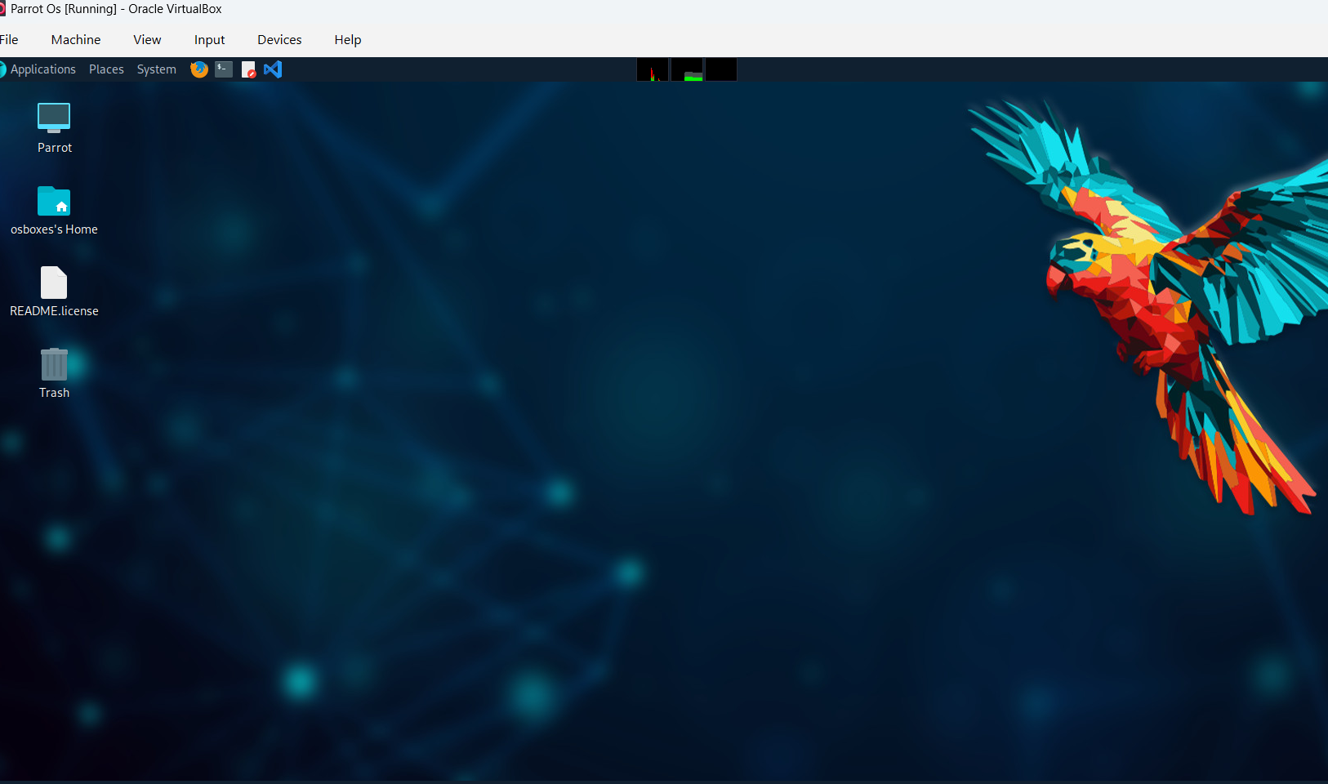
Parrot OS – Red Team Attacker Machine
  Attacker VM used for recon, scanning, and exploitation attempts
  Generates realistic adversarial traffic against the lab
  Helps validate detection rules, alerts, and firewall behavior
Notes:
Describe Parrot OS as your offensive box. Mention typical actions: nmap scans, brute-force attempts, malware simulations. Emphasize this is how you bring the 'threat' into your environment so Wazuh and pfSense have something real to detect.

Slide 8
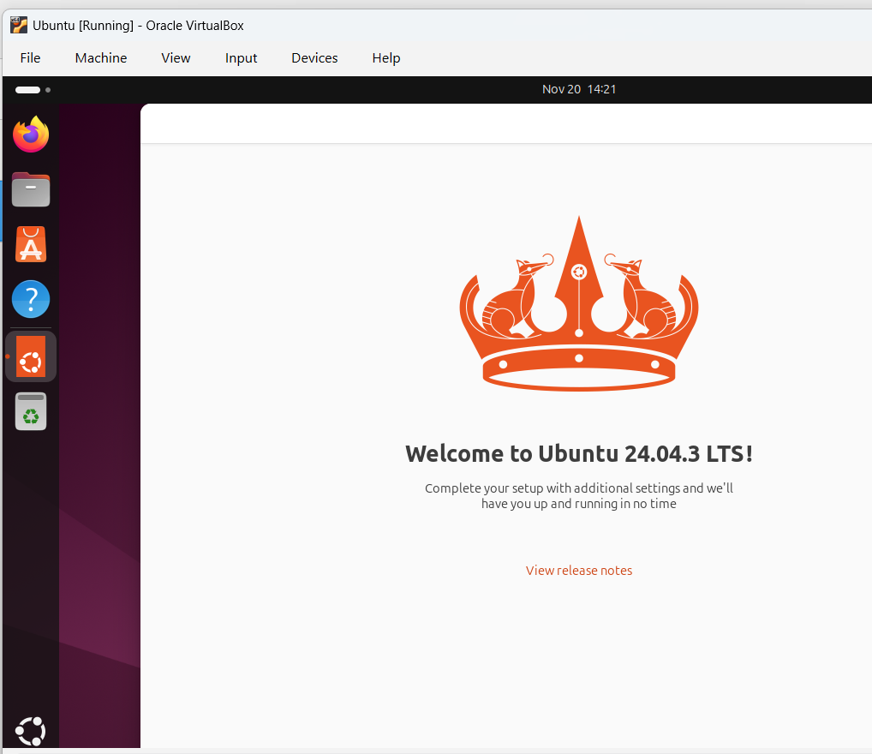
Ubuntu VM – Blue Team Monitored Endpoint
  Primary workstation monitored with a Wazuh agent
  Simulates a user machine in a police or government network
  Central to your troubleshooting: connectivity, agent errors, and duplicate names
Notes:
Explain that this box is the one you're defending. It's where the Wazuh agent runs, sending logs to the manager. Mention that many of your problems came from getting this system properly enrolled and communicating.

Slide 9
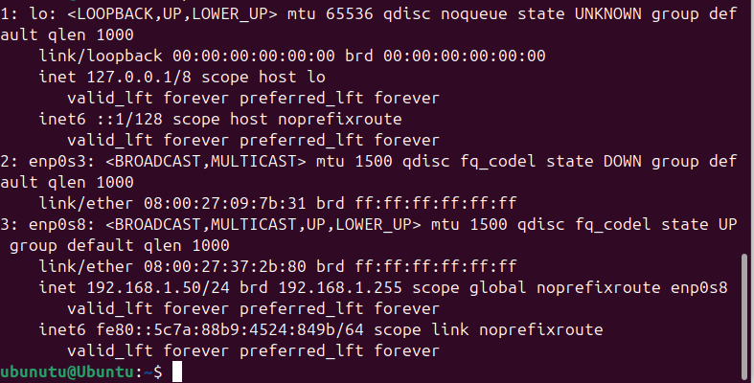
Ubuntu Network Interfaces – enp0s3 & enp0s8
  Checked interface status and IPs while debugging connectivity
  enp0s3 down, enp0s8 up with 192.168.1.50/24 on the lab LAN
  Confirmed that the VM was in the correct pfSense-managed subnet
Notes:
Explain that this screenshot shows the `ip a` output.
- lo is the loopback.
- enp0s3 is down, meaning that adapter isn't passing traffic.
- enp0s8 is UP with IP 192.168.1.50/24 and broadcast 192.168.1.255.
This confirmed the Ubuntu VM was on the 192.168.1.x LAN behind pfSense. You used this to validate networking before blaming Wazuh.

Slide 10
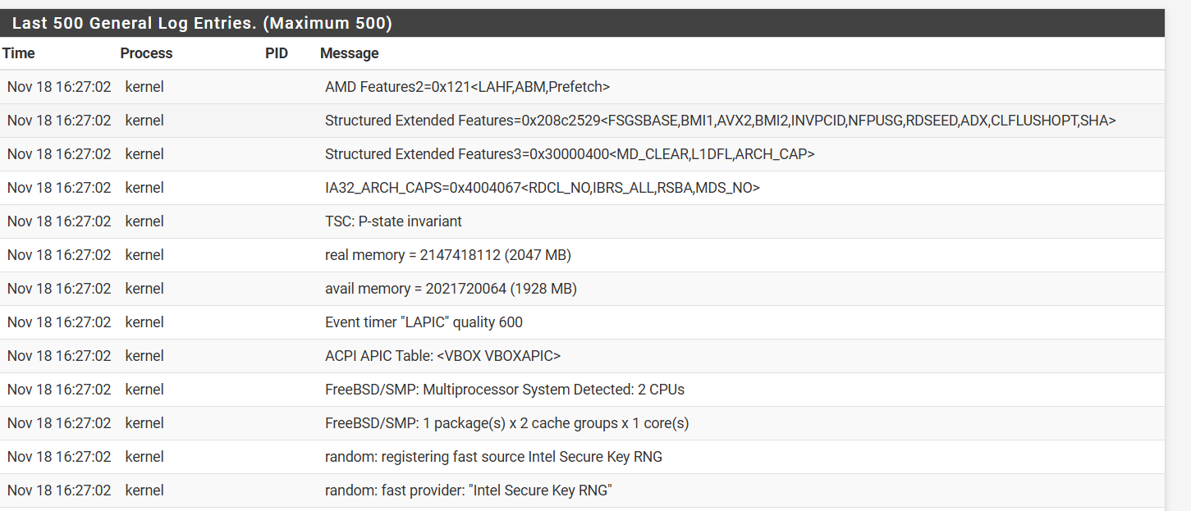
pfSense Firewall – System & Kernel Logs
  PfSense boot sequence and hardware detection logs
  Confirms FreeBSD SMP, CPU count, and kernel modules loaded
  Shows firewall OS is healthy and ready to forward logs
Notes:
Walk through what these logs tell you: the kernel is detecting CPUs, memory, timer LAPIC quality, and initializing the Intel Secure Key RNG. In a SOC mindset, this screenshot is evidence that your firewall platform is stable and ready to generate and forward logs.

Slide 11
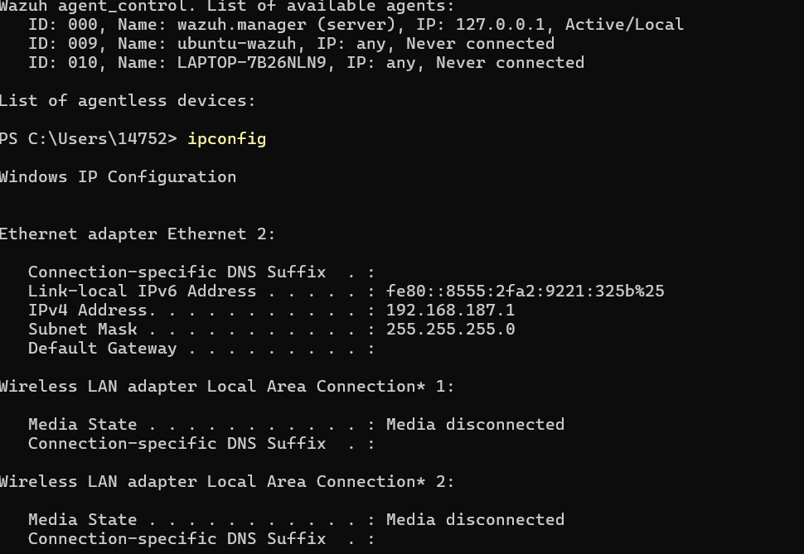
Windows Host – Wazuh Agents & Network Info
  Used wazuh-agent-control to list registered agents on the manager
  Saw wazuh.manager, ubuntu-wazuh, and Windows laptop agents listed
  Ran ipconfig to confirm Windows IPv4 address: 192.168.187.1
Notes:
Explain the top of the screenshot: `agent_control` listing agents with IDs 000 (manager), 009 (ubuntu-wazuh), 010 (laptop). This proves the manager knows about multiple agents. The `ipconfig` output shows the Windows Ethernet adapter IPv4 address 192.168.187.1, which you later used as the manager IP when enrolling the Ubuntu agent.

Slide 12
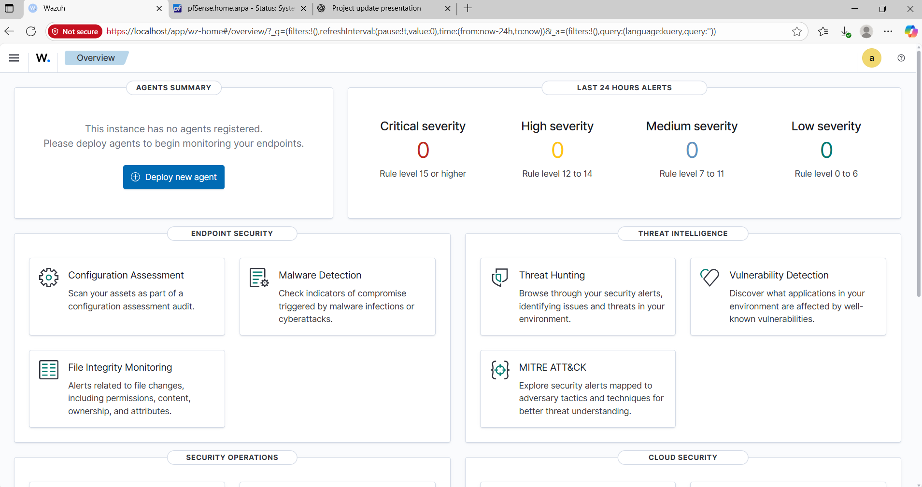
Wazuh Dashboard – Initial Empty State
  Dashboard showed no active agents registered
  No critical, high, medium, or low alerts yet
  Signaled that agent enrollment and log flow were not working
Notes:
Point out that this is what the environment looked like at first: zero agents, zero alerts. Explain that this pushed you to investigate agent enrollment, networking, and service status.

Slide 13
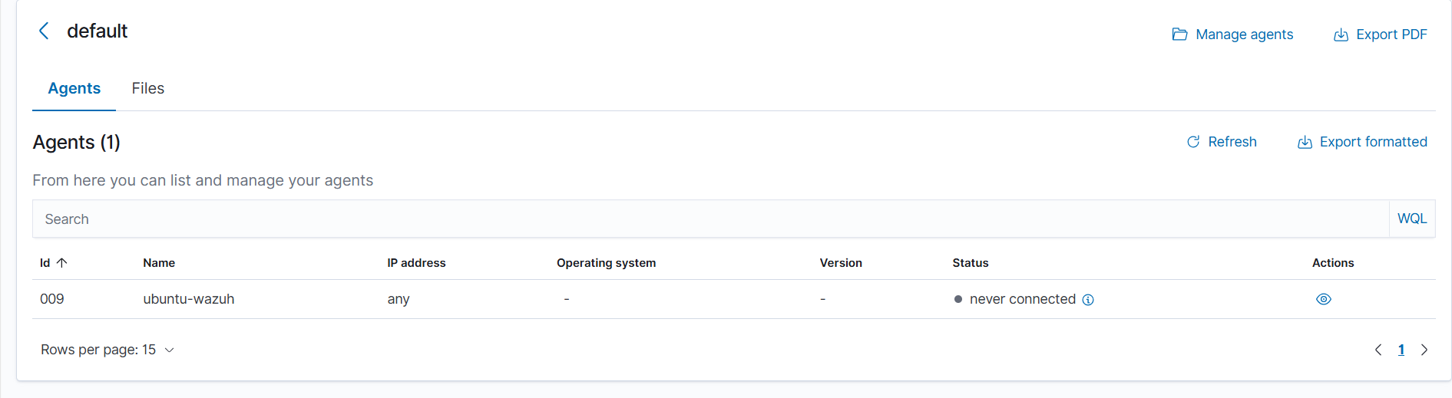
Wazuh Agent Table – 'ubuntu-wazuh' Never Connected
  ubuntu-wazuh agent created on the manager
  Status remained 'never connected' despite install attempts
  Indicated an issue between the agent and manager (network or keys)
Notes:
Explain that this table shows agent ID 009 with name ubuntu-wazuh and status 'never connected'. You learned that just creating an agent on the manager isn't enough — the key exchange and connection from the endpoint must succeed.

Slide 14
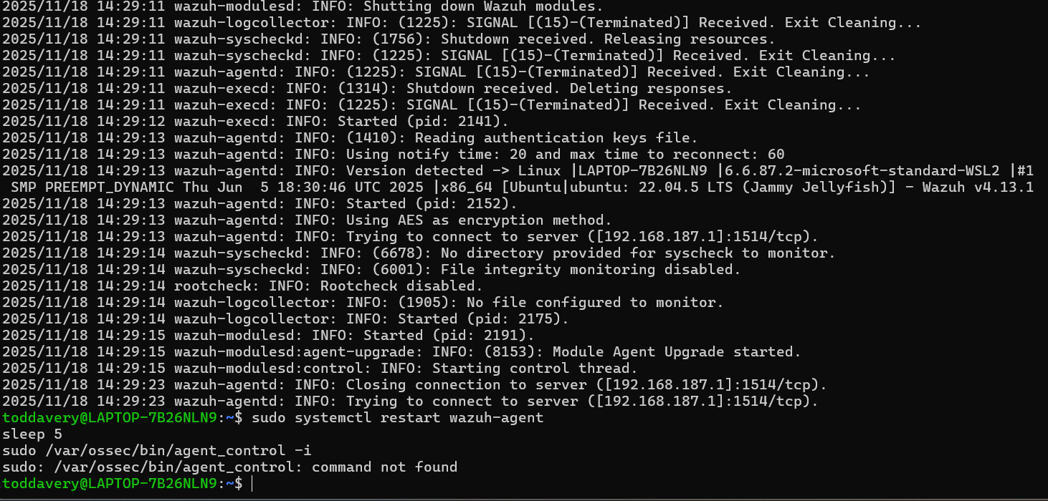
Wazuh Agent Logs – agent_control Not Found
  Restarted wazuh-agent service using systemctl
  Logs showed agent trying to connect to 192.168.187.1:1514/tcp
  Running /var/ossec/bin/agent_control failed: command not found
Notes:
Break down the commands at the bottom:
- `sudo systemctl restart wazuh-agent` : restarts the agent service.
- `sleep 5` : waits 5 seconds to let it come up.
- `/var/ossec/bin/agent_control -i` : attempts to query agent info locally.
The error 'command not found' hinted that either the binary path was wrong or the agent package wasn't installed as expected. The logs above show repeated attempts to connect to 192.168.187.1:1514/tcp, confirming networking was in play.

Slide 15
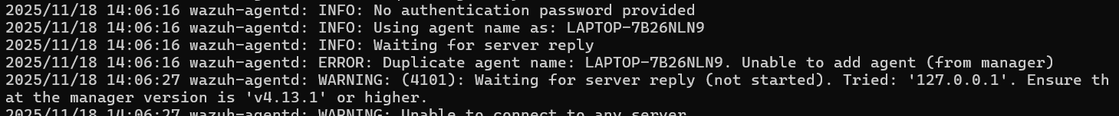
Wazuh Logs – Duplicate Agent Name Error
  Agent started using hostname LAPTOP-7B26NLN9
  Manager reported 'Duplicate agent name' and refused enrollment
  Blocked the agent from being added until old registration was removed
Notes:
Read through the key lines:
- 'No authentication password provided' – you tried enrolling without a new key.
- 'Using agent name as: LAPTOP-7B26NLN9' – host kept its default name.
- 'ERROR: Duplicate agent name' – manager already had an entry for that hostname.
This taught you that Wazuh enforces unique agent names to avoid confusion and that you must clear old entries and keys before re-enrolling.

Slide 16
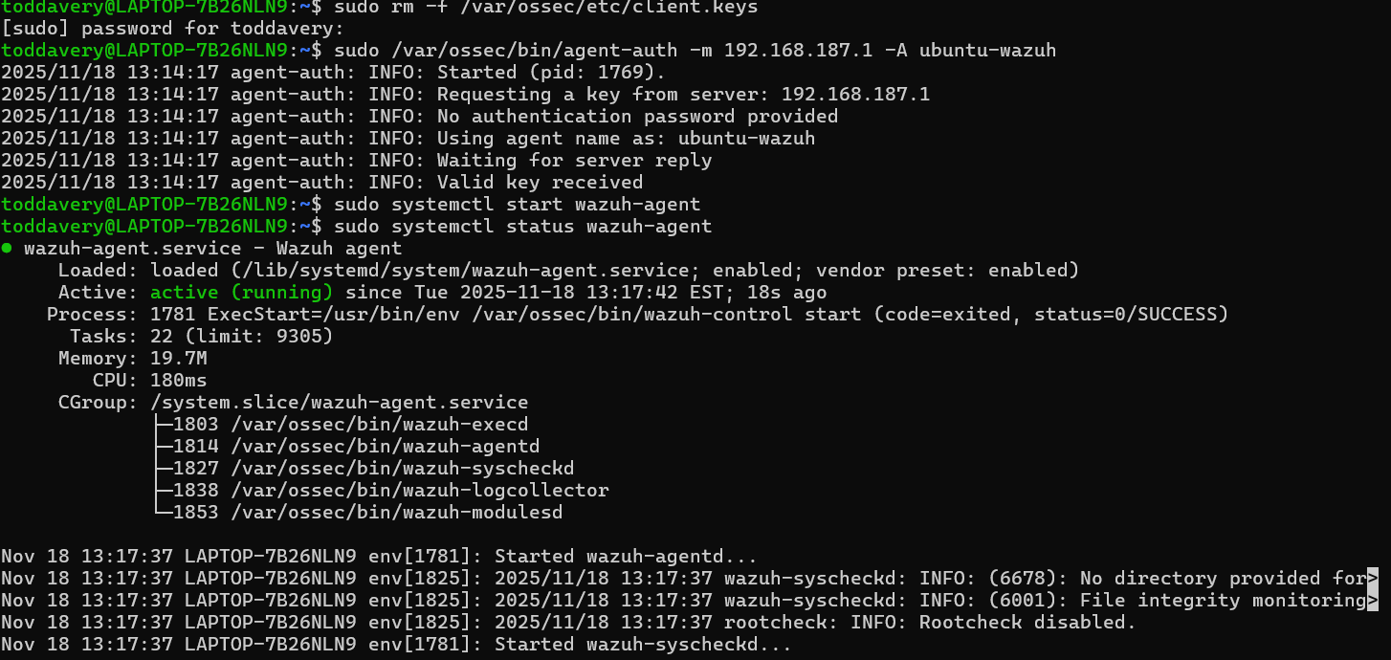
Agent Authentication Success – New Key Received
  Removed old client.keys to clear previous registrations
  Ran agent-auth against manager at 192.168.187.1 with name ubuntu-wazuh
  systemctl status showed wazuh-agent service active and running modules
Notes:
Break down the commands visible:
- `sudo rm -f /var/ossec/etc/client.keys` : forcefully deletes old key file so the agent can request a fresh one.
- `sudo /var/ossec/bin/agent-auth -m 192.168.187.1 -A ubuntu-wazuh` : contacts the manager at 192.168.187.1, registers under the name ubuntu-wazuh, and waits for a valid key.
- `sudo systemctl start wazuh-agent` and then `sudo systemctl status wazuh-agent` : starts the service and confirms it's running, showing execd, agentd, syscheckd, logcollector, and modulesd processes. You can say: 'This screenshot is the moment the agent finally joined the SOC for real.'

Slide 17
Troubleshooting Timeline – November 2025
  Nov 1–5: WSL and VM networking issues ('disconnected' states)
  Nov 6–9: pfSense LAN IP/mask misconfiguration
  Nov 10–14: Wazuh agent install problems and missing binaries
  Nov 15–17: Duplicate agent name and key errors
  Nov 18–19: Re-enrollment, new keys, and final connectivity
  Nov 20: Stable SOC pipeline from endpoint → Wazuh → dashboards
Notes:
Walk the class through this like a story: each week had a different main problem, and each fix brought you closer to a stable SOC. Emphasize persistence and learning from logs instead of guessing.

Slide 18
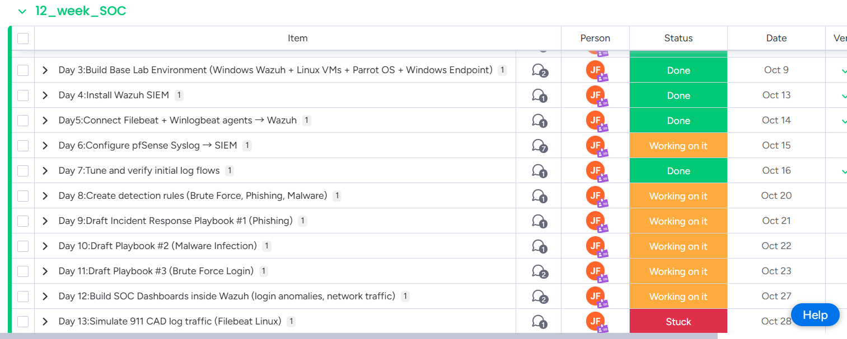
Monday.com Board – Early Progress
  Days 3–12 show strong progress: lab build, Wazuh install, and early dashboards
  Many items marked 'Done' or 'Working on it'
  Demonstrates a solid start before the heavier troubleshooting phase
Notes:
Explain that this part of the board shows the foundation: building the lab, installing Wazuh, creating early rules. This is proof that you laid the groundwork before things got messy.

Slide 19
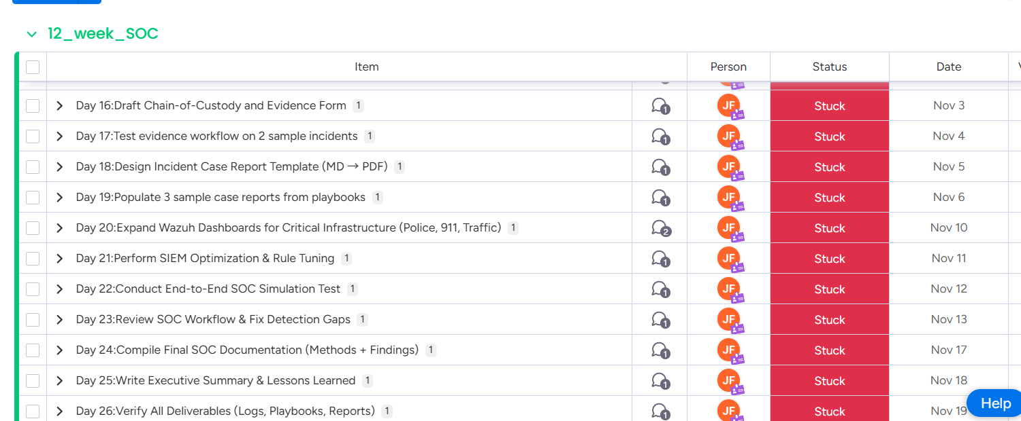
Monday.com Board – Stuck During Troubleshooting
  Days 16–26 appear 'Stuck' on the board
  In reality, time was spent deep in troubleshooting agent and network issues
  Plan is to retrospectively update these tasks with what actually got done
Notes:
Be honest: say the board doesn't fully reflect your effort because most of your energy went into solving technical issues instead of updating statuses. Emphasize that you now understand the importance of keeping project tracking in sync with real work.

Slide 20
Catch-Up Plan After November 20
  Update Monday.com Days 11–27 with accurate progress and notes
  Finalize Wazuh agents for Ubuntu and Parrot OS
  Run Red Team attack simulations and confirm Blue Team detections
  Complete SOC dashboards and documentation for playbooks and reports
  Prepare polished end-to-end demo for December presentation
Notes:
Talk through this as your roadmap going forward. Show that you aren't just reacting; you have a concrete plan to close gaps and deliver a complete SOC demonstration.

Slide 21
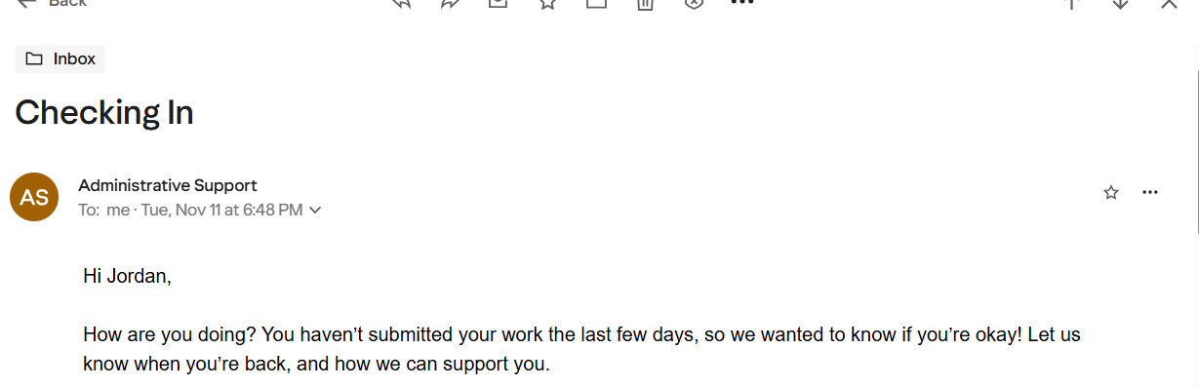
Balancing School, Work, and Life
  Faced medical and personal challenges during the month
  Communicated proactively with administrative staff about absences
  Learned to balance family, mental health, and technical work
  Staying transparent helped you stay supported and on track
Notes:
Use this slide to humanize the journey. Mention that despite challenges, you emailed staff, responded to check-ins, and kept them updated. Emphasize that in law enforcement and SOC work, communication and honesty are as important as technical skills.

Slide 22
Key Lessons from This Month
  Troubleshooting is the real teacher in cybersecurity and SOC work
  Logs and error messages are your best friends, not your enemies
  Planning and documentation (.md files, tutorials) matter as much as configs
  Balancing life, school, and long-term career goals requires communication
  Every error you fixed moves you closer to being a real SOC analyst in law enforcement
Notes:
Close by summarizing your growth: technical skills, persistence, planning, and balance. Tie it back to your goal of serving in law enforcement cyber or digital forensics. Thank the audience and invite questions.

