Slide 1
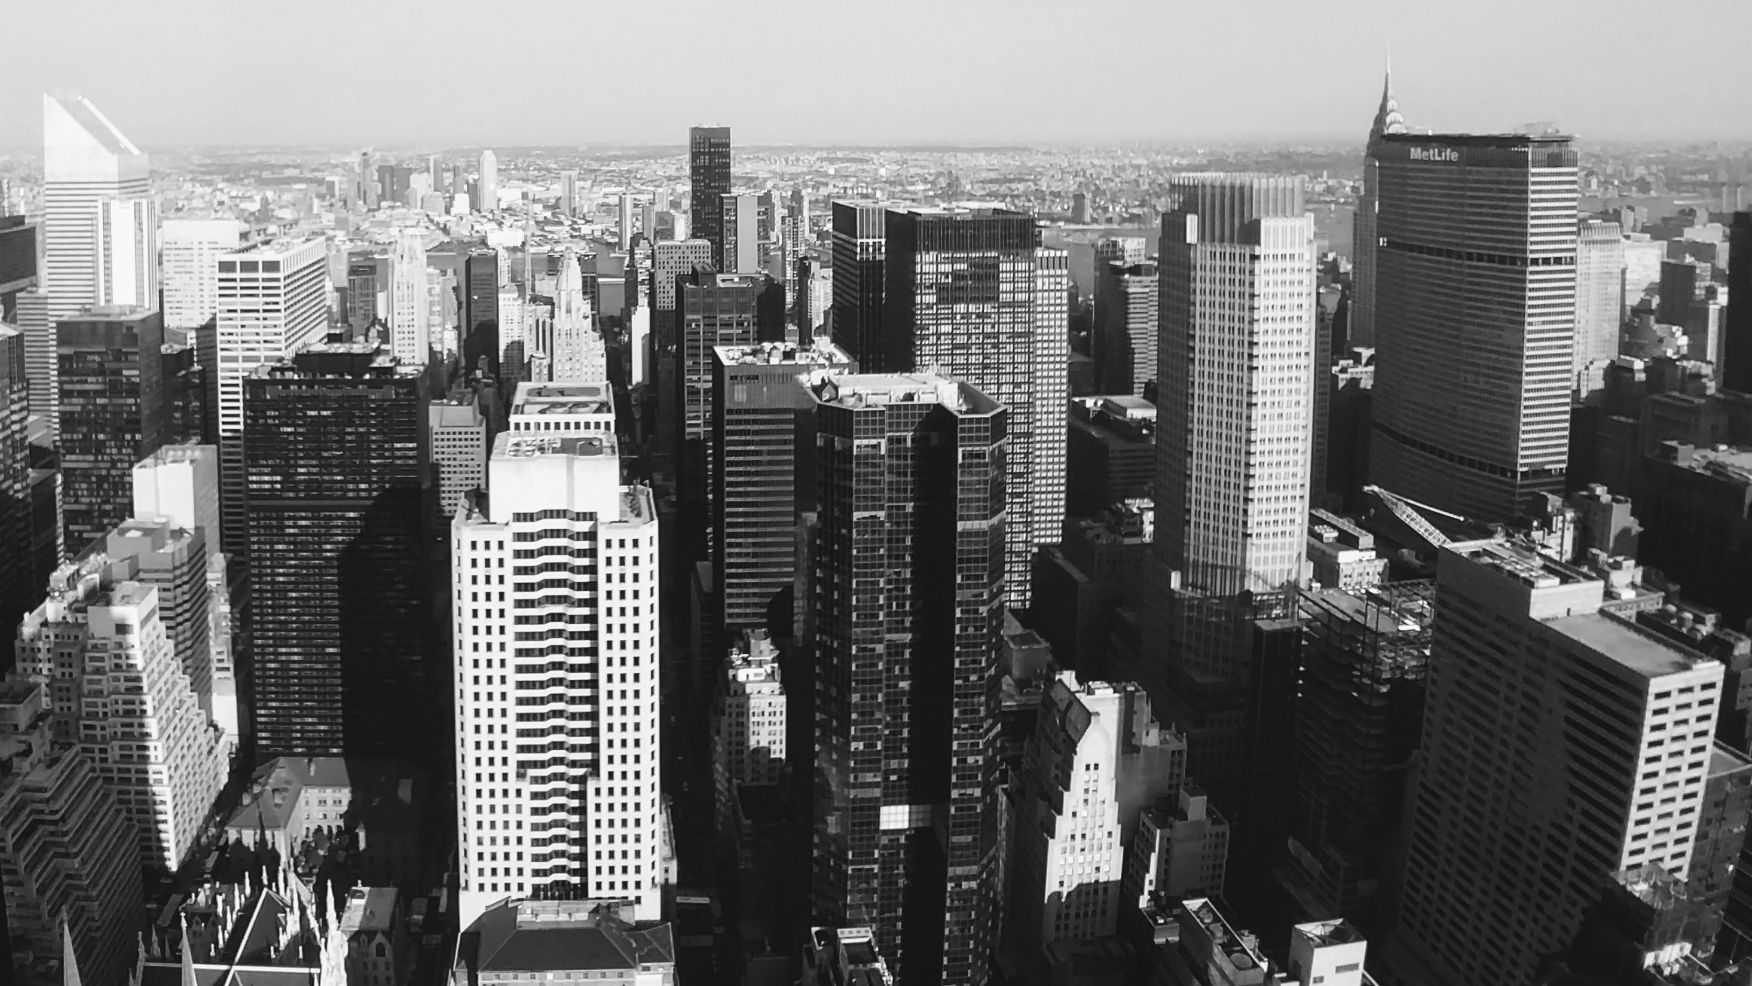
Slide 1
UB Philanthrophy

Slide 2
Problem Statement
Donor Retention:
Among first time donors, who is likely to give again?
Donor Acquisition:
What behaviors lead to a prospect becoming a first time donor?
Donor upgrade:
Likely amount of next gift.

Slide 3
Data Understanding
Data Fields (draft):
Giving Data
Lifetime cumulative giving
Total Gift Count
Largest outright gift
Largest commitment
Most recent gift amount
Date of most recent gift amount
Most recent pledge amount
Date of most recent pledge amount
First gift amount
First gift date
Giving by Fiscal Year (last 10 (or 5 years))
Channel - mail, phone, online, etc. (last 10 (or 5 years))
Constituent type
Alumni, friend, parent, attended, faculty/staff
Demographics
CBSA or Zip
State
Age - "bins"
Marital status
Academics
Degree schools and graduation years
Undergraduate/graduate degree holder (y/n)
Raw data (M.S., M.L.S, etc.)
Employment
Industry
Retired (y/n)
Employed (y/n)
Student activities
Participated (y/n)
Student Athlete (y/n)
Participation
Non-giving involvement
Non-donors: Have not given in 5 years
Lapsed: At least one year lapsed – did not give in 2017, but gave in either ’16, ’15, ’14, ’13…
Loyal donor: Gave in ’17 and any of the last 4 years
First-time donors: first time giving in 2017

Slide 4
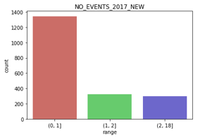
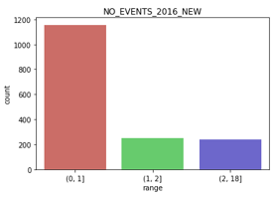
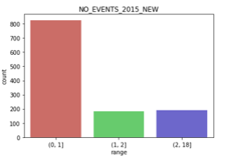
Histogram: No of events attended

Slide 5
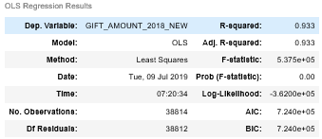
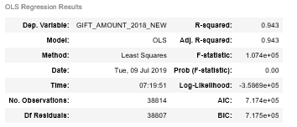
Regression Analysis
GIFT_AMOUNT_2017_NEW
GIFT_AMOUNT_2017, GIFT_AMOUNT_2016, GIFT_AMOUNT_2015,
NO_EVENTS_2017, NO_EVENTS_2016, NO_EVENTS_2015

Slide 6
Decision Tree
Root ZIPCODE
All other ZIPCODEs
ZIPCODE [10577,48104,85375,98102]
GIFT_AMOUNT_2017_NEW< 7200
Zipcode [10580,14032,14092,14120,14127,14203,14216,14221,14222,14226,14231,19437,21401]
ZIPCODE=11023,11557,13903,14031,34112
Other 31043 recs
GIFT_AMOUNT_2017_NEW>=7200

Slide 7
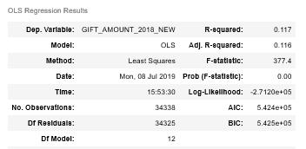
Regression Analysis
GIFT_AMOUNT_2017, GIFT_AMOUNT_2016, GIFT_AMOUNT_2015,
NO_EVENTS_2017, NO_EVENTS_2016, NO_EVENTS_2015

Slide 8
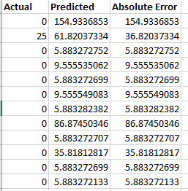
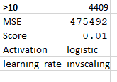
Neural Network

Slide 9
Future Roadmap
Predict the giving amount using different models
Reduce the number of records with large absolute error
Find the other attributes on which the likelihood of giving depends on

Slide 10
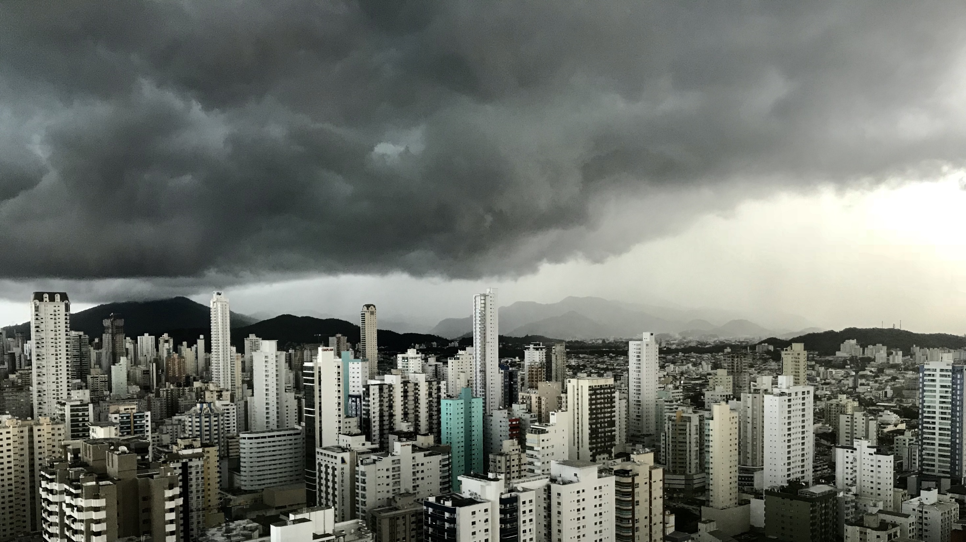
Slide 11
THANK YOU

