Slide 1


DEPARTMENT OF ARTIFICIAL INTELLIGENCE
20AM6203 - DESIGN PROJECT - II
Batch - 10
Presented by :
Guided by :
Derel Jasper M - 811722001008
Kamalnath S - 811722001020
Ragul S - 811722001041
Sitharth R - 811722001047
Mr. T. Praveen Kumar, M.E.,
Assistant Professor / AI

Slide 2
PROJECT TOPIC
“AI Based Product Promoter”

Slide 3
OBJECTIVE
To empower product owners to effortlessly promote their products locally and globally using a Gen AI-powered platform that generates product descriptions, enhanced images, and social media content from uploaded images

Slide 4
EXISTING SYSTEM
In traditional product promotion systems, users manually input product details such as name, description, hashtags, and captions. These systems often rely on text-based entries or barcode scanning to fetch product information.
DISADVANTAGE:
There is limited or no use of AI to process visual data (images). As a result, the promotional content is often generic, lacks personalization, and depends heavily on human input and creativity

Slide 5
PROPOSED SYSTEM
The proposed system allows users to upload an image of a product. The system then automatically identifies and recognizes the product, generates a detailed description, creates relevant promotional hashtags and captions, and enhances the image quality.
ADVANTAGE:
It integrates computer vision, natural language processing (NLP), and image enhancement techniques to streamline and automate product promotion

Slide 6
LITERATURE SURVEY
SNO | TITLE | YEAR | AUTHOR | TECNIQUES AND TOOLS USED | MERITS | DEMERITS
1 | A Multimodal In-Context Tuning Approach for E-Commerce Product Description Generation | 2024 | Yunxin Li, Baotian Hu, Wenhan Luo, Lin Ma, Yuxin Ding, Min Zhang | ModICT, In-context Learning, Large Language Models (LLMs) | Better description accuracy Handles multiple product categories | Needs reference product samples High computational cost
2 | Catalog Phrase Grounding (CPG): Grounding of Product Textual Attributes in Product Images for E-commerce Vision-Language Applications | 2024 | Wenyi Wu, Karim Bouyarmane, Ismail Tutar | Multimodal Transformer, MDETR, Self-Supervised Learning | Precise attribute localization Boosts attribute-based search | Requires annotated datasets May struggle with poor image quality

Slide 7
3 | Cross-Domain Product Representation Learning for Rich-Content E-Commerce | 2023 | Xuehan Bai, Yan Li, Yanhua Cheng, Wenjie Yang, Quan Chen, Han Li | COPE Framework, Multimodal Learning, ROPE Dataset | Multi-source compatibility Improves product recommendation | Difficult data synchronization Requires extensive cross-media data
4 | Optimizing and Assessing the Quality of E-Commerce Product Images Using Deep Learning Techniques | 2023 | Ruixue Zhang | CNNs, Laplacian Filter, Wavelet Transform | Clearer product visuals Better buyer engagement | Slow for large-scale datasets May depend on image input type
5 | Improving Multimodal Classification of Social Media Posts by Leveraging Image-Text Auxiliary Tasks | 2023 | Danae Sánchez Villegas, Daniel Preoţiuc-Pietro, Nikolaos Aletras | ITC/ITM Losses, Multimodal BERT, Fine-Tuning | Stronger text-image alignment Boosts classification accuracy | Not ideal for non-social media tasks Sensitive to task design

Slide 8
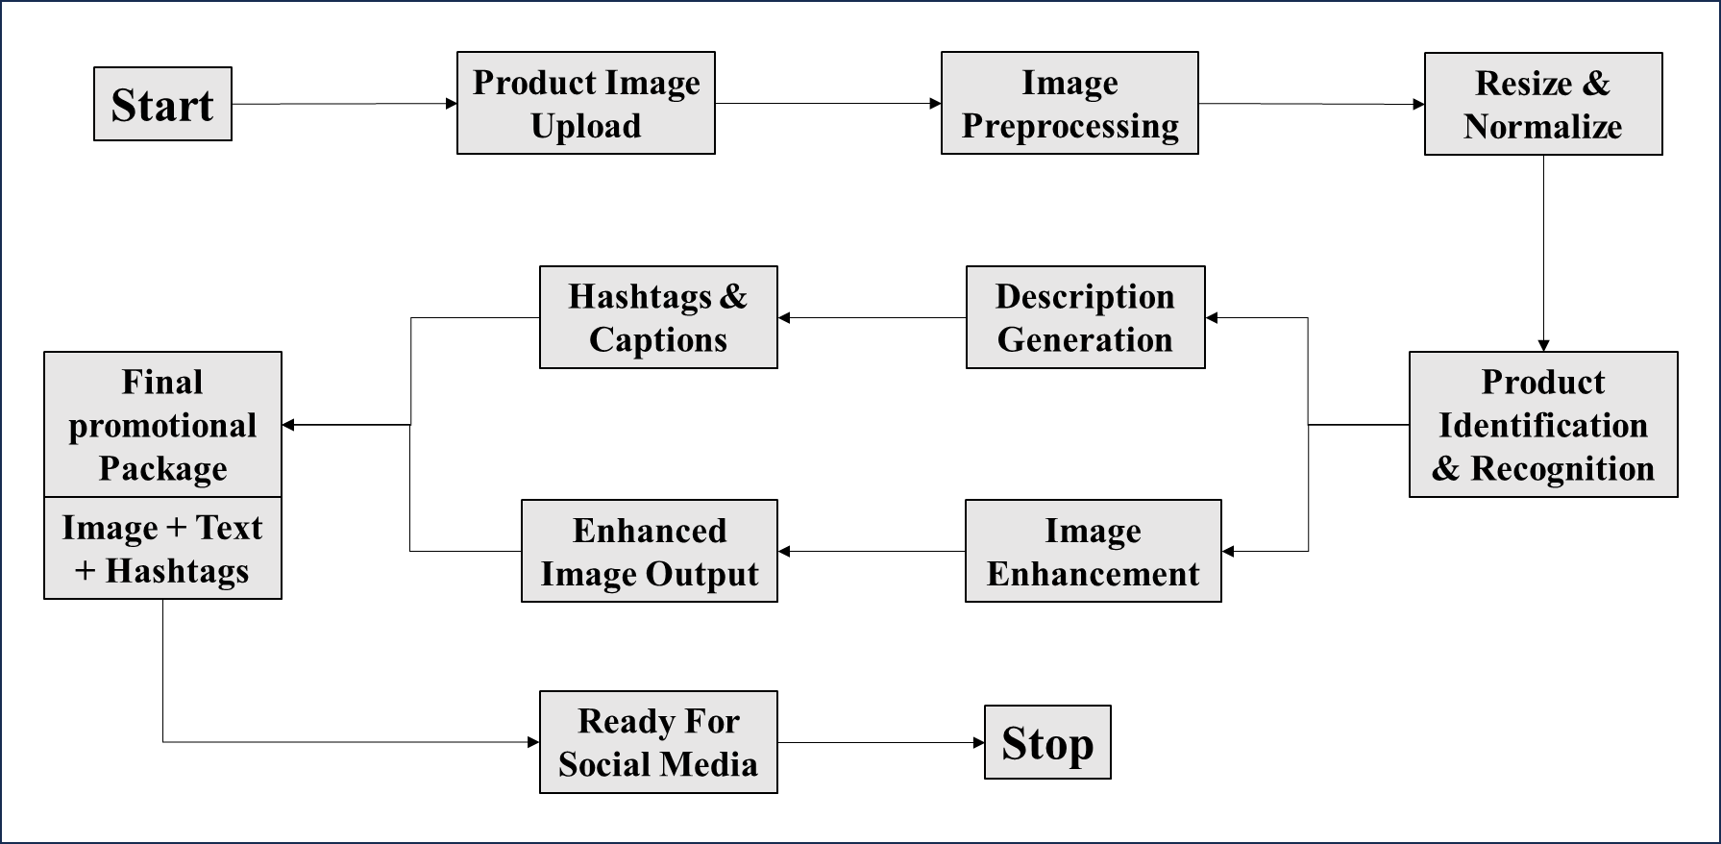
FLOW DIAGRAM

Slide 9
SYSTEM AND SOFTWARE SPECIFICATIONS
HARDWARE SPECIFICATIONS
Processor : Intel Core i5 or Higher
RAM : 16 GB or Higher
OS : Windows 11
Storage : 500 GB SSD
Network Interface : Wi-Fi
SOFTWARE SPECIFICATIONS
Web Framework : Flask
Frontend : HTML, CSS, JavaScript
Backend : Python

Slide 10
MODULES
Product Identification and Recognition Module
Product Description Generation Module
Hashtags and Captions Creation Module
Image Enhancement Module

Slide 11
PRODUCT IDENTIFICATION & RECOGNITION MODULE
PURPOSE:
The primary purpose of this module is to analyze the uploaded image and accurately identify the product present in it by recognizing visual features such as shape, brand logo, texture, and packaging.
Once the product is recognized, this module provides essential information that serves as the foundation for generating meaningful content in subsequent modules.

Slide 12
ALGORITHMS USED:
YOLOv8 (You Only Look Once version 8)
A real-time object detection model that identifies and localizes the product in the image with high accuracy and speed. Post detection, classification is assisted by ResNet-50, a robust image classification CNN.
High performance with real-time detection speed.
Supports both object detection and image segmentation.
Easily integrates with downstream pipelines for classification.

Slide 13
FUNCTIONS:
Accepts image input from the user.
Preprocesses the image
Extracts features from the image using deep learning
Matches these features against a trained dataset to identify the product
Outputs the product name, category, and confidence score

Slide 14
PRODUCT DESCRIPTION GENERATION MODULE
PURPOSE:
To automatically generate a detailed, human-like description of the identified product based on its visual features and metadata.
To contextualize the product with use-case scenarios, material details, or aesthetic features that appeal to consumers and can be used for product listings.

Slide 15
ALGORITHMS USED:
BLIP-2 (Bootstrapped Language-Image Pretraining)
A powerful vision-language model that generates rich textual descriptions by interpreting product visuals, making it ideal for zero-shot captioning and descriptive writing.
Efficient zero-shot captioning.
Understands fine-grained details in product images.
Excels at cross-modal reasoning (combining vision and text).

Slide 16
FUNCTIONS:
Accepts the identified product label or features as input
Generates a detailed product description covering aspects like brand, use case, specifications, and benefits
Uses NLP techniques to ensure grammar correctness and promotional tone
Optimizes content for SEO and user readability

Slide 17
HASHTAGS AND CAPTIONS CREATION MODULE
PURPOSE:
To analyze the product’s context, features, and appeal to generate trending and relevant hashtags for social media marketing.
To generate catchy, engaging promotional captions that align with the brand voice and audience sentiment.

Slide 18
ALGORITHMS USED:
GTOQ’s LLaMA 3 (Meta’s Large Language Model - GTOQ’s Version)
Used in the Hashtag and Caption Recommendation Module for generating persuasive, trendy, and relevant social media captions and hashtags based on product features.
Produces emotionally engaging and context-aware captions.
Efficient on GPUs/CPUs for low-latency deployment.
Customizable for brand-specific voice and tone.

Slide 19
FUNCTIONS:
Extracts keywords and topics from product description and features.
Generates 3–5 concise captions highlighting key selling points.
Suggests 8–15 relevant and trending hashtags based on product type and audience.
Avoids duplication or irrelevant tags using a filter logic

Slide 20
IMAGE ENHANCEMENT MODULE
PURPOSE:
To improve the visual quality of the product image using enhancement techniques like super-resolution, background removal, or color correction.
To prepare the product image for various promotional channels by ensuring clarity, aesthetic appeal, and format consistency.

Slide 21
ALGORITHMS USED:
Real-ESRGAN (Enhanced Super-Resolution Generative Adversarial Network)
A GAN-based model that upscales low-quality images while preserving texture details, making the product image visually appealing and suitable for professional use.
Handles real-world images better than classical SR methods.
Maintains natural texture and sharpness.
Works well on product images from low-quality uploads or screenshots.

Slide 22
FUNCTIONS:
Processes the user-uploaded image to detect quality issues
Applies filters and deep learning techniques to improve brightness, contrast, and sharpness
Enhances resolution and removes blurriness or noise
Outputs a refined image suitable for marketing or social sharing

Slide 23
ADVANTAGES
User-Friendly Interface
Automated Product Recognition
Time-Efficient
Enhanced Marketing Impact
Image Quality Improvement
Cost-Effective
Customizable Output
Scalability

Slide 24
APPLICATIONS
E-Commerce Platforms
Social Media Marketing
Digital Advertising Agencies
Retail and Inventory Management
Content Creation Tools
Branding and Product Catalogs
Mobile Commerce Applications

Slide 25
CONCLUSION
This project presents an innovative and efficient solution for automating product promotion using image-based input. By integrating product recognition, description generation, hashtag and caption creation, and image enhancement, the system streamlines the marketing process. It not only reduces manual effort but also ensures consistency, accuracy, and improved visual appeal, making it highly valuable for e-commerce, digital marketing, and branding applications

Slide 26
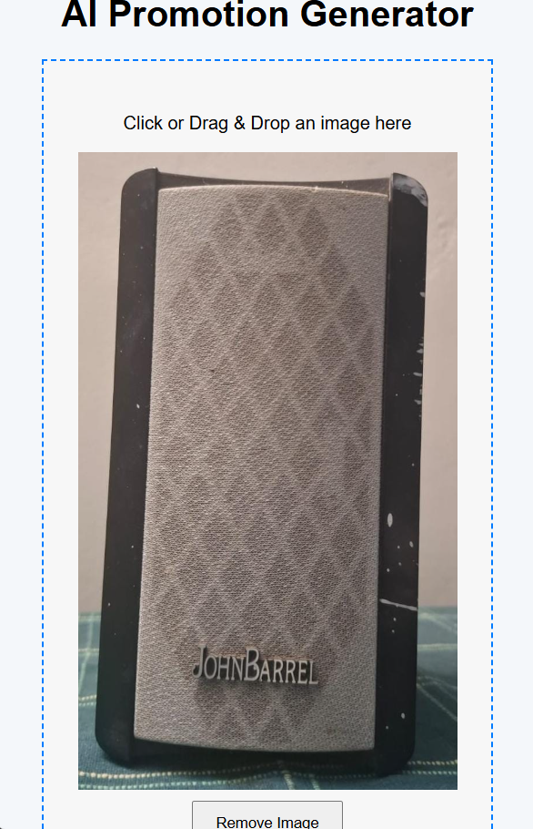
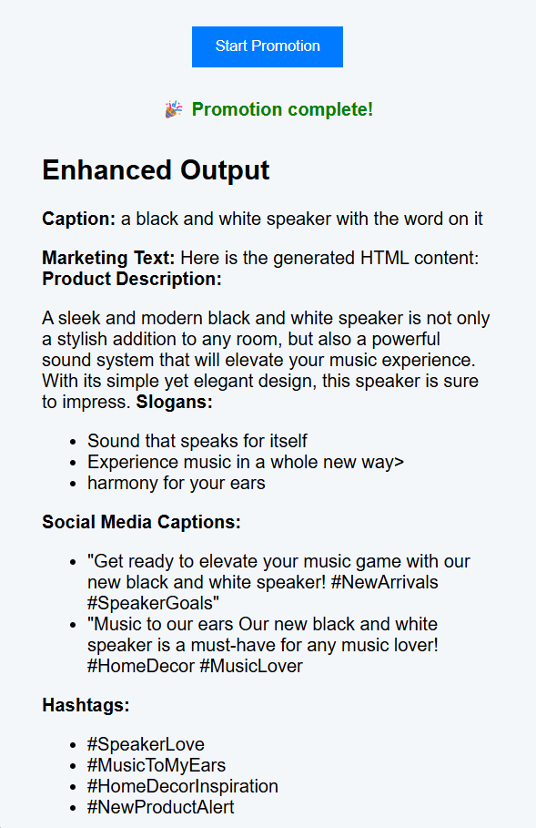
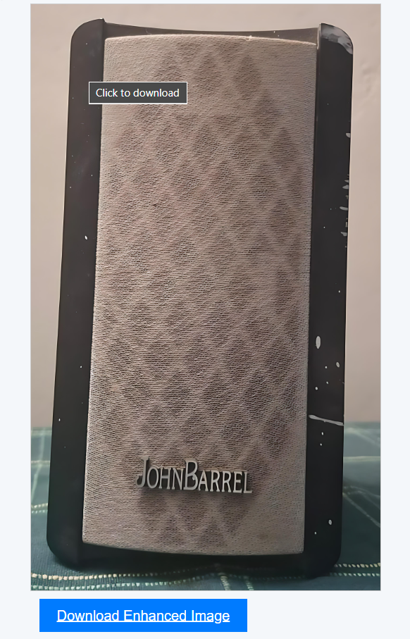
SCREENSHOTS

Slide 27
REFERENCES
Chen, L., & Zhang, X. (2022). "Multilingual Content Generation for Global E-commerce Platforms Using AI Algorithms." Journal of Global Marketing, 40(5), 431-444.
Kumar, V., & Gupta, R. (2023). "AI-based Product Promotion Strategies in E-commerce: Automation and Personalization." Journal of Artificial Intelligence and Marketing, 31(3), 175-189.
Lee, S., & Park, J. (2023). "Social Media Product Promotion via Automated Content Generation Using Natural Language Processing." Journal of Digital Marketing and E-commerce Technology, 29(2), 101-112.

Slide 28
Thank You…

