Slide 1
CORONARY HEART DISEASE PREDICTION USING MACHINE LEARNING
TEAM MEMBERS:
NARNE DHEERAJ BALARAM
MANNAM GANESH VIVEK
SITHARTH VARSAN
Data Set: Logistic regression to predict heart disease
Link: Click to view Dataset

Slide 2
TABLE OF CONTENTS
04
01
02
05
03
06
PATHOLOGY
DATA SELECTION
You can describe the topic of the section here
TREATMENT
DATA PREPROCESSING
You can describe the topic of the section here
CONCLUSIONS
MODEL SELECTION
You can describe the topic of the section here

Slide 3
INTRODUCTION
IMPORTANCE OF PREDICTING HEART DISEASE FOR A PERSON:
Reduction in mortality
Research and advancements
In summary,
Early identification of heart disease risk factors and prompt intervention are critical for preventing and managing this prevalent and life-threatening condition.
Health care improvement

Slide 4
01
DATA SET AND THE ATTRIBUTES

Slide 5
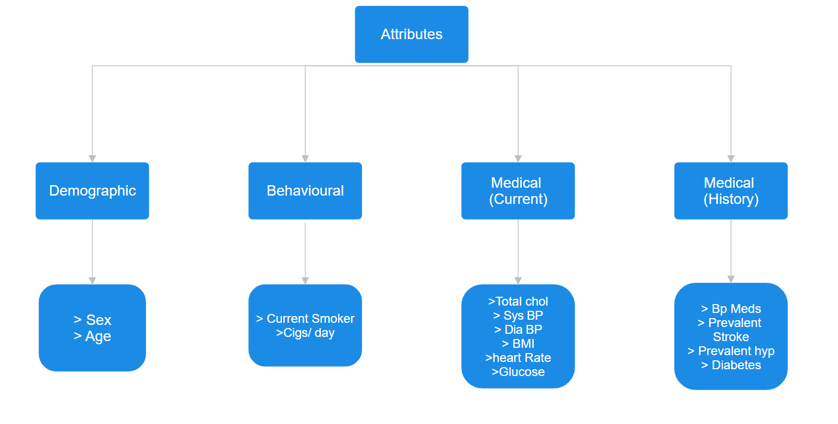
ATTRIBUTES:
Each attribute is a potential risk factor
There are demographic, behavioural and medical risk factors in the dataset.
Dependent variable of 10 year risk of coronary heart disease.
Data Set: Logistic regression to predict heart disease
Link: Click to view Dataset

Slide 6
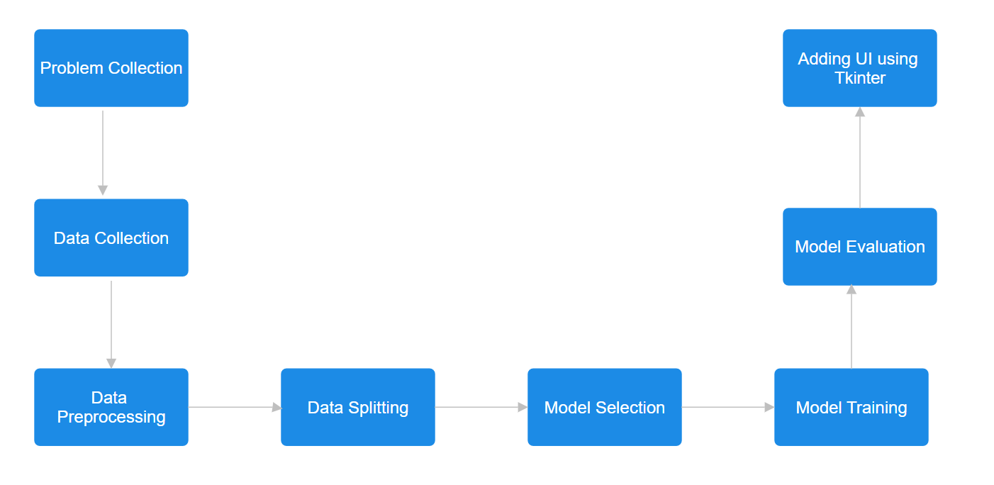
WAY OF APPROACH

Slide 7
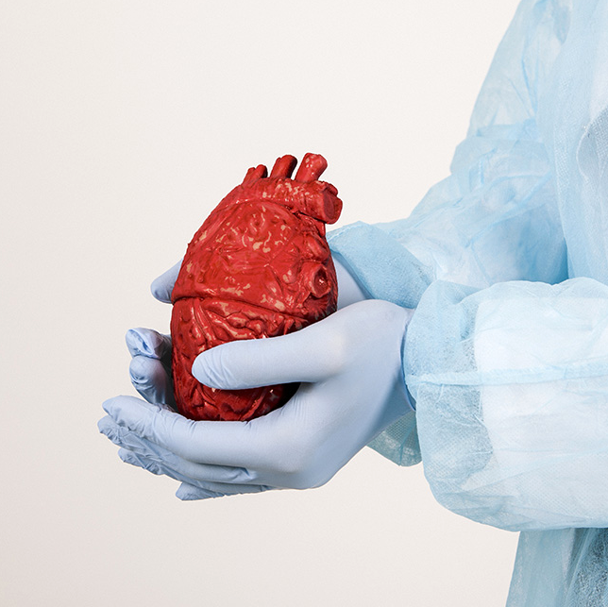
DATA PREPROCESSING
02

Slide 8
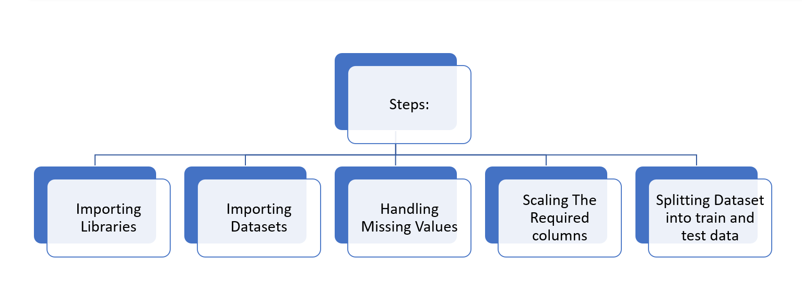
STEPS IN DATA PREPROCESSING

Slide 9
IMPORTING LIBRARIES:
Libraries Used:
PANDAS
NUMPY
SKLEARN
MATPLOTLIB
SEABORN
TKINTER

Slide 10
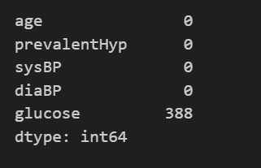
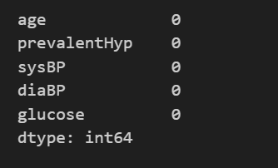
HANDLING MISSING VALUES:
There are 388 missing values in glucose column and rest of the columns which we use doesn’t have any null values.
We are filling the null values in the glucose column using numpy function fillna() with mean value of all values in glucose column
Before handing null values
After handling null values

Slide 11
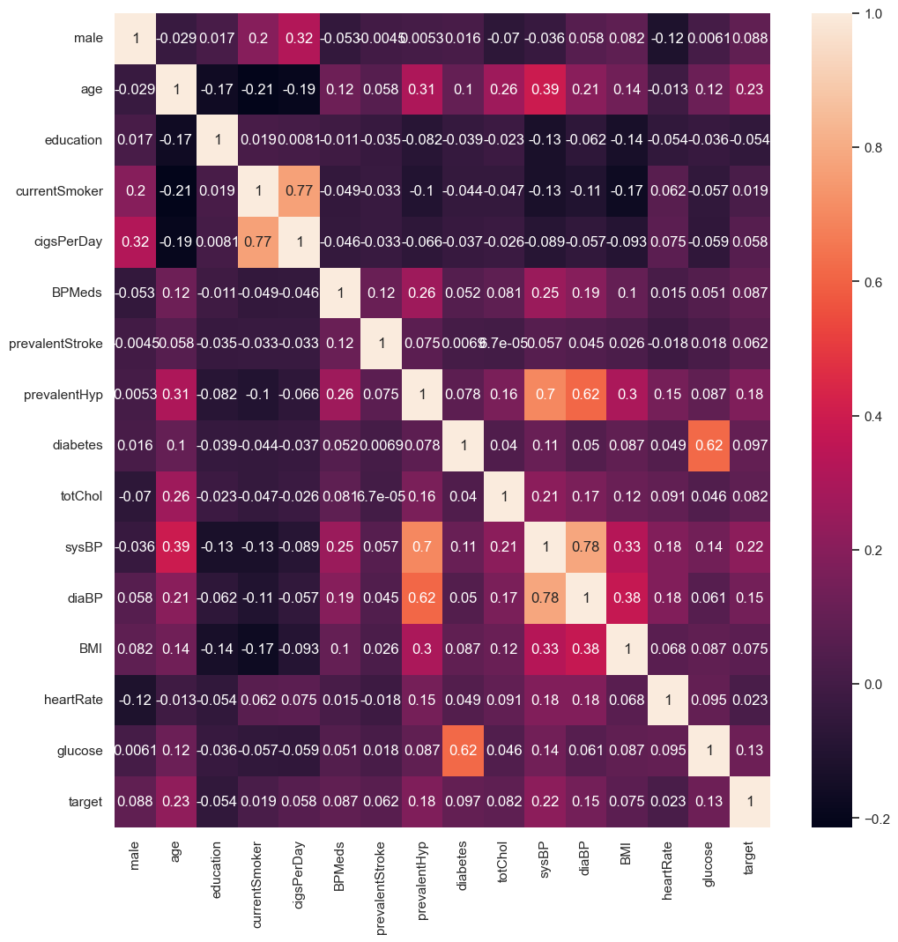
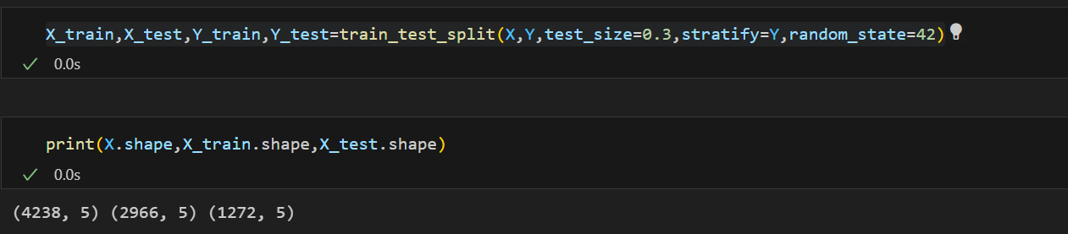
SPLITTING THE DATA INTO TRAIN AND TEST DATA
Here all the variables are independent except 10 year CHD which we renamed as target
From the Heat map we can see that age, prevalent Hyp, Sys BP, Dia BP, glucose are highly corelated with target. So we can take these elements to train our model
We are taking test data 30 percent of the data and random state as 42.

Slide 12

MODEL SELECTION
03

Slide 13
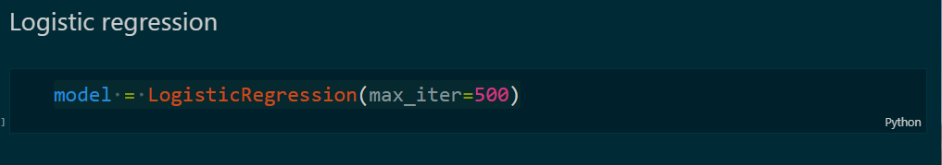
Logistic Regression:
We are using Logistic regression , as it is used for binomial classification and used to predict a binary outcome.
Using a decision boundary in 2D space i.e a line we predict the outcome as per the sigmoid function
The max_iter term is set to 500 which provides a decision after the optimization process

Slide 14
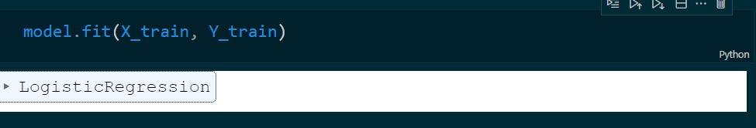
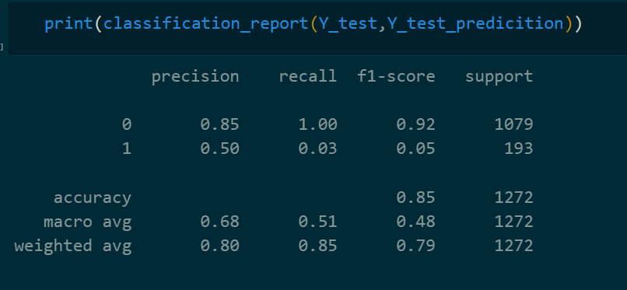
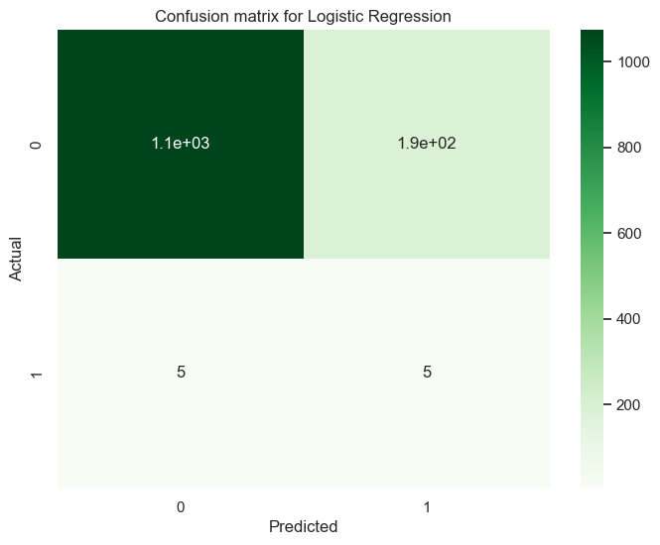
MODEL TRAINING
The classification report for model using logistic Regression
The confusion matrix for the logistic regression is:
The accuracy for the training data is nearly 85%.

Slide 15
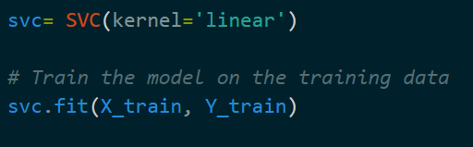

Support Vector Machines
We are testing our data with SVM as it is a process used for high-dimensional data
It is well suited for binary classification where the goal is to seperarted one of the data points
As the data is linearly separable (as per the visualization and accuracy in regression)
The model uses linear as it fits to find the decision boundary and used as kernel function
We are testing our data with SVM as it is a process used for high-dimensional data
It is well suited for binary classification where the goal is to seperarte one of the data points
As the data is linearly separable (as per the visualization and accuracy in regression)
The model uses linear as it fits to find the decision boundary and used as kernel function
The SVM model provides an accuracy of 84%

Slide 16
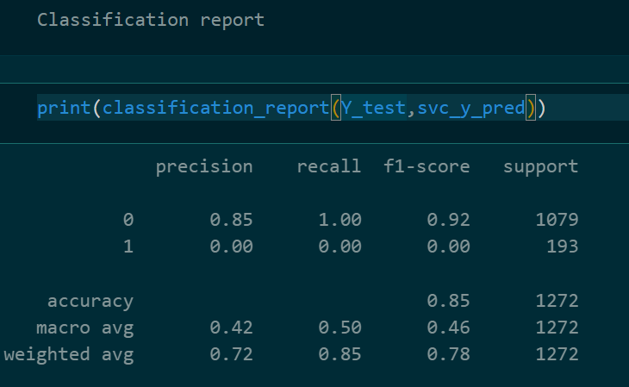
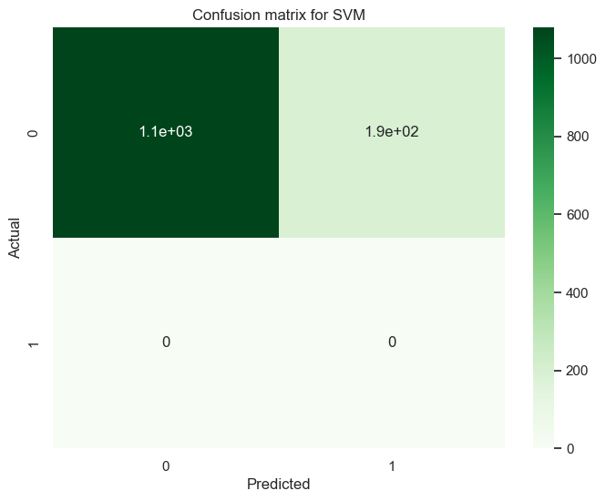
CONFUSION MATRIX FOR
MODEL USING SVM:
THE CLASSIFICATION REPORT FOR
MODEL USING SVM:

