Slide 1
Executive Sales Performance Report
Annual Business Performance | January–December 2025
Sales Performance and Business Insights
Prepared using Python, Pandas, Plotly and PowerPoint

Slide 2
Executive Summary
Total sales: INR 8,056,943.26
Average sales per region-product-month record: INR 55,950.99
Sales change from first to last month: 19.23%
Highest-performing region: North
Lowest-performing region: East
Top product category: Electronics

Slide 3
Key Performance Indicators
Total Sales
INR 8,056,943
Average Sales
INR 55,951
Sales Change
19.23%
Top Region
North

Slide 4
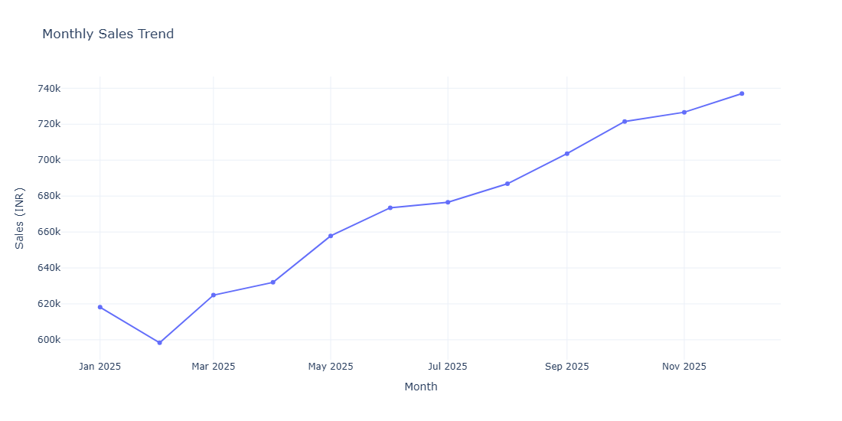
Monthly Sales Trend

Slide 5
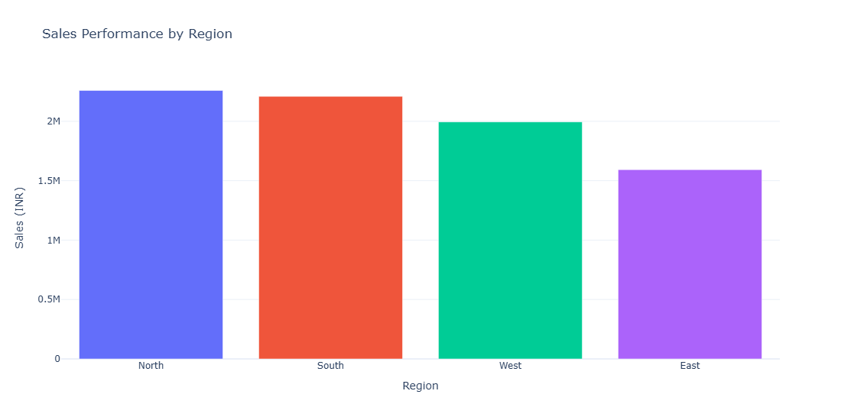
Regional Sales Performance

Slide 6
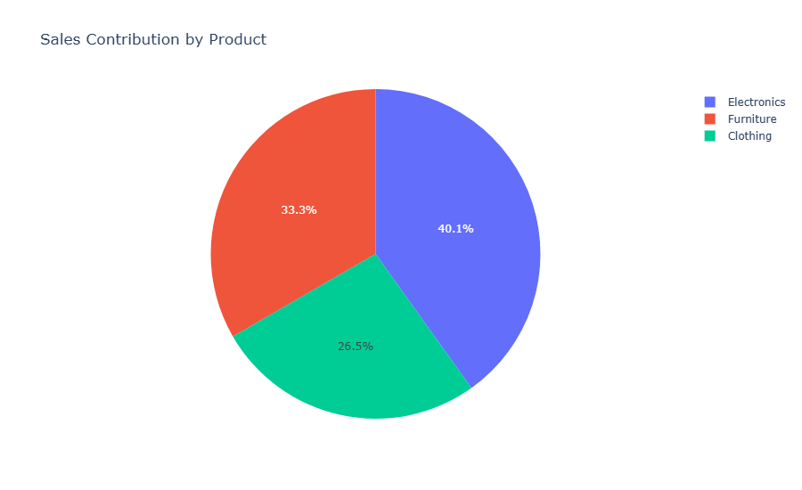
Product Sales Contribution

Slide 7
Key Business Findings
North recorded the highest total sales.
East recorded the lowest total sales.
Electronics contributed the highest product-category sales.
Sales changed by 19.23% between January and December.
Regional performance should be reviewed to identify improvement opportunities.

Slide 8
Recommendations and Next Steps
Investigate the reasons for lower sales in the East region.
Study successful sales practices in the North region.
Review inventory and marketing opportunities for Electronics.
Monitor monthly sales KPIs through a recurring executive dashboard.
Validate these findings using actual company sales data before making decisions.

Slide 9
Conclusion
The analysis summarizes sales performance across months, regions and products.
Visualizations help executives identify patterns and performance gaps.
The recommendations provide areas for further investigation and action.
This report demonstrates an automated Python-based executive reporting workflow.

