Slide 1
Planning tools

Slide 2
Gantt chart
Steps
  Identify the activity and task.
  Determine the task for the each activity and establish completion times.
  Determine the total estimated time for each activity.
  Plot activities on a Gantt chart.
  Reviews and record progress periodically.

Slide 3
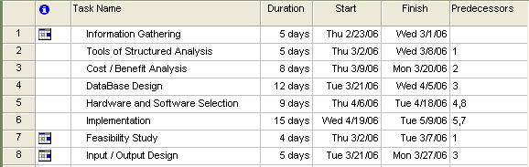
Gantt Chart

Slide 4
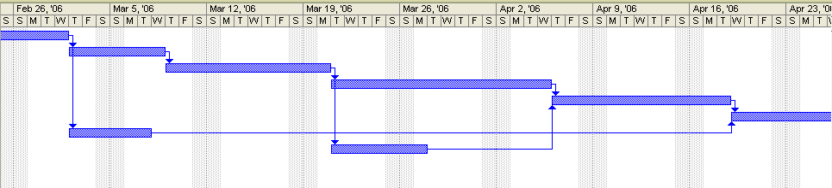
Gantt Chart

Slide 5
PERT
(Program Evaluation & Review Technique)

Slide 6
In a CPM (Critical Path Method) Network, there are no directed cycles. Such a graph is called acyclic.
3
1
6
1
2
7
2
3
4
7
3
8
5
2
4
1
1
5
6

Slide 7
Project Network Example
C,4
E,8
A,2
B,3
D,6
F,7
H,5
task
duration
G,4

Slide 8
Finding a Topological Order
1
First, find a node that has no incoming arcs. (If no such node exists, there is a directed cycle.) Label this as node 1.

Slide 9
Finding a Topological Order
2
1
Next, find a node that has no incoming arcs from unlabeled nodes.

Slide 10
Finding a Topological Order
3
2
1
Next, find a node that has no incoming arcs from unlabeled nodes.

Slide 11
Finding a Topological Order
5
3
2
1
4
Next, find a node that has no incoming arcs from unlabeled nodes.

Slide 12
Finding a Topological Order
5
7
3
2
1
6
8
4
Next, find a node that has no incoming arcs from unlabeled nodes.

Slide 13
Critical Path Definitions
Earliest Start Time (ES) is the earliest time a task can feasibly start
Earliest Finish Time (EF) is the earliest time a task can feasibly end
Latest Start Time (LS) is the latest time a task can feasibly start, without delaying the project at all.
Latest Finish Time (LF) is the latest time a task can feasibly end, without delaying the project all

Slide 14
Critical Path Method
Forward Pass
  Go through the jobs in order
  Start each job at the earliest time while satisfying the precedence constraints
  It finds the earliest start and finish times

Slide 15
CPM Example
Forward Pass
C,4
E,8
A,2
B,3
D,6
F,7
H,5
G,4
G
D
F
A
B
C
E
H
0
2
4
6
8
10
12
14
16
18
20
22
24
26

Slide 16
CPM: The Backward Pass
Fix the finishing time
Look at tasks in reverse order
Lay out tasks one at a time on the Gantt chart starting at the finish and working backwards to the start
Start the task at its latest starting time

Slide 17
CPM Example
Backward Pass
C,4
E,8
A,2
B,3
D,6
F,7
H,5
G,4
G
D
F
A
B
C
E
H
0
2
4
6
8
10
12
14
16
18
20
22
24
26

Slide 18
Critical Path
The longest path is called the
critical path.

Slide 19
Critical Path
C,4
E,8
A,2
B,3
D,6
F,7
H,5
G,4
A-B-D-F-H is the longest path. Its length is 23

Slide 20
Advantage
CPM
  Advantage of ease of use
  Lays out the Gantt chart (nicely visual)
  Identifies the critical path
  Used in practice on large projects

Slide 21
Thank you all

