Slide 1
The average concentrations of selected metals and items were calculated and summarized in the Fig.
The average concentrations of Cu, Pb, Cr and Zn in Deep Bay and Victoria Harbour areas were significantly higher than those in Mirs Bay.
The average concentrations of metals indicated the overall level of metal contamination in sediment. Compared with the National Standards of Marine Sediment Quality of China (Table S3),
the average concen- trations of metals in Mirs Bay area were at Level I, which was suitable for marine fishery, bathing beach, marine sports or public entertainment that direct exposure to sediment, and water supply for food industries.
For Deep Bay and Victoria Harbour, the average concentrations of Zn and Cu in sediments were at Level P, and Cr and Pb were at Level I.
Moreover, the average concentrations of Zn, Pb, Cu and Cr of the Deep Bay and Victoria Harbour were significantly higher than those in Mirs Bay.
It indicated that the environ- mental quality of sediment in Mirs Bay area was better than that of the other two areas and basically at the natural level with little contamination.

Slide 2
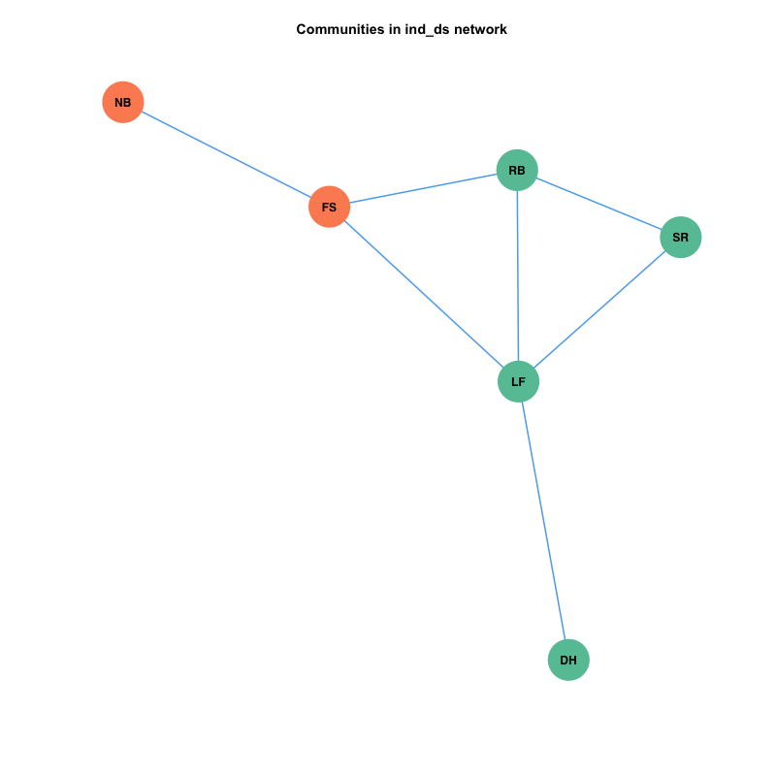
India dry season
Notes:
# we combine the result and discussion
Dry season network composed of 6 nodes (injuries, DH, NB, SR, FS, RB, and LF), and captured 7 associations. The network yielded two groups of injury profiles (the combination of injuries). It indicates the groups of the injury profiles corresponding to each communities based on the optimal clustering algorithm. It reveals a structure involving two different co-occurrence patterns among injuries. The first group is composed of DH, LF, RB and SR. Another group consists of FS and NB. One of each group (LF and FS ) has high betweenness, which indicated that they also present co-occurrence relationships within the group, and between groups. So when FS or Lf present in the fields, It is possible to be able to observed the other injuries, which are within same group or different groups. SR and RB have high clustering coefficient, which are implied that these injuries usually formed complex of multi-co-occurrence relationships. As opposed to other injuries, NB and DH have low scores on all three centrality measure. Apparently, injuries variable either are less possibly co-occur with other injuries (low betweenness), and not form multi-co-occurrences with other nodes (low degree and clustering coefficient).
Fei Yu Ching like comliment song
%Wang Zheng Liang storyland
This will be used for the discussion
For the network model constructed based on maximal modularity score. Our result suggested that LF and FS could be potentially monitored because they are high betweenness, which indicated that they are possibly to connecter to from the co-occurrence within and between group of injuries. SR should be a target to be monitored as well because it has high clustering coefficient and connected with the LF, which has high betweenness. It is likely to be inducted and when it is activated, then it will also induced the nourbering injuries (nodes) to form co-occurrence.
These symptoms also seem to score moderate to high on at least two out of three centrality measures (Figure 4). For example, ‘‘rmo’’ has a moderate strength and a very high clustering coefficient, whereas it has a low betweenness. This indicates that activation in the network does not easily affect response of mood to positive events (low betweenness), but that, if the symptom is activated, the cluster will tend to stay infected because of the high interconnectivity (high clustering coefficient). Another interesting example is ‘‘energy level’’ (ene), which has a high node strength and betweenness, but a moderate clustering coefficient. Apparently, energy level has many and/or strong connections (high strength) and lies on many paths between symptoms (high betweenness), whereas it is not part of a strongly clustered group of symptoms (moderate clustering coefficient). This symptom is probably more important in passing information through the network, or between other clusters, and might, therefore, be an interesting target for intervention

Slide 3
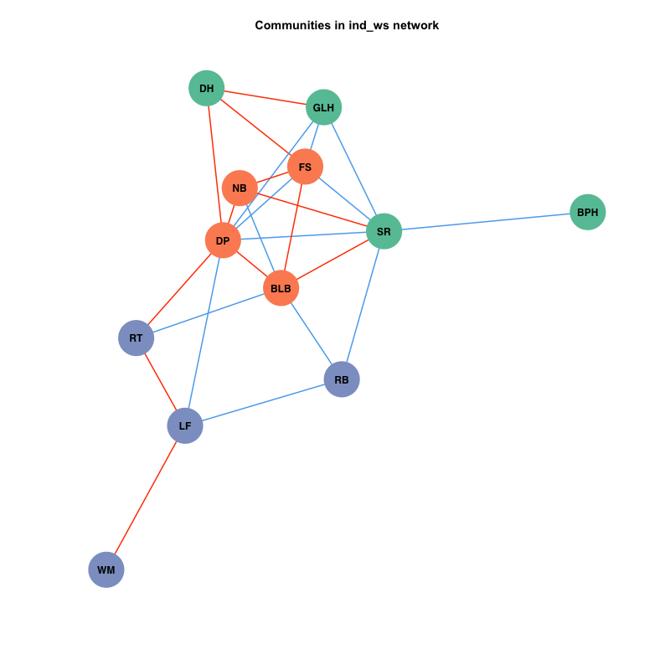
India wet season
Notes:
Wet season network (Fig) was composed of 12 nodes (injury variables, DP SR, FS, BLB, NB, LF, GLH, RT, RB, DH, WM, BPH) with edges. Fig reveals three groups of injury profiles.
DH, GLH, SR and BPH are in the first group (green color). FS, NB, DP, BLB is in the second (orange color). RT, LF, RB and WM are in the third group (purple color). Top four injuries with high betweenness are the members of each of group (DP, SR, LF, and BLB). They possibly are found co-occurrence within the group and inter-groups of injury profiles.
Considered in each group, DH and GLH have high clustering coefficient in the first group. NB has high clustering coefficient in the second group. RT has highest clustering coefficient comparing other injuries in the group. WM, BPH have low value of the three features, and located . BPH and WM were less possible to occur, and present co-occurrence patterns, and when they were observed, they were also not able to relate to many injuries.
They possibly are found co-occurrence within the group and inter-groups of injury profiles.

Slide 4
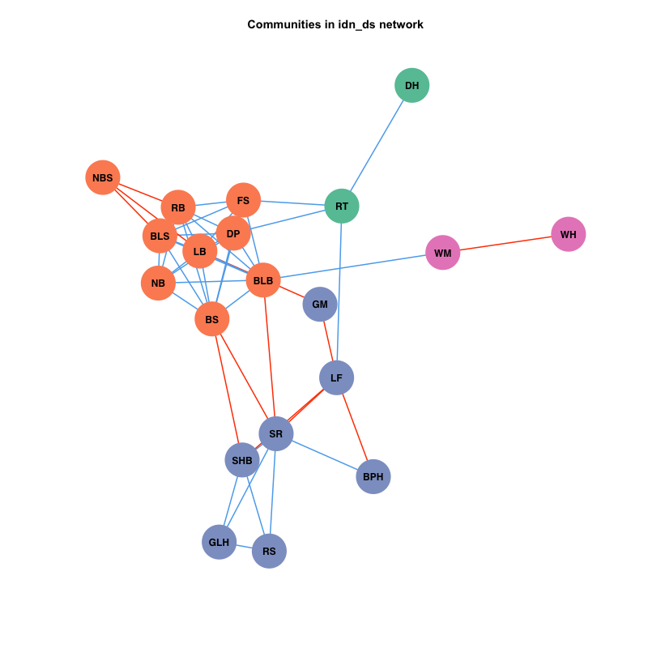
Indonesia dry season
Notes:
Dry season network (Fig.) composed of 20 nodes and 51 associations. The network reveals four groups of injury profiles. The first group (green color) include DH and RT. The second group (orange color) include NBS RB, FS, BLS, LB, DP, BLB, NB, BS. The third group (purple color) included GM, LF, BPH, SR, SHB, GLH, RS. The last group (pink color) include WM and WH. The second and third group are formed closely clusters. RT in the first group, BLB and BS in the second group, LF of the third group, and WM in the fourth groups have with high betweenness, and intermediate clustering coefficient. NBS, NB, RB, BLS, FS, DP of the second group have high clustering coefficients. Compared to the the second group, the injuries in the third group has relatively smaller than. It indicated that the injuries in the second group are tightly formed multi-co-occurrence (not few pairs of co-occurrence). DH, WH have low value of the three features, and located far from the center of the network. BPH and WM were less possible to occur, and present co-occurrence patterns, and when they were observed, they were also not able to relate to many injuries.
The discussion would be like this
The BLB and stem rot can be the targets to be monitored because they have high betweenness. SR is also best to be the target because it also associated with the RS, which has high clustering coefficients also because RS is potentially able to be co-found with many other injuries. BLB also show the association with the injuries, which present high clustering coefficient. Both of BLB and SR are intermediate clustering coefficient., so they are formed concurrence between groups, but less potentially to present complex association. DH and WH are less associated with other injuries, so they are difficult to employ other injuries to _____

Slide 5
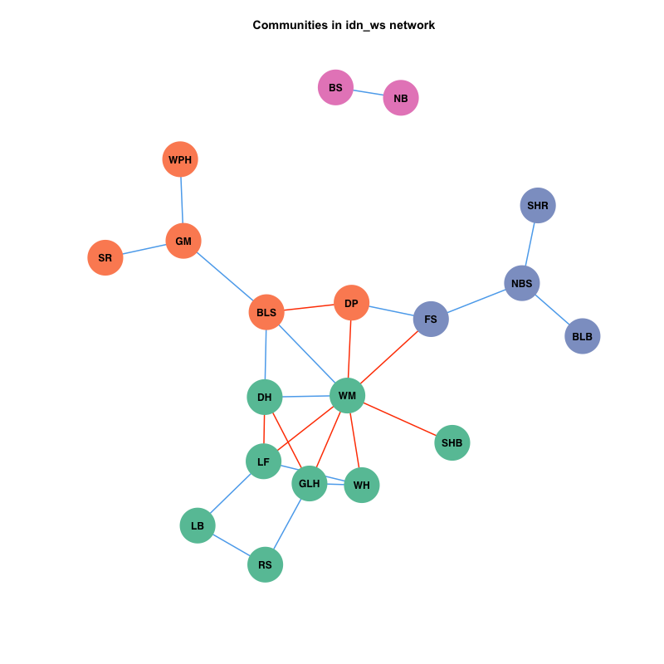
Indonesia wet season
Notes:
Wet season network (Fig.) composed of ? Nodes. (injury variables, WM, LF, GLH, DH, BLS, WH, NBS, FS, DP, RS, LB, WPH, SR, SHR, SHB, NB, BS, BLB) and ? relaships. The network is not formed the closed cluster. It reveals 4 groups of injury profiles. The first group (green) DH, WM, SHB, WH, GHL, LF, LB, and RS. The second group (orage) is composted of WPH, SR, GM, BLS and DP. The third group consist of FS, NBS, SHB, BLB. The forth group are BS and NB. The first group is the biggest group of the injuires profile with WM is the injuries with high betweenness, and WH is the injury with high clustering coefficient. The second group has BLS that the node with high betweenness, and DP is the ode with high clustering coefficient. The third group has FS node with high betweenness and high clustering coefficient. There is separated group, which is composted of BS and NB.
The first group is seem to form complex co-occurrence patterns because the average of clustering coefficient of injuries in this group are higher than other groups of injuries.

Slide 6
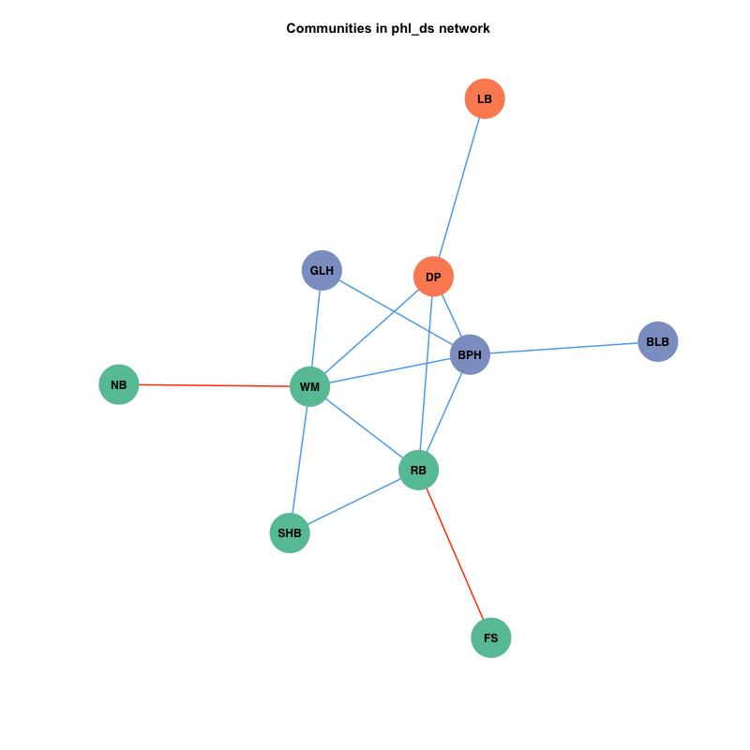
phl dry season
Notes:
The network reveal three groups of injury profiles. The first group composted of WM, RB, NB, SHB, and FS. The second group consist of LB and DP. The third group is GLH, BPH and BLB. The WM and RB in first group have high rank of betweenness. BPH and DP are also have high rank of betweenness, which are in the second and the third group, respectively. Interestingly, SHB in the first group, and GLH in the third group have high clustering coefficients. The NB, LB, FS, and BLB featured low in three of centrality.
It is the good to monitored WM and RB and SHB also even the GLH has no betweenness, but it has high clustering coefficients, and connected with two high betweenness node. It would be also good target to monitored also because when it present, it also frequency appear together.

Slide 7
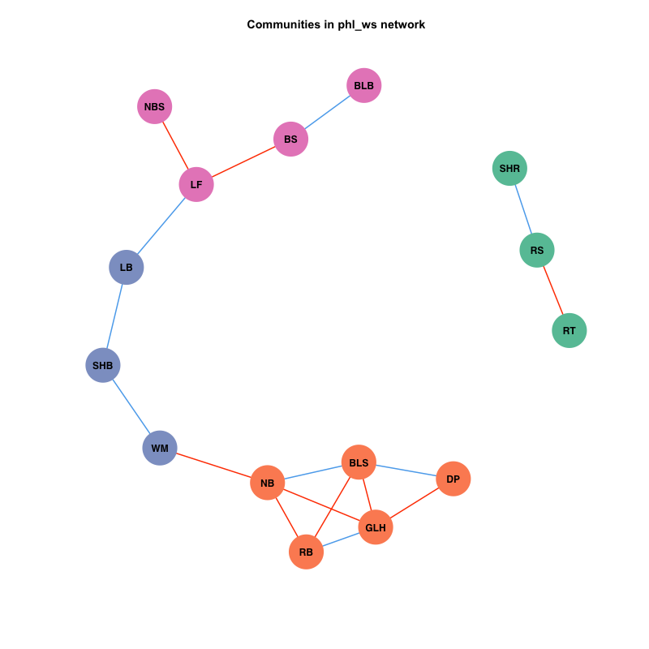
phl wet season
Notes:
Network reveals four groups of injury profiles. The second group (green) has SHR, RS, RT, which is isolated. The first group (orange) has NB, RB, GLH, BLS, and DP. The third group (purple) has LB, SHB, LB. The forth group (pink) has NBS, LF, BS, and BLB. The first group is more complex combination than others because the clustering coefficients of injuries in this group are higher. Interestingly, the third group is in between the first and the fourth group, this position supported that the injuries express high betweenness.
# the recommendation
SHB, LB and WM in the group with high betweenness, but they do not form the the complex combination of the injuries. They are tend to link the co-occurrence of the first and the fourth group of inuiry profiles, which connected to NB in the first group and LF in the fourth group. So they are potentially good target to be monitored too.. For example, when LF presented without the present of LB, SHB, WM, it is less likely NB would present, and other injuries in the first group would less likely to present neither. The second group, which is isolated could form the simple concurrence.

Slide 8
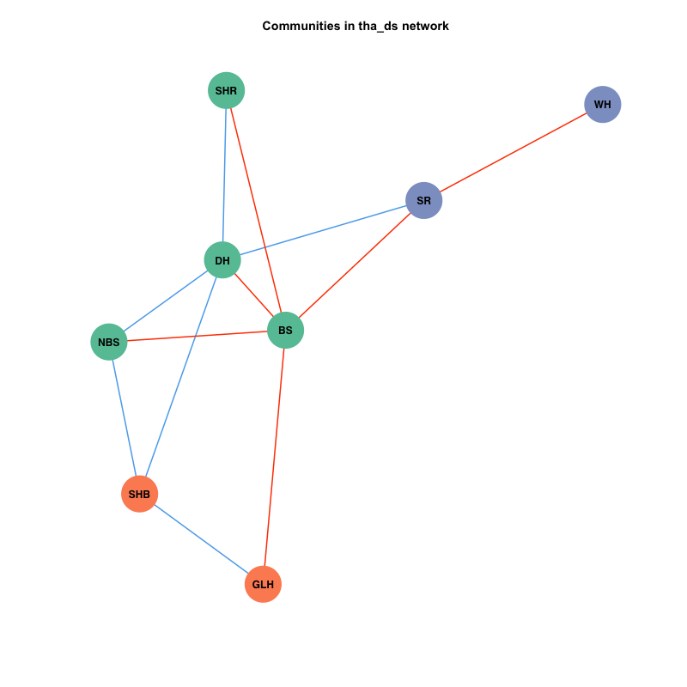
Notes:
[finish]
SUP in dry season the network shows 8 variables (DH, BS, SR, SHB, NBS, SHR, GLH, and WH) showing 12 edges (significant pair-wise relationships). From the result of community detecting. We found there are three closed co-occurrence patterns of injuries. The first group (green) is composted of NBS, DH, BS, and SHB. Second patterns (orange) is SHB and GLH, and the Third group ( purple) is SR and WH. The first one seem more complex than other two group because three out of four node in the groups present high clustering coefficient NBS, DH, SHB, and SR seem to be clustered together. BS present high betweenness in the first group, which is associated with the other two groups. SHB has high moderate degree and high betweenness, whereas it has low betweenness. It can form complex association with the injuries in the first group and the second group itself. WH and GLH feature low scores on at least two centrality measures. Apparently, they are less easily found with other injuries, do not tend to complex combination because of low inter-co-occurrence ( low clustering coefficient), or less possible for expressing co-occurrence through the network (low betweenness).
This indicates that SHB dose not easily co-occur with other injuries, but if it presented, it tend to be found with other injuries and formed complex combination of injuries.
. As opposed to , SHR, NBS, DH, SHB, and SR, WH and GLH feature low scores on at least two centrality measures. Apparently, they are less easily found with other injuries, do not tend to complex combination because of low inter-co-occurrence ( low clustering coefficient), or less possible for expressing co-occurrence through the network (low betweenness). This is to be expected, since WH and GLH are relatively low form other other injuries occurring in dry season.
Another interesting example, BS which have high betweenness, node degree, whereas it is not part of the strongly clustered group of injuries. BS is probably more important in expressing co-occurrence through the network, or between other clusters

Slide 9
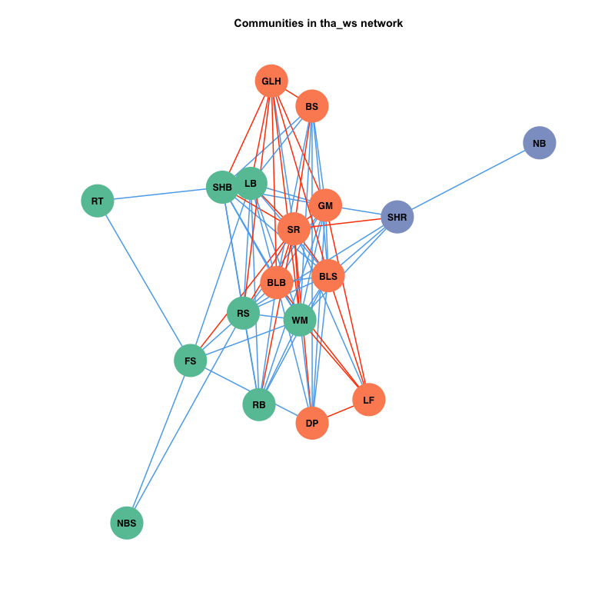
Notes:
SUP in wet season network shows 18 variables (DH, BS, SR, SHB, NBS, SHR, GLH, and WH) showing 79 edges (significant pair-wise relationships). There are three closely clustered groups. The first group (green) composted of NBS, FS, RT, SHB, LB, WM, RS and RB. The second group (orange) consist of GLH, BS, GM, SR, BLB, BLS, LF and DP. The third group consisted of SHR and NB. The first and the second group are formed complex association. Interestingly, SHR in the third group has high betweeneess, which is in-between the association of the injuries between the others and into the groups of the injuries profiles.
RB, NBS
GLH, LF
From the structure of this network,, it seem to have two closely clustered groups base on optimal clustering algorithm. One group is composed of NB, SR, BS, WPH, RS, WM, DH, GLH, FS, RT. Another group has BLB, BPH, LB, NBS, SHB, SHR, DP. The members with in clustered groups are relatively close in term of position based on force layout. The SHB and RB, RT, LB have high node degree and betweenness, whereas they are from different groups on injuries. They are probably more important in expressing co-occurrence within the group, or between groups. If they occurred, it is possible to be able to observed the multiple injuries in this season.
SHR
RS
===
SHB
FS
GM
BLS
SHB
SR
WM
The rest

Slide 10
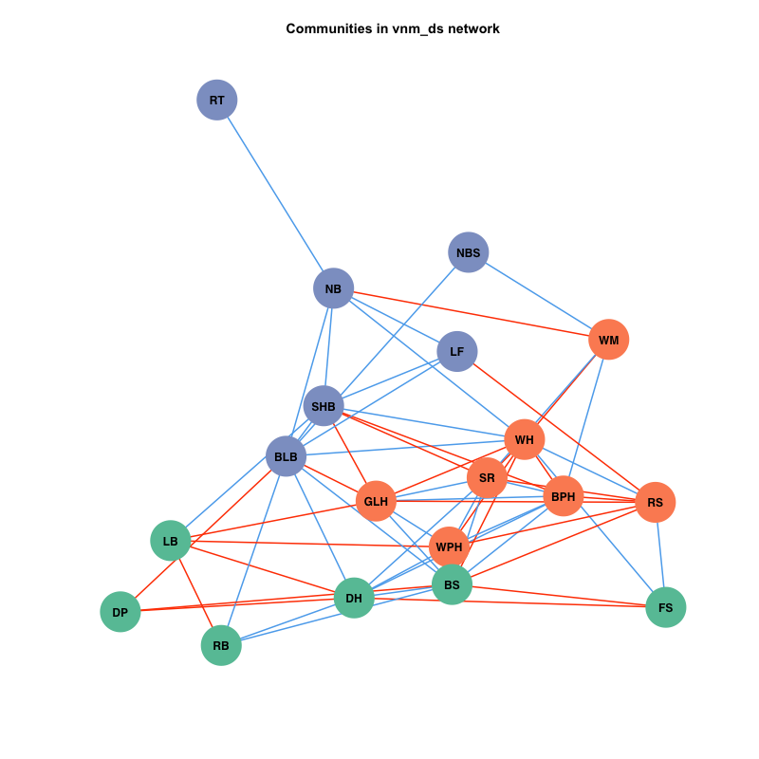
Notes:
MKD in dry season the network shows 20 variables (DH, BS, SR, SHB, NBS, SHR, GLH, and WH) showing 61 edges (significant pair-wise relationships). The network reveals the theree groups of injury profiles. The first group consisted of LB, DP, RB, DH, BS, and FS. The second group is composed of GLH, WPH, SR, WH, BPH, RS, WM. And the third group ( purple) consisted of RT, NB, SHB, BLB, LF, and NBS. The RB in the first group has high rank of betweenness and clustering coefficients. The injuries in the second group are relatively low betweenness, but high clustering cofficent, which indicated they are likely frequency to form complex association within the groups than forming between groups. In the third group BLB and NB have high rank of betweenness and they are associated with the injuries which have high betweenness. So the the first and the third group are like to more chance to fom assiciation between the groups, but less simple than the thrid group because of the average of the clustering coefficients.

Slide 11
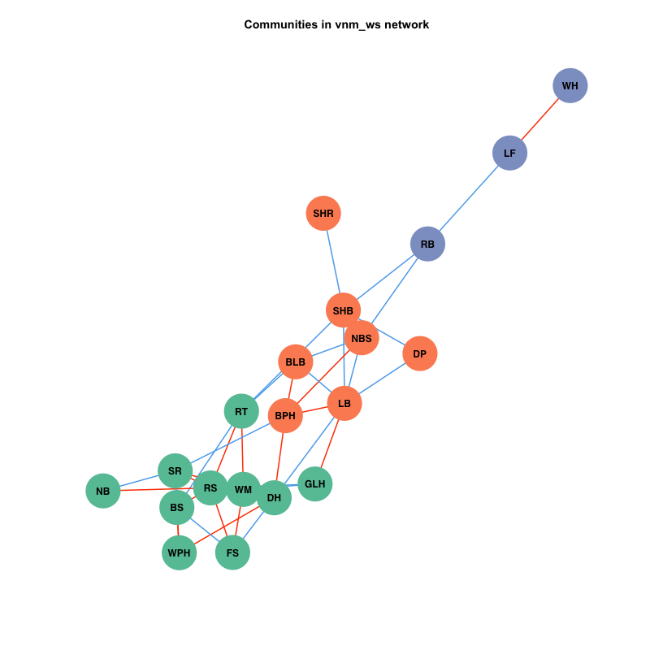
Notes:
[fnish]
MKD in wet season the network shows 21 variables (DH, BS, SR, SHB, NBS, SHR, GLH, and WH) showing 54 edges (significant pair-wise relationships). From the structure of this network,, it seem to have two closely clustered groups base on optimal clustering algorithm. One group is composed of NB, SR, BS, WPH, RS, WM, DH, GLH, FS, RT. Another group has BLB, BPH, LB, NBS, SHB, SHR, DP. The members with in clustered groups are relatively close in term of position based on force layout. The SHB and RB, RT, LB have high node degree and betweenness, whereas they are from different groups on injuries. They are probably more important in expressing co-occurrence within the group, or between groups. If they occurred, it is possible to be able to observed the multiple injuries in this season.
SHR WH
SHB and RB
RT SHB RB LB

