Slide 1
26 types of injuries
 | DH | BPH | SHB | DP | BS
F1
F2
F3
F4
F5
Value
low
high
5 production environments

Slide 2
 | DH | BPH | SHB | DP | BS
DH
BPH
SHB
DP
BS
Correlation coefficient
low
high
Correlation Matrix

Slide 3
Choosing the correlation measure
TEST
whether data are normally distributed or not
29 types of injuries
 | DH | WH | SHB | DP | BS
F1
F2
F3
F4
F5
COMPARE
the similarity of correlation coefficients from different correlation measures
IDENTIFY
which the most suitable correlation measure can capture biological relationships between variables
 | DH | WH | SHB | DP | BS
DH
WH
SHB
DP
BS
Correlation coefficient
Value
Pearson correlation
Spearman correlation
Kendall’ correlation
Biweight mid-correlation
low
low
high
high
5 production environments
Crop health survey data
Correlation Matrix

Slide 4
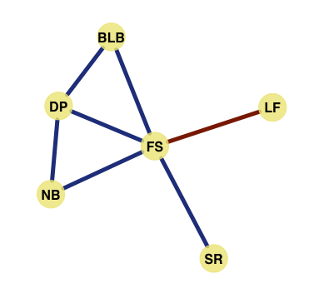
Network model

