Slide 1
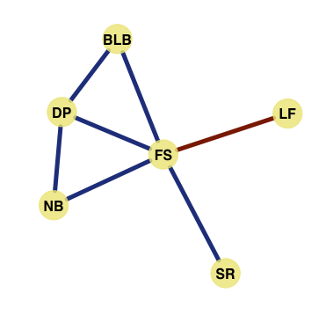
(A) Subsetting survey data for each a cropping season and a production environment
(B) Contracting correlation matrix using Spearman correlation method
(C) Building a network, and analyzing network properties
29 types of injuries
 | DP | BLB | FS | LF | SR
F1
F2
F3
F4
F5
 | DP | BLB | FS | LF | SR
F1
F2
F3
F4
F5
 | DP | BLB | FS | LF | SR
DP
BLB
FS
LF
SR
Correlation coefficient
Value
low
low
high
high
5 production environments
1 production environments
1 cropping seasons
Correlation Matrix
Network model

