Slide 1
Chapter 3
Alec Waters & Drew Klemz

Slide 2
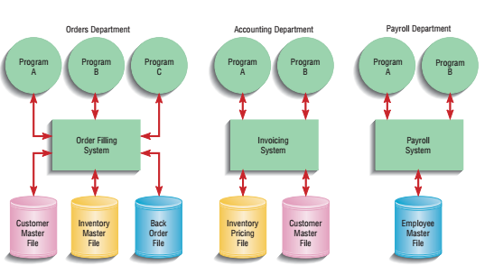
Pine Valley Furniture
Selected a network server to digitize its business processes
Explanations of how it works and what it does
Notes:
Pine valley furniture is a furniture manufacturer that distributes to retail stores in the US.
When it first started it was run out of the founders garage where he would file all of the invoices in a file cabinet, as they grew he had to hire another employee to help with the filing.
As the company grew they eventually they installed a minicomputer to automate invoicing, accounts receivable, and inventory control.
PVF decided to develop its application in-house
Each were a separate application and had its own individual files tailored to the needs of the specific department.

Slide 3
What is a Project?
A planned undertaking of a series of related activities to reach an objective that has a beginning and an end
Contains “deliverables” (end product)

Slide 4
Project Manager
Responsible for initiating, planning, executing, and closing down a project.
Notes:
Project Manager - A system analyst with usually a diverse set of skills in each area such as management, leadership, technical, conflict management, and customer relations.

Slide 5
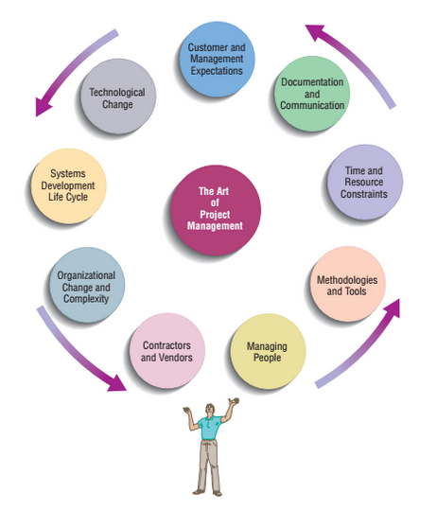
Project Cycle
Initiation
Planning
Execution
Closing it Down

Slide 6
Initiation
Establishing the Project Initiation Team
Establishing a Relationship with the Customer
Establishing the Project Initiation Plan
Establishing Management Procedures
Establishing the Project Management Environment and Project Workbook
Developing the Project Charter
Managing the IS Project

Slide 7
Planning
Describing Project Scope, Alternatives, and Feasibility
Dividing the Project into Manageable Tasks
Estimating Resources and Creating a Resource Plan
Developing a Preliminary Schedule
Developing a Communication Plan
Determining Project Standards and Procedures
Identifying and Assessing Risk
Creating a Preliminary Budget
Developing a Project Scope Statement
Setting a Baseline Project Plan
Managing the IS Project

Slide 8
Execution
Executing the Baseline Project Plan
Monitoring Project Progress against the Baseline Project Plan
Managing Changes to the Baseline Project Plan
Maintaining the Project Workbook
Communication the Project Status
Managing the IS Project

Slide 9
Closing Down
Closing Down the Project
Conducting Post-project Reviews
Closing the Customer Contact
Managing the IS Project

Slide 10
Representing Project Plans
Critical Path Scheduling
Network Diagram
Gantt Charts
PERT (Program Evaluation Review Technique)

Slide 11
Calculating Expected Time Durations Using PERT
ET =
Where:
ET = expected time for the completion of an activity
O = Optimistic completion time for an activity
r = realistic completion time for an activity
p = pessimistic completion time for an activity
O + 4r + p
6
Notes:
One of the hardest and most error-prone activities when constructing a project schedule is the determination of the time that each task will take.
PERT is a technique that uses, optimistic, pessimistic, and realistic time estimates to calculate expected time for the task.

Slide 12
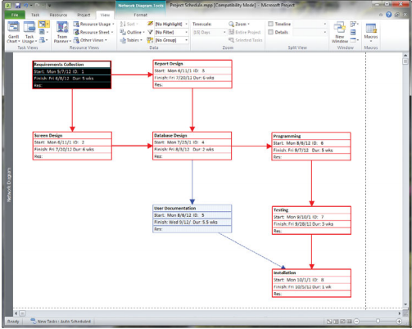
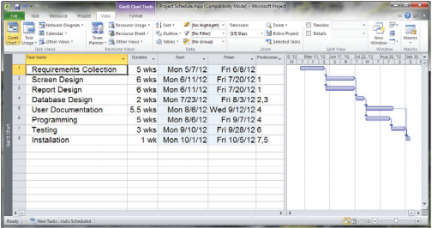
Gantt Chart vs Network Diagram
Notes:
Gantt chart is on the left and Network Diagram is on the right.
Gantt Chart shows the duration of tasks, whereas a Network diagram shows the sequence dependencies between the tasks.
Gantt Chart shows the time overlap, but does show which tasks could be done in parallel
Graphical time stamp for gantt

Slide 13
Using Project Management Software
Establishing a Project Start Date
Entering Tasks and Assigning Task Relationships
Selecting a Scheduling Method to Review Project Reports

Slide 14
Summary
Pine Valley Furniture
Managing the IS Project
Representing and scheduling Project Plans
Using Project Management Software

