Slide 1
Ling 1269 - LVC Project
Jarod Latta

Slide 2
The Big Question
Do speakers adopt the variants of the speakers around them at the expense of their native variant?
Specifically, for adult speakers outside the critical language acquisition period

Slide 3
What is Canadian Raising?
Shift in in the vowel space:
oʊ/aʊ/æʊ → ʌʊ/əʊ
About /əbæʊt/ → /əbʌʊt/ is the stereotypical example.
Where does this occur?
Primarily after voiceless plosives or voiceless fricatives
Primarily before velars, plosives, or voiced fricatives
Notes:
From here on, I’ll refer to it as simply “raising”

Slide 4
Data Collection
388 tokens across 16 variables
7 speakers
Linguistic Factors:
Preceding Consonant (and manner)
Following Consonant (and manner)
Standard Vowel
Produced Vowel
Notes:
These 16 variables also include things like year, time stamp in the recording, what the word was that included the token, etc.

Slide 5
Data Collection
Social Factors:
Speaker (as proxy for dialect: Canadian vs. American English)
Collection Method:
Identifying and coding intervals using Praat
Exporting to CSV, aggregating and plotting using R
tidyverse package

Slide 6
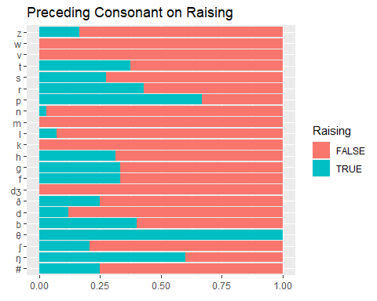
Plotting & Analyzing Data
Examining Each Constraint on Raising

Slide 7
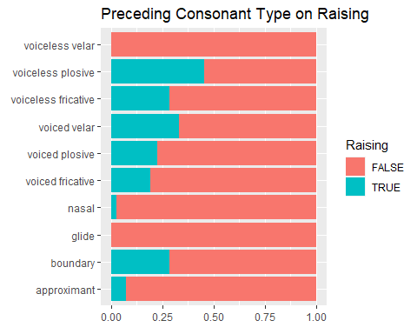

Slide 8
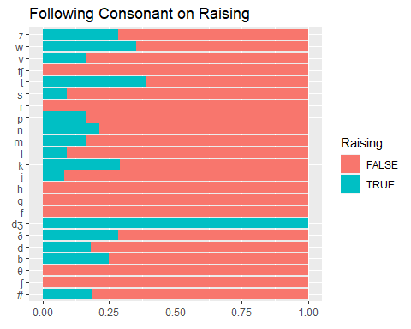

Slide 9
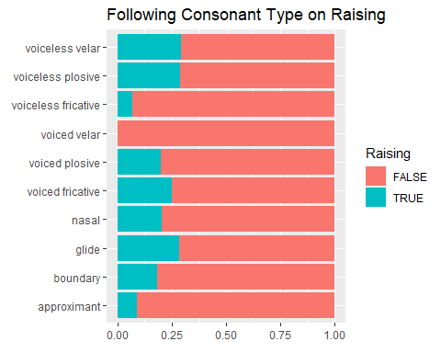

Slide 10
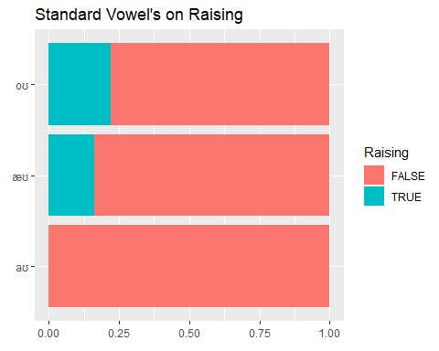

Slide 11
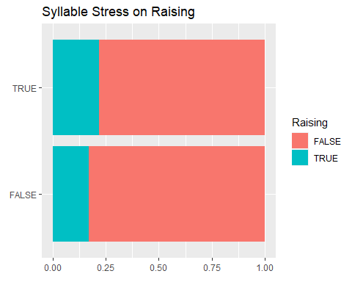

Slide 12
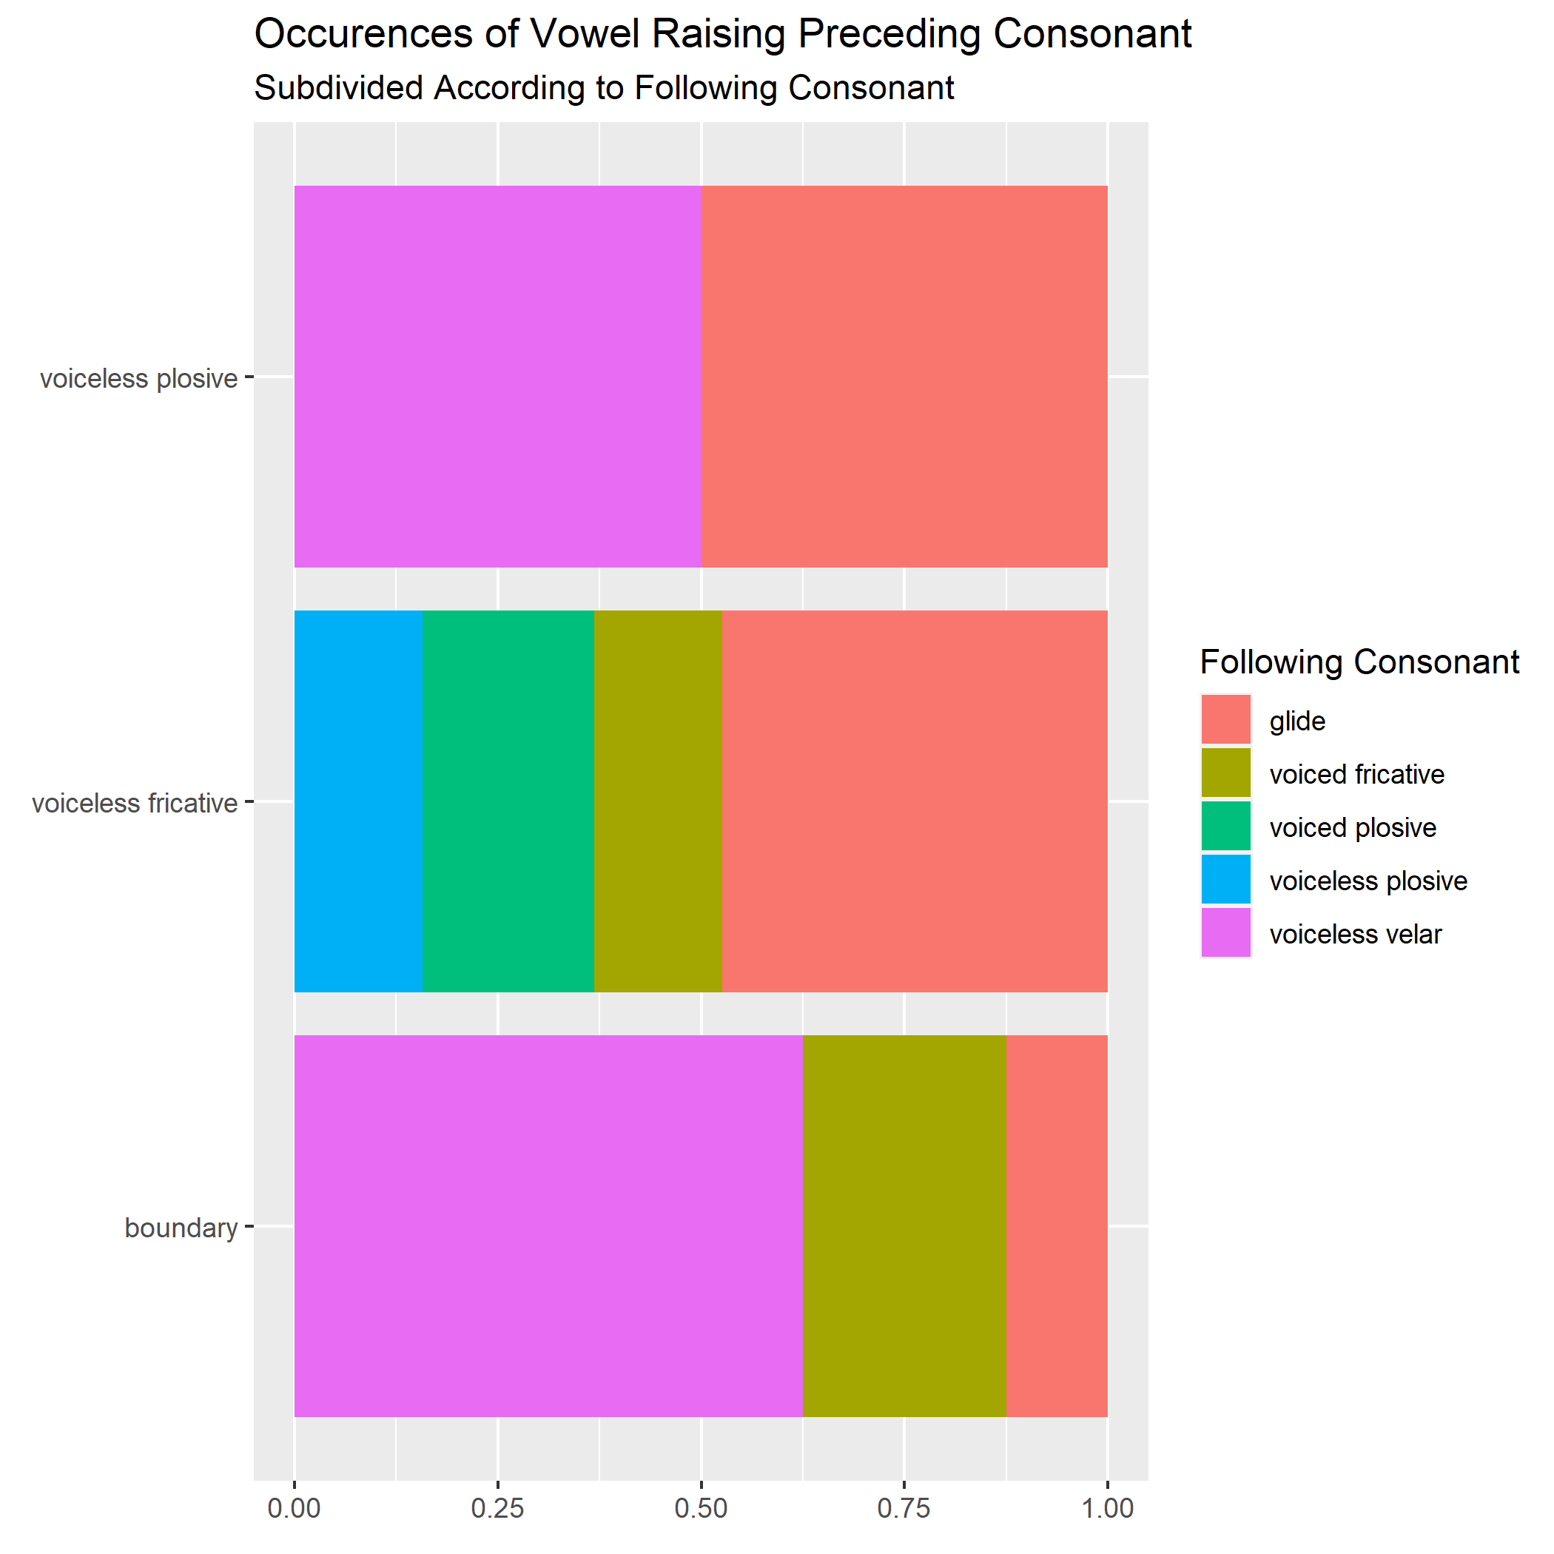

Slide 13
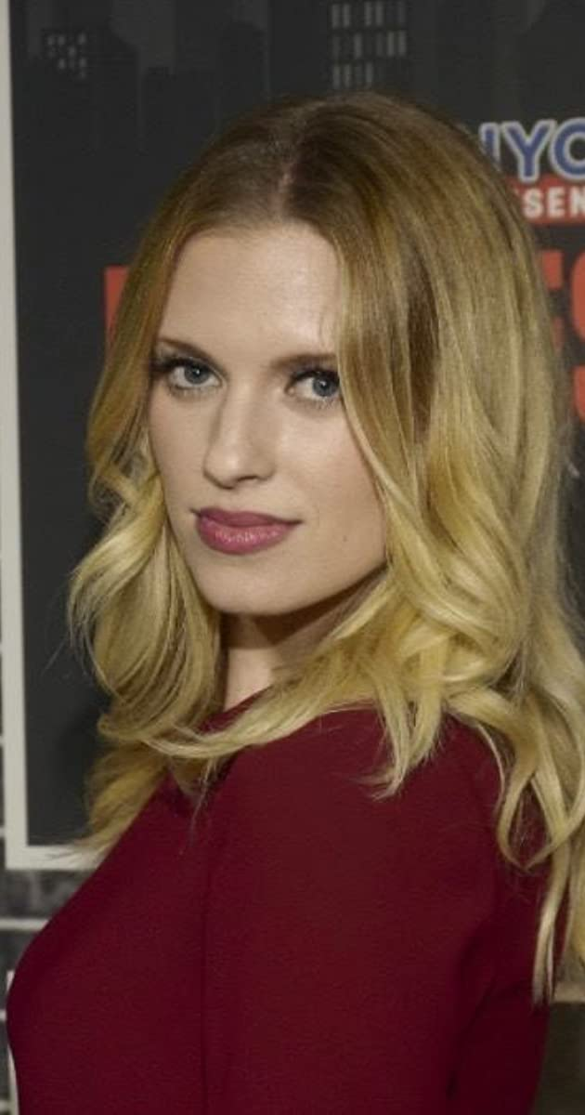
Enter Barbara Dunkelman
Born in Ottawa, Ontario, Canada (1989)
Moved to Austin, Texas, US (2011, age 22)
Began Always Open (podcast) in 2016, has been running since then
Notes:
Other speakers were Mariel Salcedo (co-host), Ashley Jenkins, Lindsay Jones, Miles Luna, Blaine Gibson, Texas Dela Rosa, and Yssa Badiola

Slide 14
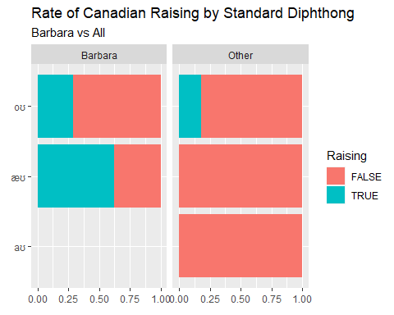
Notes:
As we can see here, Barbara does definitively produce Canadian Raising more often than her peers do.

Slide 15
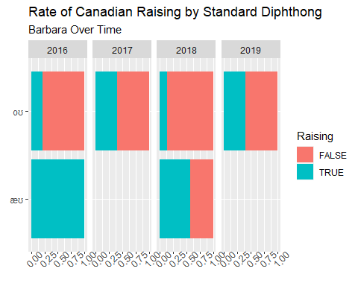
Notes:
If you’re confused by the takeaway on this graph, you’re not alone.

Slide 16
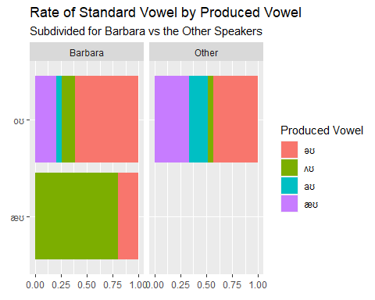
Notes:
This helps us conceptualize the most common directions of raising.

Slide 17
Takeaways
Data shows strange differences year to year, possible sample bias?
Barbara does exhibit more instances of raising than her American peers, but does not definitively use less over time
Room for improvement:
Sample more podcasts (only first 600s of 4 podcasts sampled)
Attempt to correct sample bias by prioritizing rarer tokens

Slide 18
My Code & Materials
You can find everything I wrote and did for this project (except the sound files because those are quite big) in this repository: https://github.com/sithon512/ling1269-project
If you do want the sound files, though, they can be found on Youtube. The text grids are named with a season and episode number making them easy to find.

