Slide 1
HTML Editor
R2 Release
Team C Andrew Vogler, Braxton Frederick, Arron Reed, Adam Audycki, Dylan Hogue

Slide 2
What’s New
Java
New language
Undo/Redo functionality
Command pattern
Link view
Strategy pattern
Notes:
Dylan

Slide 3
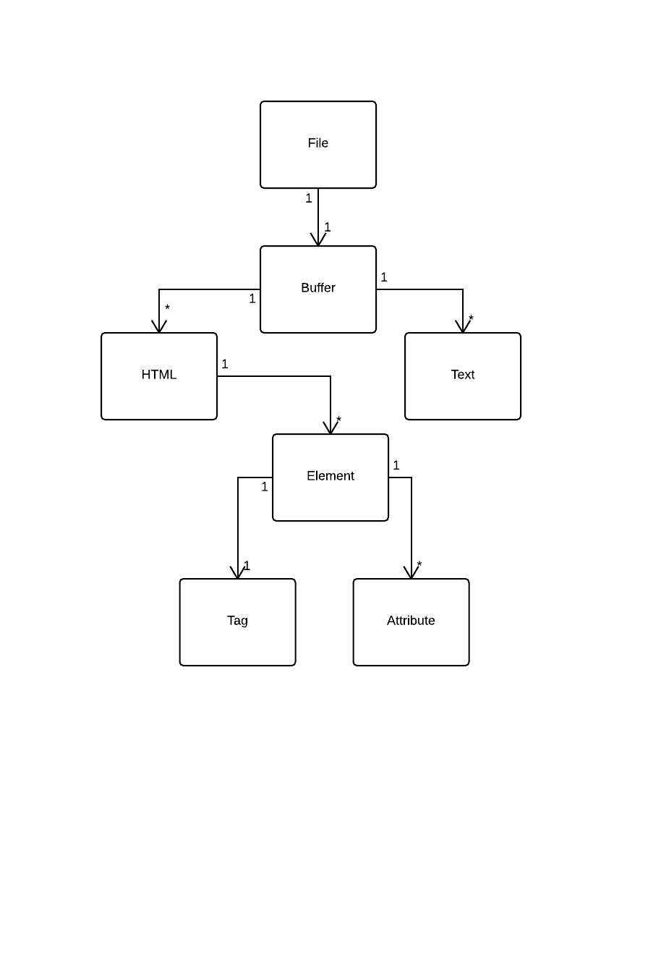
Design - Domain Model
Notes:
Dylan

Slide 4
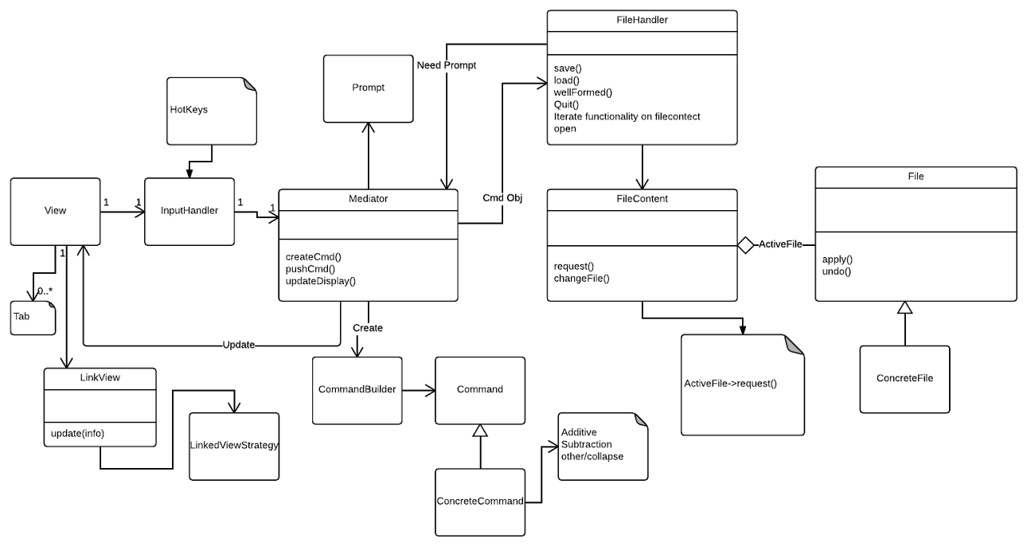
Design - System Model
Notes:
Subsystems: VIEW / FILE / COMMAND / INPUT / PROMPT
Dylan

Slide 5
Design Patterns
Mediator
Mediator and InputHandler
InputHandler passes information from View listener
Mediator interprets commands and sends it to the correct object
Observer
View
Gets observable changes and updates display
Strategy
LinkedView
Chooses how to sort links based on user input
Notes:
Andrew

Slide 6
Design Patterns
Builder
CommandBuilder
Creates commands based on passed parameters
Command
Command
Sends built commands to the Mediator
Notes:
Andrew

Slide 7
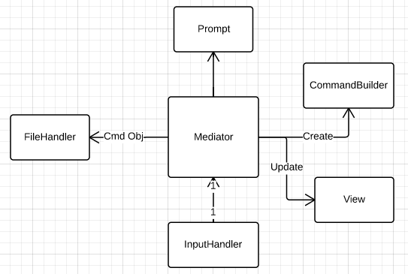
Mediator Pattern
Using two mediators
InputHandler catches and manages input
Mediator acts as a hub to separate subsystems
Notes:
Braxton

Slide 8
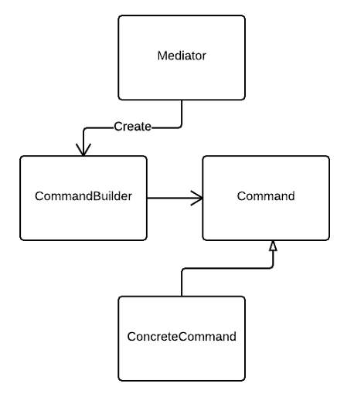
Command and Builder Patterns
Mediator acts as a director in the builder pattern
Builder returns the proper command to mediator
Mediator passes the commands onto another subsystem
Notes:
Braxton

Slide 9
R1 Functional Requirements
Some requirements built in to Java libraries
File browser/cut-and-paste/quit
Multiple Files
Java Swing built-in -- JTabPane
HTML Construct Insert
Inserts construct around highlighted area/cursor
Menus
Swing menu bar
Notes:
Arron

Slide 10
R1 Functional Requirements
Well-Formed Checks
Searches buffer, close tag for every open tag
Save
Opens bufferedreader at given location, copies our buffer to file
Load
Opens bufferedreader at given location, copies file to our buffer
Prompts
Opens new window, gets user info, performs action
Notes:
Arron

Slide 11
R2 Functional Requirements
Undo/Redo
Pushes to/pops from queue using command objects
A tags/IMG tags
Creates a link from a prompt
Link View
Grabs all URLs in file, displays in new window
Notes:
Arron

Slide 12
Removed Requirements
R1
Command-line arg opening
Reduced functionality if not well-formed
Auto-wrap
Auto-indent
R2
Outline view
Notes:
Arron

Slide 13
Difficulties
Restarting in Java
Working out what requirements are feasible to complete
Scheduling conflicts
Learning how to use Swing effectively
Proper implementation of design patterns
Improper implementation causing errors
Notes:
Adam

Slide 14
Pros Design Cons
High Cohesion
Each subsystem is focused on one task
Easy to add additional functionality
Commands
High Coupling
Subsystems rely on other systems to complete tasks
Memory intensive
Stores entire file contents
Notes:
Adam

Slide 15
Pros Project Cons
Built in functionality
Easier to properly implement patterns
No issues with file permissions
Time crunch
Inexperience with Java
Lack of Java Swing knowledge
Notes:
Adam

Slide 16
Questions?
Notes:
All

